Slide 1
The Hat Game
100101001101010101011101000111010101
Steven and Kayla Miller, Williams College, sjm1@williams.edu
.-. . -.. ....... ... --- -..- ....... .-. ..- .-.. . --..-- ....... - .... . ....... -.-- .- -. -.- . . ... ....... .- -. -.. ....... - .... . ....... -.-. --- .-. --- -. .- ...- .. .-. ..- ... ....... ... ..- -.-. -.- .-.-.-

Slide 2
Goals of the T alk
We will discuss the famous three hat game.
We will understand why it is important.
We will learn how to think mathematically.
.-. . -.. ....... ... --- -..- ....... .-. ..- .-.. . --..-- ....... - .... . ....... -.-- .- -. -.- . . ... ....... .- -. -.. ....... - .... . ....... -.-. --- .-. --- -. .- ...- .. .-. ..- ... ....... ... ..- -.-. -.- .-.-.-

Slide 3
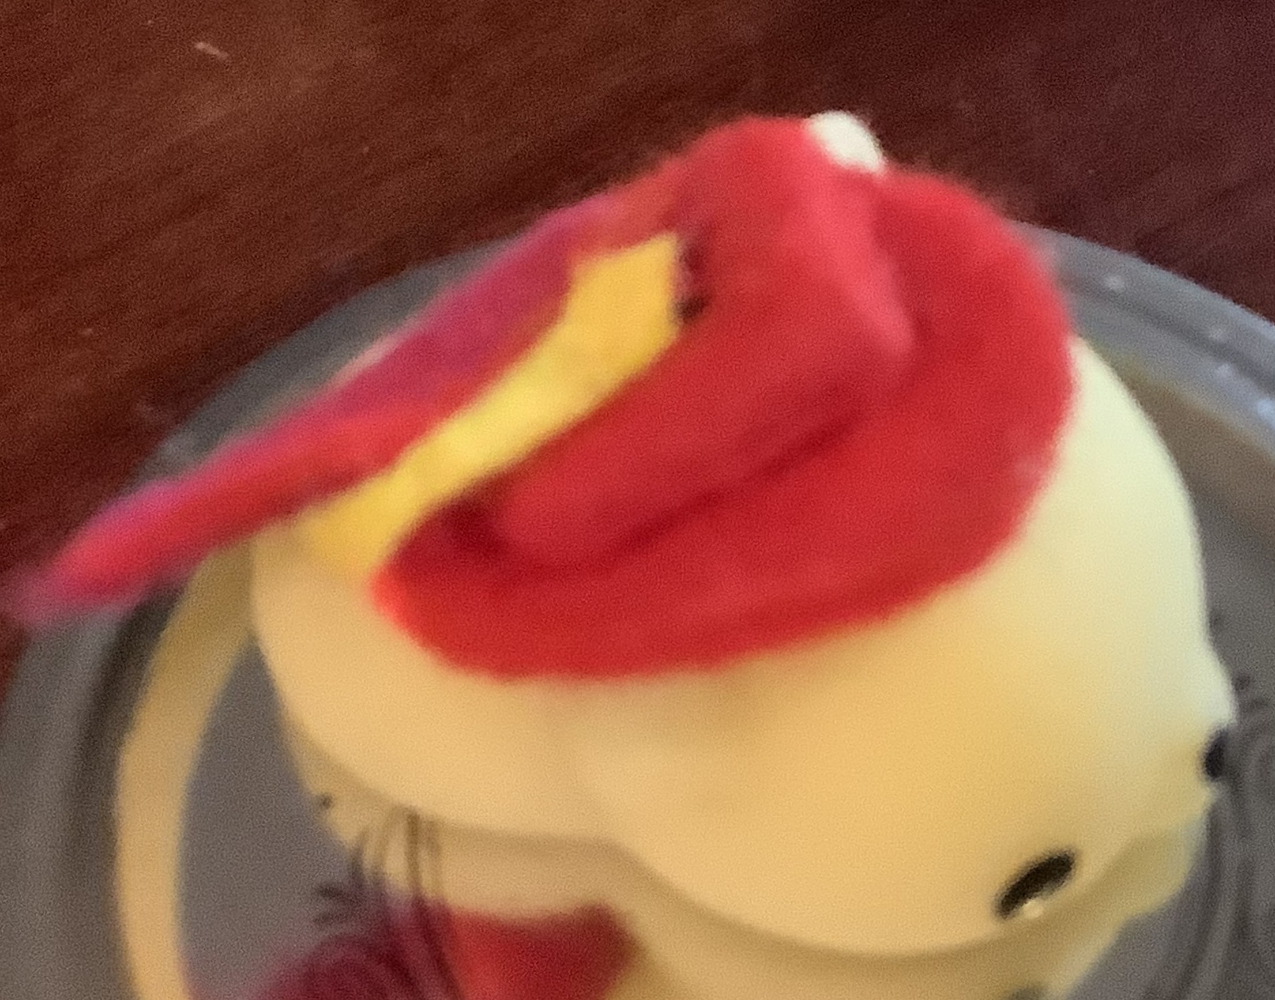
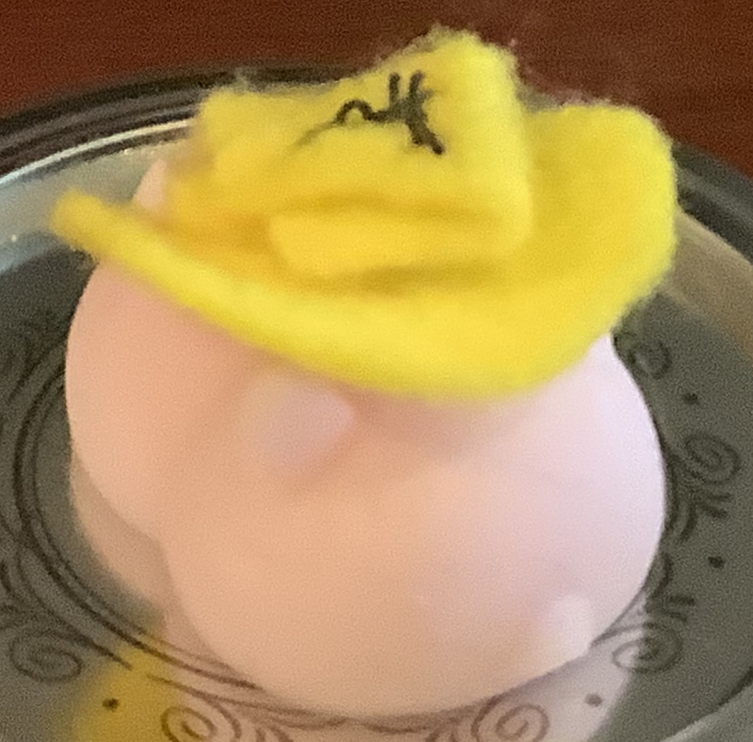
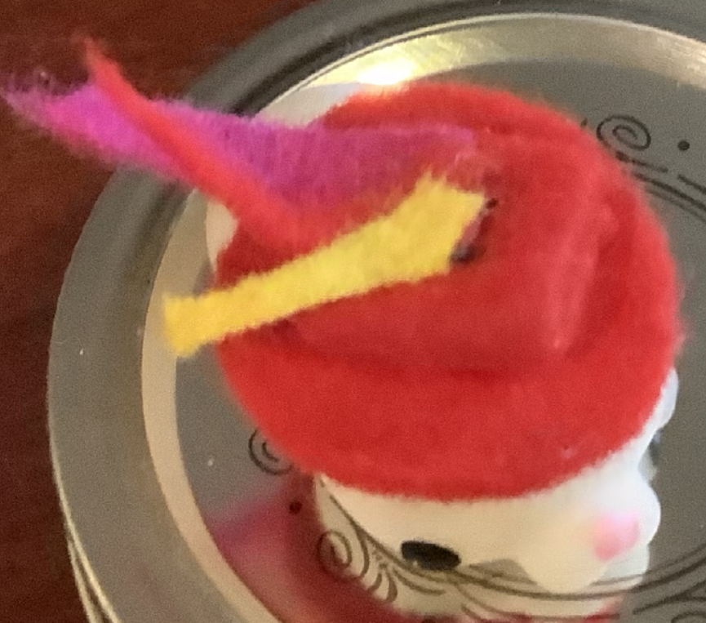
The Hat Game
There are three people.
Each person gets a RED or YELLOW hat (randomly assigned) independent of what the other two people get.
For example, OWL got a YELLOW hat, TIGER and KUALA get a RED hat.

Slide 4
The Hat Game
There are three people.
Each person gets a RED or YELLOW hat (randomly assigned) independent of what the other two people get.
You can’t see your hat, but you can see the other two hats.

Slide 5
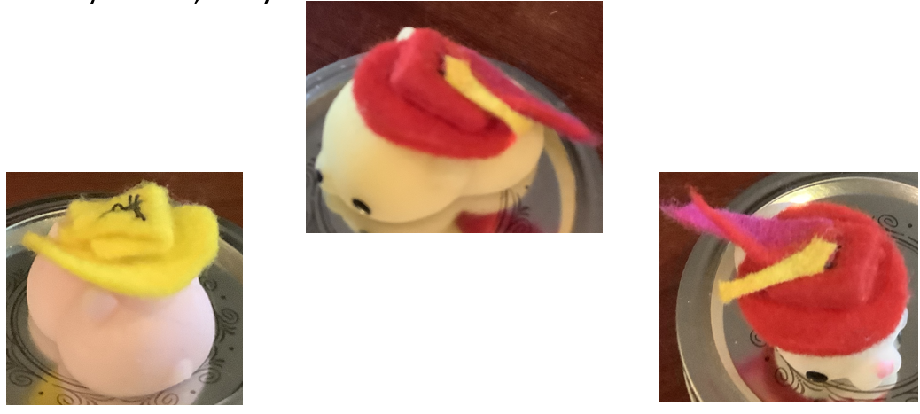
The Hat Game
There are three people.
Each person gets a RED or YELLOW hat (randomly assigned) independent of what the other two people get.
You can’t see your hat, but you can see the other two hats.
You can strategize with each other, but once the game starts you can’t talk to anyone or give signs.
At the count of three, each person chooses to either say their hat color or stay silent.
If everyone who speaks is right, you all win; if one or more is wrong, you all lose.
What is your best strategy, and how often will you win?
STOP! PAUSE THE VIDEO NOW TO THINK ABOUT THE QUESTIONS AND THE GAME.

Slide 6
The Hat Game
The Hat game seems hard.
You can only say RED or YELLOW, and if even one person who speaks is wrong the entire team loses; thus if two people are right and one is wrong, YOU LOSE!
Can you come up with a strategy where exactly half the time your team wins? You must decide when each person speaks and what they will say.
STOP! PAUSE THE VIDEO NOW TO THINK ABOUT THE QUESTION.

Slide 7
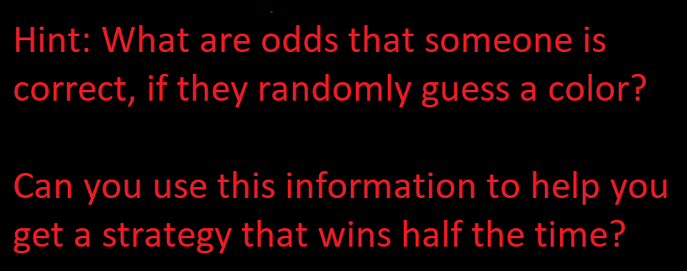
The Hat Game
The Hat game seems hard.
You can only say RED or YELLOW, and if even one person who speaks is wrong the entire team loses; thus if two people are right and one is wrong, YOU LOSE!
Can you come up with a strategy where exactly half the time your team wins? You must decide when each person speaks and what they will say.
STOP! PAUSE THE VIDEO NOW TO THINK ABOUT THE QUESTION.

Slide 8
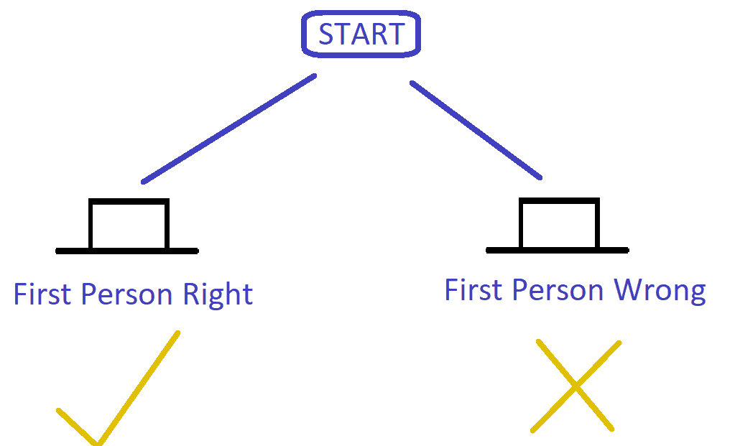
The Hat Game
If each person were to speak randomly, they would have a 50% chance of being right and a 50% chance of being wrong. So right 1 out of 2 times.
Thus the odds that two who speak randomly are both right is …..
STOP! PAUSE THE VIDEO NOW TO THINK ABOUT THE QUESTION.

Slide 9
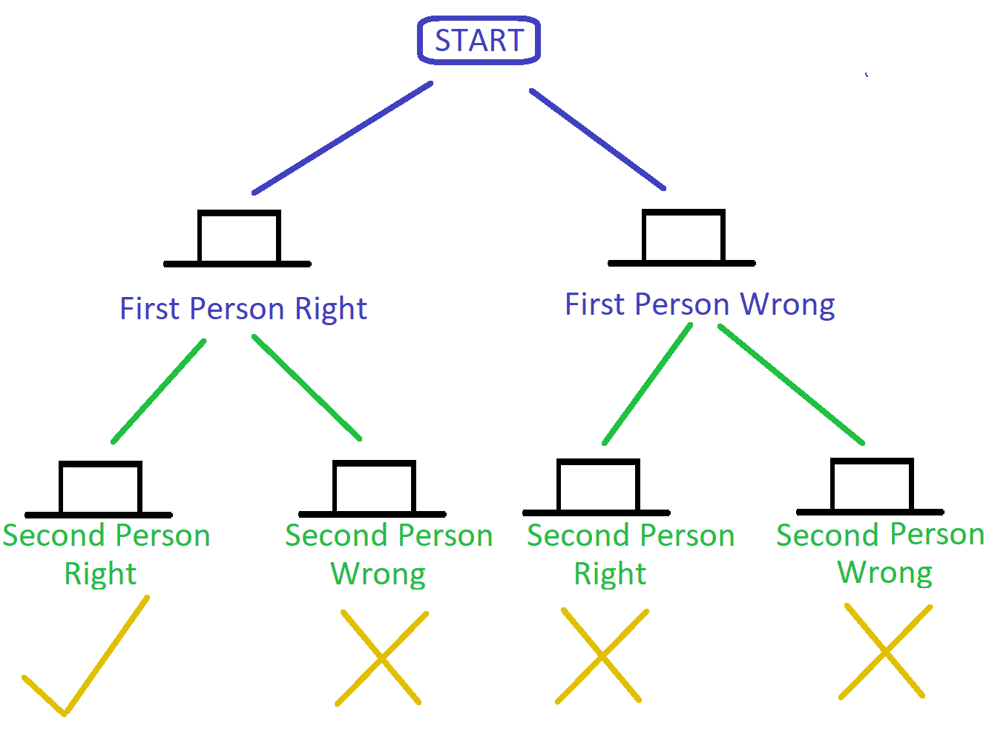
The Hat Game
If each person were to speak randomly, they would have a 50% chance of being right and a 50% chance of being wrong. So 1 out of 2 times correct.
Thus the odds that two who speak randomly are both right is 25%, or 1 out of 4 times.

Slide 10
The Hat Game
If each person were to speak randomly, they would have a 50% chance of being right and a 50% chance of being wrong. So 1 out of 2 times correct.
Thus the odds that two who speak randomly are both right is 25%, or 1 out of 4 times.
What if three people speak randomly?
What are the odds all three are right?
STOP! PAUSE THE VIDEO NOW TO THINK ABOUT THE QUESTION.

Slide 11
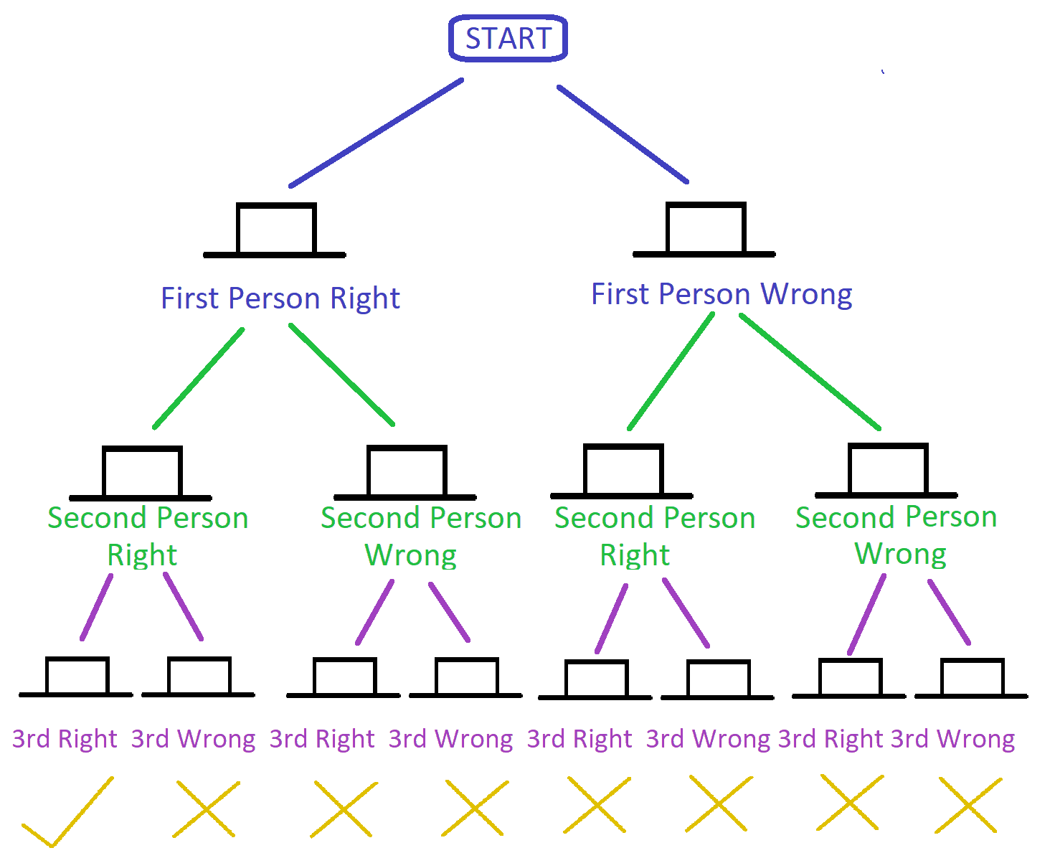
The Hat Game
If each person were to speak randomly, they would have a 50% chance of being right and a 50% chance of being wrong. So 1 out of 2 times correct.
Thus the odds that two who speak randomly are both right is 25%, or 1 out of 4 times. Why?
What if three people speak randomly?
What are the odds all three are right?
It is 12.5% or 1 out of 8.

Slide 12
The Hat Game
Remember our FIRST goal is is to find a strategy that will win half the time. We see if one person speaks randomly that works!
If two speak randomly it is worse, and works just 1 out of 4 times.
If three speak randomly it is even worse, working just 1 out of 8 times.
Can we do better than winning half the time?
STOP! PAUSE THE VIDEO NOW TO
THINK ABOUT THE QUESTION.

Slide 13
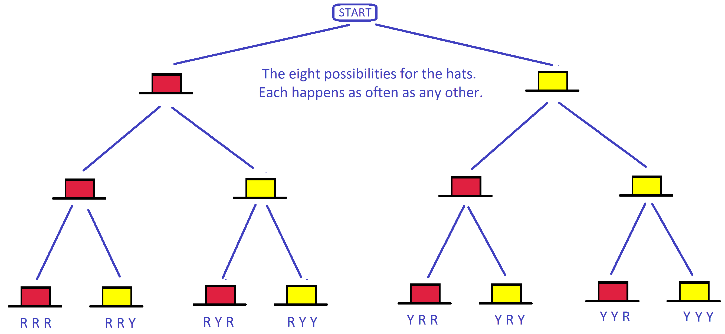
The Hat Game
Think about what each person sees in each case….
Here is a tree version of assigning the hats….

Slide 14
The Hat Game
Think about what each person sees in each case….
What are the possible hat combinations each person can see?
STOP! PAUSE THE VIDEO NOW TO THINK ABOUT THE QUESTION.

Slide 15
The Hat Game
There are three options a person can see: red-red, red-yellow (yellow-red), yellow-yellow.
Which of the eight configurations has a person seeing red-red? Which has them seeing red-yellow (yellow-red)? Which of them has them seeing yellow-yellow? Which combination is the most common?
STOP! PAUSE THE VIDEO NOW TO THINK ABOUT THE QUESTION.

Slide 16
The Hat Game
There are three options a person can see: red-red, red-yellow (yellow-red), yellow-yellow.
Which of the eight configurations has a person seeing red-red? If all are red, everyone sees red - red. If all but one are red, one person sees red-red, and the other two see red-yellow. There are six ways to see red-red, but one configuration (red - red) has three people all seeing red- red, while the other three are split up into three different cases.
What is your chance of being right if you see two red hats and say red? If you see two red hats and say yellow? Should you speak if you see two reds? If yes what should you say?

Slide 17
The Hat Game
There are three options a person can see: red-red, red-yellow (yellow-red), yellow-yellow.
Which of the eight configurations has a person seeing red-red? If all are red, everyone sees red - red. If all but one are red, one person sees red-red, and the other two see red-yellow. There are six ways to see red-red, but one configuration (red - red) has three people all seeing red- red, while the other three are split up into three different cases.
If people say yellow if you see red-red and are silent otherwise, your team wins 3 times, lose 1 time, and no one speaks 6 times.

Slide 18
The Hat Game
There are three options a person can see: red-red, red-yellow (yellow-red), yellow-yellow.
Which of the eight configurations has a person seeing yellow-yellow? If all are yellow, everyone sees yellow-yellow. If all but one are yellow, one person sees yellow-yellow, and the other two see red-yellow. There are six ways to see yellow-yellow, but one configuration (yellow-yellow) has three people all seeing yellow-yellow, while the other three are split up into three different cases.
If you say red if you see yellow-yellow and are silent otherwise, you win 3 times, lose 1 time, and no one speaks 6 times.

Slide 19
The Hat Game
There are three options a person can see: red-red, red-yellow (yellow-red), yellow-yellow.
Which of the eight configurations has a person seeing yellow-yellow? If all are yellow, everyone sees yellow-yellow. If all but one are yellow, one person sees yellow-yellow, and the other two see red-yellow. There are six ways to see yellow-yellow, but one configuration (yellow-yellow) has three people all seeing yellow-yellow, while the other three are split up into three different cases.
If you say red if you see yellow-yellow and are silent otherwise, you win 3 times, lose 1 time, and no one speaks 6 times.

Slide 20
The Hat Game
Here is a possible strategy:
If you see two hats of the same color, say the opposite color.
If you do not see two hats of the same color, stay silent.
How often do you think you will win?
STOP! PAUSE THE VIDEO NOW TO THINK ABOUT THE QUESTION.

Slide 21
The Hat Game
Here is a possible strategy:
If you see two hats of the same color, say the opposite color.
If you do not see two hats of the same color, stay silent.
We win in 6 out of 8 cases, lose in 2 out of 8 (or 75% of the time we win!).

Slide 22
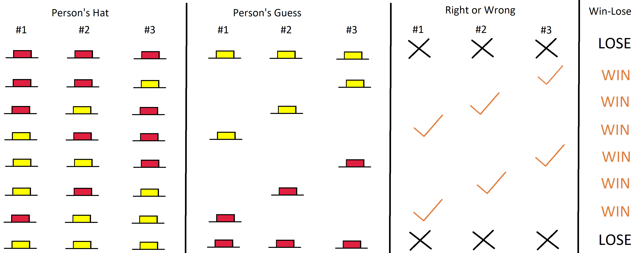
The Hat Game: Analysis
There is a lot of interesting behavior above – what do you see in the analysis? Are you surprised? Should anyone be able to be right more than half the time? Is anyone?

Slide 23
The Hat Game: Analysis
Notice each person speaks four times and is silent four times; they are right twice and wrong twice.
We have six wrong answers and six right ones; we get to 75% because when we are wrong, we are WRONG, while when we are right we just scrape by.

Slide 24
The Hat Game
We saw that we can win the hat game 75% of the time.
The strategy was to speak only if you see two hats that are the same, and say the opposite color.
Why do we care about this problem?
This has applications to error detection and error correction codes!

Slide 25
Sending Messages
Imagine we want to send a message.
We could send letters one at a time, but there is a danger.
What if one of the letters is mis-received?
Maybe we are trying to charge something on Amazon to our credit card, but the wrong digit is sent.
Or maybe their system records the wrong value for our order and sends us the wrong item!
We want to tell if a mistake is made, and even better correct such a mistake!

Slide 26
Detecting and Correcting Errors
This is a very rich subject; I have longer lectures on it, this is a short introduction.
A popular choice is the TELL ME THREE TIMES method, though better methods exist.
We assume the probability of making a mistake is low (otherwise it would be hard to send anything), and thus in any short message we will almost always have zero or at most one error.
If we want to send H E L L O we would send HHH EEE LLL LLL OOO.
If we ever get a block where the three digits are not the same we switch the different digit to the repeated one. What do you think RRR EIE DDD SSS AOO XXP is?
STOP! PAUSE THE VIDEO NOW TO THINK ABOUT THE QUESTION.

Slide 27
Detecting and Correcting Errors
This is a very rich subject; I have longer lectures on it, this is a short introduction.
A popular choice is the TELL ME THREE TIMES method, though better methods exist.
We assume the probability of making a mistake is low (otherwise it would be hard to send anything), and thus in any short message we will almost always have zero or at most one error.
If we want to send H E L L O we would send HHH EEE LLL LLL OOO.
If we ever get a block where the three digits are not the same we switch the different digit to the repeated one. What do you think RRR EIE DDD SSS AOO XXP is?
It could be RID SAP, but it is almost surely RED SOX! We are using the idea of the three hat
problem!

Slide 28
Binary
You might object to sending letters, as it is possible we could have two errors and get three letters in a message!
The hat code method works because there are just two options – if there are just two options and one is wrong, the other must be right! This is illustrated brilliantly in the Seinfeld episode “The Opposite”: https://www.youtube.com/watch?v=1Y_6fZGSOQI
One solution is to send 0’s and 1’s and use these to build up letters: 00000 is A, 00001 is B, 00010 is C, 00011 is D, 00100 is E, 00101 is F, …, 11010 is Z. This is Binary (so instead of base 10 we have base 2).

Slide 29
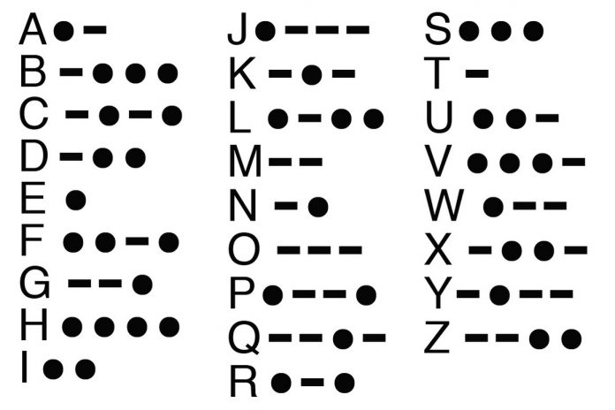
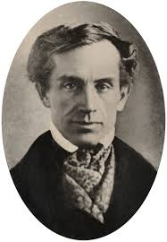
Morse Code
You might object to sending letters, as it is possible we could have two errors and get three letters in a message!
Another solution is to use Morse Code to transmit letters. We represent each letter with dots and dashes….

Slide 30
What stays with us….
Learned a lot of good things today.
Attacked a big problem by breaking into simpler one first to explore.
Saw math can have applications in the real world.
Sometimes choices made a long time ago are still with us today. For example, what does QWERTY mean?

Slide 31
What stays with us….
Sometimes choices made a long time ago are still with us today. For example, what does QWERTY mean?

