Slide 1
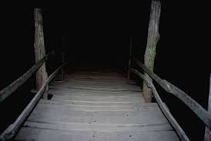
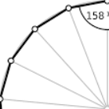
How to Attack Problems I: We WILL Cross That Bridge!
Steven Miller, Williams College (sjm1@Williams.edu)

Slide 2
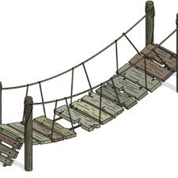
How to Attack Problems
Often in mathematics the problem statement is clear; what is unclear is how to search for the solution.
Trial and error is a great approach, at least when it works.
The difficulty is that if there aren’t many solutions, or if the solution is a bit non-standard, it might be missed.
The goal today is to talk about how to search exhaustively and not miss!

Slide 3
The We’ll Cross That Bridge Problem!
We have a rickety old bridge, it’s nighttime and dark but we have one flashlight, and we are being chased by zombies (or coronavirus victims). They are 17.5 minutes from us.
Only two people can cross the bridge at a time, and those crossing must have the flashlight. Thus two can go across with the flashlight and then one returns with the flashlight.
We must get all people across before the attackers arrive. The four people are named 1, 2, 5 and 10; these names are how long it takes each of them to cross individually; if two go over together the time it takes is the larger of the two times. We cannot have three cross together or the bridge collapses.

Slide 4
The We’ll Cross That Bridge Problem!
We have a rickety old bridge, it’s nighttime and dark but we have one flashlight, and we are being chased by zombies (or coronavirus victims). They are 17.5 minutes from us.
Only two people can cross the bridge at a time, and those crossing must have the flashlight. Thus two can go across with the flashlight and then one returns with the flashlight.
We must get all people across before the attackers arrive. The four people are named 1, 2, 5 and 10; these names are how long it takes each of them to cross individually; if two go over together the time it takes is the larger of the two times. We cannot have three cross together or the bridge collapses.
Is it possible to get the four people over in 17 minutes and survive? If everyone is not over by 17.5 minutes the bridge is infected / destroyed and we lose…. Stop and try to think about how you would approach this problem.

Slide 5
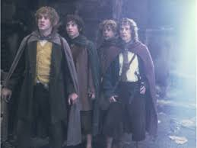
The We’ll Cross That Bridge Problem!
How should we attack this problem?
One approach is to try some combinations. Explore! Try some options and build some intuition. Any thoughts on who you want walking?

Slide 6
The We’ll Cross That Bridge Problem!
How should we attack this problem?
One approach is to try some combinations. Explore! Try some options and build some intuition. Any thoughts on who you want walking?
Maybe have the fastest walk as much as possible – we can try that!
That would be…. ( Stop and think about this for a bit )

Slide 7
The We’ll Cross That Bridge Problem!
How should we attack this problem?
One approach is to try some combinations. Explore! Try some options and build some intuition. Any thoughts on who you want walking?
Maybe have the fastest walk as much as possible – we can try that!
Send 1 and 10 over, send 1 back, send 1 and 5 over, send 1 back, send 1 and 2 over. We’re done! How long did it take? It took….

Slide 8
The We’ll Cross That Bridge Problem!
How should we attack this problem?
One approach is to try some combinations. Explore! Try some options and build some intuition. Any thoughts on who you want walking?
Maybe have the fastest walk as much as possible – we can try that!
Send 1 and 10 over, send 1 back, send 1 and 5 over, send 1 back, send 1 and 2 over. We’re done! How long did it take? It took….
Unfortunately it took 10 + 1 + 5 + 1 + 2 = 19 minutes
and we fail.

Slide 9
The We’ll Cross That Bridge Problem!
How should we attack this problem?
We could try more and more combinations.
This might give us some thoughts as to who should be paired together – look and see why these pairings fail, but we are not failing by much (our first guess was just 2 minutes over).
We need a METHODICAL way to go through all the possibilities, making
sure we don’t miss any. How can we do that?
STOP! PAUSE THE VIDEO NOW TO THINK ABOUT THE QUESTION.

Slide 10
Finding Good Notation
We need a good way to go through the possible solutions.
How can we enumerate the options and make sure we don’t miss anything?
We need good NOTATION.
As the people move back and forth, what do we need to keep track of?
STOP! PAUSE THE VIDEO NOW TO THINK ABOUT THE QUESTION.

Slide 11
Finding Good Notation
We need a good way to go through the possible solutions.
How can we enumerate the options and make sure we don’t miss anything?
We need good NOTATION.
As the people move back and forth, what do we need to keep track of?
Who is on the start side of the bridge.
Who is on the end side of the bridge.
Where is the flashlight.
How much time has passed.

Slide 12
Finding Good Notation
As the people move back and forth, what do we need to keep track of?
Who is on the start side of the bridge.
Who is on the end side of the bridge.
Where is the flashlight.
How much time has passed.
On approach is to look at the possible : (abcF|d) would mean people a, b, and c are on the start side and have the flashlight, and d is on the other side.
Thus (1 2 10 F | 5) means just 5 is over on the other side….
How many such states are there? There are….

Slide 13
Finding Good Notation
As the people move back and forth, what do we need to keep track of?
Who is on the start side of the bridge.
Who is on the end side of the bridge.
Where is the flashlight.
How much time has passed.
On approach is to look at the possible : (abcF|d) would mean people a, b, and c are on the start side and have the flashlight, and d is on the other side.
Thus (1 2 10 F | 5) means just 5 is over on the other side….
How many such states are there? There are 32, from two choices for each person and the flashlight. How can we visually represent this? Stop and think….

Slide 14
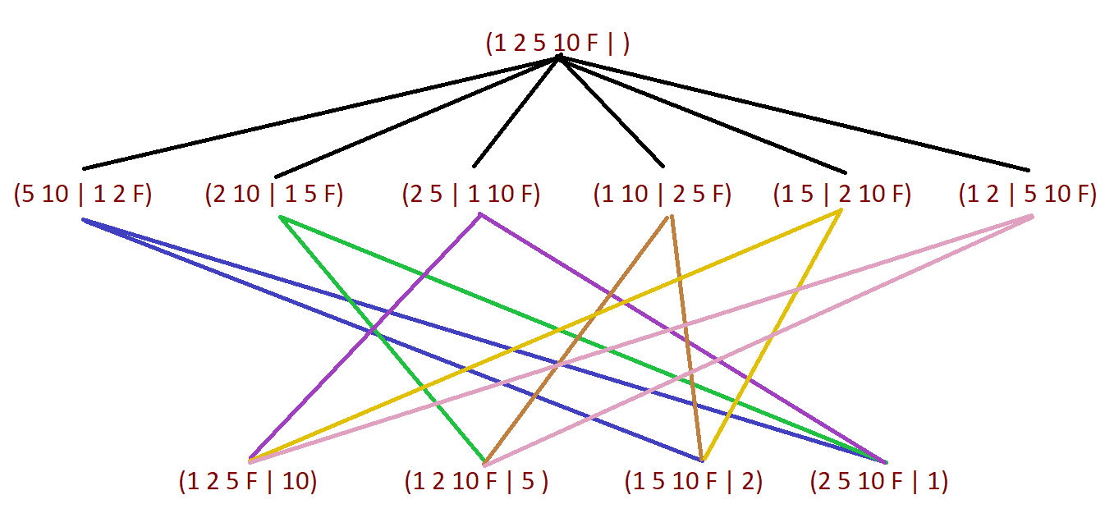
Finding Good Notation
As the people move back and forth, what do we need to keep track of?
Who is on the start side of the bridge.
Who is on the end side of the bridge.
Where is the flashlight.
How much time has passed.
This shows the first two moves.
Someone goes over.
Someone returns.
We can record the times on the lines.

Slide 15
Finding Good Notation
As the people move back and forth, what do we need to keep track of?
Who is on the start side of the bridge.
Who is on the end side of the bridge.
Where is the flashlight.
How much time has passed.
On approach is to look at the possible : (abcF|d) would mean people a, b, and c are on the start side and have the flashlight, and d is on the other side.
Thus (1 2 10 F | 5) means just 5 is over on the other side….
How many such states are there? There are 32, from two choices for each person and the flashlight. That is a lot of options – can we trim down a bit? Stop and think….

Slide 16
What configurations do we need to check?
We know we start with (1 2 5 10 F | ) and end at ( | 1 2 5 10 F).
Every other move has someone go from the start side with another person and the flashlight to the end side, and then someone from the end side return with the flashlight to the start side. Let’s call that a move!
We thus have exactly three moves, and just need to keep track of what can go to where. This cuts down on the number of possibilities.
In fact, we don’t need to keep track of where the flashlight is, and since each move results in one more person moving to the end side, there aren’t that many possibilities….

Slide 17
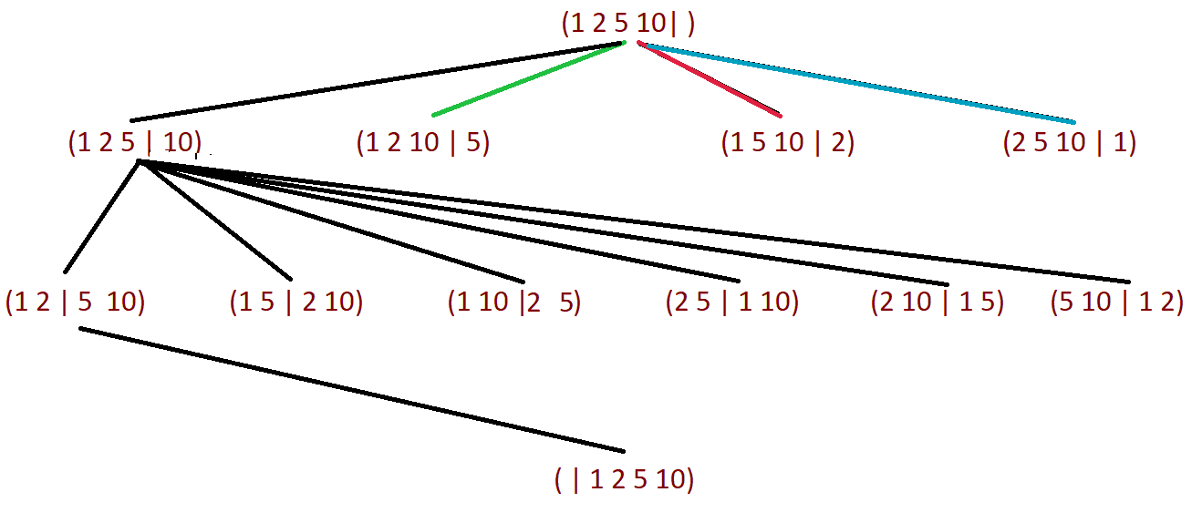
What configurations do we need to check?
Below are all possible moves. We only need three trips.
We are not showing all connecting paths, but you can go from any tuple on a level to any tuple on the next level.
We illustrated this by only showing the lines for the far left nodes to avoid too much clutter.
The problem is some information is hidden – as we are combining the crossing in both directions how much time does each move take?

Slide 18
What configurations do we need to check?
A key observation is that a pair goes from start to end,
and then a pair returns. When you go from (1 2 5 | 10) to (1 2 | 5 10) there are multiple ways to do it. We could go
(1 2 5 F | 10) → (1 | 2 5 10 F) → (1 2 F | 5 10) OR ( 1 2 5 F | 10) → (2 | 1 5 10 F) → (1 2 F | 5 10); the first takes 7 minutes, the second takes 6 minutes. Thus for each arrow we would put the SMALLEST time…. This is efficient, and just requires some work.

Slide 19
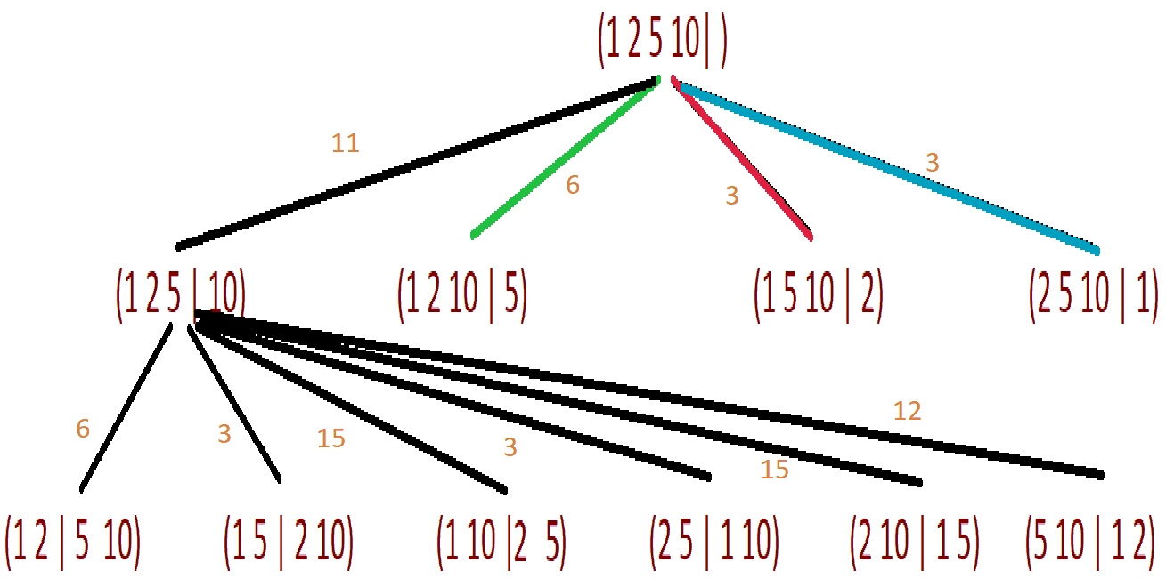
What configurations do we need to check?
A key observation is that a pair goes from start to end,
and then a pair returns. When you go from (1 2 5 | 10) to (1 2 | 5 10) there are multiple ways to do it. We could go
(1 2 5 F | 10) → (1 | 2 5 10 F) → (1 2 F | 5 10) OR ( 1 2 5 F | 10) → (2 | 1 5 10 F) → (1 2 F | 5 10); the first takes 7 minutes, the second takes 6 minutes. Thus for each arrow we would put the SMALLEST time…. This is efficient, and just requires some work. This is already enough information to see that we cannot start by going to (1 2 5 | 10)

Slide 20
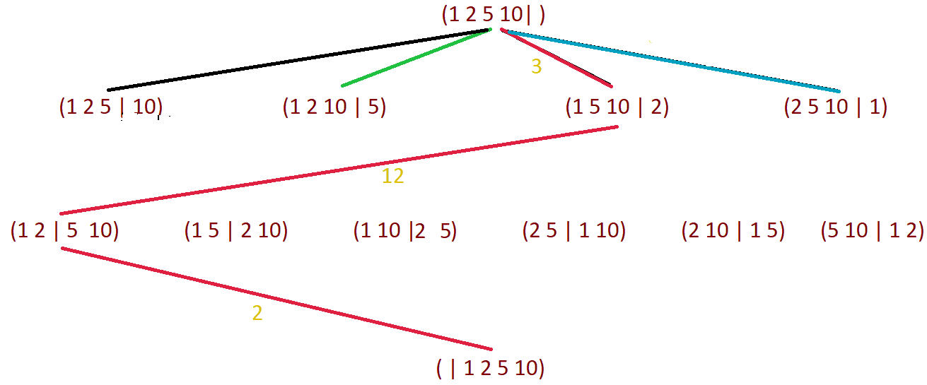
Solutions!
Here is one solution.
Note both solutions involve 5 and 10 traveling together – that makes sense.

Slide 21
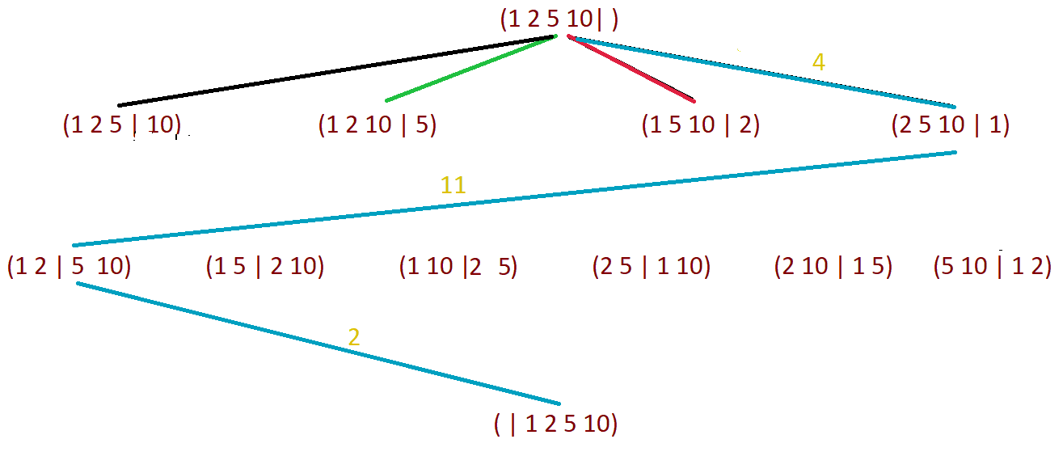
Solutions!
Here is another solution.

Slide 22
Theoretical Attack
We can also think a bit and reduce the paths we need to check.
We have valuable information: we’re told the goal is 17 minutes; it would be harder if we didn’t know the minimum time (or an upper bound for it).
We know there are three moves:
Two go over and one returns. Now three at start side and one at end side.
Two more go over and one returns. Now two at start side and one at end side.
Two go over. Now all four at the end side.
What do we know about 5 and 10? Stop and think…..

Slide 23
Theoretical Attack
We can also think a bit and reduce the paths we need to check.
We know there are three moves:
Two go over and one returns. Now 3 at start side and 1 at end side.
Two more go over and one returns. Now 2 at start side and 1 at end side.
Two go over. Now all four at the end side.
What do we know about 5 and 10? They must go over together!
If they are on separate trips that is at least 15 minutes.
We have 3 moves, and in two of them someone has to come back to the start side. That is at least 2 more minutes (if it is 1 bringing the flashlight back).
Thus we have at least 17 minutes and we have at least another half trip, so we now know that 5 and 10 must travel together at some point!

Slide 24
Theoretical Attack
We can also think a bit and reduce the paths we need to check.
We know that 5 and 10 must travel together at some point!
Cannot be the first trip, as then 5 has to come back and that’s already 15 minutes.
Similarly cannot be the last trip as then either 5 or 10 had to come back.
Thus must be the middle trip, and must have either 1 or 2 on the end side to bring back the flashlight! So 1 and 2 go over and either remains, then 5 and 10 go over, then whoever remained brings back the flashlight to the start side, then 1 and 2 go over.
Thus, if we take some time and think, we CAN solve the problem and avoid going through all the cases, but it is good to see how to methodically check all.

Slide 25
New Problem: Legal 21
Young Saul, a budding mathematician and printer, is making himself a fake ID. He needs it to say he’s 21. The problem is he’s not using a computer, but rather he has some symbols he’s bought from the store, and that’s it. He has one 1, one 5, one 6, one 7, and an unlimited supply of + – * / (the operations addition, subtraction, multiplication and division). Using each number exactly once (but you can use any number of +, any number of -, …) how can he get 21 from 1, 5, 6, 7?
Note: You can’t do things like 15+6 = 21. You have to use the four operations as ‘binary’ operations: ((1+5)*6)+7.
Note: We strongly oppose creating fake IDs…..
How can you go through all the possibilities? Try, and then tune in for the next lecture…

