Slide 2
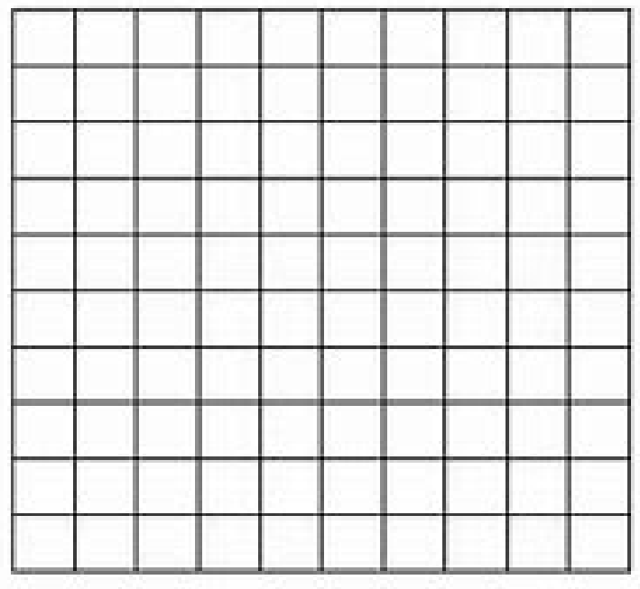
Our goal is to explore tilings. What is a tiling?
We have a collection of objects and we want to place them down to cover a space.
For example, imagine you want to cover the floor and the floor is a giant square, say 10 feet by 10 feet. What would be a good shape to use to cover it? We want the shape to be smaller that the floor, and we want all the pieces to fit together with no gaps.

Slide 3
Our goal is to explore tilings. What is a tiling?
We have a collection of objects and we want to place them down to cover a space.
For example, imagine you want to cover the floor and the floor is a giant square, say 10 feet by 10 feet. What would be a good shape to use to cover it? We want the shape to be smaller that the floor, and we want all the pieces to fit together with no gaps. Answer: 1 foot by 1 foot squares!

Slide 4
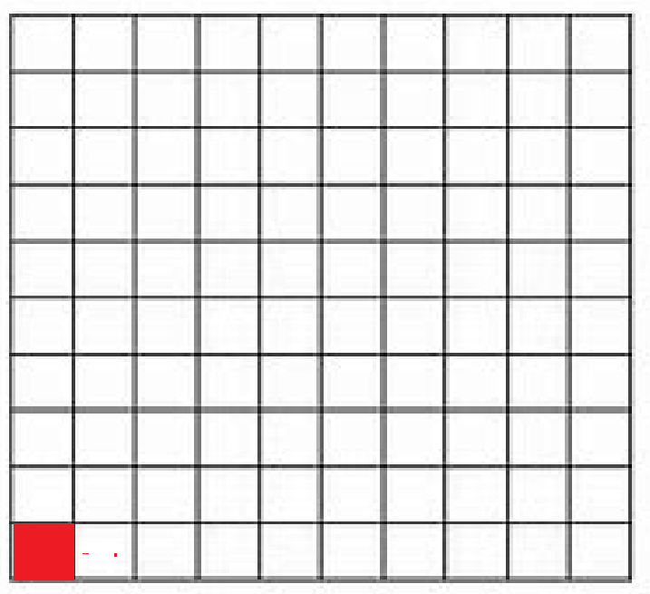
Our goal is to explore tilings. What is a tiling?
We have a collection of objects and we want to place them down to cover a space.
For example, imagine you want to cover the floor and the floor is a giant square, say 10 feet by 10 feet. What would be a good shape to use to cover it? We want the shape to be smaller that the floor, and we want all the pieces to fit together with no gaps. Answer: 1 foot by 1 foot squares!

Slide 5
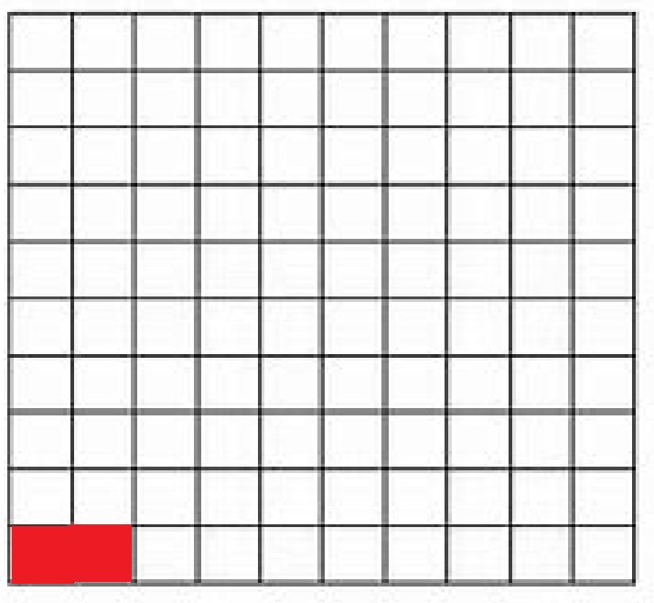
Our goal is to explore tilings. What is a tiling?
We have a collection of objects and we want to place them down to cover a space.
For example, imagine you want to cover the floor and the floor is a giant square, say 10 feet by 10 feet. What would be a good shape to use to cover it? We want the shape to be smaller that the floor, and we want all the pieces to fit together with no gaps. Answer: 1 foot by 1 foot squares!

Slide 6
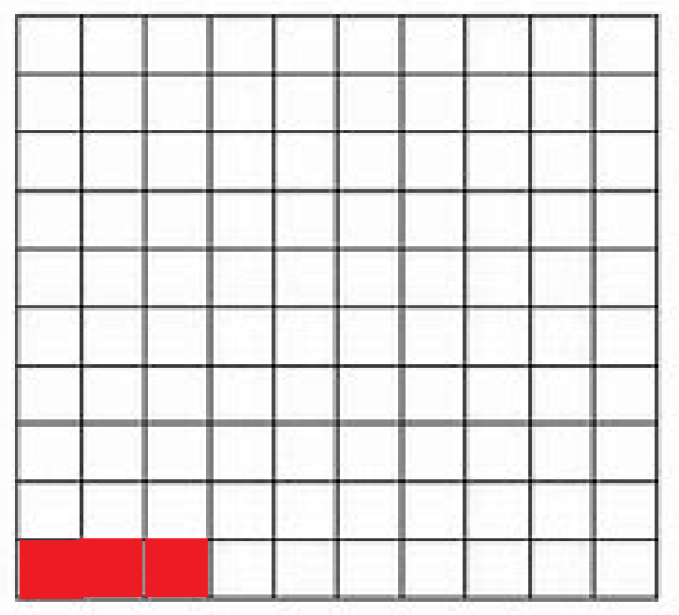
Our goal is to explore tilings. What is a tiling?
We have a collection of objects and we want to place them down to cover a space.
For example, imagine you want to cover the floor and the floor is a giant square, say 10 feet by 10 feet. What would be a good shape to use to cover it? We want the shape to be smaller that the floor, and we want all the pieces to fit together with no gaps. Answer: 1 foot by 1 foot squares!
We just continue adding the smaller squares…..

Slide 7
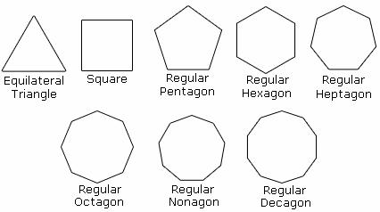
Building on our success, as a fun problem see if you can tile larger and larger regions, with no gaps, with the following shapes.

Slide 8
Building on our success, as a fun problem see if you can tile larger and larger regions, with no gaps, with the following shapes.
Note each shape above has all sides of the same length. We saw we can do it with the square. What about the triangle? What about the pentagon?
GOOD LUCK!

Slide 9
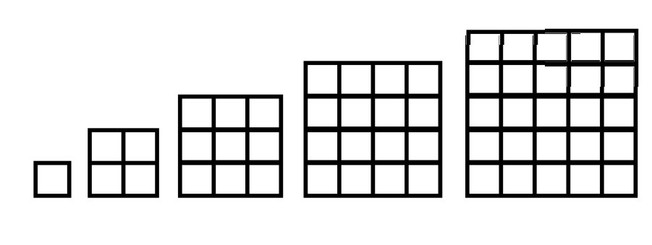
The I LOVE RECTANGLES Game
If we have an unlimited supply of 1 foot by 1 foot squares, we can cover larger and larger rectangles.
Let’s make it more interesting. Imagine now we have EXACTLY ONE of each size square. We have one 1 by 1 rectangle, one 2 by 2 rectangle, one 3 by 3 rectangle, one 4 by 4 rectangle, and so on.

Slide 10
The I LOVE RECTANGLES Game
Let’s make it more interesting. Imagine now we have EXACTLY ONE of each size square. We have one 1 by 1 rectangle, one 2 by 2 rectangle, one 3 by 3 rectangle, one 4 by 4 rectangle, and so on.
Here’s the rule: we put these squares down ONE AT A TIME, and at EVERY MOMENT IN TIME our shape MUST be a rectangle. Can it be done? Note a square IS a rectangle.

Slide 11
We have one 1 by 1 rectangle, one 2 by 2 rectangle, one 3 by 3 rectangle, one 4 by 4 rectangle, and so on.
Here’s the rule: we put these squares down ONE AT A TIME, and at EVERY MOMENT IN TIME our shape MUST be a rectangle. Can it be done? Note a square IS a rectangle.

Slide 12
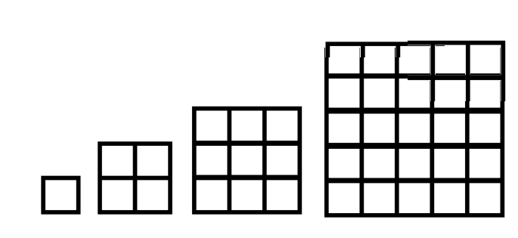
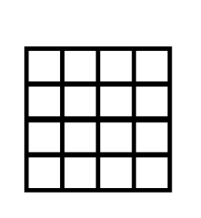
The I LOVE RECTANGLES Game
Imagine we put the 4 by 4 square down. That gives us a rectangle, so far so good. Can we put down anything else next to it and still have a rectangle?
We have placed a 4 by 4 square. This is a rectangle!
These are the squares we have left. We have a 1 by 1, a 2 by 2, a 3 by 3, a 5 by 5, a 6 by 6 (not drawn) and so on. Can we place anything next to the 4 by 4 and still have a rectangle?

Slide 13
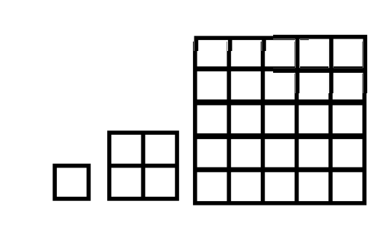
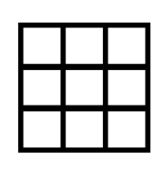
The I LOVE RECTANGLES Game
Imagine we put the 4 by 4 square down. That gives us a rectangle, so far so good. Can we put down anything else? Let’s try putting down the 3 by 3.
We have placed a 4 by 4 square. This is a rectangle!
We see the 3 by 3 will not fit next to the 4 by 4 and still give a rectangle!
These are the squares we would have left if we try to use a 3 by 3. We would have a 1 by 1, a 2 by 2, a 5 by 5, a 6 by 6 (not drawn) and so on.

Slide 14
The I LOVE RECTANGLES Game
In fact, no matter WHAT square we put down first, we cannot put any more down! If we put down a 5 by 5, to keep it a rectangle we would need something that has a side of length 5, but we only have ONE of each square!
We have to modify the game. We need to give at least ONE more square. What is the smallest square we can give?

Slide 15
The I LOVE RECTANGLES Game
In fact, no matter WHAT square we put down first, we cannot put any more down! If we put down a 5 by 5, to keep it a rectangle we would need something that has a side of length 5, but we only have ONE of each square!
We have to modify the game. We need to give at least ONE more square. What is the smallest square we can give? Answer: a 1 by 1 square! Can we do it now?

Slide 16
The I LOVE RECTANGLES Game
OK, we want to put the squares down one at a time so that we always have a rectangle. We cannot put a square on top of a square. Which should we put down first? Which should we put down second?

Slide 17
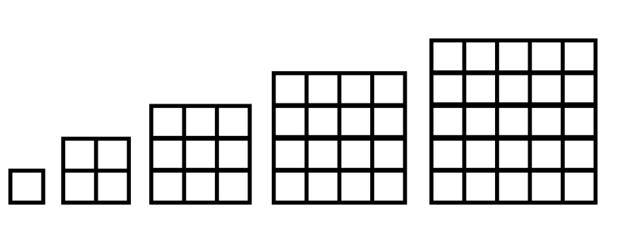
The I LOVE RECTANGLES Game
OK, we want to put the squares down one at a time so that we always have a rectangle. We cannot put a square on top of a square. Which should we put down first? Which should we put down second?
Makes sense to start with the two 1 by 1 squares, as they fit! Here is placing the first 1 by 1 square. Now we have one 1 by 1, one 2 by 2, one 3 by 3, and so on.

Slide 18
The I LOVE RECTANGLES Game
OK, we want to put the squares down one at a time so that we always have a rectangle. We cannot put a square on top of a square. Which should we put down first? Which should we put down second?
Makes sense to start with the two 1 by 1 squares, as they fit! Here is placing the second 1 by 1 next to the first 1 by 1.

Slide 19
The I LOVE RECTANGLES Game
We have placed the two 1 by 1 squares, we have a 2 by 2, a 3 by 3, a 4 by 4, a 5 by 5 and so on. What should we place next to the two 1 by 1 squares so that we still have a rectangle? Note the two 1 by 1 squares have formed a 1 by 2 rectangle…..

Slide 20
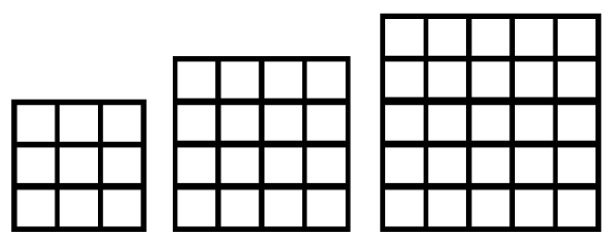
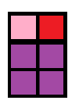
The I LOVE RECTANGLES Game
We had a 1 by 2 rectangle, so we need a square that has a side of length 1 or a side of length 2. Looking at our squares, we see we can use the 2 by 2 square!
Building on this success, what should we put down next? Note we now have a rectangle that is 2 by 3….

Slide 21
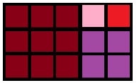
The I LOVE RECTANGLES Game
We had a 2 by 3 rectangle, so we need a square that has a side of length 2 or a side of length 3. Looking at our squares, we see we can use the 3 by 3 square!
Building on this success, what should we put down next? Note we now have a 3 by 5 rectangle.

Slide 22
The I LOVE RECTANGLES Game
We had a 2 by 3 rectangle, so we need a square that has a side of length 2 or a side of length 3. Looking at our squares, we see we can use the 3 by 3 square!
Building on this success, what should we put down next? Note we now have a 3 by 5 rectangle. Hint: the 4 by 4 square does not fit!

Slide 23
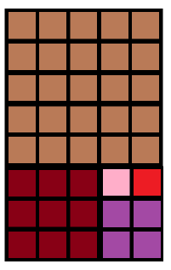
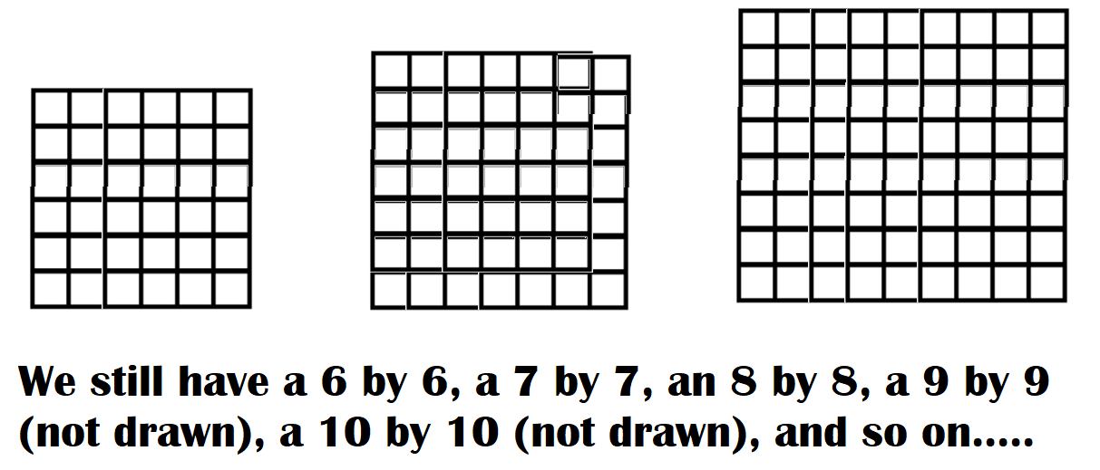
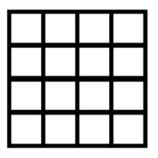
The I LOVE RECTANGLES Game
We had a 3 by 5 rectangle. Looking at our squares, we see we can use the 5 by 5 square!
Building on this success, what should we put down next? Note we now have a 5 by 8 rectangle. The 4 by 4 is too small, we still have a 6 by 6, …..

Slide 24
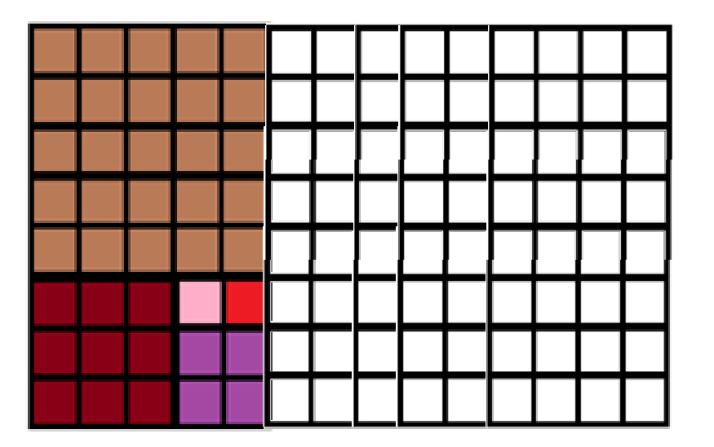
The I LOVE RECTANGLES Game
We had a 5 by 8 rectangle. We need to add something with a side of length 5 or 8. Thus we won’t use the 4 by 4, the 6 by 6 or the 7 by 7, but we will use the 8 by 8……

Slide 25
The I LOVE RECTANGLES Game
We write down the squares used in the order used:
1 by 1, 1 by 1, 2 by 2, 3 by 3, 5 by 5, 8 by 8, …..

Slide 26
The I LOVE RECTANGLES Game
Let’s just write down the side lengths of the squares in the order used:
1, 1, 2, 3, 5, 8, …. DO YOU NOTICE A PATTERN?

Slide 27
The I LOVE RECTANGLES Game
Let’s just write down the side lengths of the squares in the order used (we’ll add a few more terms to the sequence):
1, 1, 2, 3, 5, 8, 13, 21, 34, 55, 89, 144, 233, …. DO YOU NOTICE A PATTERN?

Slide 28
The I LOVE RECTANGLES Game
Let’s just write down the side lengths of the squares in the order used:
1, 1, 2, 3, 5, 8, 13, 21, 34, 55, 89, 144, 233, ….
We start 1, 1, and then after that each term is the sum of the previous two terms! 2 = 1 + 1, 3 = 2 + 1, 5 = 3 + 2, 8 = 5 + 3, and so on. Can you continue the pattern?

Slide 29
The Fibonacci Sequence
The numbers
1, 1, 2, 3, 5, 8, 13, 21, 34, 55, 89, 144, 233, ….
are called the Fibonacci numbers, and have many wondrous properties. See for example https://www.youtube.com/watch?v=me6Dnl2DOtM .

Slide 30
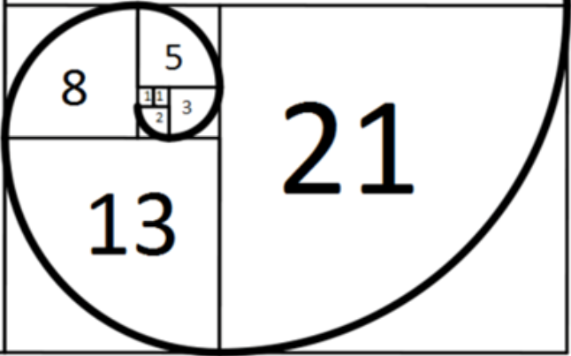
A D V A N C E D T O P I C!
Advanced: you can calculate area two ways. It is length times width, which here is 21 by 34. It is also the sum of the areas of each square, which is 1² + 1² + 2² + 3² + 5² + 8² + 13² + 21². These are equal! You can thus prove the sum of the squares of the first n Fibonacci numbers is the n^{th} Fibonacci number times the (n+1)^{st} Fibonacci number!

