Slide 1
Email: SJM1@williams.edu June 15, 2017

Slide 2
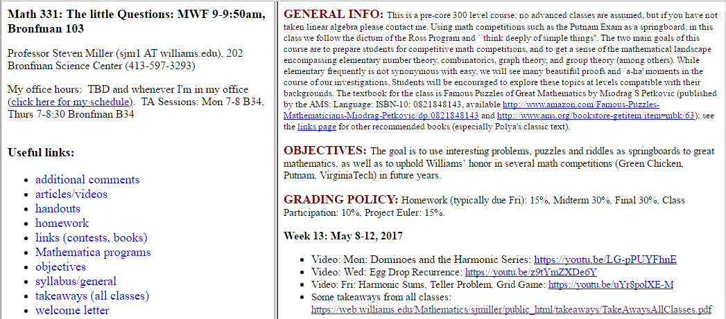
Snapshot of webpage

Slide 3
Sample video:
Math 331: https://www.youtube.com/watch?v=TGJtH7K-mXs&feature=youtu.be (go to 4:16)

