Slide 1
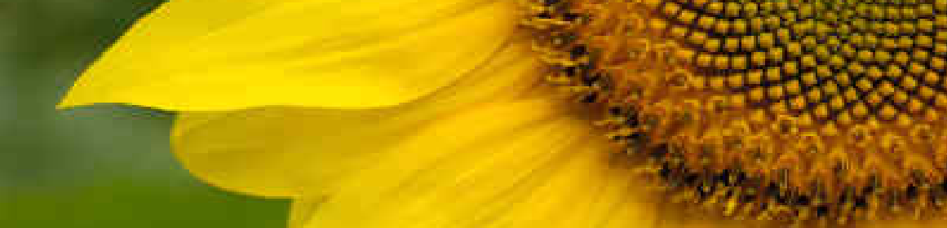

Computational Thinking Modules:
From Data to Results (through chocolate!)
Steven J. Miller, Williams College, sjm1@williams.edu
http://www.williams.edu/Mathematics/sjmiller/public_html
STANYS (Science Teachers of New York State) Conference: November 7, 2021
1

Slide 2

Objectives: Discuss computational units.
Gather data and conjecture.
Test hypotheses.
Prove claims.
Have fun!

Slide 3

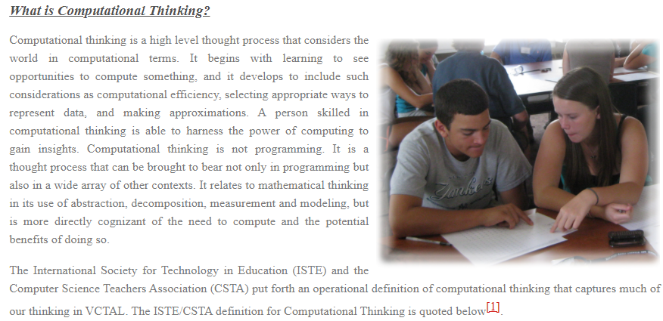
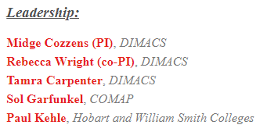
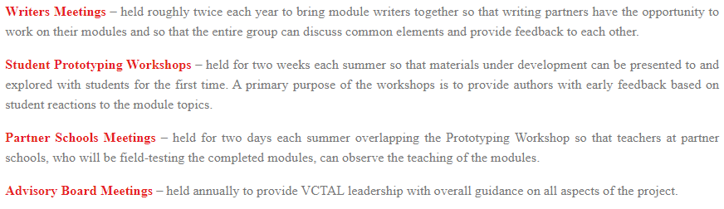
Activities & Events
http://dimacs.rutgers.edu/archive/VCTAL/computational.html

Slide 4
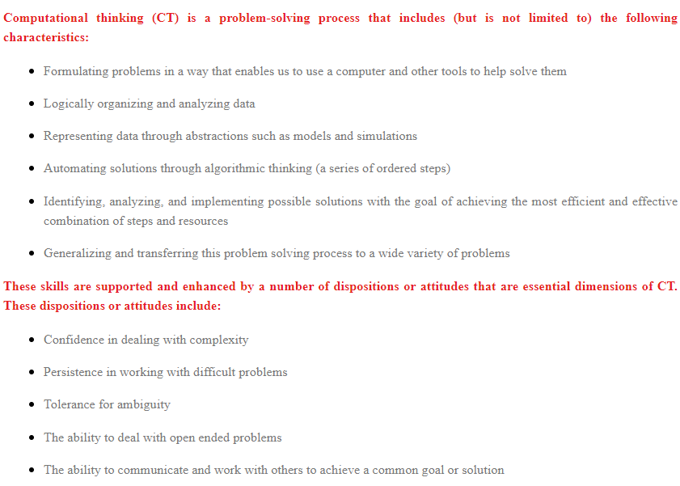
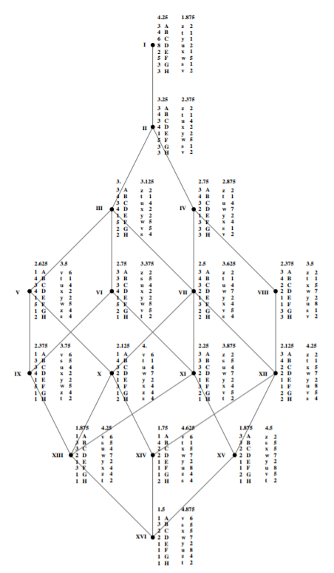

Slide 5

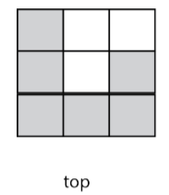

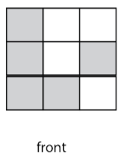
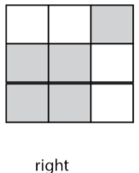
Tomography: A Geometric and Computational Approach
Tomography is the science of examining internal structure with external measurements. Most people think of tomography in the context of medical testing, such as CT scans, but tomography can be used any time it is impossible to directly look inside something. Students tackle activities in which they are challenged to determine what is inside some object. They study how CT scan images of an object are created using 3-D reconstruction of 2-D slices of the object using shadows, pin prints, graphs, and more. The main questions of the module are: How can 3-D images be created from 2-D images (i.e. slices) of it?; How much computational power and skill are required to do these reconstructions; and what do they depend on? This module is appropriate for high school classes in computer science, mathematics, biology, environmental science, and physics.
Consider the example below, which shows the top, front, and right views. Each shaded square indicates a Styrofoam ball.

Slide 6
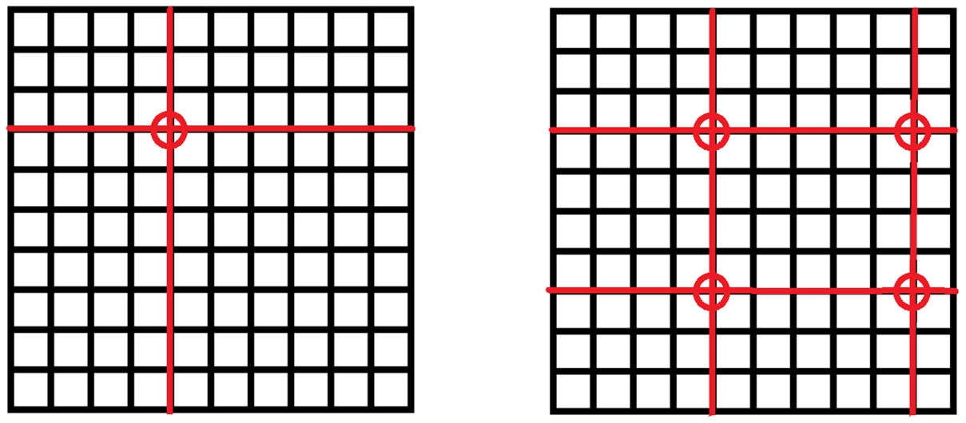

Pooled Testing: Reduces from order $n$ to order $\sqrt{n}$ tests.

Slide 7
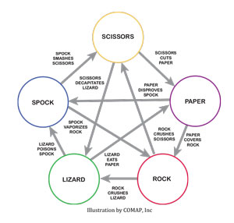
MODULES
It’s an Electrifying Idea!
Heart Transplants and the NFL Draft
Network Capacity
Your Data and Your Privacy: Do you know what “they” can tell about you?
Tomography: A Geometric and Computational Approach
Lqwurgxfwlrq wr Fubswrjudskb: Introduction to Cryptography
Fair and Stable Matching
Polynomiography: Visual Displays of Solutions to Polynomial Equations
The Analysis of Games
Competition or Collusion? Game Theory in Sports, Business, and Life
Gently Down the Stream: The Mathematics of Streaming Information
Recursion - Problem Solving and Efficiency: How to Define an Infinite Set Finitely

Slide 8
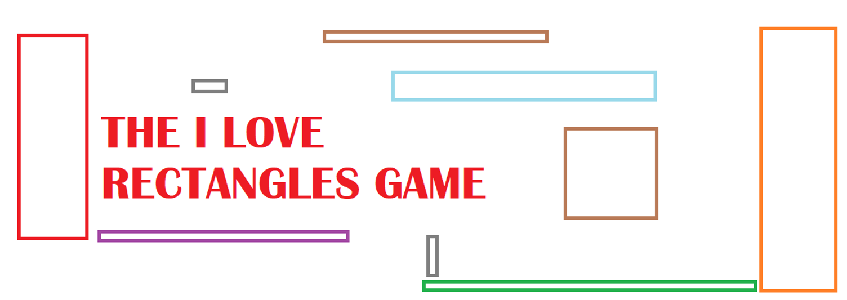

Slide 9
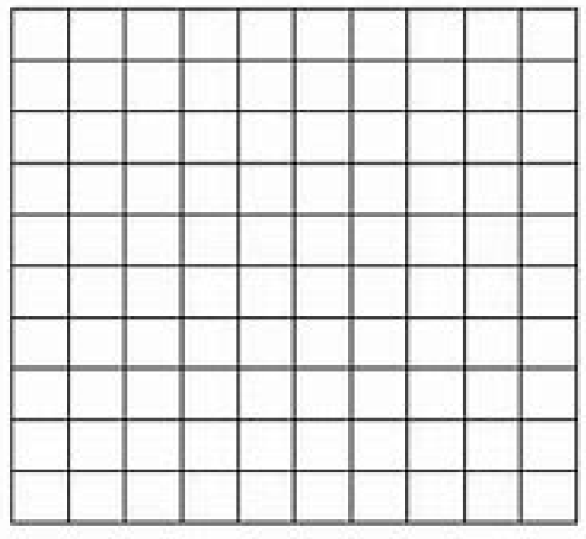
Our goal is to explore tilings. What is a tiling?
We have a collection of objects and we want to place them down to cover a space.
For example, imagine you want to cover the floor and the floor is a giant square, say 10 feet by 10 feet. What would be a good shape to use to cover it? We want the shape to be smaller that the floor, and we want all the pieces to fit together with no gaps.

Slide 10
Our goal is to explore tilings. What is a tiling?
We have a collection of objects and we want to place them down to cover a space.
For example, imagine you want to cover the floor and the floor is a giant square, say 10 feet by 10 feet. What would be a good shape to use to cover it? We want the shape to be smaller that the floor, and we want all the pieces to fit together with no gaps. Answer: 1 foot by 1 foot squares!

Slide 11
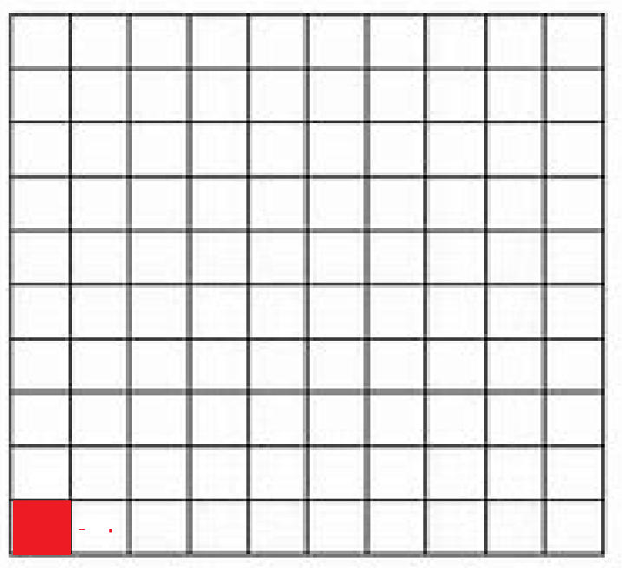
Our goal is to explore tilings. What is a tiling?
We have a collection of objects and we want to place them down to cover a space.
For example, imagine you want to cover the floor and the floor is a giant square, say 10 feet by 10 feet. What would be a good shape to use to cover it? We want the shape to be smaller that the floor, and we want all the pieces to fit together with no gaps. Answer: 1 foot by 1 foot squares!

Slide 12
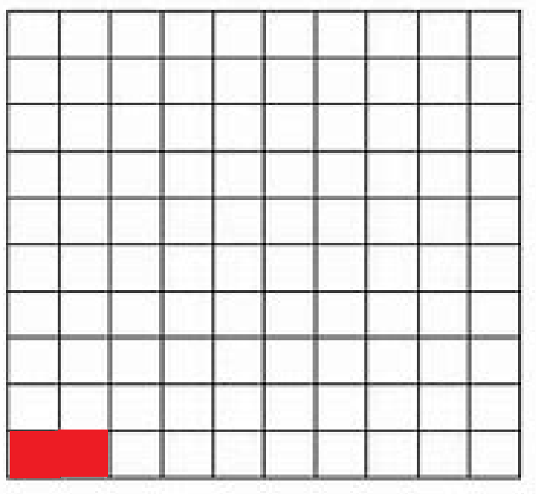
Our goal is to explore tilings. What is a tiling?
We have a collection of objects and we want to place them down to cover a space.
For example, imagine you want to cover the floor and the floor is a giant square, say 10 feet by 10 feet. What would be a good shape to use to cover it? We want the shape to be smaller that the floor, and we want all the pieces to fit together with no gaps. Answer: 1 foot by 1 foot squares!

Slide 13
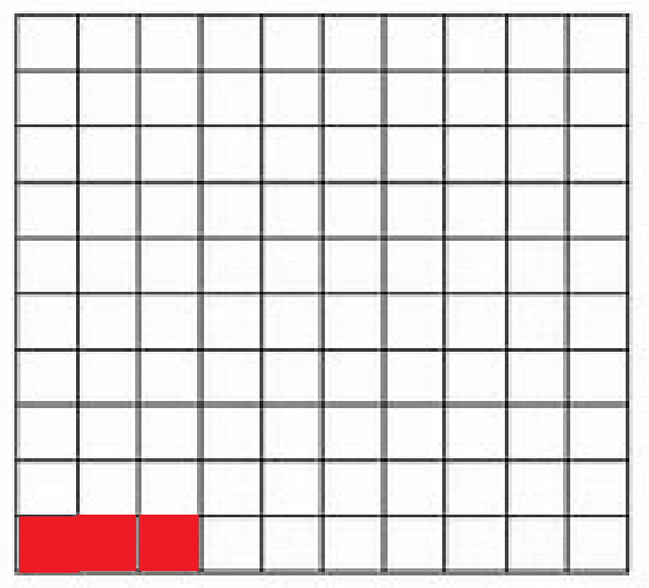
Our goal is to explore tilings. What is a tiling?
We have a collection of objects and we want to place them down to cover a space.
For example, imagine you want to cover the floor and the floor is a giant square, say 10 feet by 10 feet. What would be a good shape to use to cover it? We want the shape to be smaller that the floor, and we want all the pieces to fit together with no gaps. Answer: 1 foot by 1 foot squares!
We just continue adding the smaller squares…..

Slide 14
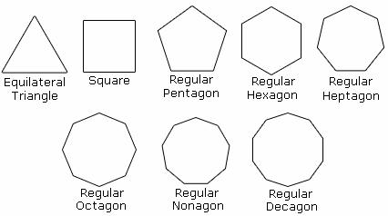
Building on our success, as a fun problem see if you can tile larger and larger regions, with no gaps, with the following shapes.

Slide 15
Building on our success, as a fun problem see if you can tile larger and larger regions, with no gaps, with the following shapes.
Note each shape above has all sides of the same length. We saw we can do it with the square. What about the triangle? What about the pentagon? What if we mix and match? GOOD LUCK!

Slide 16
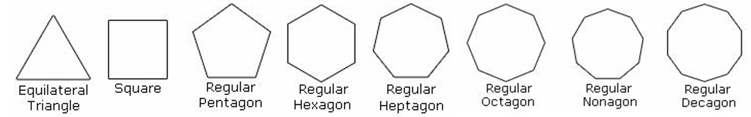
Note each shape above has all sides of the same length. We saw we can do it with the square. What about the triangle? What about the pentagon? What if we mix and match? GOOD LUCK!
Notice we have implicitly made an assumption about what we are studying?
What is that assumption?

Slide 17
Note each shape above has all sides of the same length. We saw we can do it with the square. What about the triangle? What about the pentagon? What if we mix and match? GOOD LUCK!
Notice we have implicitly made an assumption about what we are studying?
What is that assumption?
We are working IN THE PLANE – What happens in higher dimensions?
Think of the five platonic solids – how do those GENERALIZE?

Slide 18
Objectives: Discuss computational units.
Gather data and conjecture.
Test hypotheses.
Prove claims.
GENERALIZE!
Have fun!

Slide 19
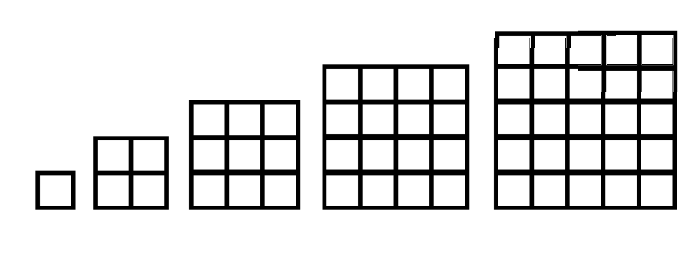
The I LOVE RECTANGLES Game
If we have an unlimited supply of 1 foot by 1 foot squares, we can cover larger and larger rectangles.
Let’s make it more interesting. Imagine now we have EXACTLY ONE of each size square. We have one 1 by 1 rectangle, one 2 by 2 rectangle, one 3 by 3 rectangle, one 4 by 4 rectangle, and so on.

Slide 20
The I LOVE RECTANGLES Game
Let’s make it more interesting. Imagine now we have EXACTLY ONE of each size square. We have one 1 by 1 rectangle, one 2 by 2 rectangle, one 3 by 3 rectangle, one 4 by 4 rectangle, and so on.
Here’s the rule: we put these squares down ONE AT A TIME, and at EVERY MOMENT IN TIME our shape MUST be a rectangle. Can it be done? Note a square IS a rectangle.

Slide 21
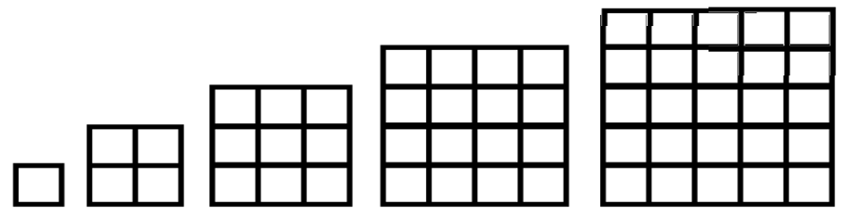

We have one 1 by 1 rectangle, one 2 by 2 rectangle, one 3 by 3 rectangle, one 4 by 4 rectangle, and so on.
Here’s the rule: we put these squares down ONE AT A TIME, and
at EVERY MOMENT IN TIME our shape MUST be
a rectangle. Can it be done?
Note a square IS a
rectangle.

Slide 22
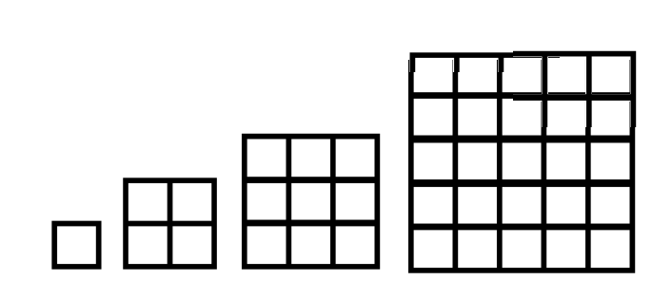
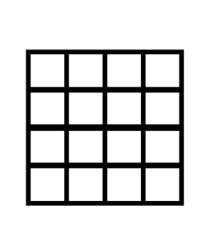
The I LOVE RECTANGLES Game
Imagine we put the 4 by 4 square down. That gives us a rectangle, so far so good. Can we put down anything else next to it and still have a rectangle?
We have placed a 4 by 4 square. This is a rectangle!
These are the squares we have left. We have a 1 by 1, a 2 by 2, a 3 by 3, a 5 by 5, a 6 by 6 (not drawn) and so on. Can we place anything next to the 4 by 4 and still have a rectangle?

Slide 23
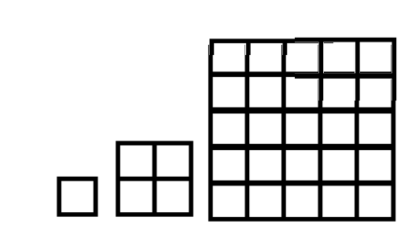
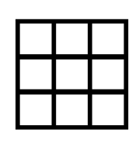
The I LOVE RECTANGLES Game
Imagine we put the 4 by 4 square down. That gives us a rectangle, so far so good. Can we put down anything else? Let’s try putting down the 3 by 3.
We have placed a 4 by 4 square. This is a rectangle!
We see the 3 by 3 will not fit next to the 4 by 4 and still give a rectangle!
These are the squares we would have left if we try to use a 3 by 3. We would have a 1 by 1, a 2 by 2, a 5 by 5, a 6 by 6 (not drawn) and so on.

Slide 24
The I LOVE RECTANGLES Game
In fact, no matter WHAT square we put down first, we cannot put any more down! If we put down a 5 by 5, to keep it a rectangle we would need something that has a side of length 5, but we only have ONE of each square!
We have to modify the game. We need to give at least ONE more square. What is the smallest square we can give?

Slide 25
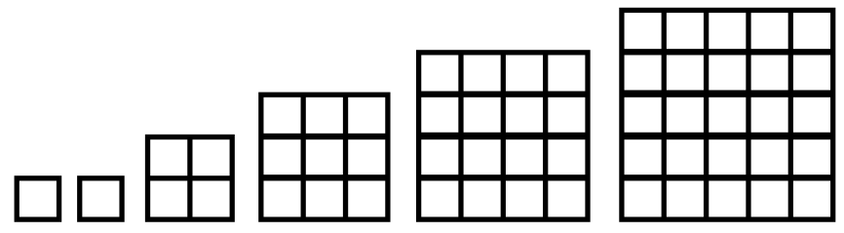
The I LOVE RECTANGLES Game
In fact, no matter WHAT square we put down first, we cannot put any more down! If we put down a 5 by 5, to keep it a rectangle we would need something that has a side of length 5, but we only have ONE of each square!
We have to modify the game. We need to give at least ONE more square. What is the smallest square we can give? Answer: a 1 by 1 square! Can we do it now?

Slide 26
The I LOVE RECTANGLES Game
OK, we want to put the squares down one at a time so that we always have a rectangle. We cannot put a square on top of a square. Which should we put down first? Which should we put down second?

Slide 27
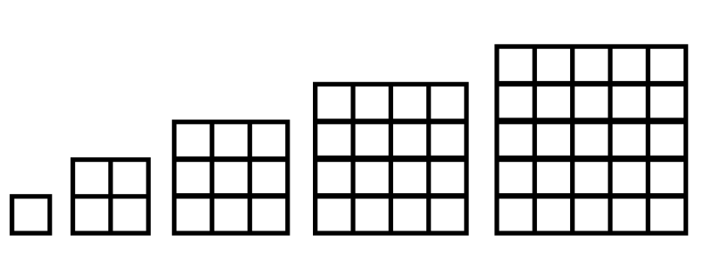

The I LOVE RECTANGLES Game
OK, we want to put the squares down one at a time so that we always have a rectangle. We cannot put a square on top of a square. Which should we put down first? Which should we put down second?
Makes sense to start with the two 1 by 1 squares, as they fit! Here is placing the first 1 by 1 square. Now we have one 1 by 1, one 2 by 2, one 3 by 3, and so on.

Slide 28


The I LOVE RECTANGLES Game
OK, we want to put the squares down one at a time so that we always have a rectangle. We cannot put a square on top of a square. Which should we put down first? Which should we put down second?
Makes sense to start with the two 1 by 1 squares, as they fit! Here is placing the second 1 by 1 next to the first 1 by 1.

Slide 29

The I LOVE RECTANGLES Game
We have placed the two 1 by 1 squares, we have a 2 by 2, a 3 by 3, a 4 by 4, a 5 by 5 and so on. What should we place next to the two 1 by 1 squares so that we still have a rectangle? Note the two 1 by 1 squares have formed a 1 by 2 rectangle…..

Slide 30
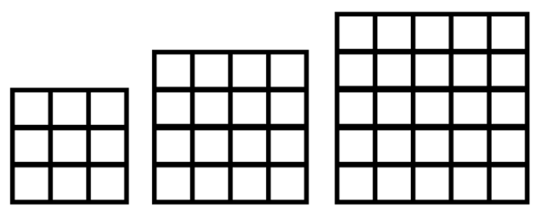
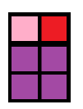


The I LOVE RECTANGLES Game
We had a 1 by 2 rectangle, so we need a square that has a side of length 1 or a side of length 2. Looking at our squares, we see we can use the 2 by 2 square!
Building on this success, what should we put down next? Note we now have a rectangle that is 2 by 3….

Slide 31

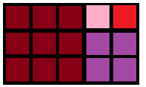

The I LOVE RECTANGLES Game
We had a 2 by 3 rectangle, so we need a square that has a side of length 2 or a side of length 3. Looking at our squares, we see we can use the 3 by 3 square!
Building on this success, what should we put down next? Note we now have a 3 by 5 rectangle.

Slide 32
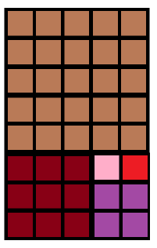
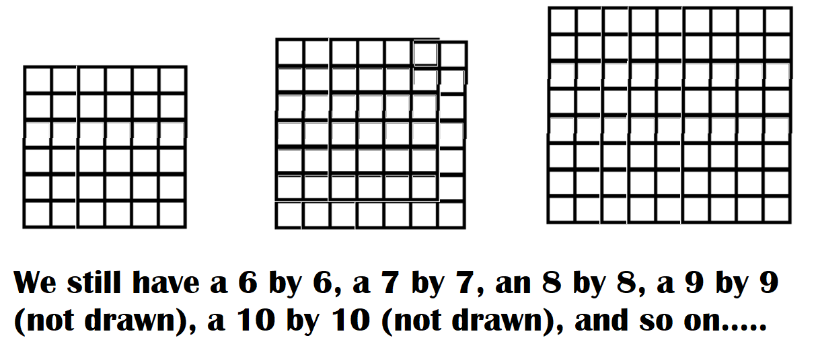
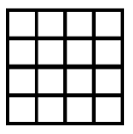
The I LOVE RECTANGLES Game
We had a 3 by 5 rectangle. Looking at our squares, we see we can use the 5 by 5 square!
Building on this success, what should we put down next? Note we now have a 5 by 8 rectangle. The 4 by 4 is too small, we still have a 6 by 6, …..

Slide 33
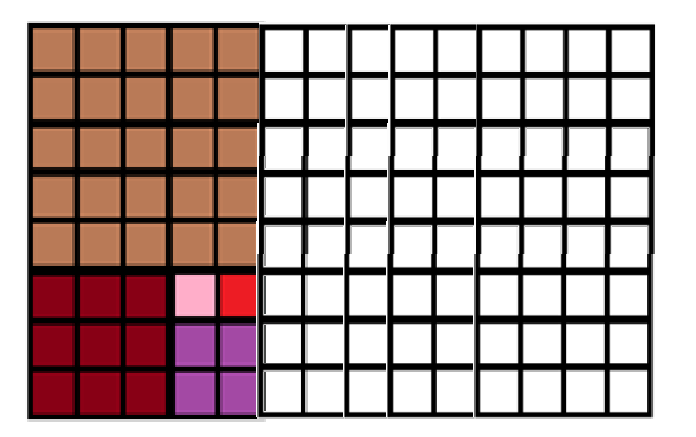
The I LOVE RECTANGLES Game
We had a 5 by 8 rectangle. We need to add something with a side of length 5 or 8. Thus we won’t use the 4 by 4, the 6 by 6 or the 7 by 7, but we will use the 8 by 8……

Slide 34
The I LOVE RECTANGLES Game
We write down the squares used in the order used:
1 by 1, 1 by 1, 2 by 2, 3 by 3, 5 by 5, 8 by 8, …..

Slide 35
The I LOVE RECTANGLES Game
Let’s just write down the side lengths of the squares in the order used:
1, 1, 2, 3, 5, 8, …. DO YOU NOTICE A PATTERN?

Slide 36
The I LOVE RECTANGLES Game
Let’s just write down the side lengths of the squares in the order used (we’ll add a few more terms to the sequence):
1, 1, 2, 3, 5, 8, 13, 21, 34, 55, 89, 144, 233, …. DO YOU NOTICE A PATTERN?

Slide 37
The I LOVE RECTANGLES Game
Let’s just write down the side lengths of the squares in the order used:
1, 1, 2, 3, 5, 8, 13, 21, 34, 55, 89, 144, 233, ….
We start 1, 1, and then after that each term is the sum of the previous two terms! 2 = 1 + 1, 3 = 2 + 1, 5 = 3 + 2, 8 = 5 + 3, and so on. Can you continue the pattern?

Slide 38
The Fibonacci Sequence
The numbers
1, 1, 2, 3, 5, 8, 13, 21, 34, 55, 89, 144, 233, ….
are called the Fibonacci numbers, and have many wondrous properties. See for example https://www.youtube.com/watch?v=me6Dnl2DOtM .

Slide 39
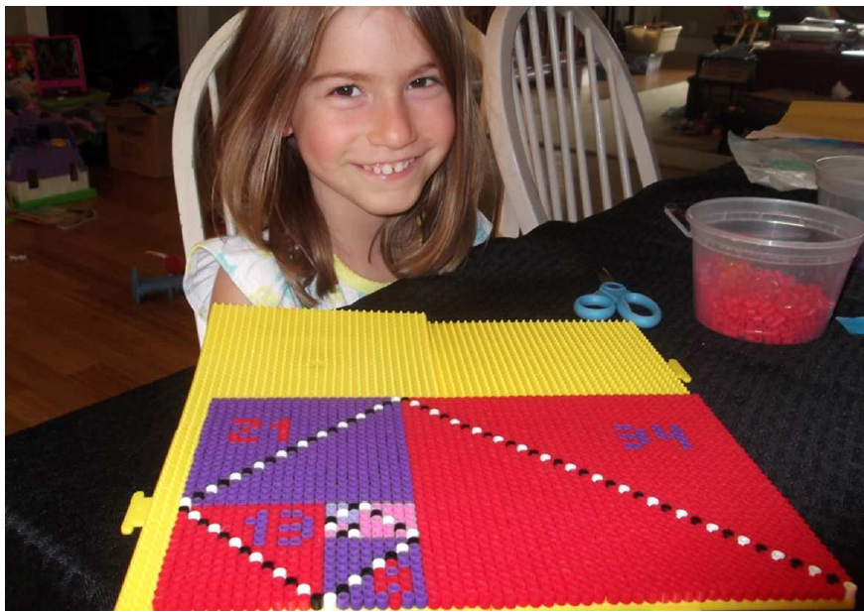
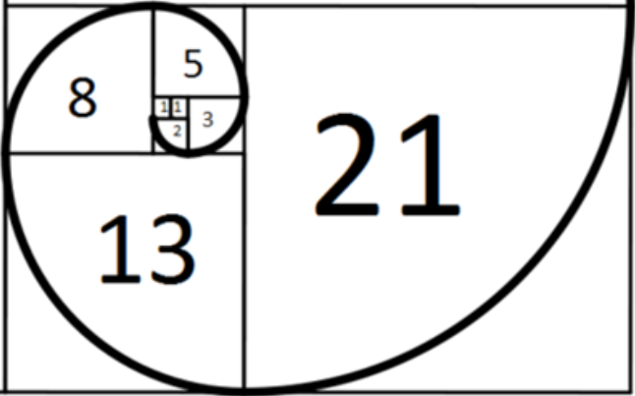
A D V A N C E D T O P I C!
Advanced: you can calculate area two ways. It is length times width, which here is 21 by 34. It is also the sum of the areas of each square, which is 1² + 1² + 2² + 3² + 5² + 8² + 13² + 21². These are equal! You can thus prove the sum of the squares of the first n Fibonacci numbers is the n^{th} Fibonacci number times the (n+1)^{st} Fibonacci number!

Slide 40
Summary: I Love Rectangles Game.
Experimentally discovered Fibonaccis!
Alternative definition: connections!
Can you GENERALIZE?

Slide 41
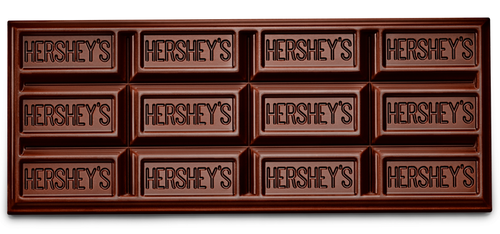
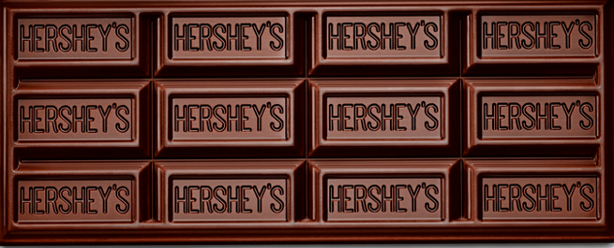
Chocolate Bar Game
https://tinyurl.com/aca5usrd
94

Slide 42
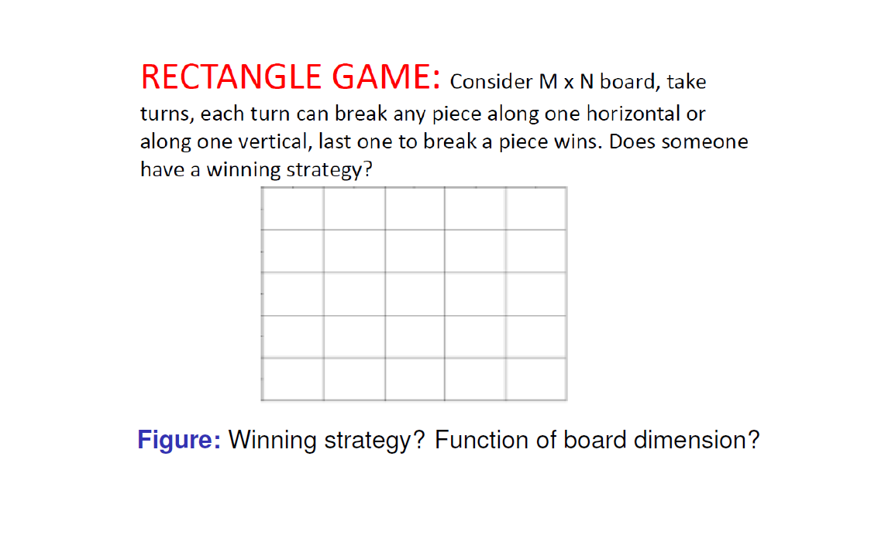

Slide 43
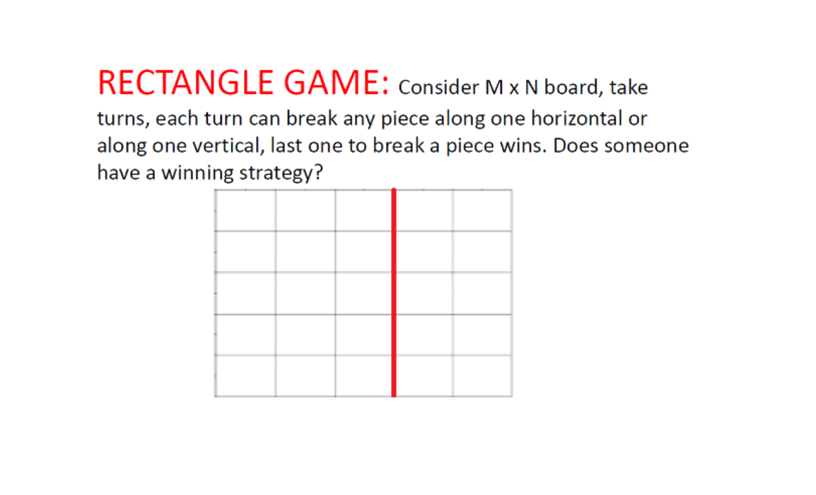

Slide 44
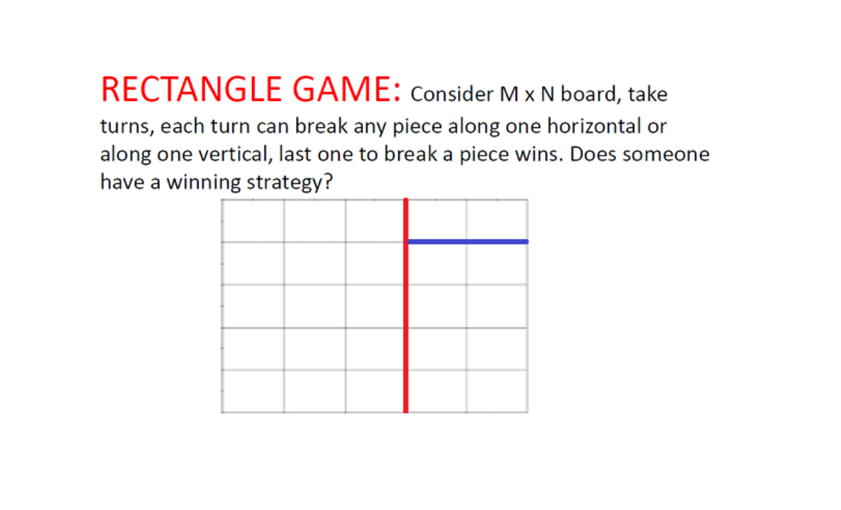

Slide 45
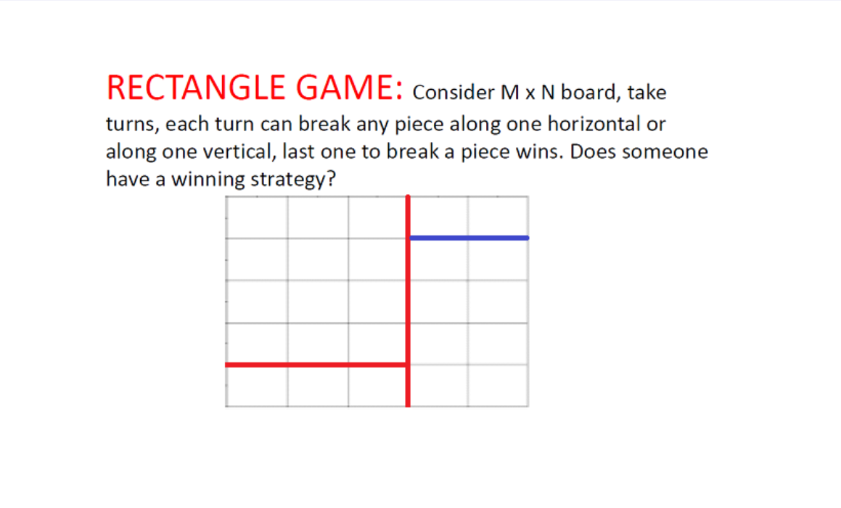

Slide 46
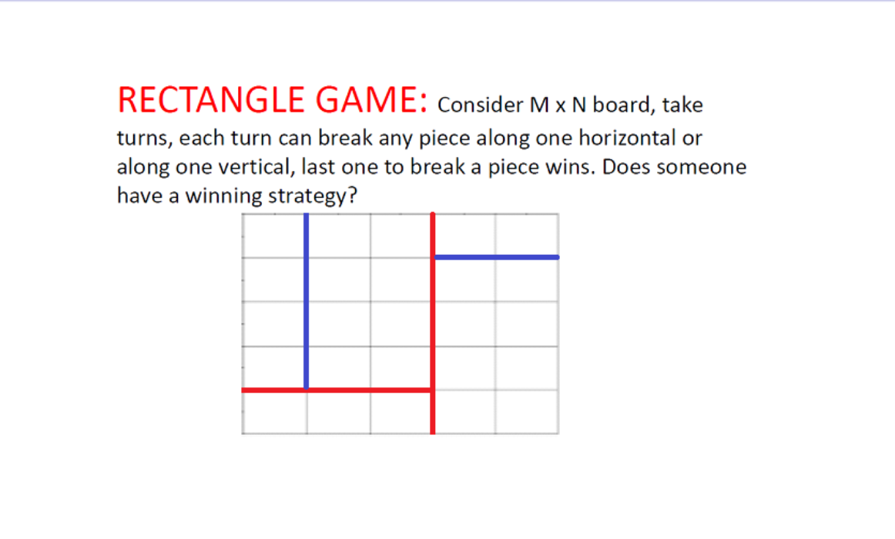

Slide 47
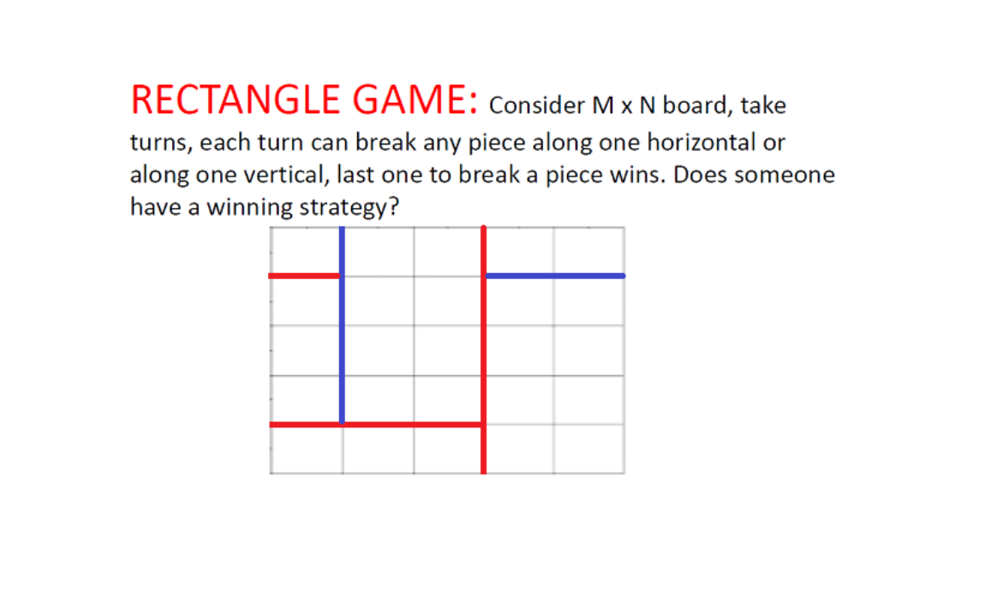

Slide 48
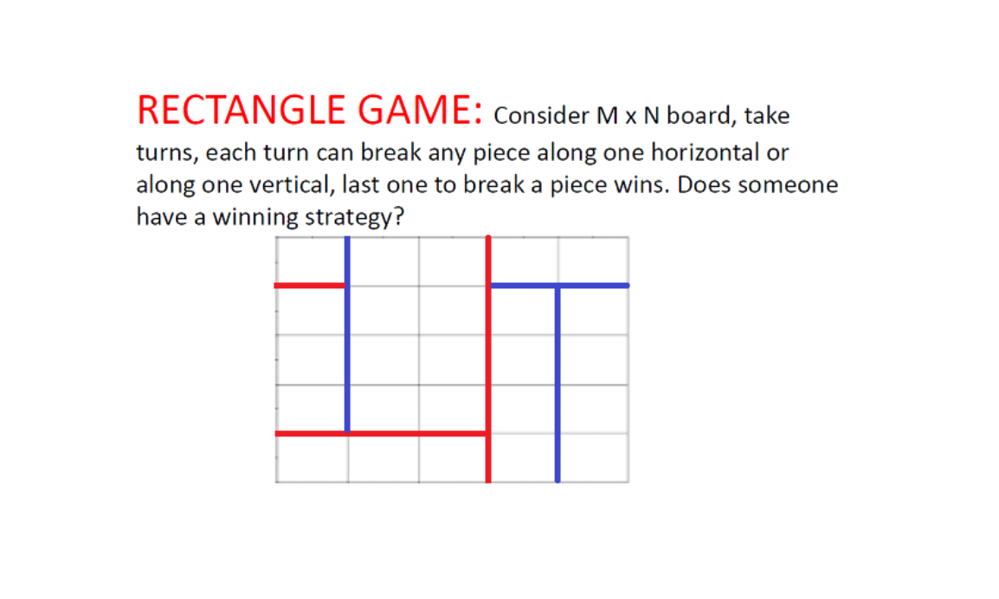

Slide 49
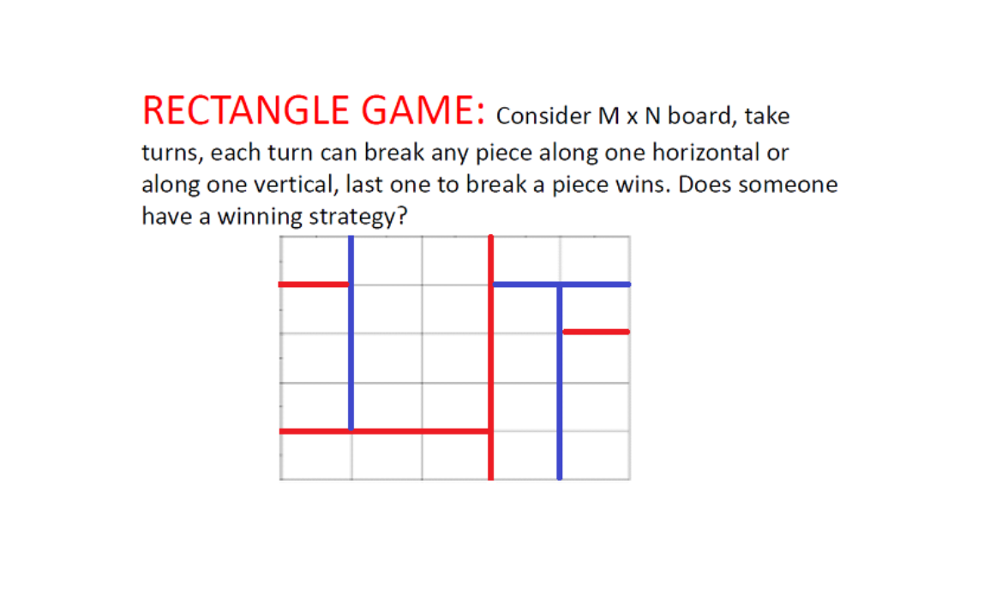

Slide 50
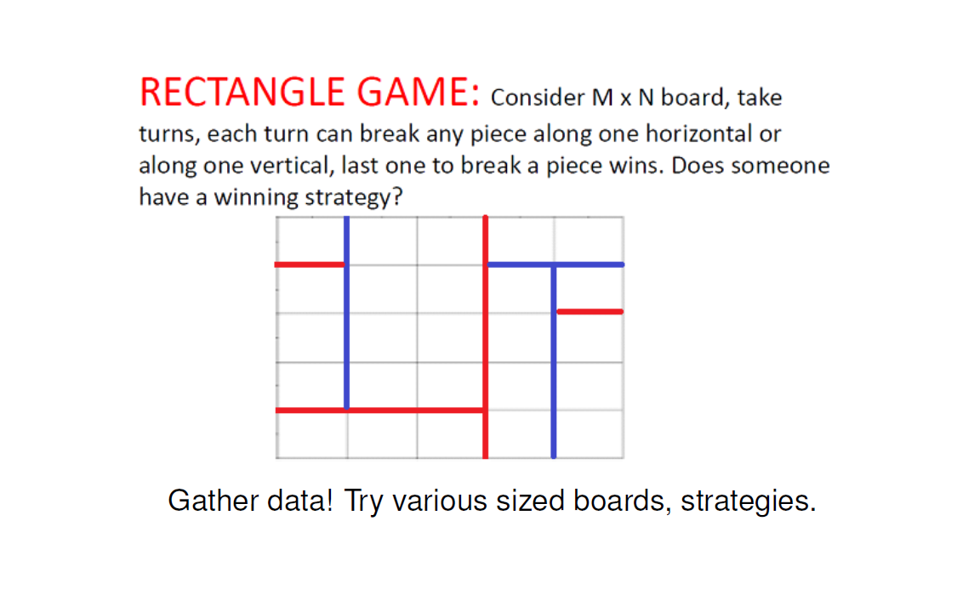
https://tinyurl.com/aca5usrd
94

Slide 51
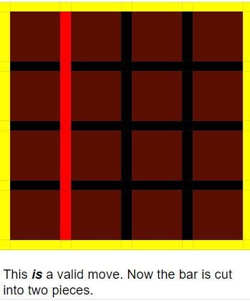
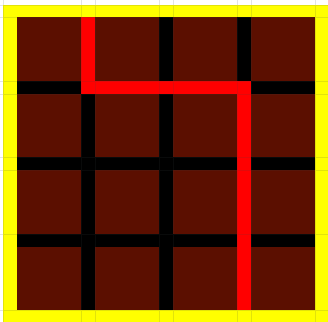
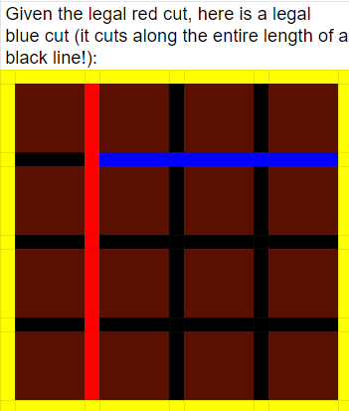
The above cut is illegal!
https://tinyurl.com/aca5usrd

Slide 52
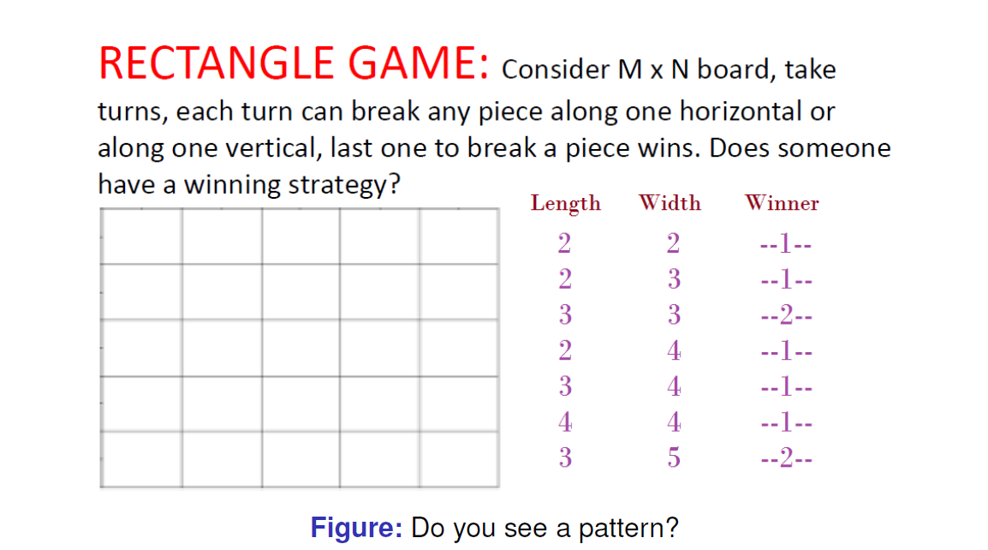




Slide 54


Chocolate Bar Game

Slide 55




Slide 56





Slide 57





Slide 58






Slide 59



Slide 60





Slide 61


The mono-variant is the number of pieces.
If board is m x n, game ends with mn pieces.
Thus takes mn - 1 moves.
If mn is even then Player 1 wins else Player 2 wins.
112
The most important part of the game is to eat the chocolate. Don’t forget!

Slide 62
Summary: Chocolate Bar Game.
Gather data! Conjecture!
New approach: Mono-variants.
Can you GENERALIZE?

Slide 64
Bonus slides: Cookie Problem

Slide 65


Slide 66


Slide 67

How to find and conjecture….?
Gather data from small values of C and P.
Feed into the Online Encyclopedia of Integer Sequences:
OEIS: https://oeis.org/
  P=1: 1,1,1,1,1,1,1,1,1
  P=2: 2,3,4,5,6,7,8,9,10,11
  P=3: 3,6,10,15,21,28,36,45,55,66
  P=4: 4,10,20,35,56,84,120,165,220,286
  P=5: 5,15,35,70,126,210,330,495,715,1001
  P=6: 6,21,56,126,252,462,792,1287,2002,3003
  P=7: 7,28,84,210,462,924,1716,3003,5005,8008
  P=8: 8,36,120,330,792,1716,3432,6435,11440,19448

Slide 68

Bonus slides: using Lego….

Slide 69


The Mathematics of LEGO Bricks
Professor Steven Miller (Math/Stats); TAs Cameron and Kayla Miller
https://web.williams.edu/Mathematics/sjmiller/public_html/legos
Article about previous courses (translation generously done by Antony Kim: https://docs.google.com/document/d/1gVixldnb9FPOIumq6y2qBQhb9W--R8OuKUqMHXfD6Vk/edit)
AWESOME time lapse video from 2014: http://www.youtube.com/watch?v=IpSjAYVZFBs&feature=youtu.be (10 minutes, 21 seconds)

Slide 70


Slide 71


Slide 72


