Slide 1
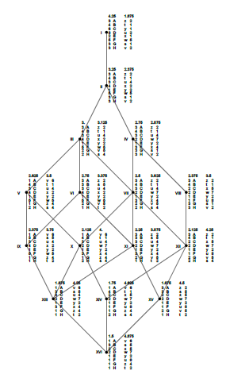
Modeling Beyond the Classroom: Linking Students and Industry
Steven J. Miller, Williams College: sjm1@williams.edu
https://web.williams.edu/Mathematics/sjmiller/public_html/
MathFest: Philadelphia: August 5, 2022
Integrating Math Modeling and Interdisciplinarity into Your Classroom

Slide 2
GOALS:
Describe Operations Research Class: https://web.williams.edu/Mathematics/sjmiller/public_html/377Fa16/index.htm
Discuss Projects

Slide 3
GOALS:
Describe Operations Research Class: https://web.williams.edu/Mathematics/sjmiller/public_html/377Fa16/index.htm
Discuss Projects
Most importantly: Teaching in a month, suggestions welcome!

Slide 4
https://web.williams.edu/Mathematics/sjmiller/public_html/

Slide 5
(especially 2004)

Slide 9
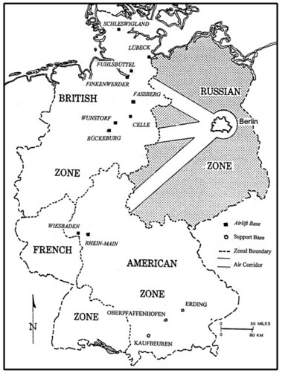
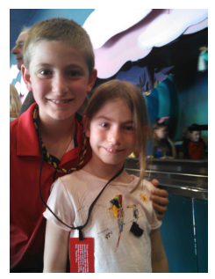

Slide 10
Student Projects:
Medical Industry (minimizing return visits)
Baseball lawsuits
Scheduling (competitions, schools, TAS)
Optimizing (resource allocation, cutting)
Image Processing

Slide 15
Thank You!

