Slide 2
Goals
The goal of this talk is to introduce the wonderful concept of a mono-variant, and show how it can be used to solve a variety of problems.
It is a mix of math and art – it is a wonderful example of a subject where it is not too bad to follow step by step, but one is left with the feeling “how did they think to look at it that way!”

Slide 3
Invariants
A quantity is invariant if it does not change throughout the process.
Examples:
Think of mass and energy in classical physics.
If you travel on a straight line from 0 to 10 it doesn’t matter how many stops you make, the total distance traveled is always 10.
If you are given 1 meter and bend it in two places to make a triangle, the area of the triangles can differ but all will have a perimeter of 1.

Slide 4
Mono-variants
A mono-variant is a quantity that can change in only one way; it is either non-decreasing (so it can stay the same or increase) or it is non-increasing (so it can stay the same or decrease).
Examples:
The number of pieces on the board in a game of chess or checkers.
The scores in a sports contest.
The distance traveled by a cannonball (unless we have a very strong wind!).

Slide 5
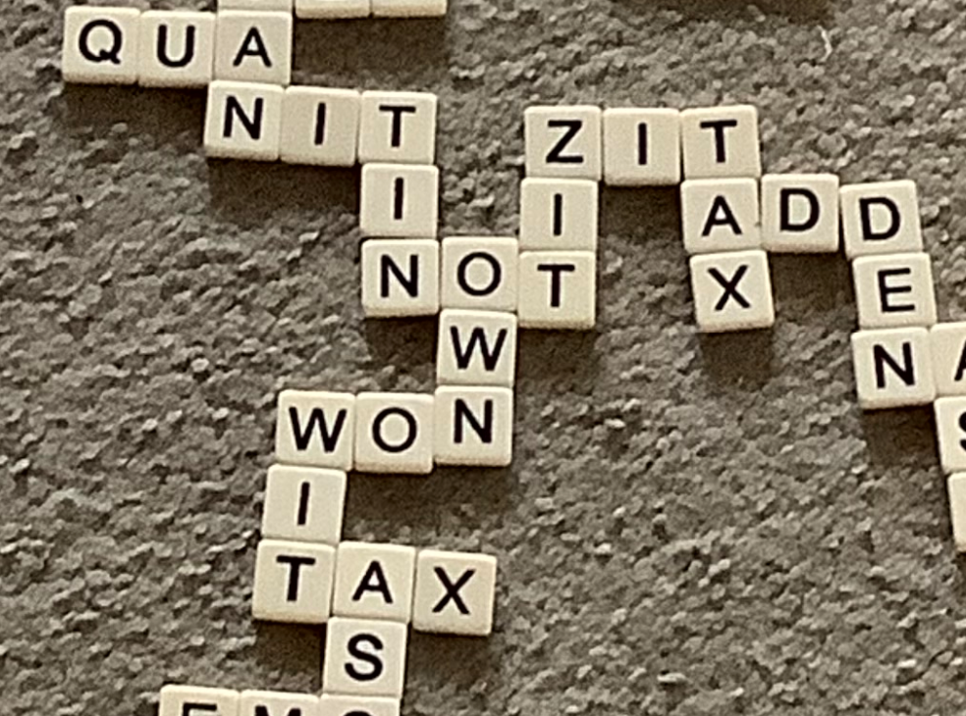
Inspiration
This lecture was inspired by a challenge my son gave himself: use all 144 tiles in a bananagram set and have one connected board, with every word exactly three letters…. A subset is below. Is it possible?

Slide 6
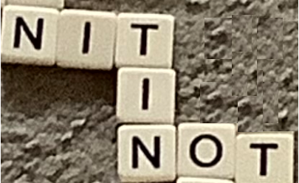
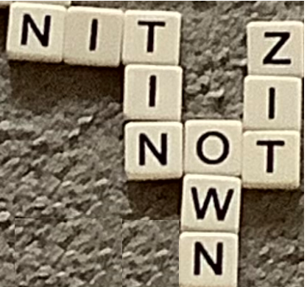
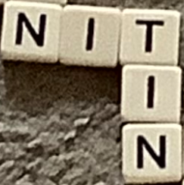
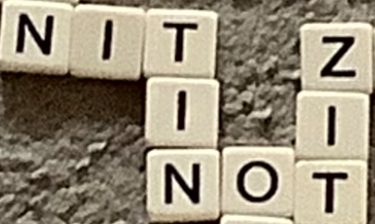
Bananagram Game
In the simplest way of trying to do the challenge, one starts with a three letter word, and then constantly adds two tiles at a time to form new three letter words.

Slide 7
Will it be possible to win, adding two tiles at a time?
Remember we start with 144 tiles, and initially place a three letter word.
SPEND A MOMENT AND SEE IF YOU CAN ANSWER THIS!

Slide 8
Bananagram Game Solution
We need to introduce a good mono-variant for this problem.
We start with 144 tiles, place 3, and there are 141 tiles left.
Note after the first word there is an ODD number of tiles on the board.
What happens after we add our next word, which costs us two tiles?

Slide 9
Bananagram Game Solution
We need to introduce a good mono-variant for this problem.
We start with 144 tiles, place 3, and there are 141 tiles left.
Note after the first word there is an ODD number of tiles on the board.
After we make our second word there is still an ODD number of tiles on the board.
What happens after we add the third word, which costs us two tiles?

Slide 10
Bananagram Game Solution
We need to introduce a good mono-variant for this problem.
We start with 144 tiles, place 3, and there are 141 tiles left.
Note after the first word there is an ODD number of tiles on the board.
After we make our second word there is still an ODD number of tiles on the board.
After the third word there is still an ODD number of tiles on the board!

Slide 11
Bananagram Game Solution
We need to introduce a good mono-variant for this problem.
We start with 144 tiles, place 3, and there are 141 tiles left.
Note after the first word there is an ODD number of tiles on the board.
After we make our second word there is still an ODD number of tiles on the board.
After the third word there is still an ODD number of tiles on the board!
There will always be an odd number of tiles – we have found a good invariant! Thus it is impossible to place all the tiles if we always add two.

Slide 12
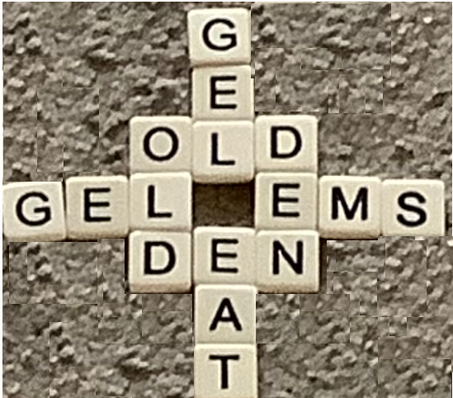
Bananagram Game Modification
We can do it if we change how we place tiles.
We must allow other patterns, we must allow for configurations where we place just one tile down to get a word, for example….

Slide 13
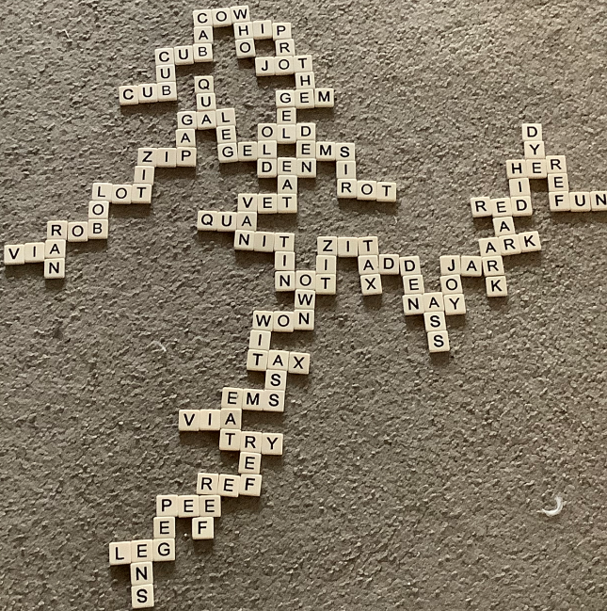

Slide 14
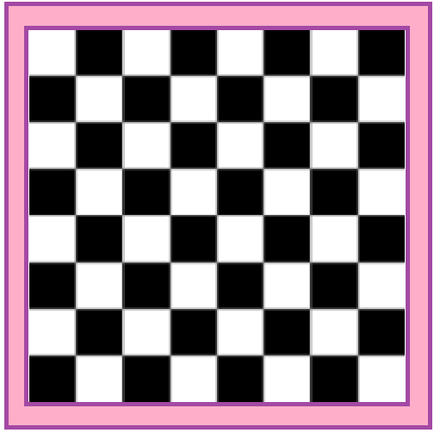
Checkerboard Problem
Consider an 8x8 Chessboard.
You want to place 2x1 tiles on it so that you cover the entire board. Is it possible?

Slide 15
Checkerboard Problem
Consider an 8x8 Chessboard.
You want to place 2x1 tiles on it so that you cover the entire board. Is it possible?
YES – just do row by row!
OK, need to modify to make it interesting…..

Slide 16
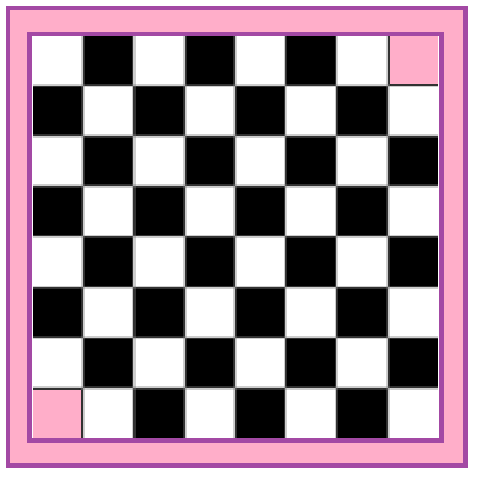
Checkerboard Problem
Consider an 8x8 Chessboard.
You want to place 2x1 tiles on it so that you cover the entire board; however, now the upper right and bottom left corners are missing. Is it possible?

Slide 17
Checkerboard Problem
How would you go about solving this problem?
Often if a problem is hard, try to do a simpler one first.
What do you think is easier?

Slide 18
Checkerboard Problem
How would you go about solving this problem?
Often if a problem is hard, try to do a simpler one first.
What do you think is easier?
Try a 1x1? No, nothing left!

Slide 19
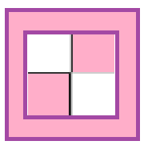
Checkerboard Problem
How would you go about solving this problem?
Often if a problem is hard, try to do a simpler one first.
What do you think is easier?
Try a 2x2 version….

Slide 20
Checkerboard Problem
How would you go about solving this problem?
Often if a problem is hard, try to do a simpler one first.
What do you think is easier?
Try a 2x2 version…. Impossible!

Slide 21
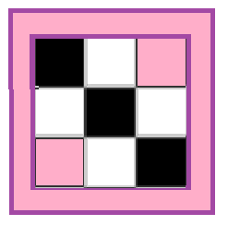
Checkerboard Problem
How would you go about solving this problem?
Often if a problem is hard, try to do a simpler one first.
What do you think is easier?
Try a 3x3 version….

Slide 22
Checkerboard Problem
How would you go about solving this problem?
Often if a problem is hard, try to do a simpler one first.
What do you think is easier?
Try a 3x3 version…. Impossible!
Cannot do as each tile covers up two squares, and thus we always cover up an EVEN number of squares, but on any ODD by ODD board there are an odd number of squares left to cover!

Slide 23
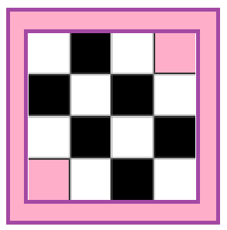
Checkerboard Problem
How would you go about solving this problem?
Often if a problem is hard, try to do a simpler one first.
What do you think is easier?
Try a 4x4 version….

Slide 24
Checkerboard Problem
How would you go about solving this problem?
Often if a problem is hard, try to do a simpler one first.
What do you think is easier?
Try a 4x4 version…. Impossible!
Though could take awhile to show no approach will work.

Slide 25
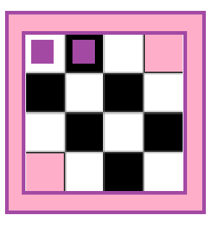
Checkerboard Problem
How would you go about solving this problem?
Try a 4x4 version…. Impossible!
Though could take awhile to show no approach will work.
By symmetry, can assume first tile is in top row going East-West. Where is next?

Slide 26
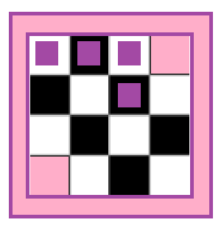
Checkerboard Problem
By symmetry, can assume first tile is in top row going East-West. Where is next?
Has to go down from top….
If we do not have one here, we cannot get the third square in the top row.
Where is next?

Slide 27
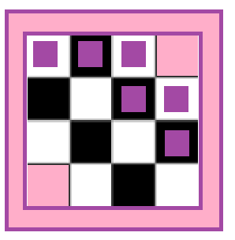
Checkerboard Problem
By symmetry, can assume first tile is in top row going East-West. Where is next?
Has to go down from top…. Where is next?
Has to be in the last column…. Where is next?

Slide 28
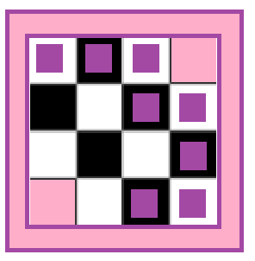
Checkerboard Problem
By symmetry, can assume first tile is in top row going East-West. Where is next?
Has to go down from top…. Where is next?
Has to be in the last column…. Where is next?
Has to be in the last row…. Where is next?

Slide 29
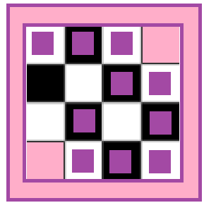
Checkerboard Problem
By symmetry, can assume first tile is in top row going East-West. Where is next?
Has to go down from top…. Where is next?
Has to be in the last column…. Where is next?
Has to be in the last row…. Where is next?
Has to come up from last row, now in trouble.
Cannot get the surrounded white square.

Slide 30
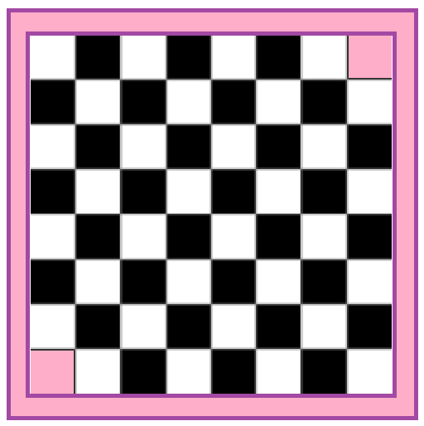
Checkerboard Problem
We need to look at all the other even boards.
Is there a better approach?
Think about what happens every time you put down a tile. What is covered up?

Slide 31
Checkerboard Problem
Think about what happens every time you put down a tile. What is covered up?
Every time we put down a tile we cover up ONE white square and ONE black square.
How does this help us?

Slide 32
Checkerboard Problem
Think about what happens every time you put down a tile. What is covered up?
Every time we put down a tile we cover up ONE white square and ONE black square.
As we removed both white corners, we start with two more black squares than white – it is impossible!

Slide 33
(though perhaps we should change it to people being infected with covid-19, given the present circumstances)

Slide 57
This is just the tip of the iceberg for problems using invariants or mono-variants. Another great one is the Conway checkers (or soldiers) problem. See https://en.wikipedia.org/wiki/Conway%27s_Soldiers for details, as well as this excellent video: https://www.youtube.com/watch?v=Or0uWM9bT5w .
However, before you go to these sites, look at the statement below, explore, conjecture, and see what you can do! Note: While there is a mono-variant solution, it is a lot more involved than the ones seen so far.

