Slide 1
CUR - Goldwater Scholars Faculty Mentor Award
Steven J Miller: sjm1@williams.edu
Department of Mathematics and Statistics, Williams College
https://web.williams.edu/Mathematics/sjmiller/public_html/
May 12, 2021

Slide 2
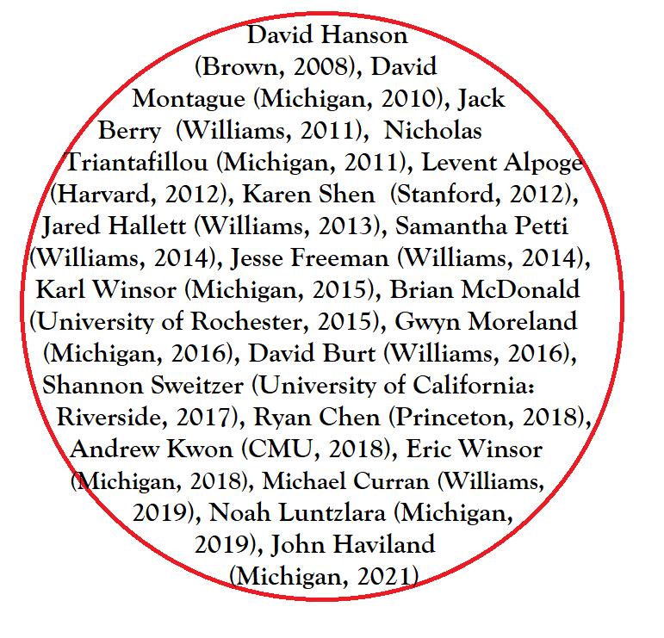
Expanding Circles
Goldwater Scholars

Slide 3
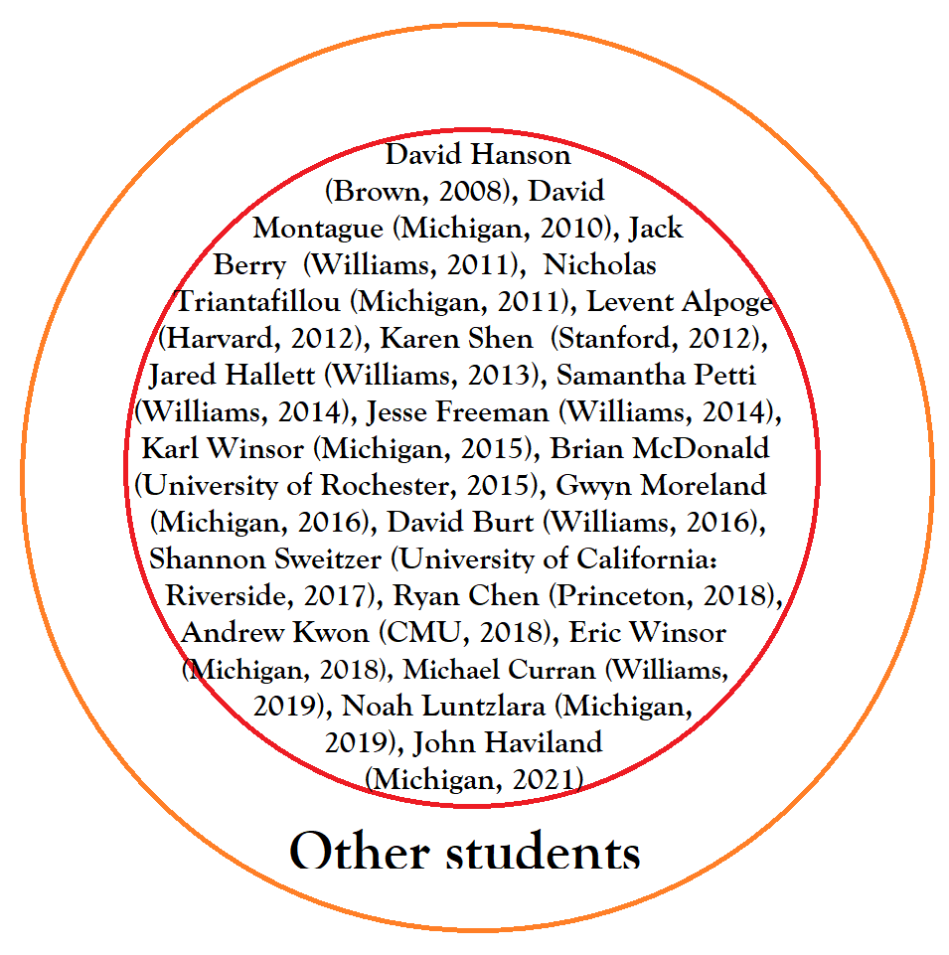
Expanding Circles
Goldwater Scholars
Other students: 400+ high school and
college students

Slide 4
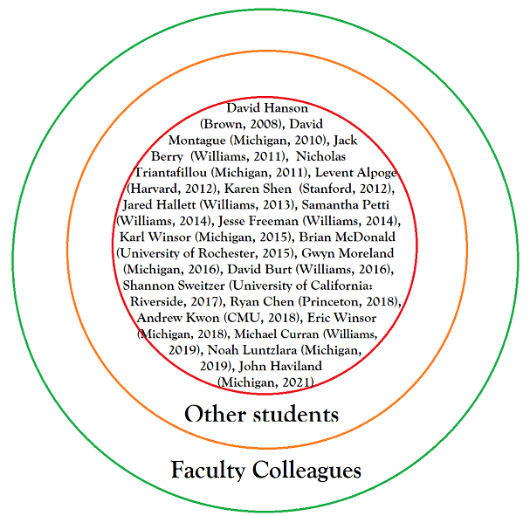
Expanding Circles
Goldwater Scholars
Other students: 400+ high school and
college students
Faculty Colleagues: Especially those
at Williams and Michigan

Slide 5
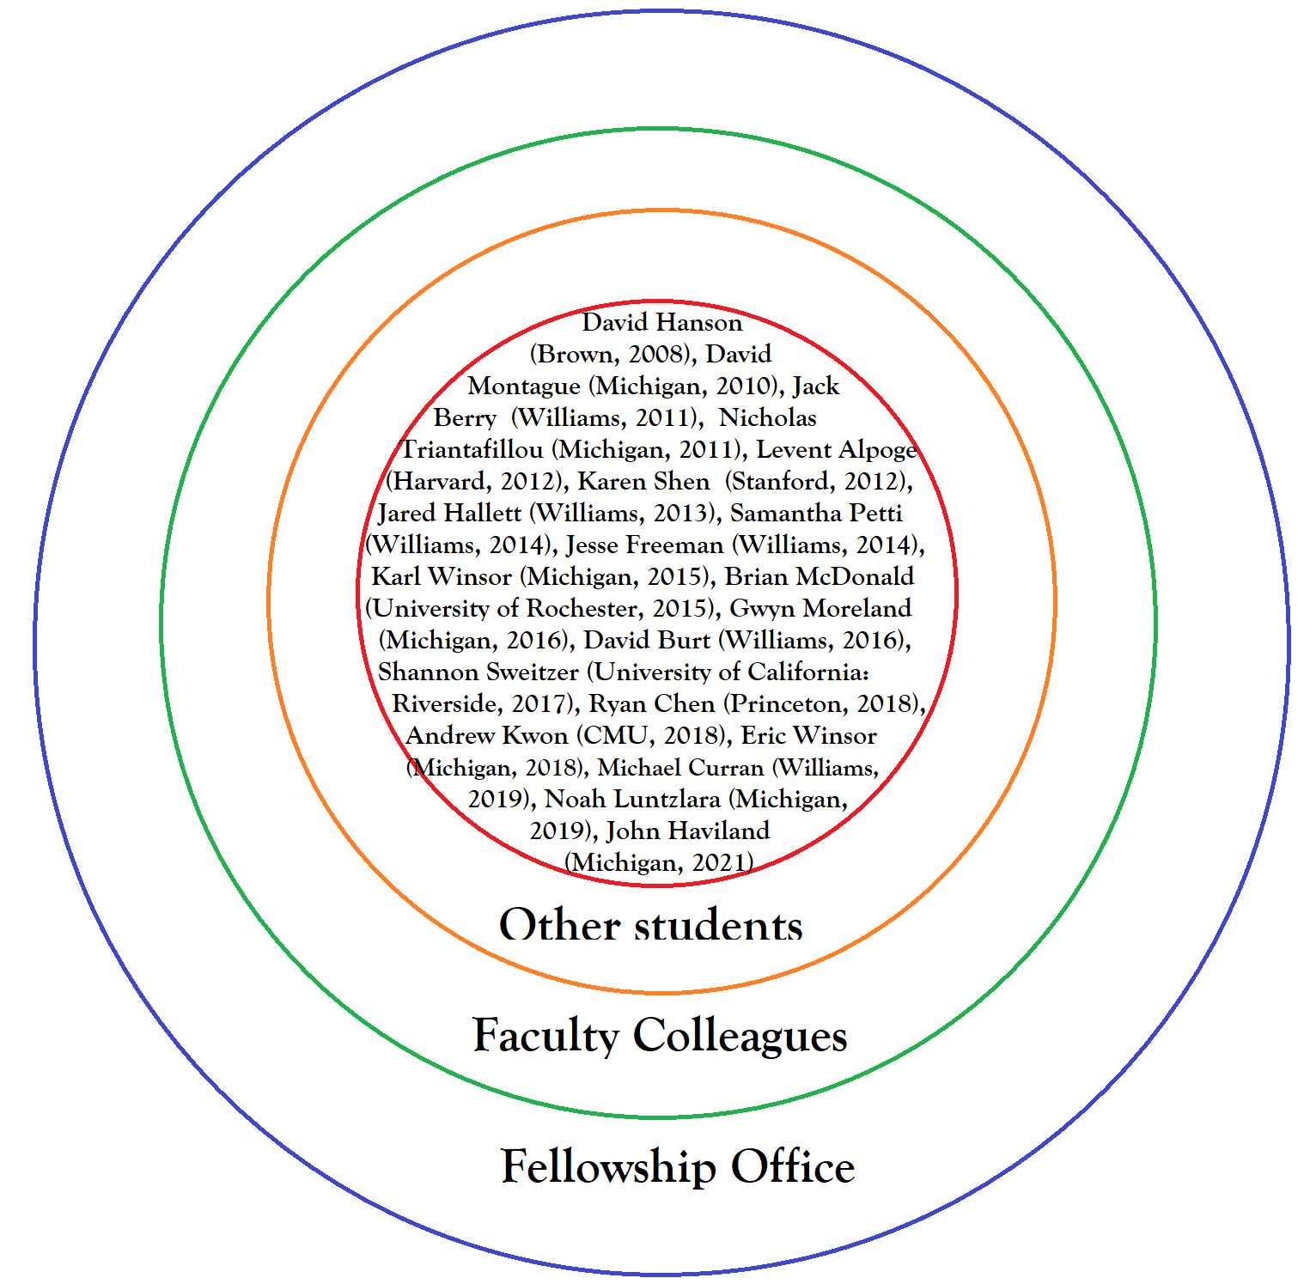
Expanding Circles
Goldwater Scholars
Other students: 400+ high school and
college students
Faculty Colleagues: Especially those
at Williams and Michigan
Fellowship Office: Especially
Lynn Chick, Katya King

Slide 6
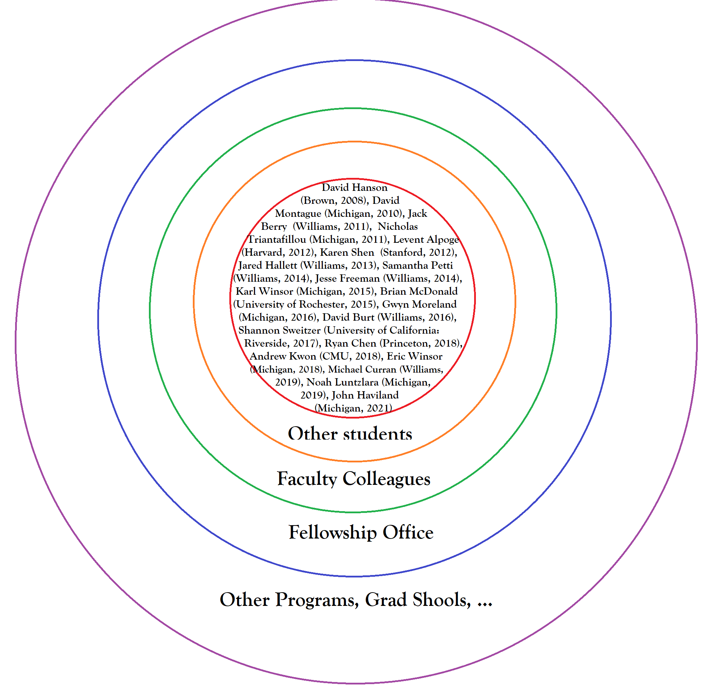
Expanding Circles
Goldwater Scholars
Other students: 400+ high school and
college students
Faculty Colleagues: Especially those
at Williams and Michigan
Fellowship Office: Especially
Lynn Chick, Katya King
Other Programs: Graduate School,
Industry, Churchill (8), NSF, ….
(Only a subset – my colleagues, advisors and family….)

Slide 7
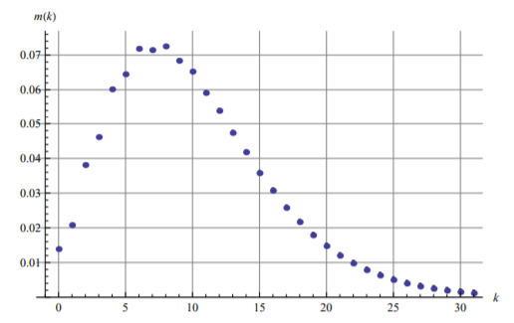
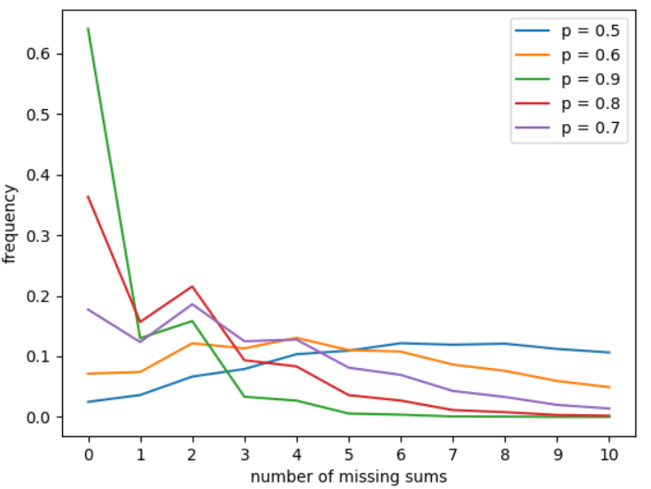
Joys of Undergraduate Research
Opens students to possibilities.

Slide 8
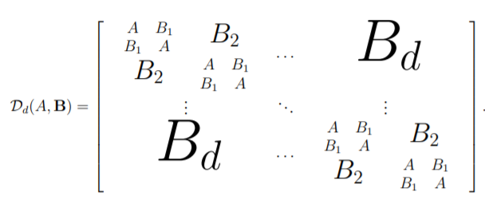
Joys of Undergraduate Research
Opens students to possibilities.
Valuable skills for all walks of life.

Slide 9
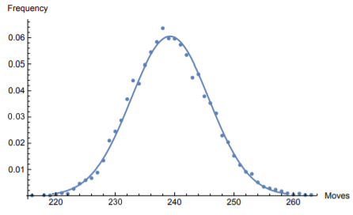
Joys of Undergraduate Research
Opens students to possibilities.
Valuable skills for all walks of life.
Rising tide lifts all boats.

Slide 10
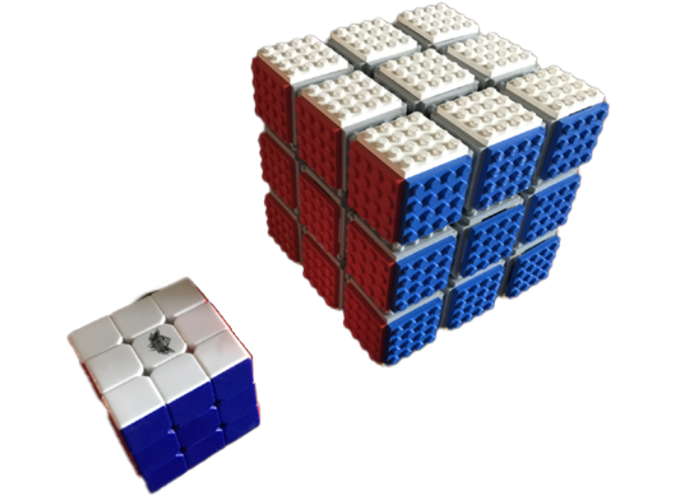
Joys of Undergraduate Research
Opens students to possibilities.
Valuable skills for all walks of life.
Rising tide lifts all boats.
Pay it forward (service, next scholars).

Slide 11
Joys of Undergraduate Research
Opens students to possibilities.
Valuable skills for all walks of life.
Rising tide lifts all boats.
Pay it forward (service, next scholars).
Springboard to the future.

Slide 12
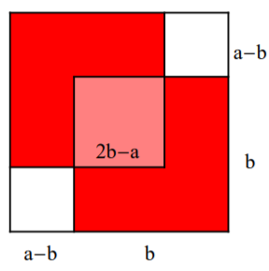
Problems across the years: Irrationality
Good problem is interesting, explainable, and generalizable.
Stanley Tennenbaum:
Geometric proof of the irrationality of $\sqrt{2}$
(not a/b for integers a, b).
If rational, $2= a^{2} / b^{2}$ and assume b smallest such integer.
Double counted pink square equals the two white squares.
Get $2={(2b−a)}^{2} / {(a−b)}^{2}$, and a-b < b.

Slide 13
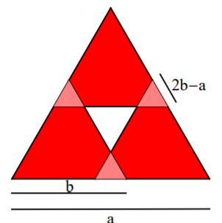
Problems across the years : Irrationality
Good problem is interesting, explainable, and generalizable.

Slide 14
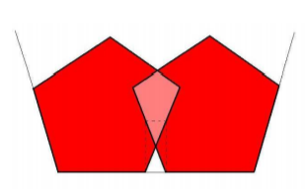
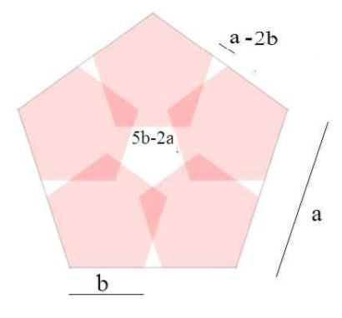
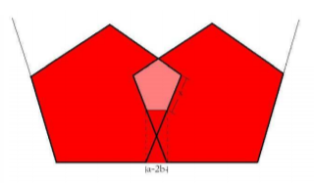
Problems across the years : Irrationality
Rational irrationality proofs (with David Montague), Mathematics Magazine 85 (2012), no. 2, 110--114. https://web.williams.edu/Mathematics/sjmiller/public_html/math/papers/irrationality50.pdf (expanded version): Mathologer’s animation: https://youtu.be/yk6wbvNPZW0?t=540 (20 second)

Slide 15
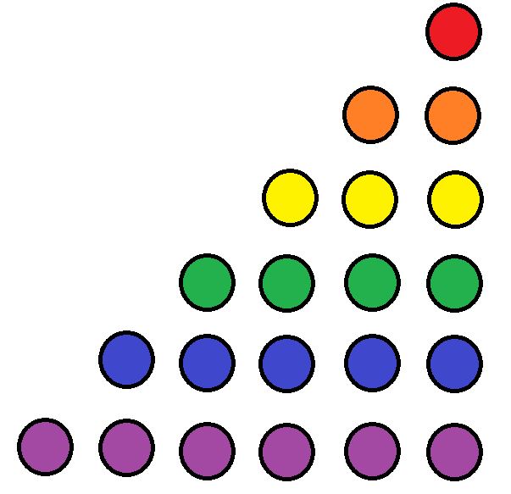
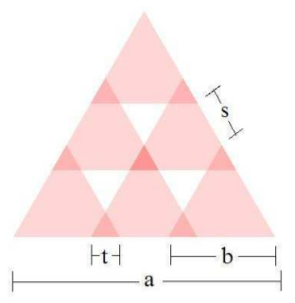
Problems across the years : Irrationality
Rational irrationality proofs (with David Montague), Mathematics Magazine 85 (2012), no. 2, 110--114. https://web.williams.edu/Mathematics/sjmiller/public_html/math/papers/irrationality50.pdf (expanded version)
Triangle numbers:
1, 1 + 2 = 3, 1 + 2 + 3 = 6, 1 + 2 + 3 + 4 = 10, ….
We proved the irrationality of $\sqrt{3}, \sqrt{6}, \sqrt{10}, ….$
But the proof must break down as n^{th} triangle number is n(n+1)/2.
Note 8th triangle number is 36 = 6².

Slide 16
Problems across the years : Irrationality
Rational irrationality proofs (with David Montague), Mathematics Magazine 85 (2012), no. 2, 110--114. https://web.williams.edu/Mathematics/sjmiller/public_html/math/papers/irrationality50.pdf (expanded version)
Triangle numbers:
1, 1 + 2 = 3, 1 + 2 + 3 = 6, 1 + 2 + 3 + 4 = 10, ….
We proved the irrationality of $\sqrt{3}, \sqrt{6}, \sqrt{10}, ….$
But the proof must break down as n^{th} triangle number is n(n+1)/2.
Note 8th triangle number is 36 = 6².
OPEN:
$$\sqrt{7}, \sqrt[3]{2}$$

Slide 17
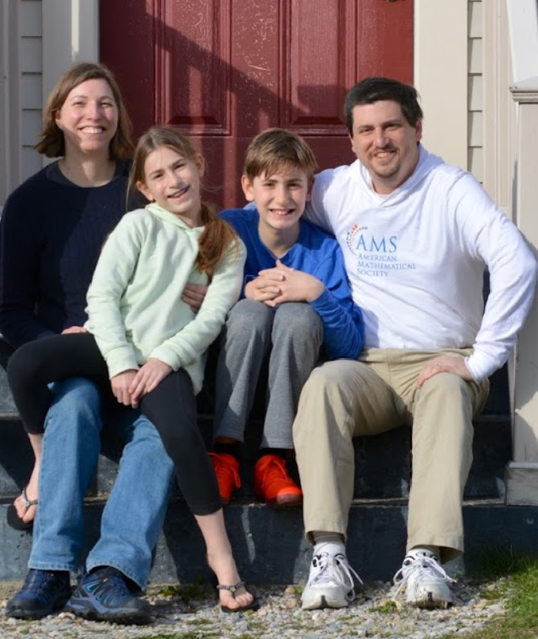
Thank you!
https://web.williams.edu/Mathematics/sjmiller/public_html/

Slide 18
Problems across the years: Fibonacci Games
Fibonacci numbers: 1, 2, 3, 5, 8, 13, 21, 34, 89, 144, 233, 377, 610, 987, 1597, 2584, …, in general F_{n+1} = F_{n} + F_{n-1}.
Zeckendorf’s Theorem: Every integer has a unique representation as a sum of non-consecutive Fibonacci numbers.

Slide 19
Problems across the years: Fibonacci Games
Fibonacci numbers: 1, 2, 3, 5, 8, 13, 21, 34, 89, 144, 233, 377, 610, 987, 1597, 2584, …, in general F_{n+1} = F_{n} + F_{n-1}.
Zeckendorf’s Theorem: Every integer has a unique representation as a sum of non-consecutive Fibonacci numbers.
Example: 2021 = 1597 + 377 + 34 + 13.
Created game on this….

Slide 20
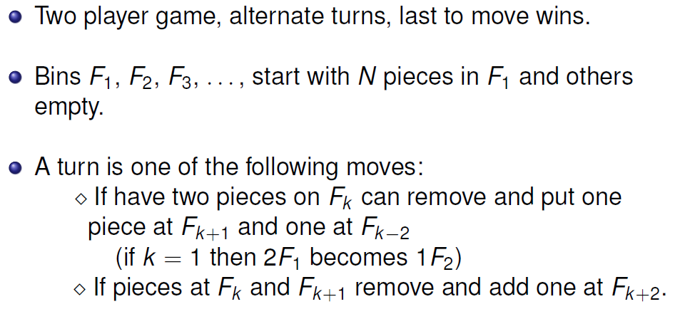
Problems across the years: Fibonacci Games
Fibonacci numbers: 1, 2, 3, 5, 8, 13, 21, 34, 89, 144, 233, 377, 610, 987, 1597, 2584, …, in general F_{n+1} = F_{n} + F_{n-1}.

Slide 21
Problems across the years: Fibonacci Games
Fibonacci numbers: 1, 2, 3, 5, 8, 13, 21, 34, 89, 144, 233, 377, 610, 987, 1597, 2584, …, in general F_{n+1} = F_{n} + F_{n-1}.

Slide 22
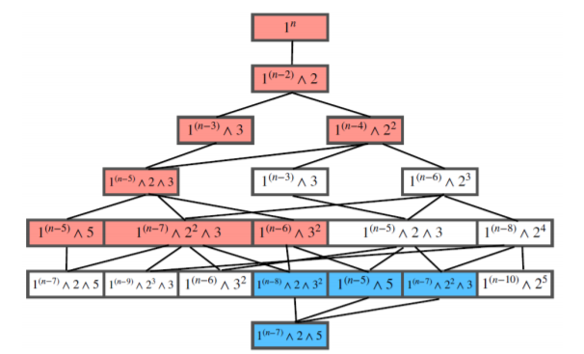
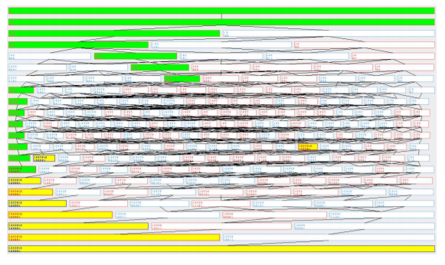
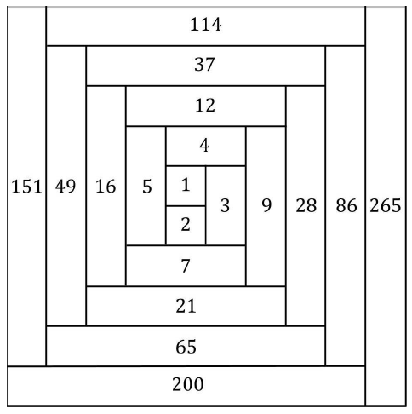
Problems across the years: Fibonacci Games
Fibonacci numbers: 1, 2, 3, 5, 8, 13, 21, 34, 89, 144, 233, 377, 610, 987, 1597, 2584, …, in general F_{n+1} = F_{n} + F_{n-1}.
Theorem: If n > 2 then Player 2 has a winning strategy, but it is a non-constructive proof!
Lots of papers with students, most recently with John Haviland: Extending Zeckendorf's Theorem to a Non-constant Recurrence and the Zeckendorf Game on this Non-constant Recurrence Relation} (with Ela Boldyriew, Anna Cusenza, Linglong Dai, Pei Ding, Aidan Dunkelberg, John Haviland, Kate Huffman, Dianhui Ke, Daniel Kleber, Jason Kuretski, John Lentfer, Tianhao Luo, Clayton Mizgerd, Vashisth Tiwari, Jingkai Ye, Yunhao Zhang, Xiaoyan Zheng, and Weiduo Zhu), Fibonacci Quarterly 58 (2020), no. 5, 55--76. https://web.williams.edu/Mathematics/sjmiller/public_html/math/papers/ZeckExtendingZeckNonConstantGame40.pdf
Can you find the winning
strategy?

Slide 23
Thank you!
https://web.williams.edu/Mathematics/sjmiller/public_html/

