Slide 1
Introduction to Sums
Steven J Miller, Williams College
sjm1@Williams.edu

Slide 2
Goals
Want to learn how to evaluate sums.
Will see a variety of techniques, including Induction.

Slide 3
Part I: Induction

Slide 4
Notation
Imagine we have a sequence a₁, a₂, a₃, a₄, ….
Perhaps a_{n} = n² so the sequence is

Slide 5
Notation
Imagine we have a sequence a₁, a₂, a₃, a₄, ….
Perhaps a_{n} = n² so the sequence is 1, 4, 9, 16, …..
Or maybe a_{n} is the n^{th} prime, so the sequence is

Slide 6
Notation
Imagine we have a sequence a₁, a₂, a₃, a₄, ….
Perhaps a_{n} = n² so the sequence is 1, 4, 9, 16, …..
Or maybe a_{n} is the n^{th} prime, so the sequence is 2, 3, 5, 7, …..

Slide 7
Notation
Imagine we have a sequence a₁, a₂, a₃, a₄, ….
Perhaps a_{n} = n² so the sequence is 1, 4, 9, 16, …..
Or maybe a_{n} is the n^{th} prime, so the sequence is 2, 3, 5, 7, …..
By $\sum_{n=4}^{9}{an }$we mean a₄ + a₅ + a₆ + a₇ + a₈ + a₉. This is concise notation, and saves us the trouble of writing everything each time.
Sometimes convenient to start with a₀.

Slide 8
Induction
One of the most important techniques we have for proving results.
Say we have some statement P(n). Perhaps P(n) is “the sum of the first n integers is n(n+1)/2”.
We can check this for various n; every time we check it is true but that is NOT the same as a proof!
Example: $\frac{16}{64}$ = $\frac{1}{4}$, $\frac{19}{95}$ = $\frac{1}{5}$, $\frac{49}{98}$= $\frac{1}{2}$ but $\frac{12}{24}$ is not $\frac{1}{4}$.

Slide 9
Induction
One of the most important techniques we have for proving results.
Say we have some statement P(n). Perhaps P(n) is “the sum of the first n integers is n(n+1)/2”.
We can check this for various n; every time we check it is true but that is NOT the same as a proof!
Example: $\frac{16}{64}$ = $\frac{1}{4}$, $\frac{19}{95}$ = $\frac{1}{5}$, $\frac{49}{98}$= $\frac{1}{2}$ but $\frac{12}{24}$ is not $\frac{1}{4}$.

Slide 10
Induction
Say we have some statement P(n). Perhaps P(n) is “the sum of the first n integers is n(n+1)/2”.
Imagine we can show the following two statements are true.
P(1) is true, and
Whenever P(n) is true then P(n+1) is true.
If we can do this we now have P(n) is true for all n!
(Note: Sometimes we start at n=0 not n=1)

Slide 11
Induction
Say we have some statement P(n). Perhaps P(n) is “the sum of the first n integers is n(n+1)/2”.
Imagine we can show the following two statements are true.
Base case: P(1) is true, and
Inductive Step: Whenever P(n) is true then P(n+1) is true.
Why does this imply that it holds for all n?

Slide 12
Induction (Box, Dirichlet, Pigeonhole Principle)
Imagine we can show the following two statements are true.
Base case: P(1) is true, and
Inductive Step: Whenever P(n) is true then P(n+1) is true.
Take n=1: thus the second becomes P(1) true implies P(2) true
P(1) is true
P(1) true implies P(2) true
THEREFORE since P(1) is true we now know P(2) is true.

Slide 13
Induction (Box, Dirichlet, Pigeonhole Principle)
Imagine we can show the following two statements are true.
Base case: P(1) is true, and
Inductive Step: Whenever P(n) is true then P(n+1) is true.
We know P(1) and P(2) are true.
Take n=2: thus the second becomes P(2) true implies P(3) true
P(2) is true
P(2) true implies P(3) true
THEREFORE since P(2) is true we now know P(3) is true.

Slide 14
Induction (Box, Dirichlet, Pigeonhole Principle)
Imagine we can show the following two statements are true.
Base case: P(1) is true, and
Inductive Step: Whenever P(n) is true then P(n+1) is true.
We know P(1), P(2) and P(3) are true.
Take n=3: thus the second becomes P(3) true implies P(4) true
P(3) is true
P(3) true implies P(4) true
THEREFORE since P(3) is true we now know P(4) is true. AND SO ON!

Slide 15
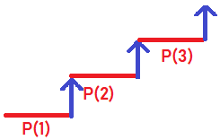
Induction (Box, Dirichlet, Pigeonhole Principle)
To prove P(n) is true for all n, must show
Base case: P(1) is true, and
Inductive Step: Whenever P(n) is true then P(n+1) is true.
This is often viewed
as a staircase.

Slide 16
Example: P(n): 1 + 2 + … + n = n(n+1)/2
To prove P(n) is true for all n, must show
Base case: P(1) is true, and
Inductive Step: Whenever P(n) is true then P(n+1) is true.
We will prove this by induction. There are two steps.
First we prove P(1) is true, then we show IF P(n) is true THEN P(n+1) is true.

Slide 17
Example: P(n): 1 + 2 + … + n = n(n+1)/2
To prove P(n) is true for all n, must show
Base case: P(1) is true, and
Inductive Step: Whenever P(n) is true then P(n+1) is true.
Step 1: Base Case: We must show P(1) is true.
Thus we must show that when n=1, we have 1 = 1(1+1)/2.
This however follows immediately!
We are done with the base case.

Slide 18
Example: P(n): 1 + 2 + … + n = n(n+1)/2
To prove P(n) is true for all n, must show
Base case: P(1) is true, and
Inductive Step: Whenever P(n) is true then P(n+1) is true.
Step 2: Inductive Step: We now get to ASSUME that P(n) is true, and we must show that P(n+1) is true.
We are done with the base case. We could try to do n=2 or n=3 to build up intuition, but it is not necessary.

Slide 19
Example: P(n): 1 + 2 + … + n = n(n+1)/2
To prove P(n) is true for all n, must show
Base case: P(1) is true, and
Inductive Step: Whenever P(n) is true then P(n+1) is true.
Step 2: Inductive Step: We now get to ASSUME that P(n) is true, and we must show that P(n+1) is true.
Extra work: If n=2 let’s check: Does 1+2 = 2(2+1)/2? YES!
Extra work: if n=3 let’s check: Does 1+2+3 = 3(3+1)/2? YES!
These extra checks are not a substitute for a proof, but the more values of n that work, the more confident we are that it is true.

Slide 20
Example: P(n): 1 + 2 + … + n = n(n+1)/2
To prove P(n) is true for all n, must show
Base case: P(1) is true, and
Inductive Step: Whenever P(n) is true then P(n+1) is true.
Step 2: Inductive Step: We now get to ASSUME that P(n) is true, and we must show that P(n+1) is true.
OK, we now get to assume P(n) is true, we want to prove P(n+1) is true.
What does this mean?
P(n) true means we assume 1 + 2 + … + n = n(n+1)/2.
We want to prove that P(n+1): 1 + 2 + … + n + (n+1) = (n+1)(n+1+1)/2 is true.
How should we proceed? When we look at P(n+1), do we see anything related to P(n)?

Slide 21
Example: P(n): 1 + 2 + … + n = n(n+1)/2
To prove P(n) is true for all n, must show
Base case: P(1) is true, and
Inductive Step: Whenever P(n) is true then P(n+1) is true.
Step 2: Inductive Step: We now get to ASSUME that P(n) is true, and we must show that P(n+1) is true.
OK, we now get to assume P(n) is true, we want to prove P(n+1) is true.
What does this mean?
P(n) true means we assume 1 + 2 + … + n = n(n+1)/2.
We want to prove that P(n+1): 1 + 2 + … + n + (n+1) = (n+1)(n+1+1)/2 is true.
How should we proceed? Notice that the sum for n+1 starts off exactly as the sum for n!
What are we assuming we know about 1 + 2 + … + n? We are assuming it equals ….

Slide 22
Example: P(n): 1 + 2 + … + n = n(n+1)/2
To prove P(n) is true for all n, must show
Base case: P(1) is true, and
Inductive Step: Whenever P(n) is true then P(n+1) is true.
Step 2: Inductive Step: We now get to ASSUME that P(n) is true, and we must show that P(n+1) is true.
OK, we now get to assume P(n) is true, we want to prove P(n+1) is true.
What does this mean?
P(n) true means we assume 1 + 2 + … + n = n(n+1)/2.
We want to prove that P(n+1): 1 + 2 + … + n + (n+1) = (n+1)(n+1+1)/2 is true.
How should we proceed? Notice that the sum for n+1 starts off exactly as the sum for n!
What are we assuming we know about 1 + 2 + … + n? We are assuming it equals n(n+1)/2.
Thus let’s substitute for 1 + 2 + … + n in 1 + 2 + … + n + (n+1).

Slide 23
Example: P(n): 1 + 2 + … + n = n(n+1)/2
To prove P(n) is true for all n, must show
Base case: P(1) is true, and
Inductive Step: Whenever P(n) is true then P(n+1) is true.
Step 2: Inductive Step: We now get to ASSUME that P(n) is true, and we must show that P(n+1) is true.
OK, we now get to assume P(n) is true, we want to prove P(n+1) is true.
What does this mean?
P(n) true means we assume 1 + 2 + … + n = n(n+1)/2.
We want to prove that P(n+1): 1 + 2 + … + n + (n+1) = (n+1)(n+1+1)/2 is true.
Using the inductive assumption, we have
1 + 2 + … + n + (n+1) = (1 + 2 + … + n) + (n+1) = n(n+1)/2 + (n+1).
Now we just need to show the far right equals our claim, (n+1)(n+1+1)/2. How do we add two fractions?

Slide 24
Example: P(n): 1 + 2 + … + n = n(n+1)/2
To prove P(n) is true for all n, must show
Base case: P(1) is true, and
Inductive Step: Whenever P(n) is true then P(n+1) is true.
Step 2: Inductive Step: We now get to ASSUME that P(n) is true, and we must show that P(n+1) is true.
OK, we now get to assume P(n) is true, we want to prove P(n+1) is true.
What does this mean?
P(n) true means we assume 1 + 2 + … + n = n(n+1)/2.
We want to prove that P(n+1): 1 + 2 + … + n + (n+1) = (n+1)(n+1+1)/2 is true.
We have 1 + 2 + … + n + (n+1) = n(n+1)/2 + (n+1).
But $\frac{n(n+1)}{2}+\left(n+1\right)=$

Slide 25
Example: P(n): 1 + 2 + … + n = n(n+1)/2
To prove P(n) is true for all n, must show
Base case: P(1) is true, and
Inductive Step: Whenever P(n) is true then P(n+1) is true.
Step 2: Inductive Step: We now get to ASSUME that P(n) is true, and we must show that P(n+1) is true.
OK, we now get to assume P(n) is true, we want to prove P(n+1) is true.
What does this mean?
P(n) true means we assume 1 + 2 + … + n = n(n+1)/2.
We want to prove that P(n+1): 1 + 2 + … + n + (n+1) = (n+1)(n+1+1)/2 is true.
We have 1 + 2 + … + n + (n+1) = n(n+1)/2 + (n+1).
But $\frac{n(n+1)}{2}+\left(n+1\right)= \frac{n(n+1)}{2}$ + $\frac{2(n+1)}{2} =$

Slide 26
Example: P(n): 1 + 2 + … + n = n(n+1)/2
To prove P(n) is true for all n, must show
Base case: P(1) is true, and
Inductive Step: Whenever P(n) is true then P(n+1) is true.
Step 2: Inductive Step: We now get to ASSUME that P(n) is true, and we must show that P(n+1) is true.
OK, we now get to assume P(n) is true, we want to prove P(n+1) is true.
What does this mean?
P(n) true means we assume 1 + 2 + … + n = n(n+1)/2.
We want to prove that P(n+1): 1 + 2 + … + n + (n+1) = (n+1)(n+1+1)/2 is true.
We have 1 + 2 + … + n + (n+1) = n(n+1)/2 + (n+1).
But $\frac{n(n+1)}{2}+\left(n+1\right)= \frac{n(n+1)}{2}$ + $\frac{2(n+1)}{2} =\frac{n\left(n+1\right) +2(n+1)}{2} =$

Slide 27
Example: P(n): 1 + 2 + … + n = n(n+1)/2
To prove P(n) is true for all n, must show
Base case: P(1) is true, and
Inductive Step: Whenever P(n) is true then P(n+1) is true.
Step 2: Inductive Step: We now get to ASSUME that P(n) is true, and we must show that P(n+1) is true.
OK, we now get to assume P(n) is true, we want to prove P(n+1) is true.
What does this mean?
P(n) true means we assume 1 + 2 + … + n = n(n+1)/2.
We want to prove that P(n+1): 1 + 2 + … + n + (n+1) = (n+1)(n+1+1)/2 is true.
We have 1 + 2 + … + n + (n+1) = n(n+1)/2 + (n+1).
But $\frac{n(n+1)}{2}+\left(n+1\right)= \frac{n(n+1)}{2}$ + $\frac{2(n+1)}{2} =\frac{n\left(n+1\right) +2(n+1)}{2} =\frac{(n+1)(n+2)}{2}$, which is what we needed to show, completing the proof (as n+2 = n+1+1)!

Slide 28
Example: P(n): 1² + 2² + … + n² = n(n+1)(2n+1)/6
To prove P(n) is true for all n, must show
Base case: P(1) is true, and
Inductive Step: Whenever P(n) is true then P(n+1) is true.
The proof is similar to what we just did!
Step 1: The Base Case: n=1: Is

Slide 29
Example: P(n): 1² + 2² + … + n² = n(n+1)(2n+1)/6
To prove P(n) is true for all n, must show
Base case: P(1) is true, and
Inductive Step: Whenever P(n) is true then P(n+1) is true.
The proof is similar to what we just did!
Step 1: The Base Case: n=1: Is 1² = 1(1+1)(2*1 + 1)/6? YES!
We don’t need to, but we can check other values of n.
If n=2 does
If n=3 does

Slide 30
Example: P(n): 1² + 2² + … + n² = n(n+1)(2n+1)/6
To prove P(n) is true for all n, must show
Base case: P(1) is true, and
Inductive Step: Whenever P(n) is true then P(n+1) is true.
The proof is similar to what we just did!
Step 1: The Base Case: n=1: Is 1² = 1(1+1)(2*1 + 1)/6? YES!
We don’t need to, but we can check other values of n.
If n=2 does 1² + 2² = 2(2+1)(2*2+1)/6? YES!
If n=3 does 1² + 2² + 3² = 3(3+1)(2*3 + 1)/6? YES!

Slide 31
Example: P(n): 1² + 2² + … + n² = n(n+1)(2n+1)/6
To prove P(n) is true for all n, must show
Base case: P(1) is true, and
Inductive Step: Whenever P(n) is true then P(n+1) is true.
Step 2: Inductive Step: Assume P(n) is true, must show P(n+1) is true.
Since we are assuming P(n) is true, what do we know?

Slide 32
Example: P(n): 1² + 2² + … + n² = n(n+1)(2n+1)/6
To prove P(n) is true for all n, must show
Base case: P(1) is true, and
Inductive Step: Whenever P(n) is true then P(n+1) is true.
Step 2: Inductive Step: Assume P(n) is true, must show P(n+1) is true.
Since we are assuming P(n) is true, what do we know?
P(n) is true means 1² + 2² + … + n² = n(n+1)(2n+1)/6.
We must show P(n+1) is true. What is that?

Slide 33
Example: P(n): 1² + 2² + … + n² = n(n+1)(2n+1)/6
To prove P(n) is true for all n, must show
Base case: P(1) is true, and
Inductive Step: Whenever P(n) is true then P(n+1) is true.
Step 2: Inductive Step: Assume P(n) is true, must show P(n+1) is true.
Since we are assuming P(n) is true, what do we know?
P(n) is true means 1² + 2² + … + n² = n(n+1)(2n+1)/6.
We must show P(n+1) is true. What is that?
P(n+1) is 1² + 2² + … + n² + (n+1)² = (n+1)(n+1+1)(2(n+1)+1)/6, note the right hand side is (n+1)(n+2)(2n+3)/6.
What is in common with P(n) and P(n+1)?

Slide 34
Example: P(n): 1² + 2² + … + n² = n(n+1)(2n+1)/6
To prove P(n) is true for all n, must show
Base case: P(1) is true, and
Inductive Step: Whenever P(n) is true then P(n+1) is true.
Step 2: Inductive Step: Assume P(n) is true, must show P(n+1) is true.
Since we are assuming P(n) is true, what do we know?
P(n) is true means 1² + 2² + … + n² = n(n+1)(2n+1)/6.
We must show P(n+1) is true. What is that?
P(n+1) is 1² + 2² + … + n² + (n+1)² = (n+1)(n+1+1)(2(n+1)+1)/6, note the right hand side is (n+1)(n+2)(2n+3)/6.
What is in common with P(n) and P(n+1)? We can now substitute….

Slide 35
Example: P(n): 1² + 2² + … + n² = n(n+1)(2n+1)/6
To prove P(n) is true for all n, must show
Base case: P(1) is true, and
Inductive Step: Whenever P(n) is true then P(n+1) is true.
Step 2: Inductive Step: Assume P(n) is true, must show P(n+1) is true.
Since we are assuming P(n) is true, what do we know?
P(n) is true means 1² + 2² + … + n² = n(n+1)(2n+1)/6.
We must show P(n+1) is true. What is that?
P(n+1) is 1² + 2² + … + n² + (n+1)² = (n+1)(n+1+1)(2(n+1)+1)/6, note the right hand side is (n+1)(n+2)(2n+3)/6.
So is 1² + 2² + … + n² + (n+1)² = (1² + 2² + … + n²) + (n+1)² = n(n+1)(2n+1)/6 + (n+1)^{2.}
We have to combine the fractions – how do we do that?

Slide 36
Example: P(n): 1² + 2² + … + n² = n(n+1)(2n+1)/6
To prove P(n) is true for all n, must show
Base case: P(1) is true, and
Inductive Step: Whenever P(n) is true then P(n+1) is true.
Step 2: Inductive Step: Assume P(n) is true, must show P(n+1) is true.
Since we are assuming P(n) is true, what do we know?
P(n) is true means 1² + 2² + … + n² = n(n+1)(2n+1)/6.
We must show P(n+1) is true. What is that?
P(n+1) is 1² + 2² + … + n² + (n+1)² = (n+1)(n+1+1)(2(n+1)+1)/6, note the right hand side is (n+1)(n+2)(2n+3)/6.
So is 1² + 2² + … + n² + (n+1)² = = n(n+1)(2n+1)/6 + (n+1)^{2.}
We have $\frac{n(n+1)(2n+1)}{6} = \frac{6\left(n+1\right)2}{6} =$??? What is in common with the two fractions? Both have a ….

Slide 37
Example: P(n): 1² + 2² + … + n² = n(n+1)(2n+1)/6
To prove P(n) is true for all n, must show
Base case: P(1) is true, and
Inductive Step: Whenever P(n) is true then P(n+1) is true.
Step 2: Inductive Step: Assume P(n) is true, must show P(n+1) is true.
Since we are assuming P(n) is true, what do we know?
P(n) is true means 1² + 2² + … + n² = n(n+1)(2n+1)/6.
We must show P(n+1) is true. What is that?
P(n+1) is 1² + 2² + … + n² + (n+1)² = (n+1)(n+1+1)(2(n+1)+1)/6, note the right hand side is (n+1)(n+2)(2n+3)/6.
So is 1² + 2² + … + n² + (n+1)² = = n(n+1)(2n+1)/6 + (n+1)^{2.}
We have $\frac{n(n+1)(2n+1)}{6} = \frac{6\left(n+1\right)2}{6} = \frac{\left(n+1\right)(n\left(2n+1\right)+ 6\left(n+1\right))}{6} = \frac{(n+1)(2n2+n+6n+6)}{6} =\frac{(n+1)(2n2+7n+6)}{6}$
Doing some algebra, we see $2n2+7n+6$ equals (n+2)(2n+3) by FOIL, completing the proof.

Slide 38
Example: P(n): 1 + 3 + … + (2n-1) = n²
To prove P(n) is true for all n, must show
Base case: P(1) is true, and
Inductive Step: Whenever P(n) is true then P(n+1) is true.
The proof is similar to what we just did!
Step 1: The Base Case: n=1: Is 1 = 1²? YES!
We don’t need to, but we can check other values of n.
If n=2 does
If n=3 does
Rest of the proof is similar to what we’ve done before….

Slide 39
Example: P(n): 1 + 3 + … + (2n-1) = n²
To prove P(n) is true for all n, must show
Base case: P(1) is true, and
Inductive Step: Whenever P(n) is true then P(n+1) is true.
The proof is similar to what we just did!
Step 1: The Base Case: n=1: Is 1 = 1²? YES!
We don’t need to, but we can check other values of n.
If n=2 does 1 + 3 = 2²? YES!
If n=3 does 1 + 3 + 5 = 3²? YES!
Rest of the proof is similar to what we’ve done before….

Slide 40
Example: P(n): 1 + 3 + … + (2n-1) = n²
To prove P(n) is true for all n, must show
Base case: P(1) is true, and
Inductive Step: Whenever P(n) is true then P(n+1) is true.
Can prove in other ways than Induction….

Slide 41
Example: P(n): 133 divides 11^{n+1} + 12^{2n-1}
To prove P(n) is true for all n, must show
Base case: P(1) is true, and
Inductive Step: Whenever P(n) is true then P(n+1) is true.
Let’s try to show P(1) is true: does 133 divide 11¹⁺¹ + 12²*¹⁻¹?

Slide 42
Example: P(n): 133 divides 11^{n+1} + 12^{2n-1}
To prove P(n) is true for all n, must show
Base case: P(1) is true, and
Inductive Step: Whenever P(n) is true then P(n+1) is true.
Let’s try to show P(1) is true: does 133 divide 11¹⁺¹ + 12²*¹⁻¹?
Yes, as 11¹⁺¹ + 12²*¹⁻¹ = 11² +12 = 121 + 12 = 133, which is clearly a multiple of 133.

Slide 43
Example: P(n): 133 divides 11^{n+1} + 12^{2n-1}
To prove P(n) is true for all n, must show
Base case: P(1) is true, and
Inductive Step: Whenever P(n) is true then P(n+1) is true.
Now assume P(n) is true, we must show P(n+1) is true.
Can assume 133 divides 11^{n+1} + 12^{2n – 1}, must show 133 divides 11^{n+1} + 12^{2n – 1}.

Slide 44
Getting a feel for the answer….
We showed 1 + 2 + … + n = n(n+1)/2 = n²/2 + n/2.
Is this reasonable?
How can we try to get an UPPER BOUND and a LOWER BOUND for the sum?

Slide 45
Getting a feel for the answer….
We showed 1 + 2 + … + n = n(n+1)/2 = n²/2 + n/2.
Is this reasonable?
How can we try to get an UPPER BOUND and a LOWER BOUND for the sum?
Every term in the sum is at most ???
Every term in the sum is at least ???
The number of terms is ???
Thus an upper bound is ???
Thus a lower bound is ???

Slide 46
Getting a feel for the answer….
We showed 1 + 2 + … + n = n(n+1)/2 = n²/2 + n/2.
Is this reasonable?
How can we try to get an UPPER BOUND and a LOWER BOUND for the sum?
Every term in the sum is at most n
Every term in the sum is at least 1
The number of terms is n
Thus an upper bound is n*n = n²
Thus a lower bound is 1*n = n.
Note there is a large difference between the upper and lower bounds, need to do better.

Slide 47
Getting a feel for the answer….
We showed 1 + 2 + … + n = n(n+1)/2 = n²/2 + n/2.
Is this reasonable?
How can we try to get an UPPER BOUND and a LOWER BOUND for the sum?
Every term in the sum is at most n
The number of terms is n
Thus an upper bound is n*n = n²
The last half of the terms are each at least n/2 and there are n/2.
Thus a lower bound is n/2 * n/2 = n²/4.
Now n² / 4 ≤ 1 + 2 + … + n ≤ n², note these bounds are of the same power in n!

Slide 48
Final thoughts on sums of powers….
Hardest part of the induction is knowing what to PROVE.
How can we find the formula?
Looking at the cases we’ve done it looks like it is always a polynomial of degree one higher than the power, constant term is zero, leading term (if sum of k^{th} powers) is n^{k+1} / (k+1).
Note 2 points determine a line, 3 points a quadratic (parabola), 4 a cubic, and so on; we can evaluate the sum for a few points and then INTERPOLATE and figure out the polynomial!
Homework: Prove 1³ + 2³ + … + n³ = n² (n+1)² / 4.

Slide 49
False proofs by Induction
The following is my favorite false proof by induction. Where is the mistake?
P(n): In any group of n people, everyone has the same name! (Note different groups of n people can have different names).
Let’s try to prove this by induction. We must show:
Base Case: In any group with 1 person, everyone has the same name.
Inductive Step: If everyone in a group of size n has the same name, then everyone in a group of size n+1 has the same name.

Slide 50
False proofs by Induction
The following is my favorite false proof by induction. Where is the mistake?
P(n): In any group of n people, everyone has the same name! (Note different groups of n people can have different names).
Let’s try to prove this by induction. We must show:
Base Case: In any group with 1 person, everyone has the same name.
PROOF OF BASE CASE: This follows immediately, as….

Slide 51
False proofs by Induction
The following is my favorite false proof by induction. Where is the mistake?
P(n): In any group of n people, everyone has the same name! (Note different groups of n people can have different names).
Let’s try to prove this by induction. We must show:
Base Case: In any group with 1 person, everyone has the same name.
PROOF OF BASE CASE: This follows immediately, as there is only one person in the group, so clearly everyone in the group has the same name!

Slide 52
False proofs by Induction
P(n): In any group of n people, everyone has the same name! (Note different groups of n people can have different names).
Inductive Step: If everyone in a group of size n has the same name, then everyone in a group of size n+1 has the same name.
“PROOF” OF INDUCTIVE STEP: We assume everyone in a group of size n has the same name, must show true for a group of size n+1. Consider a group of n+1 people. How can we use the inductive assumption (all groups of size n have all with the same name)? Can you find some groups of size n?

Slide 53
False proofs by Induction
P(n): In any group of n people, everyone has the same name! (Note different groups of n people can have different names).
Inductive Step: If everyone in a group of size n has the same name, then everyone in a group of size n+1 has the same name.
“PROOF” OF INDUCTIVE STEP: We assume everyone in a group of size n has the same name, must show true for a group of size n+1. Consider a group of n+1 people. How can we use the inductive assumption (all groups of size n have all with the same name)? Can you find some groups of size n? First n people all have the same name!

Slide 54
False proofs by Induction
P(n): In any group of n people, everyone has the same name! (Note different groups of n people can have different names).
Inductive Step: If everyone in a group of size n has the same name, then everyone in a group of size n+1 has the same name.
“PROOF” OF INDUCTIVE STEP: We assume everyone in a group of size n has the same name, must show true for a group of size n+1. Consider a group of n+1 people. How can we use the inductive assumption (all groups of size n have all with the same name)? Can you find some groups of size n? Last n people all have the same name!

Slide 55
False proofs by Induction
P(n): In any group of n people, everyone has the same name! (Note different groups of n people can have different names).
Inductive Step: If everyone in a group of size n has the same name, then everyone in a group of size n+1 has the same name.
“PROOF” OF INDUCTIVE STEP: We assume everyone in a group of size n has the same name, must show true for a group of size n+1. Consider a group of n+1 people. How can we use the inductive assumption (all groups of size n have all with the same name)? Can you find some groups of size n? Note people 2, 3, …, n are in both groups!

Slide 56
False proofs by Induction
P(n): In any group of n people, everyone has the same name! (Note different groups of n people can have different names).
Inductive Step: If everyone in a group of size n has the same name, then everyone in a group of size n+1 has the same name.
“PROOF” OF INDUCTIVE STEP: We assume everyone in a group of size n has the same name, must show true for a group of size n+1. Consider a group of n+1 people. How can we use the inductive assumption (all groups of size n have all with the same name)? Can you find some groups of size n? Note people 2, 3, …, n are in both groups! Thus everyone in the first n has the same name, everyone in the last n has the same name, and since people 2, 3, …, n are in both that means those two names are the same and our proof is done! If your name is not Steve Miller, you should be skeptical. Mistake?

Slide 57
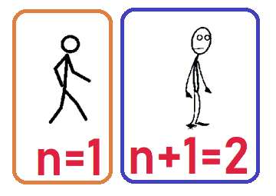
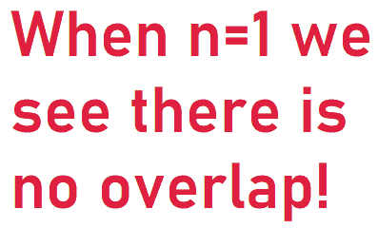
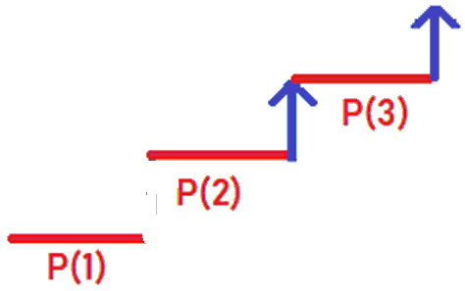
False proofs by Induction
P(n): In any group of n people, everyone has the same name! (Note different groups of n people can have different names).
Inductive Step: If everyone in a group of size n has the same name, then everyone in a group of size n+1 has the same name.
“PROOF” OF INDUCTIVE STEP: The mistake is we drew this for a “large” n. Remember we must show for ANY n that if P(n) is true then P(n+1) is true. If n is 2 or more then there is a person in both groups, but if n=1 there is not!

Slide 58
Part II: The Geometric Series Formula

Slide 60
The Geometric Series Formula
The Geometric Series Formula is one of the most important in mathematics. It is one of the few sums we can evaluate exactly.
If |r| < 1 then 1 + r + r² + r³ + r⁴ + … = $\frac{1}{1−r}.$
This is often proved by first computing the finite sum, up to r^{n}, and taking a limit. Note since |r| < 1 that each term r^{n} gets small fast…..

Slide 61
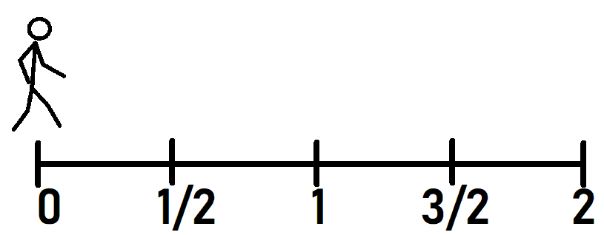
The Geometric Series Converges if |r| < 1
$1 +r+r2+r3+r4 +…$ = $\frac{1}{1−r}.$
Why does this converge? Take r = ½. We then have 1 + ½ + ¼ + …. = $\frac{1}{1 −\frac{1}{2}} =2$, and we can view this as we start at 0, and each step covers half the distance to 2. We thus never reach it in finitely many steps, but we cover half the ground each time.

Slide 62
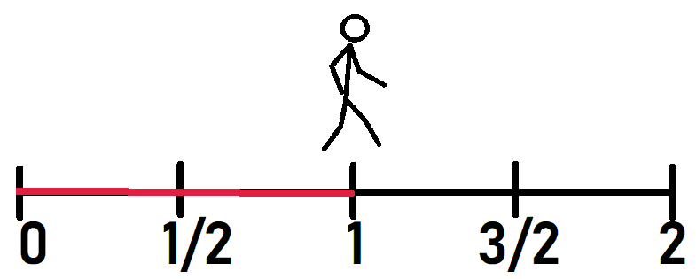
The Geometric Series Converges if |r| < 1
$1 +r+r2+r3+r4 +…$ = $\frac{1}{1−r}.$
Why does this converge? Take r = ½. We then have 1 + ½ + ¼ + …. = $\frac{1}{1 −\frac{1}{2}} =2$, and we can view this as we start at 0, and each step covers half the distance to 2. We thus never reach it in finitely many steps, but we cover half the ground each time.

Slide 63
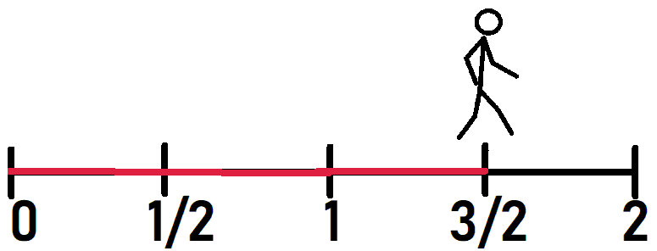
The Geometric Series Converges if |r| < 1
$1 +r+r2+r3+r4 +…$ = $\frac{1}{1−r}.$
Why does this converge? Take r = ½. We then have 1 + ½ + ¼ + …. = $\frac{1}{1 −\frac{1}{2}} =2$, and we can view this as we start at 0, and each step covers half the distance to 2. We thus never reach it in finitely many steps, but we cover half the ground each time.

Slide 64
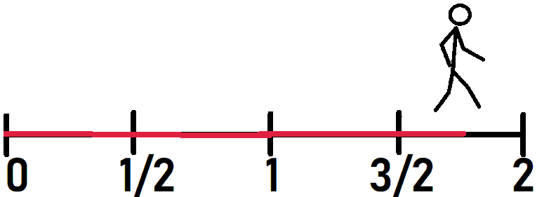
The Geometric Series Converges if |r| < 1
$1 +r+r2+r3+r4 +…$ = $\frac{1}{1−r}.$
Why does this converge? Take r = ½. We then have 1 + ½ + ¼ + …. = $\frac{1}{1 −\frac{1}{2}} =2$, and we can view this as we start at 0, and each step covers half the distance to 2. We thus never reach it in finitely many steps, but we cover half the ground each time.

Slide 65
The Geometric Series Formula
The Geometric Series Formula is one of the most important in mathematics. It is one of the few sums we can evaluate exactly.
Lemma: If |r| < 1 then 1 + r + r² + r³ + r⁴ + … + r^{n} = $\frac{1 −r^{n+1}}{1−r}.$
Proof: Let S_{n} = 1 + r + r² + r³ + r⁴ + … + r^{n}
Then r S_{n} = r + r² + r³ + r⁴ + … + r^{n} + r^{n+1}
What should we do now?

Slide 66
The Geometric Series Formula
The Geometric Series Formula is one of the most important in mathematics. It is one of the few sums we can evaluate exactly.
Lemma: If |r| < 1 then 1 + r + r² + r³ + r⁴ + … + r^{n} = $\frac{1 −r^{n+1}}{1−r}.$
Proof: Let S_{n} = 1 + r + r² + r³ + r⁴ + … + r^{n}
Then r S_{n} = r + r² + r³ + r⁴ + … + r^{n} + r^{n+1}
Subtract: S_{n} – r S_{n} = 1 – r^{n+1},
So (1-r) S_{n} = 1 – r^{n+1}, or S_{n}

Slide 67
The Geometric Series Formula
The Geometric Series Formula is one of the most important in mathematics. It is one of the few sums we can evaluate exactly.
Lemma: If |r| < 1 then 1 + r + r² + r³ + r⁴ + … + r^{n} = $\frac{1 −r^{n+1}}{1−r}.$
Proof: Let S_{n} = 1 + r + r² + r³ + r⁴ + … + r^{n}
Then r S_{n} = r + r² + r³ + r⁴ + … + r^{n} + r^{n+1}
Subtract: S_{n} – r S_{n} = 1 – r^{n+1},
So (1-r) S_{n} = 1 – r^{n+1}, or S_{n} = $\frac{1 −r^{n+1}}{1−r}$.
If we let n go to infinity, we see r^{n+1} goes to

Slide 68
The Geometric Series Formula
The Geometric Series Formula is one of the most important in mathematics. It is one of the few sums we can evaluate exactly.
Lemma: If |r| < 1 then 1 + r + r² + r³ + r⁴ + … + r^{n} = $\frac{1 −r^{n+1}}{1−r}.$
Proof: Let S_{n} = 1 + r + r² + r³ + r⁴ + … + r^{n}
Then r S_{n} = r + r² + r³ + r⁴ + … + r^{n} + r^{n+1}
Subtract: S_{n} – r S_{n} = 1 – r^{n+1},
So (1-r) S_{n} = 1 – r^{n+1}, or S_{n} = $\frac{1 −r^{n+1}}{1−r}$.
If we let n go to infinity, we see r^{n+1} goes to 0, so we get the infinite sum is $\frac{1 }{1−r}$.

Slide 69
We will prove the Geometric Series Formula just by studying this basketball game!

Slide 84
Advanced Geometric Series Comments
Always carefully look at what you did, and be explicit on what you proved.
The geometric series formula is:
If |r| < 1 then 1 + r + r² + r³ + r⁴ + … = $\frac{1}{1−r}.$
We proved this when r = (1-p)(1-q), where p and q are the probabilities of making a basket for Bird and Magic. What are the ranges for p and q? We have what range of p and q?

Slide 85
Advanced Geometric Series Comments
Always carefully look at what you did, and be explicit on what you proved.
The geometric series formula is:
If |r| < 1 then 1 + r + r² + r³ + r⁴ + … = $\frac{1}{1−r}.$
We proved this when r = (1-p)(1-q), where p and q are the probabilities of making a basket for Bird and Magic. What are the ranges for p and q? We have 0 ≤ p, q ≤ 1 BUT we cannot have p=q=0, or the game never ends. Thus we only proved the Geometric Series Formula for what range of r?

Slide 86
Advanced Geometric Series Comments
Always carefully look at what you did, and be explicit on what you proved.
The geometric series formula is:
If |r| < 1 then 1 + r + r² + r³ + r⁴ + … = $\frac{1}{1−r}.$
We proved this when r = (1-p)(1-q), where p and q are the probabilities of making a basket for Bird and Magic. What are the ranges for p and q? We have 0 ≤ p, q ≤ 1 BUT we cannot have p=q=0, or the game never ends. Thus we only proved the Geometric Series Formula for 0 ≤ r < 1. Is there a way to deduce the formula for |r| < 1 and r negative from what we have already done? (YES)

Slide 88
New Sum: The Harmonic Series
The Harmonic Series {H_{n}} is defined as the sequence where
$$Hn = \frac{1}{1} +\frac{1}{2}+ \frac{1}{3}+…+\frac{1}{n}.$$
Thus the first few terms are
1,
1 + 1/2 = 3/2 = 1.5,
1 + 1/2 + 1/3 = 11/6 or about 1.83,
1 + 1/2 + 1/3 + 1/4 = 25/12 or about 2.08
H₁₀₀ = or about 5.18
H₁₀₀₀₀ is about 9.78
H₁₀₀₀₀₀₀ is about 14.3927; the terms are growing but VERY slowly…..

Slide 89
The Harmonic Series Diverges!
The Harmonic Series {H_{n}} is the sequence where $Hn = \frac{1}{1} +\frac{1}{2}+ \frac{1}{3}+…+\frac{1}{n}.$
Let H be the limit as n goes to infinity of H_{n}, thus it is the sum of the reciprocals of integers. We claim H = $∞, so the sum diverges$
Proof: Assume H is finite, let H_{even} be the sum of the reciprocals of even numbers, H_{odd} the sum of the odd terms.
$Hodd = \frac{1}{1} +\frac{1}{3}+ \frac{1}{5}+\frac{1}{7}+…$ $Heven = \frac{1}{2} +\frac{1}{4}+ \frac{1}{6}+\frac{1}{8}+…$
As 1/1 > 1/2, 1/3 > 1/4, what can you say about the size of H_{odd} versus the size of H_{even}?

Slide 90
The Harmonic Series Diverges!
The Harmonic Series {H_{n}} is the sequence where $Hn = \frac{1}{1} +\frac{1}{2}+ \frac{1}{3}+ …+\frac{1}{n}.$
Let H be the limit as n goes to infinity of H_{n}, thus it is the sum of the reciprocals of integers. We claim H = $∞, so the sum diverges$
Proof: Assume H is finite, let H_{even} be the sum of the reciprocals of even numbers, H_{odd} the sum of the odd terms. As 1/1 > 1/2, 1/3 > 1/4, and so on we see the sum of the odd terms is larger than the sum of the evens.
Thus H = H_{even} + H_{odd} > H_{even} + H_{even} = 2H_{even}.
Note however that H_{even} = 1/2 + 1/4 + 1/6 + 1/8 + … = $\frac{1}{2}$ (1 + 1/2 + 1/3 + 1/4 +…) = $\frac{1}{2}$ H.
Why is this true?

Slide 91
The Harmonic Series Diverges!
The Harmonic Series {H_{n}} is the sequence where $Hn = \frac{1}{1} +\frac{1}{2}+ \frac{1}{3}+ …+\frac{1}{n}.$
Let H be the limit as n goes to infinity of H_{n}, thus it is the sum of the reciprocals of integers. We claim H = $∞, so the sum diverges$
Proof: Assume H is finite, let H_{even} be the sum of the reciprocals of even numbers, H_{odd} the sum of the odd terms. As 1/1 > 1/2, 1/3 > 1/4, and so on we see the sum of the odd terms is larger than the sum of the evens.
Thus H = H_{even} + H_{odd} > H_{even} + H_{even} = 2H_{even}.
Note however that H_{even} = 1/2 + 1/4 + 1/6 + 1/8 + … = $\frac{1}{2}$ (1 + 1/2 + 1/3 + 1/4 +…) = $\frac{1}{2}$ H.
So H > 2 H_{even} = 2 * $\frac{1}{2}$ H = H; why is this a contradiction?

Slide 92
The Harmonic Series Diverges!
The Harmonic Series {H_{n}} is the sequence where $Hn = \frac{1}{1} +\frac{1}{2}+ \frac{1}{3}+ …+\frac{1}{n}.$
Let H be the limit as n goes to infinity of H_{n}, thus it is the sum of the reciprocals of integers. We claim H = $∞, so the sum diverges$
Proof: Assume H is finite, let H_{even} be the sum of the reciprocals of even numbers, H_{odd} the sum of the odd terms. As 1/1 > 1/2, 1/3 > 1/4, and so on we see the sum of the odd terms is larger than the sum of the evens.
Thus H = H_{even} + H_{odd} > H_{even} + H_{even} = 2H_{even}.
Note however that H_{even} = 1/2 + 1/4 + 1/6 + 1/8 + … = $\frac{1}{2}$ (1 + 1/2 + 1/3 + 1/4 +…) = $\frac{1}{2}$ H.
So H > 2 H_{even} = 2 * $\frac{1}{2}$ H = H; but H cannot be larger than H, contradiction, thus our assumption that H converges is false!

Slide 93
The Harmonic Series Diverges!
The Harmonic Series {H_{n}} is the sequence where $Hn = \frac{1}{1} +\frac{1}{2}+ \frac{1}{3}+ …+\frac{1}{n}.$
The divergence of this sum is so important we give another proof.
$\frac{1}{1} +\frac{1}{2}+ \frac{1}{3}+$ $\frac{1}{4} +\frac{1}{5}+ \frac{1}{6}+ \frac{1}{7} +\frac{1}{8}+ \frac{1}{9}+\frac{1}{10}+\frac{1}{11} +\frac{1}{12}+ \frac{1}{13}+ \frac{1}{14} +\frac{1}{15}+ \frac{1}{16}+…$
If we group terms together, we can get infinitely many sums that are more than 1/2, so it diverges.
What should we group with 1/3 to get terms that sum to more than 1/2?

Slide 94
The Harmonic Series Diverges!
The Harmonic Series {H_{n}} is the sequence where $Hn = \frac{1}{1} +\frac{1}{2}+ \frac{1}{3}+ …+\frac{1}{n}.$
The divergence of this sum is so important we give another proof.
If we group terms together, we can get infinitely many sums that are more than 1/2, so it diverges.
Note 1/3 and 1/4 are each at least 1/4, so their sum is at least 2 * 1/2 = 1/2.
Note 1/5, …, 1/8 are each at least 1/8, so their sum is at least 4 * 1/8 = 1/2.
Note 1/9, …, 1/16 are each at least 1/16, so their sum is at least 8 * 1/16 = 1/2.

Slide 95
Part III: From the Geometric Series Formula to Primes

Slide 96
Application of the Geometric Series Formula: Infinitude of Primes!
One of the most important applications of the Geometric Series Formula is in Number Theory.
It is used in creating / understanding the Riemann Zeta Function, which gives us tremendous information about primes.
Remember primes are numbers with exactly two factors, 1 and themselves: 2, 3, 5, 7, 11, 13, 17, 19, 23, …. If you are divisible by two or more primes you are called composite, while 1 is called a unit. We will see it is convenient NOT to have 1 be a prime.

Slide 97
Euclid and the Infinitude of Primes
There are many proofs that there are infinitely many primes. This one goes back over 2000 years to Euclid….
Assume there are only finitely many primes, say p₁ = 2, p₂ = 3, p₃ = 5, …, p_{n}.
Consider the new number x = p₁ * p₂ * p₃ * … * p_{n} + 1.
Can this be divisible by p₁?

Slide 98
Euclid and the Infinitude of Primes
There are many proofs that there are infinitely many primes. This one goes back over 2000 years to Euclid….
Assume there are only finitely many primes, say p₁ = 2, p₂ = 3, p₃ = 5, …, p_{n}.
Consider the new number x = p₁ * p₂ * p₃ * … * p_{n} + 1.
Can this be divisible by p₁? No, the remainder is 1.
Can this be divisible by p₂?

Slide 99
Euclid and the Infinitude of Primes
There are many proofs that there are infinitely many primes. This one goes back over 2000 years to Euclid….
Assume there are only finitely many primes, say p₁ = 2, p₂ = 3, p₃ = 5, …, p_{n}.
Consider the new number x = p₁ * p₂ * p₃ * … * p_{n} + 1.
Can this be divisible by p₁? No, the remainder is 1.
Can this be divisible by p₂? No, the remainder is 1.
Continuing we see it cannot be divisible by ANY prime in our list. As we assumed our list was complete, we have found a new prime (either this number is prime, or it is divisible by a prime not on our list).

Slide 100
Euclid and the Infinitude of Primes
Consider the numbers generated by Euclid’s method; it’s fun to try this process.
We start with 2, then look at 2+1 and get 3 as the next number.
Then 2 * 3 + 1 = 7 for our next prime.
Then 2 * 3 * 7 + 1 = 43 which is also prime.
Do we always get a prime when we apply this? Do we get all the primes?

Slide 101
Euclid and the Infinitude of Primes
Consider the numbers generated by Euclid’s method; It’s fun to try this process.
We start with 2, then look at 2+1 and get 3 as the next number.
Then 2 * 3 + 1 = 7 for our next prime.
Then 2 * 3 * 7 + 1 = 43 which is also prime.
Do we always get a prime when we apply this? Do we get all the primes?
We do not always get a prime – look at the next term!
2 * 3 * 7 * 43 + 1 = 1807 = 13 * 139.
The other questions are open….. We don’t have to go far to find open questions about primes (others include are there infinitely many pairs of primes differing by 2, and can every even number at least 4 be written as the sum of two primes).

Slide 102
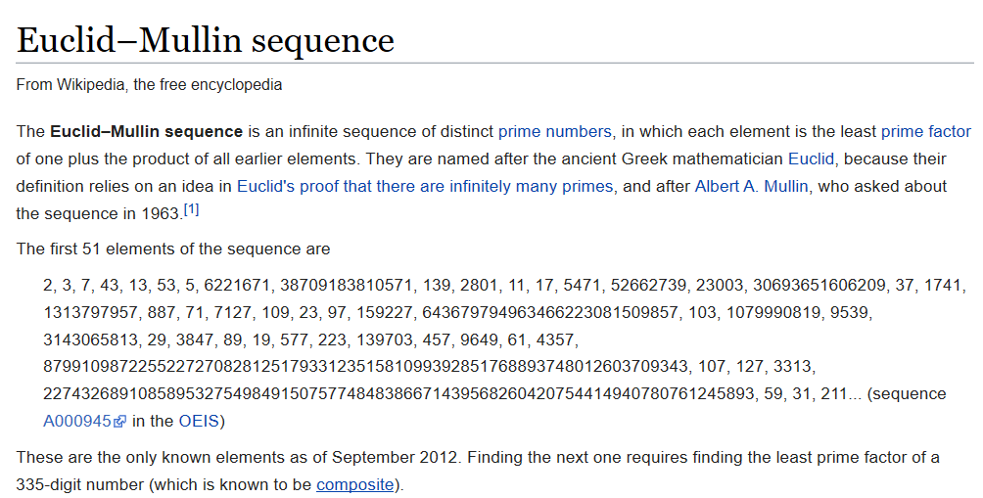
https://en.wikipedia.org/wiki/Euclid–Mullin_sequence

Slide 103
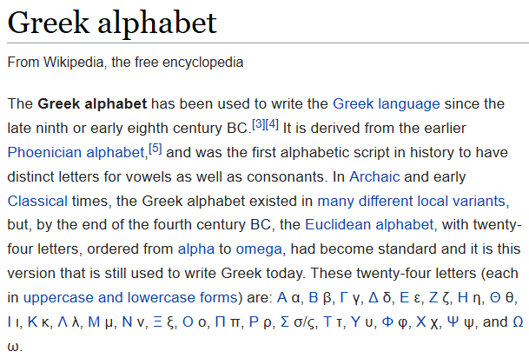
The Riemann Zeta Function ζ(s)
https://en.wikipedia.org/wiki/Greek_alphabet
ζ(s)
There are many different ways of writing a Greek letter zeta; here is how Powerpoint displays it.

Slide 104
The Riemann Zeta Function ζ(s)
We define this function as follows:
$$ζ\left(s\right)= \sum_{n=1}^{∞}{\frac{1}{ns} =1 + \frac{1}{2s} + \frac{1}{3s} + \frac{1}{4s} + \frac{1}{5s}} + …$$
and for us we will take s > 1 which ensures the infinite sum converges (for those knowing more, s can be any complex number with real part at least 1).
Looking at this function, it is NOT clear why it is worth studying….

Slide 105
Integers and Primes
Most of us are familiar with the positive integers: 1, 2, 3, 4, 5, ….
What is the next integer after 2020?

Slide 106
Integers and Primes
Most of us are familiar with the positive integers: 1, 2, 3, 4, 5, ….
What is the next integer after 2020? 2021
What is the next integer after 2021?

Slide 107
Integers and Primes
Most of us are familiar with the positive integers: 1, 2, 3, 4, 5, ….
What is the next integer after 2020? 2021
What is the next integer after 2021? 2022
What is the next integer after 2022?

Slide 108
Integers and Primes
Most of us are familiar with the positive integers: 1, 2, 3, 4, 5, ….
What is the next integer after 2020? 2021
What is the next integer after 2021? 2022
What is the next integer after 2022? 2023
As you have hopefully noticed, there is not much mystery in the spacings between integers!

Slide 109
Integers and Primes
What about the primes: 2, 3, 5, 7, ….
What is the next prime after 2020?

Slide 110
Integers and Primes
What about the primes: 2, 3, 5, 7, ….
What is the next prime after 2020? 2027
What is the next prime after 2027?

Slide 111
Integers and Primes
What about the primes: 2, 3, 5, 7, ….
What is the next prime after 2020? 2027
What is the next prime after 2027? 2029
What is the next prime after 2029?

Slide 112
Integers and Primes
What about the primes: 2, 3, 5, 7, ….
What is the next prime after 2020? 2027
What is the next prime after 2027? 2029
What is the next prime after 2029? 2039
As you have hopefully noticed, it is a lot harder to find the next prime than to find the next integer!

Slide 113
The Riemann Zeta Function ζ(s) and Primes
We defined the Riemann Zeta Function (for s > 1) by
$$ζ\left(s\right)= \sum_{n=1}^{∞}{\frac{1}{ns} =1 + \frac{1}{2s} + \frac{1}{3s} + \frac{1}{4s} + \frac{1}{5s}} + …$$
and now we note a remarkable property; we also have
$$ζ\left(s\right)= \prod_{p prime}{{\left(1 − \frac{1}{ps}\right)}^{−1} ={\left(1 − \frac{1}{2s}\right)}^{−1}{\left(1 − \frac{1}{3s}\right)}^{−1}{\left(1 − \frac{1}{5s}\right)}^{−1}….}$$
Two questions: (1) Why is this true, and (2) Why do we care?

Slide 114
The Riemann Zeta Function ζ(s) and Primes
$$ζ\left(s\right)= \sum_{n=1}^{∞}{\frac{1}{ns} =\prod_{p prime}{{\left(1 − \frac{1}{ps}\right)}^{−1} ,}}$$
or $1 + \frac{1}{2s} + \frac{1}{3s} + \frac{1}{4s}$+ … = ${\left(1 − \frac{1}{2s}\right)}^{−1}{\left(1 − \frac{1}{3s}\right)}^{−1}{\left(1 − \frac{1}{5s}\right)}^{−1}….$
Why do we care?
The integers are completely understood. We even have a great formula for the n^{th} integer!
The Riemann zeta function connects the integers and the primes.
Perhaps we can pass from knowledge about the integers to knowledge about the primes….

Slide 115
The Riemann Zeta Function ζ(s) and Primes
$$ζ\left(s\right)= \sum_{n=1}^{∞}{\frac{1}{ns} =\prod_{p prime}{{\left(1 − \frac{1}{ps}\right)}^{−1} ,}}$$
or $1 + \frac{1}{2s} + \frac{1}{3s} + \frac{1}{4s}$+ … = ${\left(1 − \frac{1}{2s}\right)}^{−1}{\left(1 − \frac{1}{3s}\right)}^{−1}{\left(1 − \frac{1}{5s}\right)}^{−1}….$
If we take s=1 the sum becomes the Harmonic Series, which we showed diverges!
If there were only finitely many primes the product would ???.

Slide 116
The Riemann Zeta Function ζ(s) and Primes
$$ζ\left(s\right)= \sum_{n=1}^{∞}{\frac{1}{ns} =\prod_{p prime}{{\left(1 − \frac{1}{ps}\right)}^{−1} ,}}$$
or $1 + \frac{1}{2s} + \frac{1}{3s} + \frac{1}{4s}$+ … = ${\left(1 − \frac{1}{2s}\right)}^{−1}{\left(1 − \frac{1}{3s}\right)}^{−1}{\left(1 − \frac{1}{5s}\right)}^{−1}….$
If we take s=1 the sum becomes the Harmonic Series, which we showed diverges!
If there were only finitely many primes the product would converge!
Thus there are infinitely many primes! (Advanced: can prove more, can prove the sum of the reciprocals of the primes diverges.)

Slide 117
The Riemann Zeta Function ζ(s) and Primes
$$ζ\left(s\right)= \sum_{n=1}^{∞}{\frac{1}{ns} =\prod_{p prime}{{\left(1 − \frac{1}{ps}\right)}^{−1} ,}}$$
or $1 + \frac{1}{2s} + \frac{1}{3s} + \frac{1}{4s}$+ … = ${\left(1 − \frac{1}{2s}\right)}^{−1}{\left(1 − \frac{1}{3s}\right)}^{−1}{\left(1 − \frac{1}{5s}\right)}^{−1}….$
The following is beyond the scope of this talk, but if we take s=2 then the sum is π² / 6, which is an irrational number (this means we cannot write it as a ratio of two integers).
If there were only finitely many primes then the product would be a finite product of rational numbers, and hence rational! For example, if only 2 and 3 are prime:
$$\prod_{p prime}{{\left(1 − \frac{1}{p2}\right)}^{−1} ={\left(1 − \frac{1}{22}\right)}^{−1}{\left(1 − \frac{1}{32}\right)}^{−1}={\left( \frac{3}{4}\right)}^{−1}{\left( \frac{8}{9}\right)}^{−1}= }\frac{4}{3}\frac{9}{8}=\frac{3}{2}$$

Slide 118
The Riemann Zeta Function ζ(s) and Primes
$$ζ\left(s\right)= \sum_{n=1}^{∞}{\frac{1}{ns} =\prod_{p prime}{{\left(1 − \frac{1}{ps}\right)}^{−1} ,}}$$
or $1 + \frac{1}{2s} + \frac{1}{3s} + \frac{1}{4s}$+ … = ${\left(1 − \frac{1}{2s}\right)}^{−1}{\left(1 − \frac{1}{3s}\right)}^{−1}{\left(1 − \frac{1}{5s}\right)}^{−1}….$
The following is beyond the scope of this talk, but if we take s=2 then the sum is π² / 6, which is an irrational number (this means we cannot write it as a ratio of two integers).
If there were only finitely many primes then the product would be a finite product of rational numbers, and hence rational!
Thus there are infinitely many primes!

Slide 119
The Riemann Zeta Function ζ(s) and Primes
$$ζ\left(s\right)= \sum_{n=1}^{∞}{\frac{1}{ns} =\prod_{p prime}{{\left(1 − \frac{1}{ps}\right)}^{−1} ,}}$$
or $1 + \frac{1}{2s} + \frac{1}{3s} + \frac{1}{4s}$+ … = ${\left(1 − \frac{1}{2s}\right)}^{−1}{\left(1 − \frac{1}{3s}\right)}^{−1}{\left(1 − \frac{1}{5s}\right)}^{−1}….$
We thus see the importance of the formula above, which connects sums over integers with products over primes.
It allows us to pass from knowledge of integers to knowledge of primes.
We now prove it, or at least sketch the proof.

Slide 120
The Riemann Zeta Function ζ(s) and Primes
$$ζ\left(s\right)= \sum_{n=1}^{∞}{\frac{1}{ns} =\prod_{p prime}{{\left(1 − \frac{1}{ps}\right)}^{−1} ,}}$$
or $1 + \frac{1}{2s} + \frac{1}{3s} + \frac{1}{4s}$+ … = ${\left(1 − \frac{1}{2s}\right)}^{−1}{\left(1 − \frac{1}{3s}\right)}^{−1}{\left(1 − \frac{1}{5s}\right)}^{−1}….$
We need the Fundamental Theorem of Arithmetic: Every positive integer can be written uniquely as a product of prime powers, where we write the primes in increasing order, and we let the empty product be 1.
Thus 12 =

Slide 121
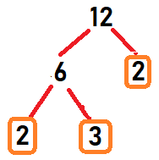
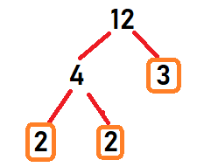
The Riemann Zeta Function ζ(s) and Primes
$$ζ\left(s\right)= \sum_{n=1}^{∞}{\frac{1}{ns} =\prod_{p prime}{{\left(1 − \frac{1}{ps}\right)}^{−1} ,}}$$
or $1 + \frac{1}{2s} + \frac{1}{3s} + \frac{1}{4s}$+ … = ${\left(1 − \frac{1}{2s}\right)}^{−1}{\left(1 − \frac{1}{3s}\right)}^{−1}{\left(1 − \frac{1}{5s}\right)}^{−1}….$
We need the Fundamental Theorem of Arithmetic: Every positive integer can be written uniquely as a product of prime powers, where we write the primes in increasing order, and we let the empty product be 1.
Thus 12 = 2² * 3 and 90 =

Slide 122
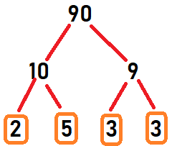
The Riemann Zeta Function ζ(s) and Primes
$$ζ\left(s\right)= \sum_{n=1}^{∞}{\frac{1}{ns} =\prod_{p prime}{{\left(1 − \frac{1}{ps}\right)}^{−1} ,}}$$
or $1 + \frac{1}{2s} + \frac{1}{3s} + \frac{1}{4s}$+ … = ${\left(1 − \frac{1}{2s}\right)}^{−1}{\left(1 − \frac{1}{3s}\right)}^{−1}{\left(1 − \frac{1}{5s}\right)}^{−1}….$
We need the Fundamental Theorem of Arithmetic: Every positive integer can be written uniquely as a product of prime powers, where we write the primes in increasing order, and we let the empty product be 1.
Thus 12 = 2² * 3 and 90 = 2 * 3² * 5,

Slide 123
The Riemann Zeta Function ζ(s) and Primes
$$ζ\left(s\right)= \sum_{n=1}^{∞}{\frac{1}{ns} =\prod_{p prime}{{\left(1 − \frac{1}{ps}\right)}^{−1} ,}}$$
or $1 + \frac{1}{2s} + \frac{1}{3s} + \frac{1}{4s}$+ … = ${\left(1 − \frac{1}{2s}\right)}^{−1}{\left(1 − \frac{1}{3s}\right)}^{−1}{\left(1 − \frac{1}{5s}\right)}^{−1}….$
We need the Fundamental Theorem of Arithmetic: Every positive integer can be written uniquely as a product of prime powers, where we write the primes in increasing order, and we let the empty product be 1.
Thus 12 = 2² * 3 and 90 = 2 * 3² * 5, and there are no other ways to write these numbers. If 1 were prime, we would lose uniqueness: 2² * 3 = 1²⁰²⁰ * 2² * 3.

Slide 124
The Riemann Zeta Function ζ(s) and Primes
$$ζ\left(s\right)= \sum_{n=1}^{∞}{\frac{1}{ns} =\prod_{p prime}{{\left(1 − \frac{1}{ps}\right)}^{−1} ,}}$$
or $1 + \frac{1}{2s} + \frac{1}{3s} + \frac{1}{4s}$+ … = ${\left(1 − \frac{1}{2s}\right)}^{−1}{\left(1 − \frac{1}{3s}\right)}^{−1}{\left(1 − \frac{1}{5s}\right)}^{−1}….$
We will not give a fully rigorous argument.
What we do is consider a finite product, the product over the first P primes, and show that as P gets larger and larger we get more and more of the terms in the sum (once and only once), including all the terms up to P, and thus in the limit as we take all the primes we get the sum.

Slide 125
The Riemann Zeta Function ζ(s) and Primes
$$ζ\left(s\right)= \sum_{n=1}^{∞}{\frac{1}{ns} =\prod_{p prime}{{\left(1 − \frac{1}{ps}\right)}^{−1} ,}}$$
or $1 + \frac{1}{2s} + \frac{1}{3s} + \frac{1}{4s}$+ … = ${\left(1 − \frac{1}{2s}\right)}^{−1}{\left(1 − \frac{1}{3s}\right)}^{−1}{\left(1 − \frac{1}{5s}\right)}^{−1}….$
We use the Geometric Series Formula to expand each factor.
${\left(1 − \frac{1}{ps}\right)}^{−1}$ = $\frac{1}{\left(1 − \frac{1}{ps}\right)}$ and this is a Geometric Series with r = 1/p^{s}.
Since 1 + r + r² + r³ + … = $\frac{1}{1−r}$, we have ${\left(1 − \frac{1}{ps}\right)}^{−1}$ = $1 + \frac{1}{ps} + \frac{1}{p2s} + \frac{1}{p3s}$+ …

Slide 126
The Riemann Zeta Function ζ(s) and Primes
$$ζ\left(s\right)= \sum_{n=1}^{∞}{\frac{1}{ns} =\prod_{p prime}{{\left(1 − \frac{1}{ps}\right)}^{−1} ,}}$$
or $1 + \frac{1}{2s} + \frac{1}{3s} + \frac{1}{4s}$+ … = ${\left(1 − \frac{1}{2s}\right)}^{−1}{\left(1 − \frac{1}{3s}\right)}^{−1}{\left(1 − \frac{1}{5s}\right)}^{−1}….$
We use the Geometric Series Formula to expand each factor. If p = 2:
${\left(1 − \frac{1}{2s}\right)}^{−1}$ = $\frac{1}{\left(1 − \frac{1}{2s}\right)}$ and this is a Geometric Series with r = 1/p^{s}.
Since 1 + r + r² + r³ + … = $\frac{1}{1−r}$, we have ${\left(1 − \frac{1}{2s}\right)}^{−1}$ = $1 + \frac{1}{2s} + \frac{1}{(22)s} + \frac{1}{(23)s}$+ …
But (2²)^{s} = ???^{s}, (2³)^{s} = ??? ^{s}, so….

Slide 127
The Riemann Zeta Function ζ(s) and Primes
$$ζ\left(s\right)= \sum_{n=1}^{∞}{\frac{1}{ns} =\prod_{p prime}{{\left(1 − \frac{1}{ps}\right)}^{−1} ,}}$$
or $1 + \frac{1}{2s} + \frac{1}{3s} + \frac{1}{4s}$+ … = ${\left(1 − \frac{1}{2s}\right)}^{−1}{\left(1 − \frac{1}{3s}\right)}^{−1}{\left(1 − \frac{1}{5s}\right)}^{−1}….$
We use the Geometric Series Formula to expand each factor. If p = 2:
${\left(1 − \frac{1}{2s}\right)}^{−1}$ = $\frac{1}{\left(1 − \frac{1}{2s}\right)}$ and this is a Geometric Series with r = 1/p^{s}.
Since 1 + r + r² + r³ + … = $\frac{1}{1−r}$, we have ${\left(1 − \frac{1}{2s}\right)}^{−1}$ = $1 + \frac{1}{2s} + \frac{1}{(22)s} + \frac{1}{(23)s}$+ …
But (2²)^{s} = 4^{s}, (2³)^{s} = 8^{s}, so….

Slide 128
The Riemann Zeta Function ζ(s) and Primes
$$ζ\left(s\right)= \sum_{n=1}^{∞}{\frac{1}{ns} =\prod_{p prime}{{\left(1 − \frac{1}{ps}\right)}^{−1} ,}}$$
or $1 + \frac{1}{2s} + \frac{1}{3s} + \frac{1}{4s}$+ … = ${\left(1 − \frac{1}{2s}\right)}^{−1}{\left(1 − \frac{1}{3s}\right)}^{−1}{\left(1 − \frac{1}{5s}\right)}^{−1}….$
We use the Geometric Series Formula to expand each factor. If p = 2:
${\left(1 − \frac{1}{2s}\right)}^{−1}$ = $\frac{1}{\left(1 − \frac{1}{2s}\right)}$ and this is a Geometric Series with r = 1/p^{s}.
Since 1 + r + r² + r³ + … = $\frac{1}{1−r}$, we have ${\left(1 − \frac{1}{2s}\right)}^{−1}$ = $1 + \frac{1}{2s} + \frac{1}{4s} + \frac{1}{8s}$+ …
since (2²)^{s} = 4^{s}, (2³)^{s} = 8^{s}, ….

Slide 129
The Riemann Zeta Function ζ(s) and Primes
$$ζ\left(s\right)= \sum_{n=1}^{∞}{\frac{1}{ns} =\prod_{p prime}{{\left(1 − \frac{1}{ps}\right)}^{−1} ,}}$$
or $1 + \frac{1}{2s} + \frac{1}{3s} + \frac{1}{4s}$+ … = ${\left(1 − \frac{1}{2s}\right)}^{−1}{\left(1 − \frac{1}{3s}\right)}^{−1}{\left(1 − \frac{1}{5s}\right)}^{−1}….$
Let’s look at multiplying the factors
${\left(1 − \frac{1}{2s}\right)}^{−1}$ ${\left(1 − \frac{1}{3s}\right)}^{−1}$ = $(1 + \frac{1}{2s} + \frac{1}{4s} + \frac{1}{8s}$+ …) * $(1 + \frac{1}{3s} + \frac{1}{9s} + \frac{1}{27s}$+ …)
When we multiply out we get
$1 + \frac{1}{2s} + \frac{1}{3s}+ \frac{1}{4s} + \frac{1}{6s}+ \frac{1}{8s}+ \frac{1}{9s}$ $+ \frac{1}{12s}$ $+\frac{1}{16s}+\frac{1}{18s}+\frac{1}{24s}+\frac{1}{27s}+\frac{1}{32s}+\frac{1}{36s}+…$
We get exactly the numbers that have only 2 and 3 as prime factors….

Slide 130
Conclusion
Primes are the building blocks of numbers.
There are many questions about them, and most are beyond our ability to answer!
Algebra I is useful – helps to be able to expand products, to deal with exponents, ….
We need tools to approach them.
We saw how to use our knowledge of sums like the Geoemetric Series and the Harmonic Series to learn about the primes; what allows us to do this is the Riemann Zeta Function, which translates information about the integers (which are well understood) to information about the primes.

