Slide 1

Population Health in The Berkshires
October 21, 2016
Mark Pettus MD and Gray Ellrodt
Berkshire Health Systems

Slide 2

The term “population health” has been used to describe both a clinical perspective focused on delivering care to groups enrolled in a health system and a broader perspective that focuses on the health of all people in a given geographic area and emphasizes multisector approaches and incorporation of nonclinical interventions to address social determinants of health.
N Engl J Med 2015; 372:109-111 January 8, 2015

Slide 3
Quadruple Aim
Health of a Population
Experience of Care
Per Capita Cost
Care of the Provider
Adapted from:
Berwick DM, Nolan TW, Whittington J. The Triple Aim: care, health, and cost. Health Aff (Millwood). 2008;27(3):759–769.
Bodenheimer T, Sinsky C. From Triple to Quadruple Aim: Care of the Patient Requires Care of the Provider. Ann Fam Med, November/December 2014 vol. 12 no. 6 573-576.

Slide 4
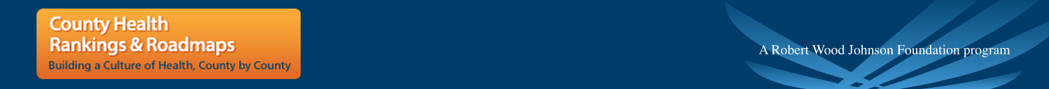
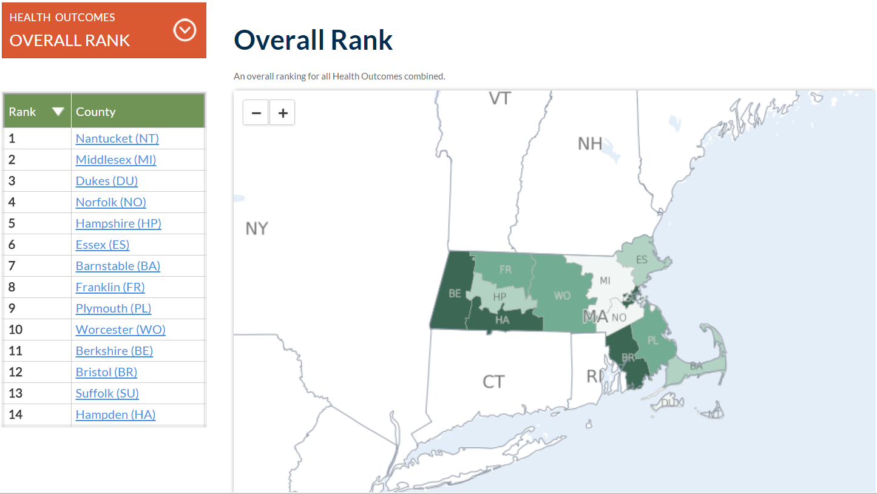
Health Outcomes

Slide 5
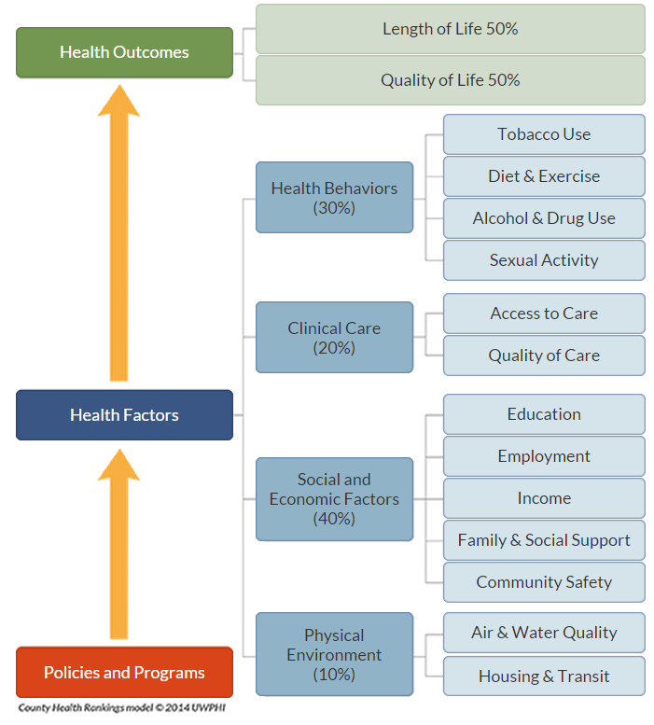
County Health Rankings Model of Population Health

Slide 6
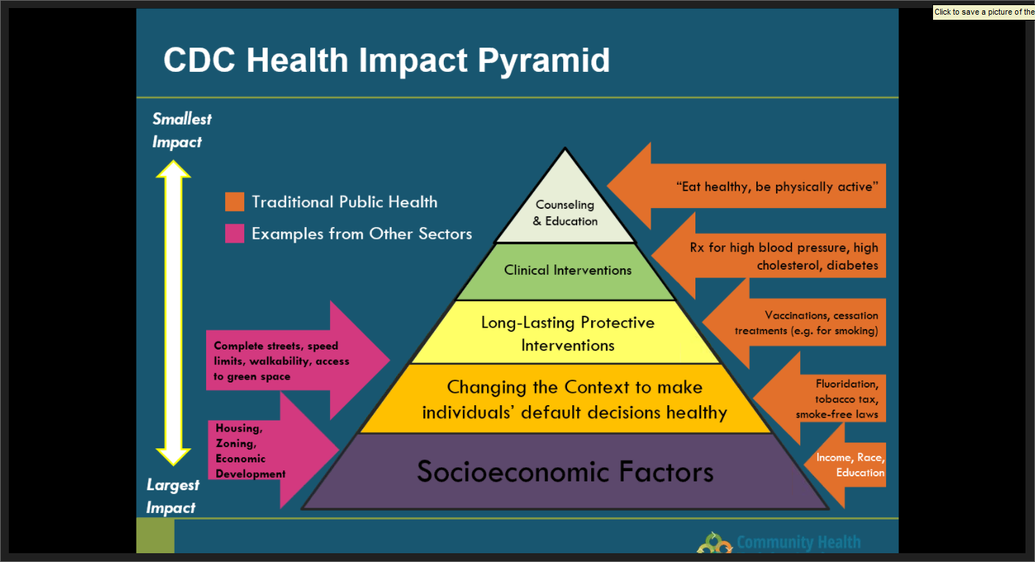

Slide 7
Creating Health - 2016
Creating Health
Primary Prevention
Disease Management
End of Life
E.g. Wellness at Work, Canyon Ranch Institute/ Berkshire Health Systems, PCMH¹
E.g. Prevention Wellness Trust Fund, PCMH¹
E.g. CHART² , PCMH¹
E.g. Compression of Morbidity, Palliative Care, Hospice
Ideal
6
Quality of Life / Health Reserve
Primordial prevention
Primary prevention
Disease management
QALYs³
Life’s Slippery Slope
Population Health
Hospitalization
MET Call
End
of
Life
Time in Years
1 PCMH=Patient Centered Medical Home
2 CHART=Community Hospital Acceleration, Revitalization, & Transformation
3 QALY=Quality-Adjusted Life Year

Slide 8
Partners
Northern Berkshire Community Coalition
Berkshire County Boards of Health Association
BRPC/ Berkshire Public Health Alliance
Fairview Hospital
Tri-Town Health Dept.
Berkshire Medical Center
(Coord. Partner)
YMCA (Pittsfield/ N.A.)
Community Health Programs (central)
Volunteers in Medicine
Berkshire South
Clinical-Community Integration!

Slide 9

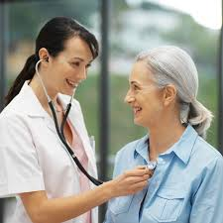

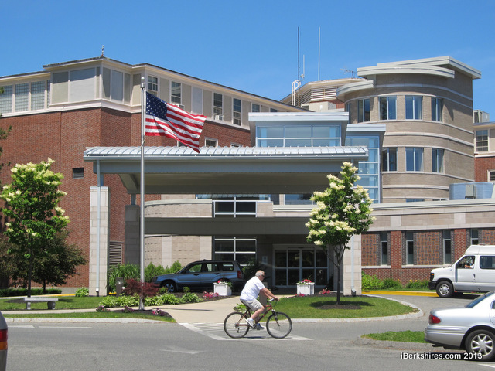
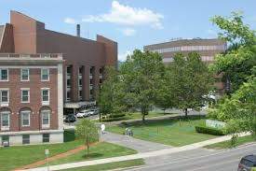

The
Neighborhood for Health
PCP
Adult NP
Diabetic
Support
SUD
Day Treatment
Smoke
Cessation
CHF
Behavioral
Health Support
Nutrition
Counseling
Community
support
Care Navigation Team

Slide 10
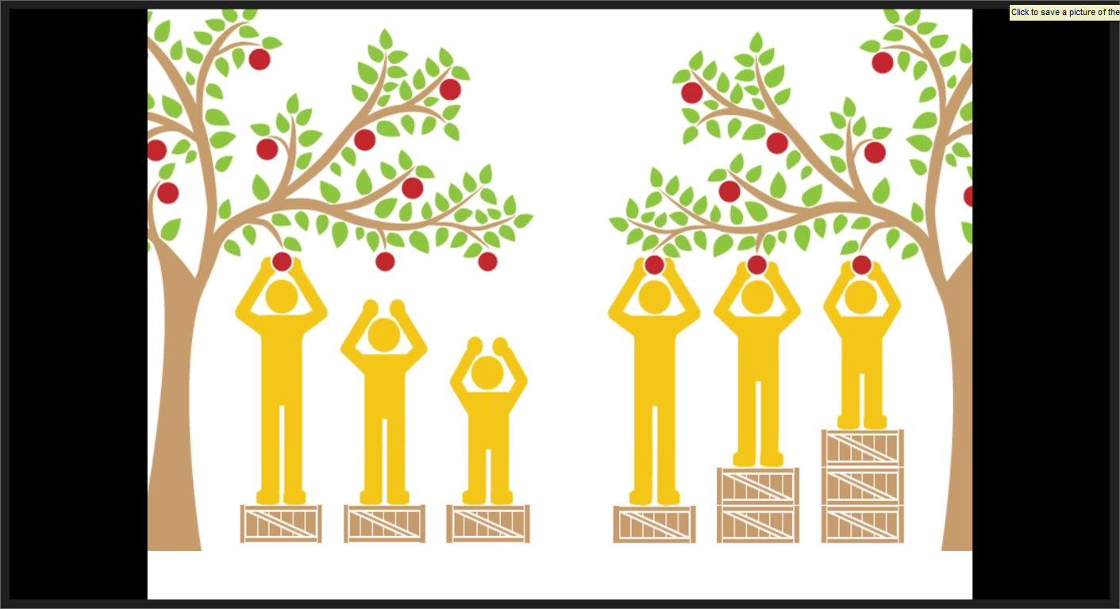

Slide 11
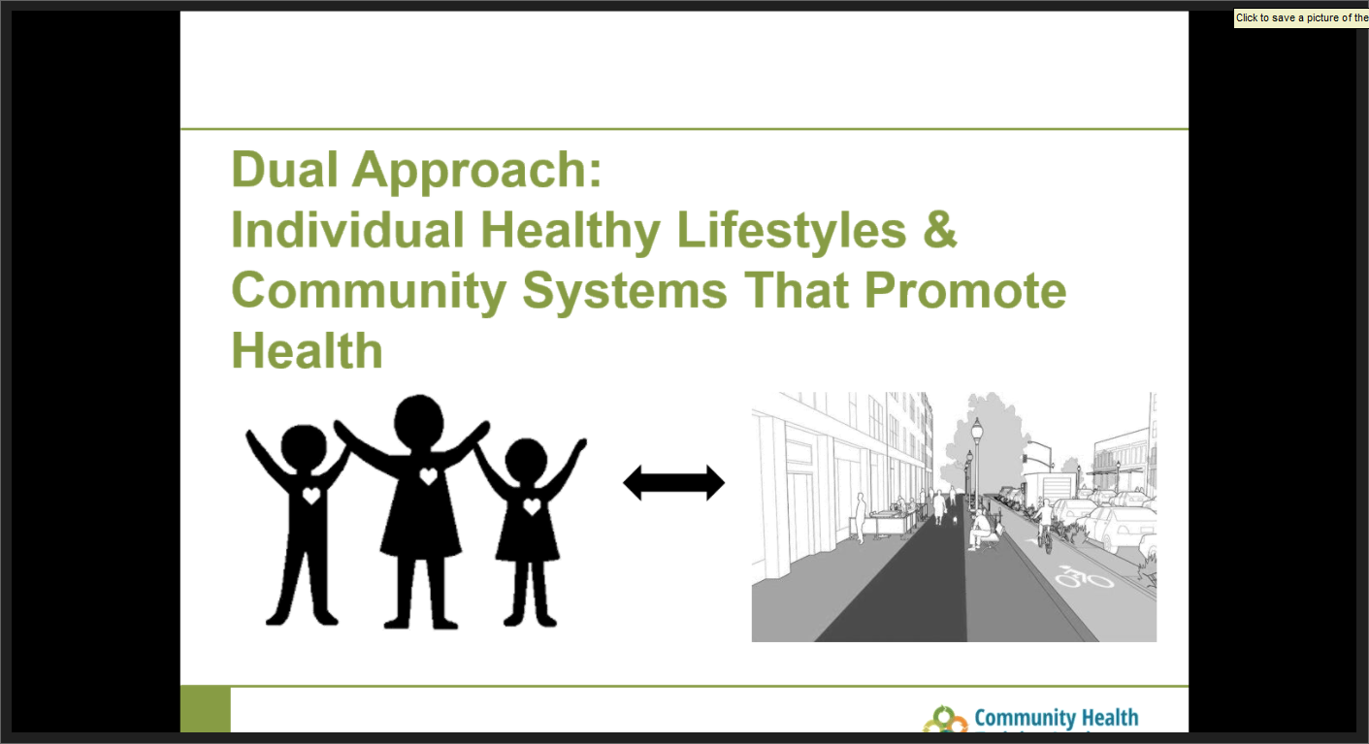

Slide 12

Thank You

