Slide 1
Math 331: Problem Solving
Steven J Miller (sjm1@Williams.edu)
Second Remote Participation Lecture
April 26, 2017

Slide 2
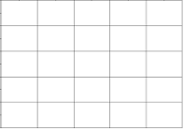
RECTANGLE GAME: Consider M x N board, take turns, each turn can break any piece along one horizontal or along one vertical, last one to break a piece wins. Does someone have a winning strategy?

Slide 8
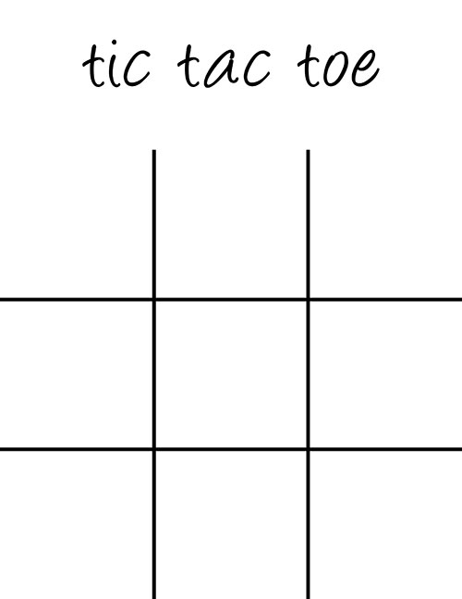
Move | #1's Money | #2's Money | #1's Bid | #2's Bid
1
2
3
4
5
6
7
8
9
10
11
12
13

Slide 9
Move | #1's Money | #2's Money | #1's Bid | #2's Bid
1
2
3
4
5
6
7
8
9
10
11
12
13

Slide 10
Move | #1's Money | #2's Money | #1's Bid | #2's Bid
1
2
3
4
5
6
7
8
9
10
11
12
13

Slide 11
Move | #1's Money | #2's Money | #1's Bid | #2's Bid
1
2
3
4
5
6
7
8
9
10
11
12
13

Slide 16
Castle game: Have castles labeled 1 through 10 (label is value), divide 100 soldiers to attack the castles against an opponent, whomever sends more to a castle wins it. What strategy is best to get more points than opponent?
 | Castle 1 | Castle 2 | Castle 3 | Castle 4 | Castle 5 | Castle 6 | Castle 7 | Castle 8 | Castle 9 | Castle 10
Team 1
Team 2
Outcome

Slide 17
 | Castle 1 | Castle 2 | Castle 3 | Castle 4 | Castle 5 | Castle 6 | Castle 7 | Castle 8 | Castle 9 | Castle 10
Team 1
Team 2
Outcome

Slide 18
 | Castle 1 | Castle 2 | Castle 3 | Castle 4 | Castle 5 | Castle 6 | Castle 7 | Castle 8 | Castle 9 | Castle 10
Team 1
Team 2
Outcome

