Slide 1
Time Scales, Switching, Control, Survival and Extinction in a Population Dynamics Model with Time-Varying Carrying Capacity
Harold M Hastings
Simon’s Rock and Hofstra Univ
Michael Radin
RIT

Slide 2
Towards a Simple, Robust Mathematical Framework for Analyzing Survival Versus Collapse
Elinor Ostrom. A General Framework for Analyzing Sustainability of Social-Ecological Systems. Science 325, 419 (2009)

Slide 3
Outline
Examples of collapse
- Easter Island, Basener-Ross (2004) model
- Cod fishery, Gordon-Schaefer model
- Non-linearity
The models
Time scales and collapse
Time delays
Nelson thesis – T. Wiandt, advisor
Discrete-time logistic
Stochastic dynamics
Summary

Slide 4
Collapse of Easter Island population

Slide 5
Collapse of Easter Island population
the decline of resources was accelerated by Polynesian rats … which reduced the overall growth rate of trees

Slide 6
Collapse of Easter Island population
Basener et al. (2008)
People
Rats
Trees

Slide 7
Collapse of Easter Island population
Basener et al. (2008)
People
Rats
Trees

Slide 8
Collapse of Easter Island population
Basener et al. (2008)
f = 0.0004
f = 0.001

Slide 9
The models
Ansatz
$$\frac{dx}{dt}=f\left(x,t\right)$$
$$\frac{dy}{dt}= r_{y}y\left(1−\frac{y}{x}\right)−h(y,z)$$
$$\frac{dz}{dt}= r_{z}z(1−\frac{z}{h\left(y,z\right)})$$
Mass action harvest
$$\frac{dx}{dt}=f\left(x,t\right)$$
$$\frac{dy}{dt}= r_{y}y\left(1−\frac{y}{x}\right)−hyz$$
$$\frac{dz}{dt}= r_{z}z(1−\frac{1}{hy})$$
Basener-Ross (2004)
$$\frac{dx}{dt}=f\left(x,t\right)$$
$$\begin{matrix} \\ \frac{dy}{dt}= cy\left(1−\frac{y}{K}\right)−hz\end{matrix}$$
$$\begin{matrix} \frac{dz}{dt}=az\left(1−\frac{z}{y}\right) \\ \end{matrix}$$
Gordon-Schaefer
$$\frac{dy}{dt}=ry\left(1−\frac{y}{K}\right)−qEy$$

Slide 10
Gordon Schaefer Model
$$\frac{dx}{dt}=rx\left(1−\frac{x}{K}\right)−H$$
x = resource, r = intrinsic growth rate, K = carrying capacity, H = harvest
$$H=qEx$$
q = efficiency, E = effort
We will let $E=z$, where y = harvester population, and incorporate the effort per unit z into q, obtaining
$$\frac{dx}{dt}=rx\left(1−\frac{x}{K}\right)−qxy$$
Schaefer, MB. J Fisheries Board of Canada 14 (1957), 669-681.
Gordon, HS. J Fisheries Board of Canada 10 (1953), 442-457.

Slide 11
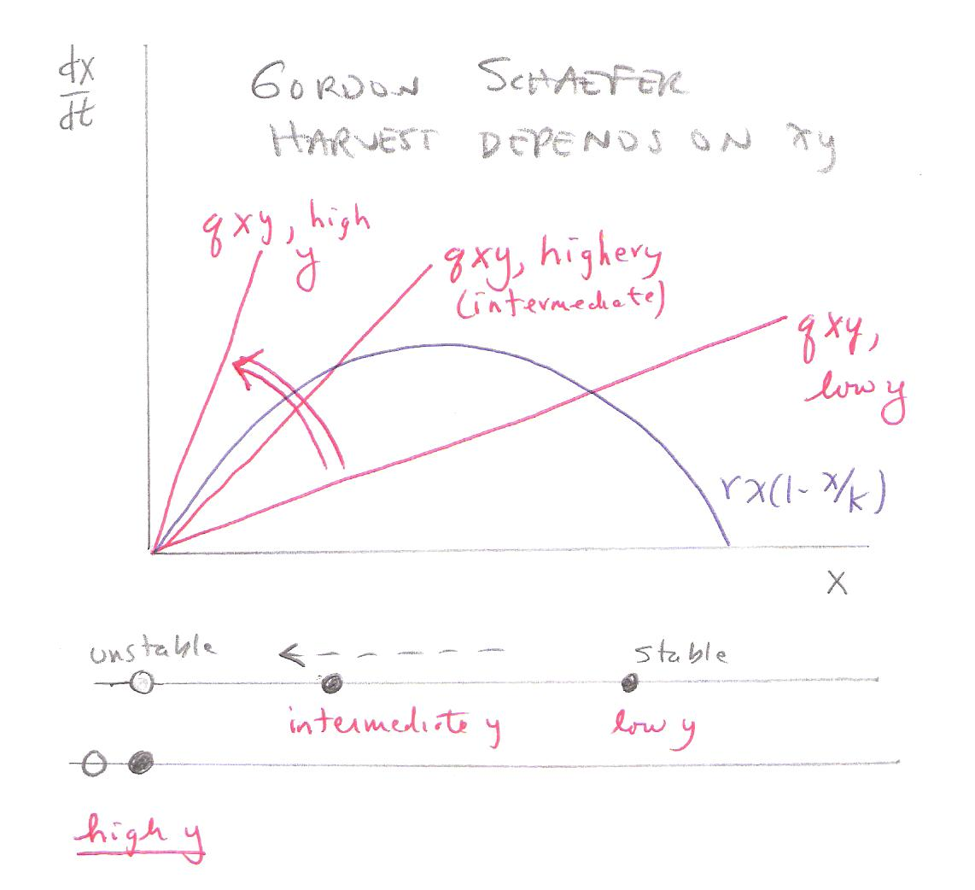
Gordon Schafer Model

Slide 12
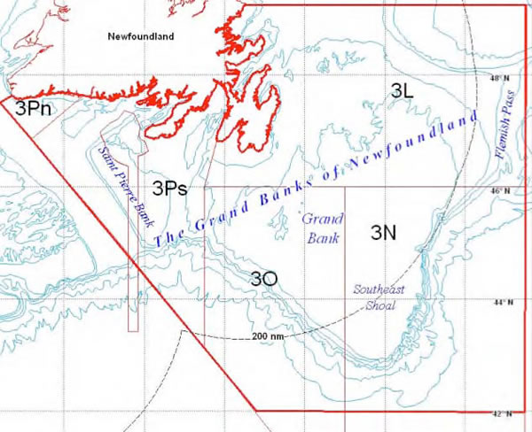
Collapse of the Cod Fishery

Slide 13
Collapse of the Cod fishery
Left: http://www.unep.org/maweb/ documents/document.300.aspx.pdf
Above: http://www.millennium assessment.org/en/GraphicResources.aspx

Slide 14
Collapse of the Cod fishery
Finlayson, A. C., & McCay, B. J. (1998). Crossing the threshold of ecosystem resilience: the commercial extinction of northern cod. Linking social and ecological systems: Management practices and social mechanisms for building resilience, 311-37.
Above: http://www.millennium assessment.org/en/GraphicResources.aspx

Slide 15
Examples of nonlinear change
Fisheries collapse
The Atlantic cod stocks off the east coast of Newfoundland collapsed in 1992, forcing the closure of the fishery
Depleted stocks may not recover even if harvesting is significantly reduced or eliminated entirely
This slide from Millennium Ecosystem Assessment, document 359, slide 41

Slide 16
Non-linear behavior – multiple steady states

Slide 17
Back to Basener-Ross Model
$$\begin{matrix} \frac{dP}{dt}=aP\left(1−\frac{P}{R}\right) \\ \frac{dR}{dt}= cR\left(1−\frac{R}{K}\right)−hP\end{matrix}$$
Basener, B., & Ross, D. S. (2004). Booming and crashing populations and Easter Island. SIAM Journal on Applied Mathematics, 65(2004), 684-701.

Slide 18
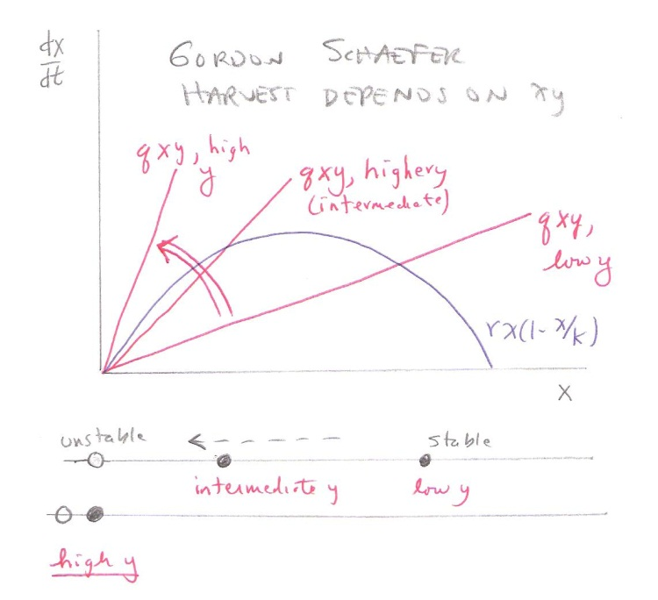
Back to Basener-Ross Model

Slide 19
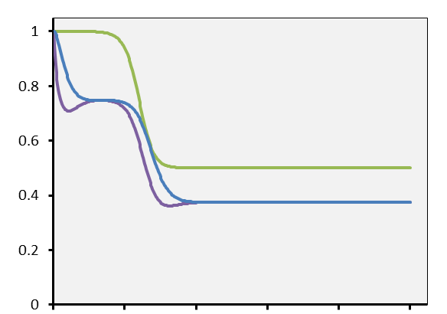
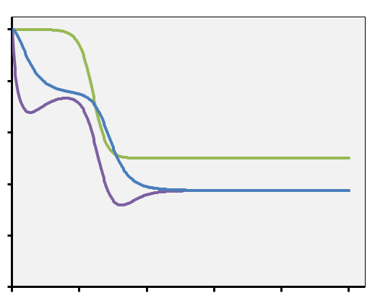
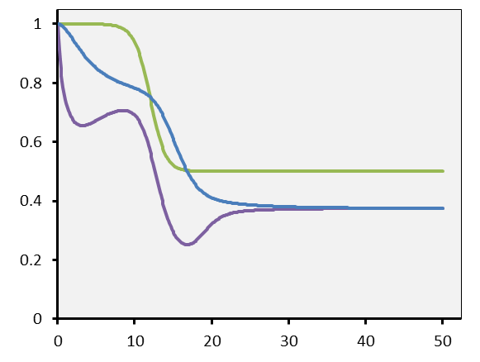
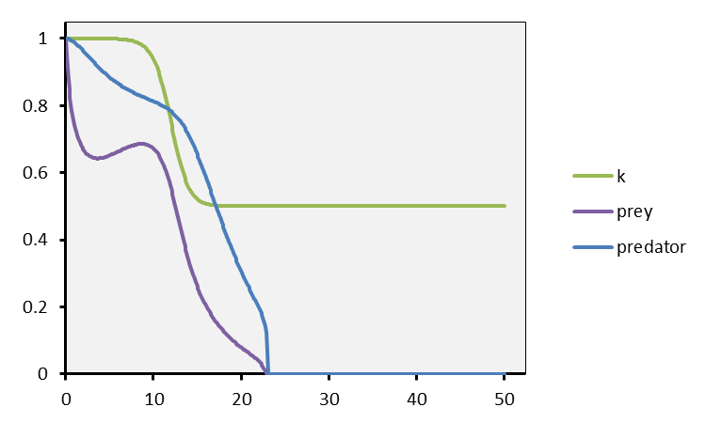
Long predator time scale brings extinction Simulations using the Basener-Ross (2004) model (time scales illustrated vary from 2 years to 15 years)
2 years
5 years
Environmental collapse
10 years
15 years

Slide 20
How the models fit together
Ansatz
$$\frac{dx}{dt}=f\left(x,t\right)$$
$$\frac{dy}{dt}= r_{y}y\left(1−\frac{y}{x}\right)−h(y,z)$$
$$\frac{dz}{dt}= r_{z}z(1−\frac{z}{h\left(y,z\right)})$$
Mass action harvest
$$\frac{dx}{dt}=f\left(x,t\right)$$
$$\frac{dy}{dt}= r_{y}y\left(1−\frac{y}{x}\right)−hyz$$
$$\frac{dz}{dt}= r_{z}z(1−\frac{1}{hy})$$
Basener-Ross (2004)
$$\frac{dx}{dt}=f\left(x,t\right)$$
$$\begin{matrix} \\ \frac{dy}{dt}= cy\left(1−\frac{y}{K}\right)−hz\end{matrix}$$
$$\begin{matrix} \frac{dz}{dt}=az\left(1−\frac{z}{y}\right) \\ \end{matrix}$$
Gordon-Schaefer
$$\frac{dy}{dt}=ry\left(1−\frac{y}{K}\right)−qEy$$

Slide 21
Generalizations
Delays: Nelson, S. Population Modeling with Delay Differential Equations (Doctoral dissertation, RIT, 2013).
Discrete time
Stochastic
What are general principles

Slide 22
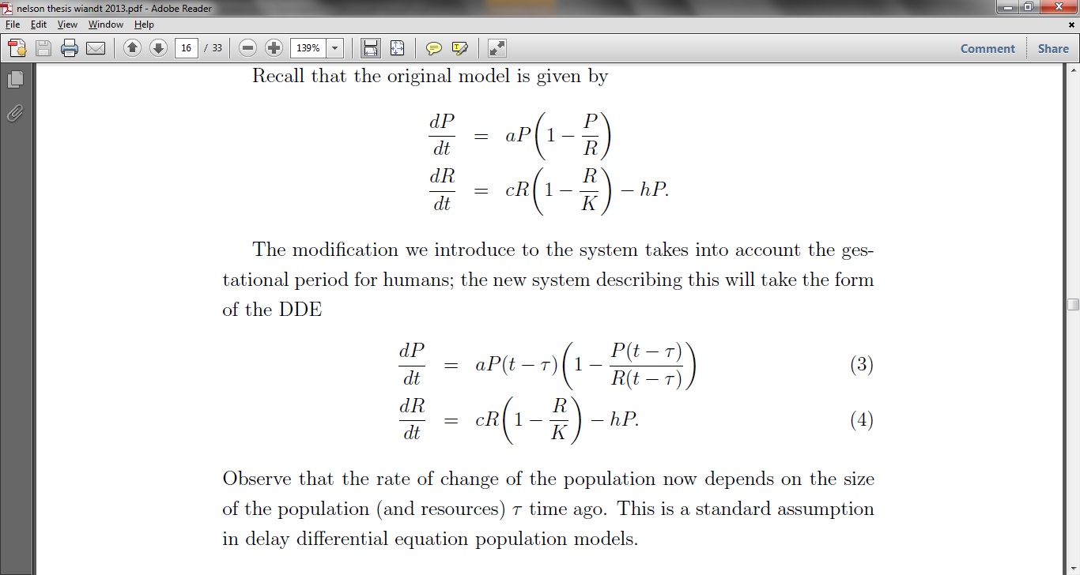
DDE – S. Nelson
Nelson, S. Population Modeling with Delay Differential Equations (PhD dissertation, RIT, 2013). Advisor T. Wiandt.

Slide 23
Effects of time delays
Bifurcation as time delay τ is increased in the model
, leading to extinction
Nelson, S. Population Modeling with Delay Differential Equations (PhD dissertation, RIT, 2013). Advisor T. Wiandt.

Slide 24
More on time delays
Start with the logistic equation
$$\frac{dy}{dy}=ry(1−y)$$
Apply the Euler method - which contains an implicit time delay $∆t$
$$y\left(t+ ∆t\right)=y\left(t\right)+ry\left(t\right)\left(1−y\left(t\right)\right)∆t$$
$$=\left(1+r∆t\right) y\left(t\right)−r{y(t)}^{2}∆t$$
$$=\left(1+r∆t\right) [y\left(t\right)−\frac{r}{1+r∆t}{ y\left(t\right)}^{2}]$$

Slide 25
More on time delays
Continue
$$y\left(t\right)=\left(1+r∆t\right) y\left(t\right)[1−\frac{r}{1+r∆t}y(t)]$$
$$=\left(1+r∆t\right) y\left(t\right)[1−y(t)/(\frac{1+r∆t}{r})]$$
Now normalize to get
$$y\left(t+ ∆t\right)=\left(1+r∆t\right) (1−y\left(t\right))$$

Slide 26
More on time delays
T$he discrete−time logistic equation$
$$y\left(t+ ∆t\right)=\left(1+r∆t\right) (1−y\left(t\right))$$
undergoes a series of period-doubling bifurcations beginning as $1+r∆t$ is increased beyond 3, or alternatively as $∆t> 2/{r }$.

Slide 27
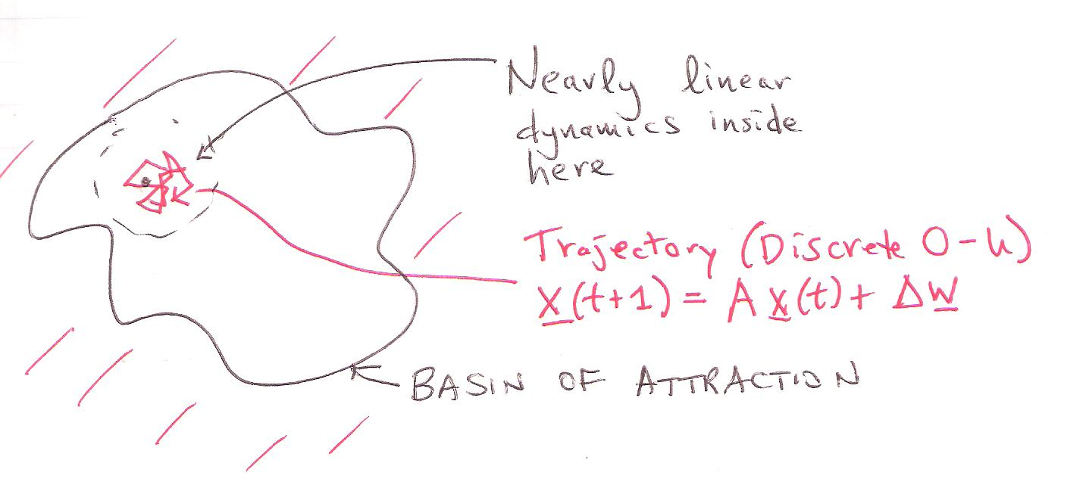
Stochastic dynamics – discrete time Ornstein-Uhlenbeck (O-U) model

Slide 28
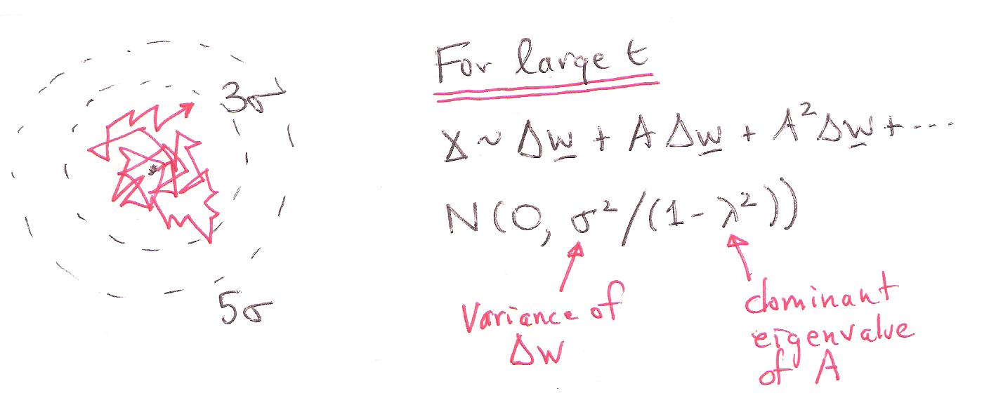
Stochastic dynamics – discrete time Ornstein-Uhlenbeck (O-U) model
HMH, BioSystems, 1984
A closer look:
Survival time - First passage time
3σ/√(1-λ²)
5σ/√(1-λ²)

Slide 29
Summary – key points
Over-harvesting a resource can cause a collapse (no fooling)
Climate change as perturbation
Timescale of response must not be too long compared to time scale of perturbation
Time delays – cause of bifurcations - …
Future: non-linearity – multiple steady states – hard to recover
Future: stochastic effects
Can get general ansatz

