Slide 1

The Fundamentals Of Modeling A Gaussian Coil-Gun Orbital Launcher

Slide 2

What is a Gaussian Coil-gun?
A Gaussian Coil-gun is a Solenoid that uses the properties of an electromagnetic field to propel a projectile
A Solenoid is a coil of wire usually in cylindrical form that when carrying a current acts like a magnet
In our Case the Solenoid will have an air filled Core

Slide 3

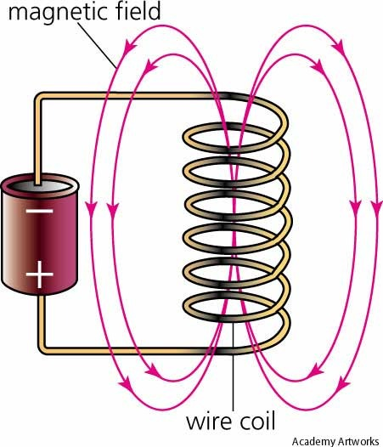
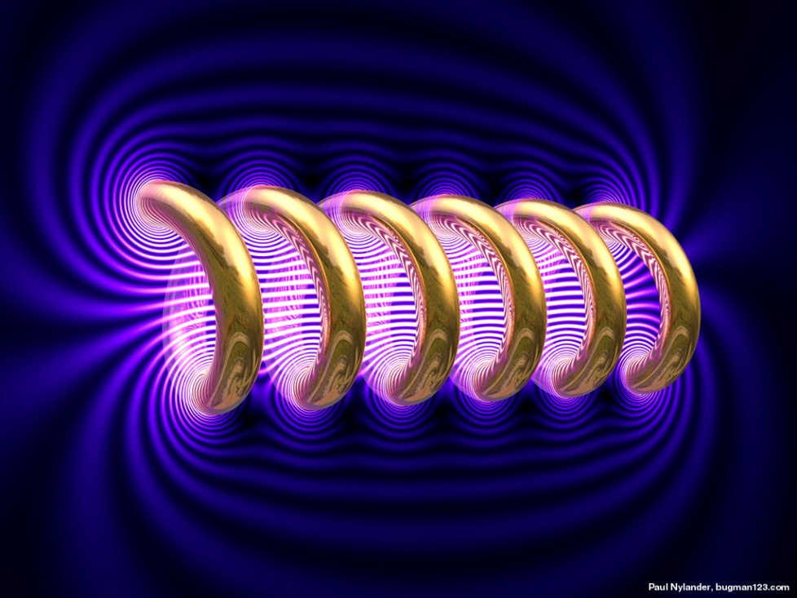
Representations of Solenoids

Slide 4

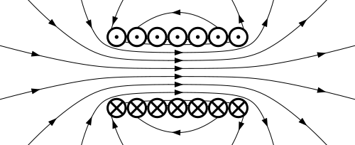
How Does This help us Launch a Projectile?
The Current loops induce magnetic flux through the center of the air filled solenoid
Using the Right-Hand Rule, We can determine the direction of the Magnetic Field

Slide 5
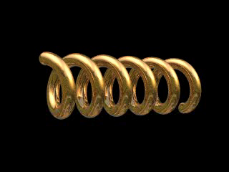
When a Current is applied through the loops of a solenoid a magnetic field develops
When the Source of the Current is shut off the Magnetic Field dissipates.

Slide 6
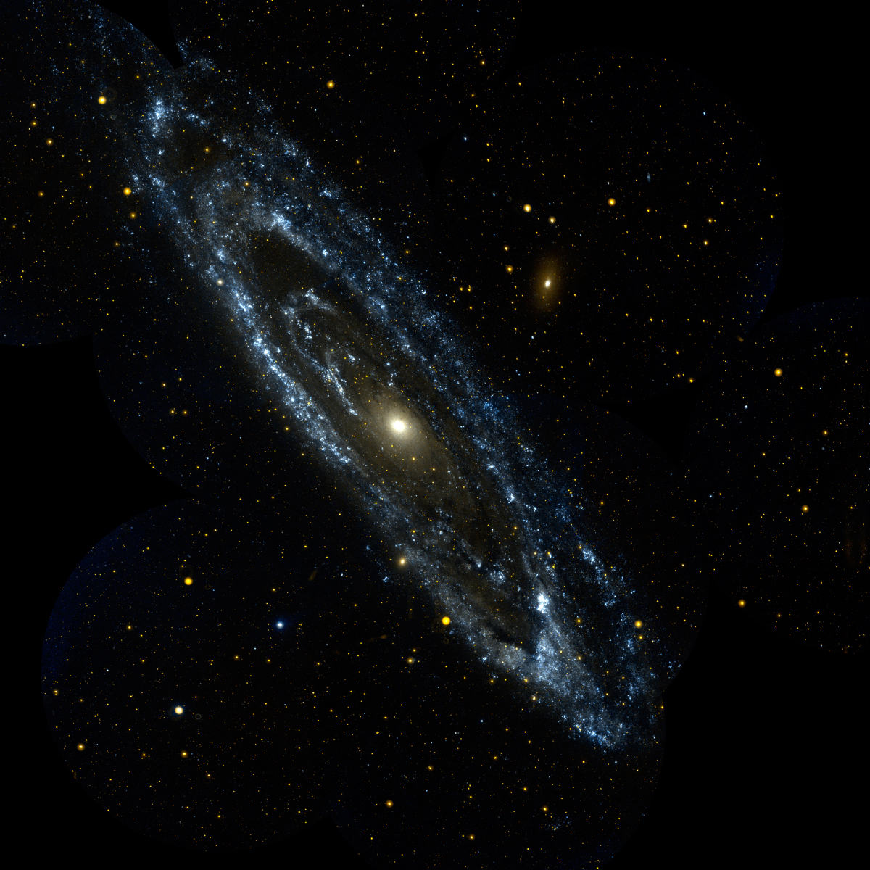
Creating Projectile Motion
The Projectile is a Ferro-magnetic material which becomes magnetized due to the induced current
A Ferro-magnetic materials are charecterized to substances with an abnormally high magnetic permeability, a definite saturation point, and appreciable residual magnetism and hysteresis (such as iron-cobalt-nickel and alloys containing these metals)

Slide 7

Creating Projectile Motion Contd…
Due to the current producing the magnetization on the Ferromagnetic projectile, It does not matter which way the current is flowing as it will attract the slug to the center of the solenoid
This is because of the magnetization is induced from the current!
This causes the projectile to accelerate to the center solenoid, if the projectile passes the midpoint of the solenoid before the current is shut off, then negative acceleration will occur.
This is called suck-back.

Slide 8
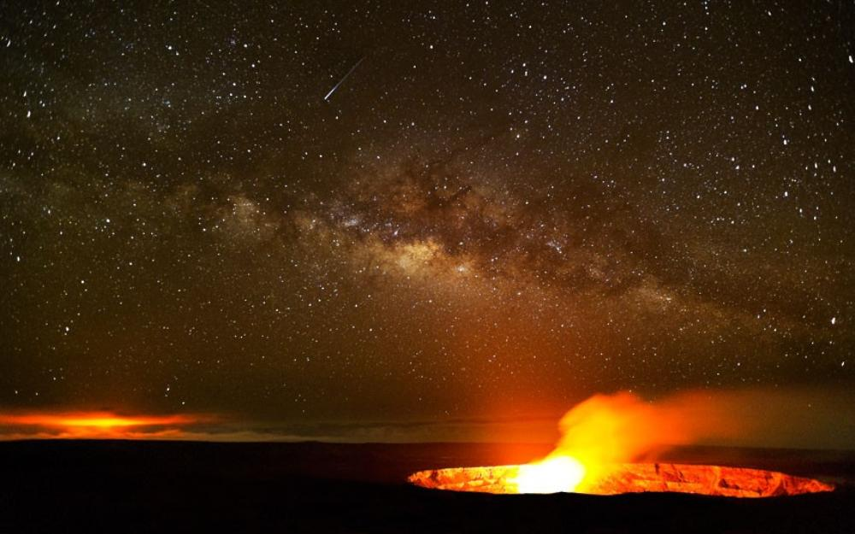
Simplifying Assumptions
We are creating the simplest possible model in this case!
This means, ignoring things like eddy currents, field resonance, time delays, centripetal force, resistance, earth’s movement/rotation, wind speeds, air resistance (for now), acts of nature, and any other force not described above
We the Solenoid to be infinitely long, single stage, and single layered.
We are also assuming constant Force

Slide 9

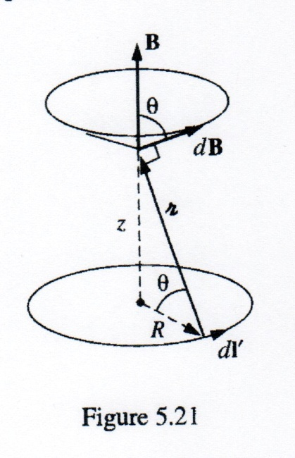
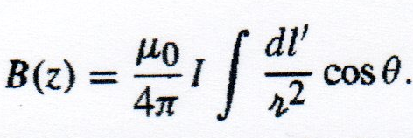
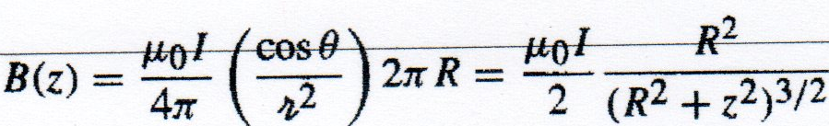
The Difficulty of A Finite Solenoid
The Difficulty of a Finite solenoid lies in the calculation of the field at the entrance to the solenoid, here it is not uniform.
We would use this formula to Map the field of a finite solenoid. When ready, we can include this into our model, making it more accurate.

Slide 10
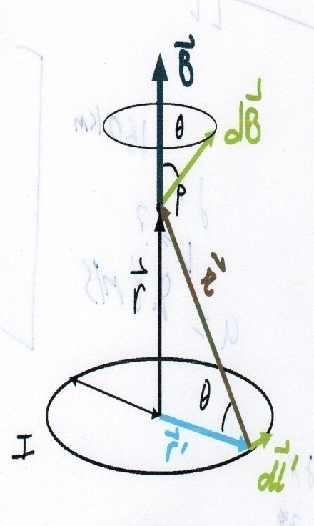
An Explanation of the Formulas of a Finite Solenoid
B is the Magnetic Field
µ₀ is the Permeability of free space
I is the Current
dl’ is the element of length
R is radius
dB is the Field attributable to the segment dl’
r is the vector from the source point to point P
As we integrate dl’ around the loop, dB sweeps out a cone. The horizontal components cancel and the vertical components combine.
dl’ and r are perpendicular in this case. The factor of cosӨ projects out the vertical component. cosӨ and r² are constants, and is simply the circumference 2πR which gives
Remember: this is for one point of many along the center of the Solenoid

Slide 11
Formulas
We can find a first estimate for the exit velocity of the slug by comparing the projectile energy state inside and outside of the coil
F = µ₀ ∇(M · H) · M = X_{m} H= X_{m} N I
H= N I · E_{inside}= -µ₀ M H = - µ₀ X_{m} n² I²
E_{outside}= 0 Joules
H is the Applied Field · M is the projectile magnetization · F is Force
µ0 is the permeability of free space = 4πX10⁻⁷
N Is the number of turns per unit length
I is the current · X_{m} is magnetic Susceptibility
E is the potential energy · is an axial unit vector
We assume all potential energy is transferred to Kinetic Energy
V_{exit} = (V_{exit} is the exit Velocity) (V is Volume of Projectile m^3)
V_{exit} = (m is mass in kg)

Slide 12
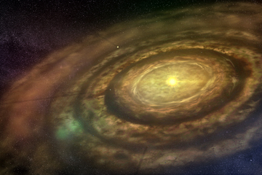
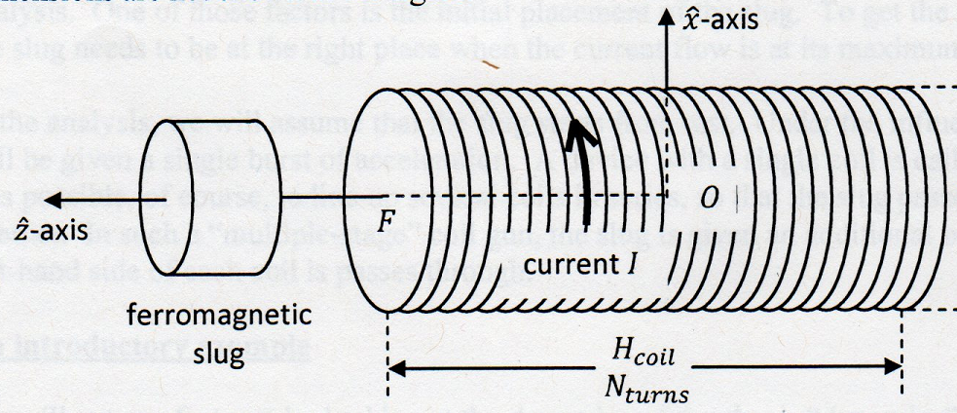
Constants We Have obtained from Real World scenarios
Mass of Projectile is 100,000 kg (1X10⁵) (Taken From Space Shuttle Orbiter)
Diameter of Coil 20 M (Also taken from space Shuttle Orbiter)
Length Of Coil is 500 M (Taken from tallest buildings built)
Length Of Projectile is 40 M (which is Also taken from the space shuttle orbiter)
The number of turns will be 5000 (note: each coil being a .1m thick The length and the thickness will cause a large amount of Resistivity in the real world.)
This means force will only
be exerted on the Projectile
for 250 meters

Slide 13
Calculations
M=1X10⁵kg n= =10
V= π r² h = 400πm³ X_{m}=100
I =10000 amperes
We have V_{exit} =
Plugging in =
= 177.72 m/s

Slide 14
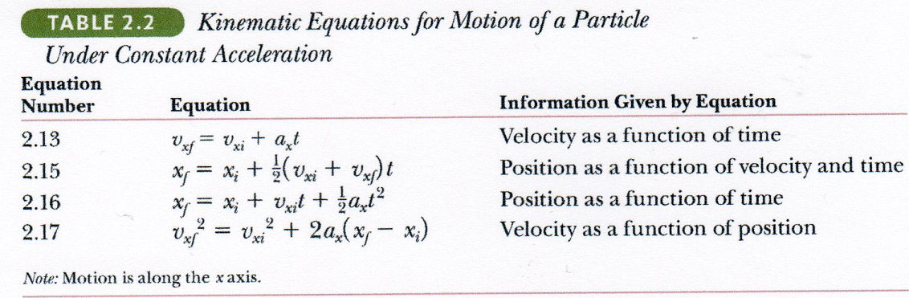
Successful Launch?
We Can now use one of several methods to determine whether the projectile will hit Low Earth Orbit (LEO) at 160km or geo-synchronous orbit which is at a height of 35000km or come back down and crash
After the projectile has left the solenoid we have a constant acceleration = -9.81m/s This is Due to gravity.

Slide 15
Finding the Maximum Height
We Can use equation 2.16 from the previous slide of the Kinematics equations to solve however in terms of Z (We are using Z in place of X as a vertical component). We’ll say the structure to the coil gun is underground and start at Z_{i}=0. This gives us Z_{f}(t)= 177.72t –
To hit LEO we need to reach a height of Z_{F}=160000m (1.6X10⁵m)
To find the maximum at Z_{f}(t). We take the derivative in respects to t and set the equation equal to 0
From this we calculate t_{max}=18.12sec

Slide 16
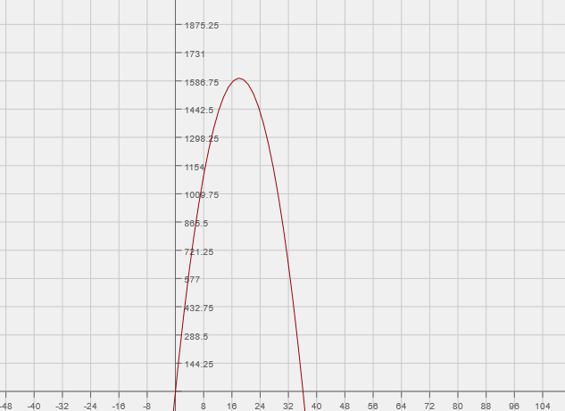
Position of Projectile as a Function of Time
From solving the Kinematic Equation at t=18.12s
Z_{f}=1600.67m Which means We have crash landed!

Slide 17
Summary and Conclusion
There are multiple ways to improve the design of the coil-gun
As mathematicians, we can add more turns, layer them, or increase the current.
The next thing we can theoretically do is add multiple stages which would also improve the results of the Coil-gun

Slide 18
This Basic Model
We started with a simplified model to first, gain understanding of the physics involved in the problem
Main simplifications are:
Did not Include suck-back force
Did not Include the change in the permeability of free space as the projectile traveled through the Solenoid
Did not map the field at the entrance to the Solenoid and assumed constant force at this point
Modeled only one stage
This model had one stage which made it impractical, however with multiple stages it becomes surprisingly efficient.

Slide 19


