Slide 1
Van Eyck:
Follow the Light
Krista Kelly
Kevin Ma
Advisors: Ingrid Daubechies & Rayan Saab

Slide 2
The Ghent Altarpiece
Finished in 1432
24 framed panels
Religious painting
Light source significance

Slide 3
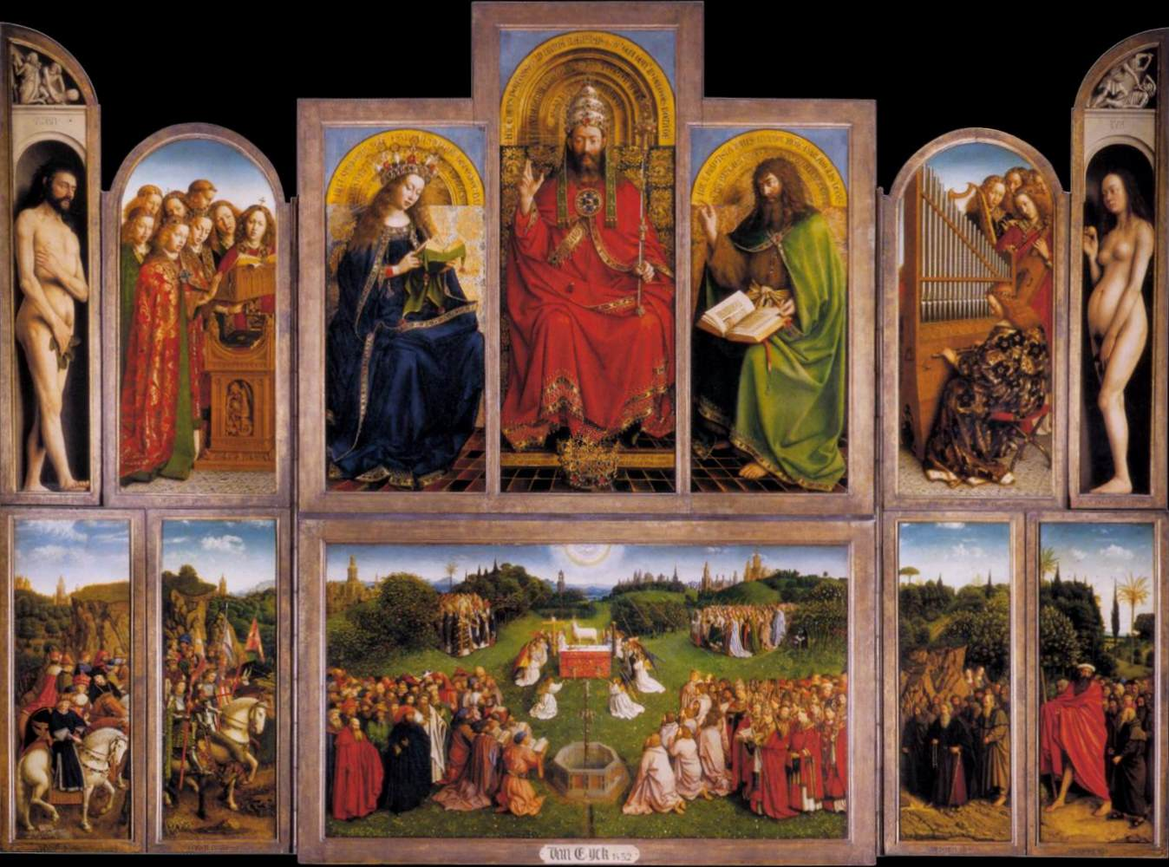

Slide 5
Original size:
[6668 4992 3] Pixels
Rescaled and converted to black and white
Resized: [1111 832]
Reduced amount of data by a factor of 108
Which reduced calculation time significantly

Slide 6
How to Analyze the Image?
There are other reflections but for consistency and purest results- focus on one shape
  The pearl (dundundun…!)
    Circuluar
    Uniform
    Existing codes available
      Hough
      Gabor

Slide 7
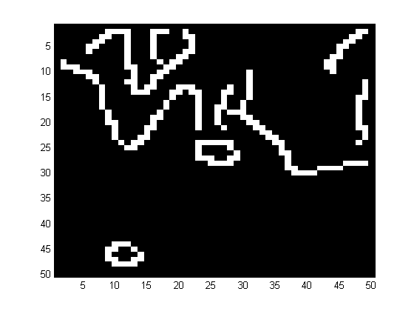
Canny Filter
Matlab function:
  e = edge(bwimage,`canny’, .5);
  Shows up in both Hough and Gabor
Canny .3
Canny .5

Slide 8
Hough Transform
Edge detection technique
http://www.markschulze.net/java/hough/
Returns a 3-D accumulator array
  Voting on circle locations & radii

Slide 9
Hough Transform - Raw

Slide 10

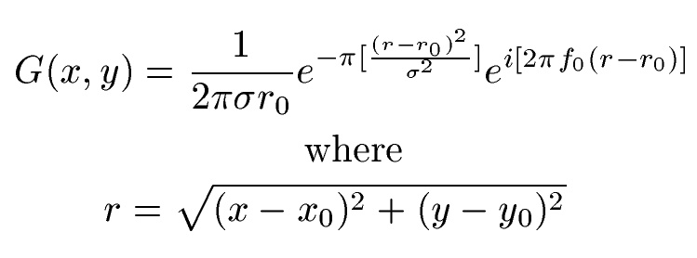

Gabor Annulus
Circular wavelet filter
Inputs:
  Kernel Size --- 80
  Wavelength (=100) --- f₀
  Gaussian deviation (1-10 usually) --- $σ$
  Radius of circle --- r

Slide 11
Loop Control
Thresholding for Gabor

Slide 12
Gabor Continued…
Gabor Annulus Without Thresholding
Gabor Annulus With Thresholding

Slide 13
Once the Gabor is used…
Threshold again using “loop control”
This is then put through a function called imdilate – a logical matrix that will threshold further so we can locate the pearls.

Slide 14
Plot of Rough Pearl Locations

Slide 15
Plot of Thresholded Pearl Locations

Slide 16
“Pcards”
There are no Aces, Kings, or Queens.
Given the locations of where pearls may be found
  We create “Pcards”: small 40x40 images around each location and fill up what we call P, the deck of cards/images
  The size of P is [40 40 #-of-cards]
    Sample Pcard →

Slide 17
Use and abuse the Pcards
Apply the Hough Transform
  Locates the relative center and radius on the Pcard
Extract the literal locations
Able to cut out the pearl
Now what about the light?

Slide 18
Wedges – find the light
Used two variables, alpha and delta.
Cut out 20 degree wedges from -90 to 90
Average the values by summing the pixel values and divide by the number of pixels.
Find the max
If n<3, disregard

Slide 19
Raw Angles

Slide 20
Thresholding
We discounted an angle using the following rule:
  If the MaxValue<MeanValue*1.2
  Discount the angle

Slide 21
Thresholded Angles

Slide 23
Conclusions
Our research suggests he was at least accurate enough to have a general direction
Is there more than one light source?
Was he really that good?
Error in our calculations is significant –
The answer is still up in the air
Questions?

Slide 24
References
Hough Transform Code:
  http://www.mathworks.com/matlabcentral/fileexchange/26978-hough-transform-for-circles
Gabor Annulus Code & Paper:
  http://red.cs.nott.ac.uk/~aqr//circle/
  A. Rhodes and L. Bai. Circle Detection Using a Gabor Annulus. Proceedings of the 22nd British Machine Vision Conference. Dundee, UK, 2011.

