Slide 1
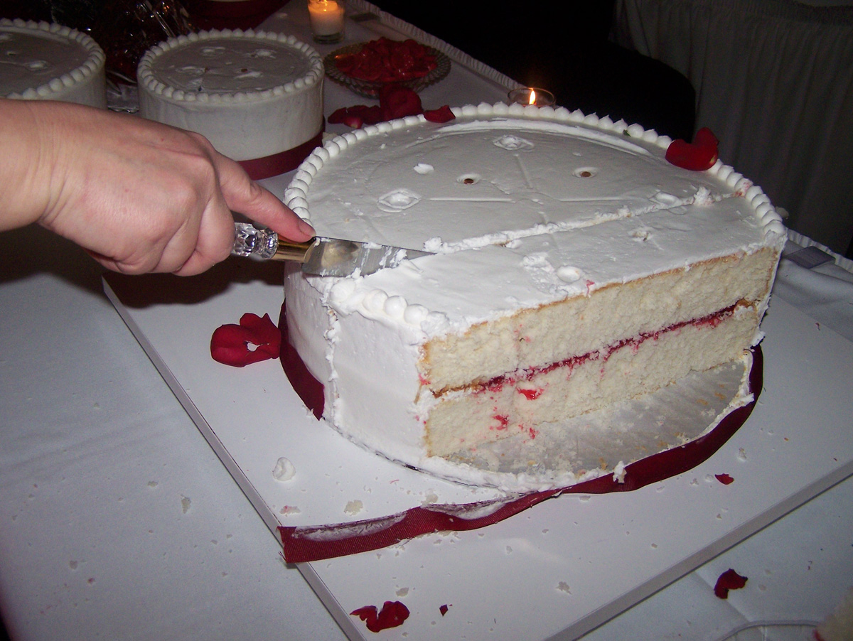
Selfridge-Conway Discrete Procedure: Envy-Free Division Among Three People
Aviv Lipman
Williams College

Slide 2

Marriage and Divorce in America
2 million US marriages per year
Almost half end in divorce
Notes:
http://www.stateofourunions.org/2011/social_indicators.php

Slide 3

Post-Divorce
Options
  Lawyers
  Math! Envy free division

Slide 4
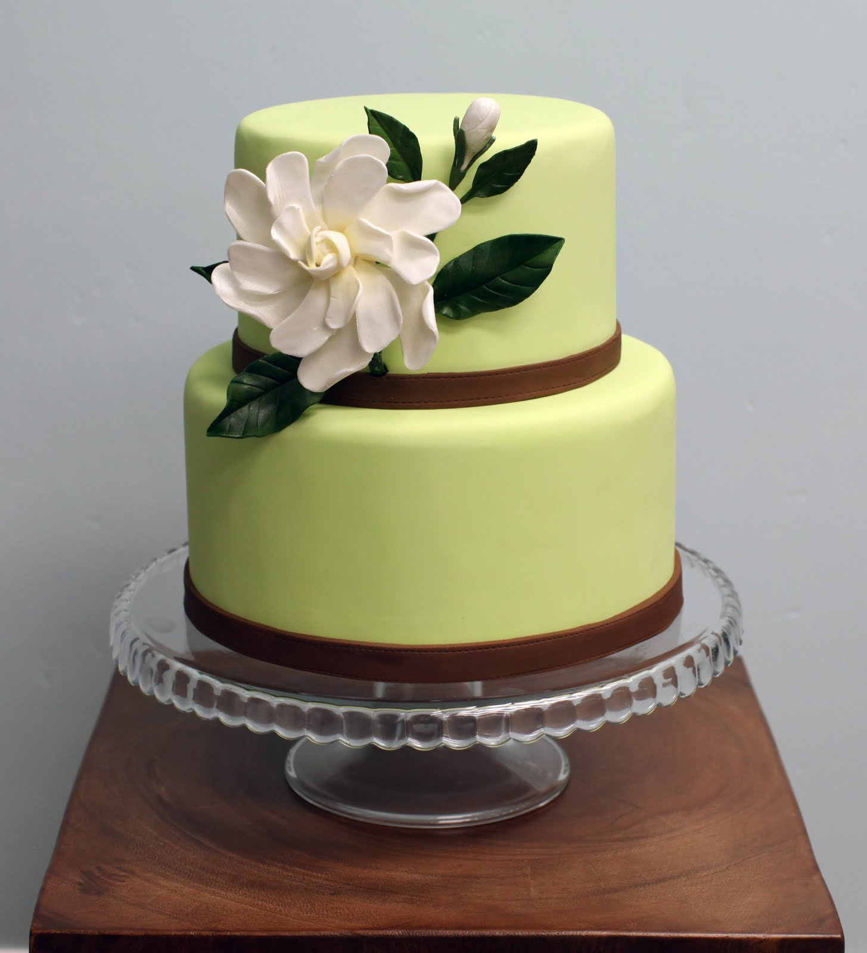
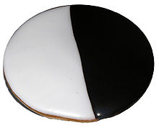
Envy-Free Division Between Two People
A cuts
B Chooses
B
A

Slide 5
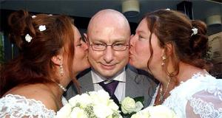

3-way civil union (Netherlands 2005)
Victor de Brujin, Bianca, Mirjam
Polyfidelitous union (Brazil 2012)
Notes:
http://www.brusselsjournal.com/node/301

Slide 6
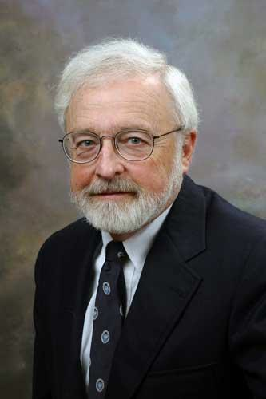
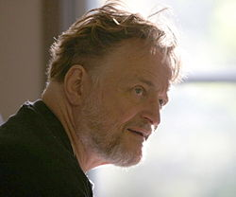
Envy-Free Division Among Three People (1960s)
John L. Selfridge
John H. Conway

Slide 7
Selfridge-Conway Procedure
A cuts
B trims largest
C chooses
B chooses
C
C cuts trim
B chooses
A chooses
B
B
C
A
A

Slide 8
Selfridge-Conway Procedure, Case II
A cuts
B trims largest
C chooses
B chooses
B
B cuts trim
C chooses
A chooses
C
C
B
A
A

Slide 9
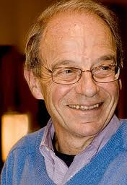
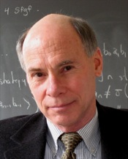
Quartets? Quintets? …?
For n ≥ 4, number of cuts unbounded but finite for fixed n (1995)
Alan D. Taylor
Steven J. Brams
Notes:
http://www.jstor.org/stable/pdfplus/2974850.pdf?acceptTC=true

