Slide 1
Land Ho!
Choosing The
Perfect Map
Julio Luquin
Williams College

Slide 2
Outline
Introduction
  Globes
  Properties of Maps
  Map Projections
    The Equidistance Conic Projection
    Lambert Conformal Projection
    Lambert Azimuthal Equal Area Projection
    Mercator Projection
  Mercator Map Projection
    Proving Mercator Map is Angle Preserving
      Scale Factor
      Preserved Angles
  Google Maps
  Future of Maps

Slide 3
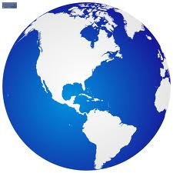
Globes
www.vectortemplates.com
Notes:
Of all the maps that exist the one item that provides us with the most realistic picture as a whole is a globe. They conserve basic attributes like direction, distance, shape, and area. The present the best possible map projection because they include minimum spatial distortion.
However globes a variety of disadvantages. For one, we are not able to view multiple parts at the same time. Secondly globes are really bulky. We are not able to properly handle them and store them, especially when the size and weight increases. Just imagine carrying a globe in your car or with you just to figure a way to get around. That would be way too much work! But one may ask, what if we would to carry a globe the size of a baseball surely that would make our life easier? However, if we were to use such a globe lie that then we would have a size reduction of about 1 to 125,00,000. We would need to use a globe about the height of a four-story building in order to provide an image with scale that is used with state highway maps. A globe that is about 180 feet in diameter needs to be used in order to provide a map image that is equivalent to the standard 1:24,000 scale topographical mapping series that is used in the United States. Finally globe production takes time and money, much more than a regular flat map.
It would be ideal if their would be some way that we can portray the earth’ surface into a flat medium, like a sheet of paper. Not only would it be cheap to produce but it would also provide us with a way to view multiple parts of the earth at the same time. However the earth is not a developable surface, in other words distortion would always happen. It is not possible to transform a spherical surface that curves away in every direction from every point into a plane surface that does not exhibit curvature in any direction from any point.

Slide 4
Properties of Maps
Distance
Direction
Area
Conformity
Notes:
Distance: to be truly distance-preserving the scale would have to be equal in all directions from every point
At best a partial achievement
Shape: When angles are preserved in mapping, the projection is called conformal or orthomorphic
Scales must be equivalent in all directions from a point
Conformal: if the images of any two intersecting paths on the surface intersect at an angle between paths is just the angle between the original paths themselves, where the angle between paths is just the angle between their tangent vectors.
Direction: azimuthal or zeithal geometry is symmetrical about a central point
Area: when relative size of regions is preserved, the projection is said to be equal area or equivalent

Slide 5
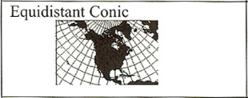
The Equidistance Conic Projection
Notes:
In order for a map to truly be distance preserving the scale would have to equal in all directions from every point. This is something that is not possible or only partially possible. The Equidistance Conic projection is one example of a projection that partially preserves distance. Some properties of this projection is distance is true along standard parallels and meridians, it true along stand parallels, but distortions increases away from the parallels. This projection is usually used for atlas maps of small countries.

Slide 6
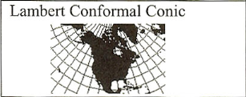
Lambert Conformal Conic
Notes:
This is not a universal property just like distance. This can only be preserved over a specific area. A specific projection that preserves direction over an area is the Lambert Conformal Conic. This projection preserves angles locally and distance is true along parallels. This projection is used for regional mapping of states and smaller countries in the middle latitudes, for State Plane Coordinate System and many USGS maps.

Slide 7
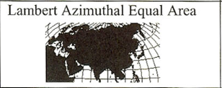
Lambert Azimuthal Equal Area
Notes:
A projection is area preserving when relative size of regions is preserved or areas are presented in their correct proportions. Lambert Azimuthal equal area is projection that preserves area. Direction is true radiating for the center point and distance distortion increases from the center. This projection is useful for representing maps and continents and large countries.

Slide 8
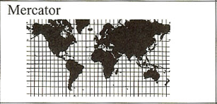
Mercator
Notes:
A map is conformal if the images of any two intersecting paths on the surface intersect at an angle between paths is just the angle between the original paths themselves, where the angle between paths is just the angle between their tangent vectors. In other words the map needs to preserve angles. One projection that preserves angles is the Mercator projection. What is really special about this projection is that compass direction is true. This projection is used as a navigational map and other maps that require true direction like current and wind directions.

Slide 9
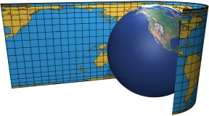
Cylindrical Projections
Notes:
In order to fully understand the di↵erent properties that a map has, it is important to understand the type of projection that is used in order to create the map.
3
A cylindrical map projection can be visualized by wrapping a cylinder sheet around a globe and projecting the points from the globe onto the sheet.
Two important features that cylindrical map projections have is that the parallels (paths of constant lati- tude) map to the horizontal line segments of constant width and the meridians (paths of constant longitude) map to vertical line segments of constant height.

Slide 10
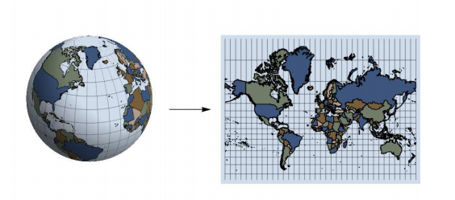
The Mercator Map Projection
Notes:
In 1569, Mercator was able to create a conformal world map that shows paths of constant compass bearing as straight lines, facilitating navigation. As I have explained before for the Mercator map projection area and distance are increasingly distorted with distance from the equator. One common question that may arise is how much distortion happens as one gets farther and farther from the equator. This can be represented by $ln(|sec(\alpha) + tan(\alpha)|)$ . With the figure of the equation we are able to see that as we move towards the poles we are getting more and more distorted.

Slide 11

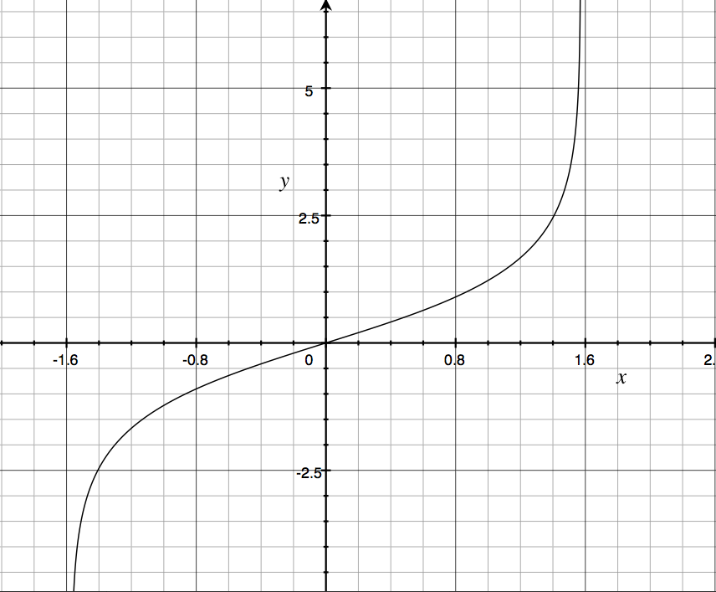
Actual Distortion

Slide 12
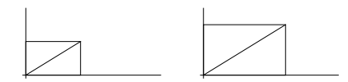
Proving Mercator Map is Conformal
Notes:
As mentioned before a map is conformal if the angle between two intersecting paths is always preserved. To check for conformality then, it would appear to be necessary to check the angles for all possible paths. However the map that we are considering has the important feature that “rectangles” on the sphere, regions bounded by two meridians and two parallels, are mapped to either “polar rectangles” or Cartesian rectangles in the plane. Under these circumstances all angles will be preserved and angles conformality achieved, if, at each pint , the scale factors
along the parallel, represented by the horizontal edge in the figure, is equal to the scale factor along the the meridian, represented by the vertical edge in the figure

Slide 13
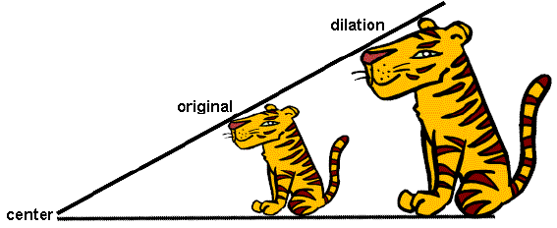
Scale Factor
https://www.google.com/url?sa=i&rct=j&q=&esrc=s&source=images&cd=&cad=rja&docid=l6EHZc72wASfNM&tbnid=Zr47mH2RNPIVRM:&ved=0CAQQjB0&url=http%3A%2F%2Feigthgrademathmocity.
wikispaces.com%2FScale%2Bfactor&ei=Vh1JUemTM4e6iwLspYCACA&bvm=bv.44011176,d.cGE&psig=AFQjCNFtuW_rzHkmsKmyHUuxju2gnSLdBg&ust=1363832466453130
Notes:
If we move from point A to point B on the globe, this induces a change of distance on the map.
The corresponding scaling factor is simply the change in distance on the globe divided by the change in distance on the map. This simple idea is the key to understanding which geometrical properties are preserved by a map projection. The local scale factor of the map at a given point along a given path is the ratio of the arclength elements along the image of the path along the path itself. For our present purposes, the only paths we need to look at are the parallels and the meridians.

Slide 14
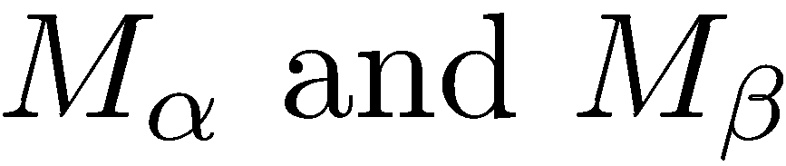
Scale Factor for Mercator Projection
Notes:
In order to figure out the scale factors for the Mercator map projection we take the scale factors along the parallel and along a meridian to be two cardinal directions. For our purposes we denote the scaling factors $M_\alpha$ and $M_\beta $ respectively. Thus if we are at the point ($\alpha$,$\beta$) on the globe, our cylindrical map projection will be conformal near that point if $M_\alpha$ and $M_\beta $ there.

Slide 15
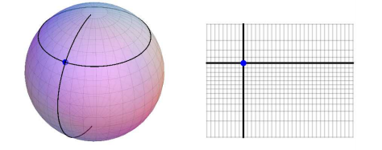


Scaling factor along parallel and Meridian
Notes:
Suppose a pint on the globe is at position ($\alpha$,$\beta$). Consider the parallel through that point. On the globe, that parallel is circle of radius cos($\alpha$). Thus, the circumference of that parallel on the globe is 2$\pi$cos($\alpha$). This parallel maps to a line segment that stretches the whole width of the map. The length of that segment is 2$\pi$. Thus the scaling factor can be represented as: $M_\alpha$ = $\frac{2\pi}{2\pi cos(\alpha)}$ = $sec(\alpha)$
If we want to talk about the scale factor along the meridian then we need to use the formula that represents a cylindrical projection. The cylindrical projection has the form $T(\alpha, \beta)= (\beta, h(\alpha))$. While $M_\alpha$ is uniform an depends only on $\alpha$ , $M_\beta$ is not necessarily uniform and depends on the function h. Suppose we are at a point with latitude $\alpha$ and we increase the latitude a bit $\alpha + t $. On the globe we move a distance t. On the map we move from the point h($\alpha$) to h($\alpha + t $). Thus our scaling factor (the change of distance on the map over the change in distance on the globe) is $frac{h(\alpha + t ) - h(\alpha)}{t}$
To reiterate for a cylindrical map projection $T(\alpha, \beta)= (\beta, h(\alpha))$,
the scaling factor $M_\alpha$ along a parallel is sec($\alpha$)
the scaling factor $M_\beta$ along the meridian is h$\textprime$($\alpha$)

Slide 16

Setting up to prove conformality
Find the scaling factors along the parallel and meridian
Take partial derivatives
Set up the correct scaling factors
Notes:
To generalize the analysis of conformal maps that we applied to the cylindrical situations, we need to be able to compute the scaling factors $M_\alpha$ and $M_\beta$ for an arbitrary map projection $T(\alpha,\beta) =(x(\alpha,\beta), y(\alpha,\beta))$. One way to do this is to take partial derivatives $T_\alpha = (x_\alpha ,y_\alpha)$ and $T_\beta = (x_\beta, y_\beta)$. The scaling factor $M_\alpha$ along a parallel (where the longitude $\beta$ is changing) should be ||$T_\beta$|| and the scaling factor $M_\beta$ along a meridian (where the latitude $\beta$ is changing) should be ||$T_\alpha$. One thing that we have to take into consideration is that like area distortion analysis, we are interesting in measuring the scale the scaling factors are $M_\alpha = sec(\alpha) ||T_\beta||$ and $M_\beta = ||T_\alpha||$

Slide 17

Proving Conformality
For the general map
projection will be conformal if and only if
Notes:
For a general map projection $ T(\alpha,\beta) =(x(\alpha,\beta), y(\alpha,\beta))$ will be conformal if and only if $sec(\alpha) ||T_\beta|| = ||T_\alpha||$
So now lets prove that the Mercator map is conformal. Since $T(\alpha,\beta) =(\beta, ln(|sec(\alpha) + tan(\alpha)|))$, we have $ sec(\alpha) ||T_\beta||=sec(\alpha)||(1,0)|| = sec(\alpha)$ and $||T_\beta|| = ||(0, sec(\alpha))|| = sec(\alpha)$. Thus $sec(\alpha) ||T_\beta|| = ||T_\alpha||$

Slide 18
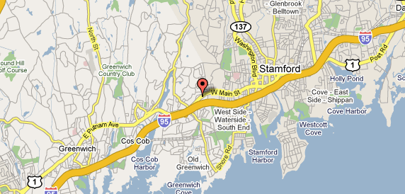
Google Maps
https://www.google.com/url?sa=i&rct=j&q=&esrc=s&source=images&cd=&docid=e5dlUl6nNJJ18M&tbnid=nOqpvjZ-xOTGzM:&ved=0CAQQjB0&url=http%3A%2F%2Fwww.destination3
60.com%2Fnorth-america%2Fus%2Fconnecticut%2Fold-greenwich%2Fhyatt-regency-greenwich-stamford%2Fhotel-map&ei=uHhLUeGhL-PliALJ64CADQ&bvm=bv.44158598,d.cGE&psig=AFQjC
NEye8hw8Cw_jEmv9o1GBbg3HHhvvw&ust=1363986985463180
Notes:
Google maps are based on a variant of the Mercator projection. The Earth were perfectly spherical, the projection would be the same as the Mercator. Google Maps uses the formulæ for the spherical Mercator, but the coordinates of features on Google Maps are the GPS coordinates based on the WGS 84 datum. The difference between a sphere and the WGS 84 ellipsoid causes the resultant projection not to be precisely conformal. The discrepancy is imperceptible at the global scale but causes maps of local areas to deviate slightly from true ellipsoidal Mercator maps at the same scale.
As I was looking at the forums in Google one of the question that arose was “Every time I see a "Powered By Google" website display the default Google world map, I wince and wonder "why does the most sophisticated information technology company in the world use the most distorted and archaic world map known to humankind?".” The post when on to state the various problems with the Mercator projection and he urged Google to “be responsible with the world's knowledge and follow the advice of numerous cartographic associations that request that the Mercator Project not be used. For anything. Ever.”
Google responded by saying “Hi John - Thanks for the feedback. Maps uses Mercator because it preserves angles. The first launch of Maps actually did not use Mercator, and streets in high latitude places like Stockholm did not meet at right angles on the map the way they do in reality. While this distorts a 'zoomed-out view' of the map, it allows close-ups (street level) to appear more like reality. The majority of our users are looking down at the street level for businesses, directions, etc... so we're sticking with this projection for now. In the meantime, you might want to look at our favorite 3D view of the world. “

Slide 19
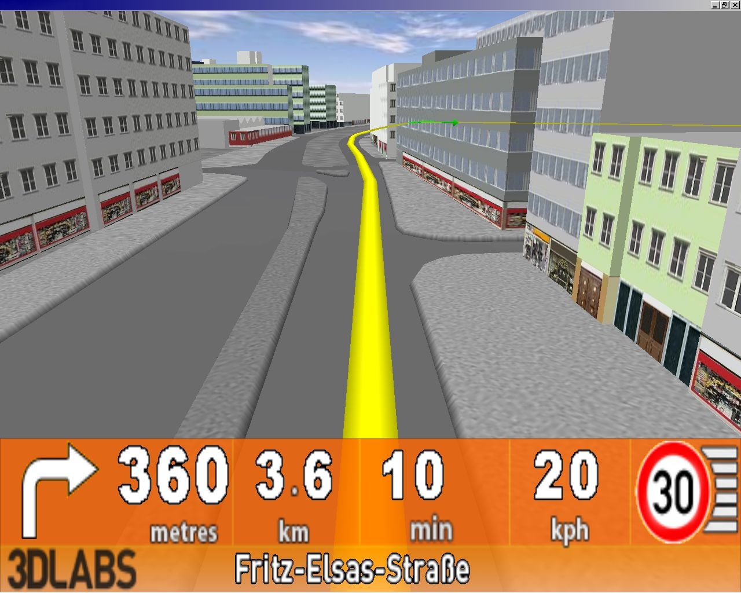
Future of Maps
www.gpsreview.net
Notes:
As we look into the future one question that arises is, what would be the future of maps? One thing that we need to understand is that different maps are made for different purposes. For example like one of the primary reasons that the Mercator map was created in order to have a world map that shows paths of constant compass bearing as straight lines, facilitating navigation. We are living in a time in which most people use the GPS in street view in order to get from one place to another. By doing this we allow ourselves a little distortion. Even though Google maps uses a version of the Mercator projection that has distortions Google explains that locally this does not matter. GPS is a wonderful thing, it uses a variety of satellites to pinpoint our location and provide information like where we want to go. I wonder how the future of maps looks like. We are already able to create a 3D image of the earth and use this image to help pilots fly from one place to another. What other types of maps would we be able to create?

Slide 20
Bibliography
Feeman, Timothy G. (2001) Conformlity, the Exponential Function, and World Map Projections. Retrieved March 2013, from The College Mathematics Journal : https://www.jstor.org/action/ showLogin?redirectUri=/stable/10.2307/2687304
Google. Why does Google maps use the inaccurate, ancient and distorted Mercator Projection? Re- trieved March 2013, from Google Forums: http://productforums.google.com/forum/#!topic/ maps/A2ygEJ5eG-o
Madrigal, Alexis, C. How Google Builds Its Mapsand What It Means for the Future of Everything. Retrieved March 2013, from The Atlantic http://www.theatlantic.com/technology/archive/2012/09/ how-google-builds-its-maps-and-what-it-means-for-the-future-of-everything/ 261913/
McClure, Mark. Map Projection: An Intro for Calc III. Retrieved March 2013, from http:// facstaff.unca.edu/mcmcclur/class/Fall10CalcIII/handouts/MapProjection.pdf
Muehce, Phillip C. (2004) Map Use: Reading, Analysis, and Interpretation Map Use: Reading, Analysis, and Interpretation. JP Publications.

