Slide 1
Pretty Pictures: Polynomial Progressions and their Primes
By, Michael Mailloux
Westfield State University
mmailloux9727@westfield.ma.edu

Slide 2
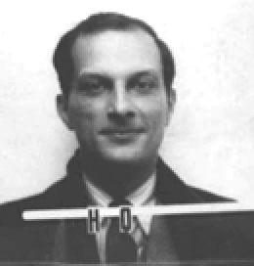
What is the Ulam Spiral…and who is Ulam?
~Stanislaw Ulam was a 20th century,
Polish mathematician, who moved to America at the
start of WW2.
~Was a leading figure in the Manhattan
project.
~Inventor of the Monte Carlo method for
solving difficult mathematical problems.
~Creator of the Ulam Spiral.

Slide 3
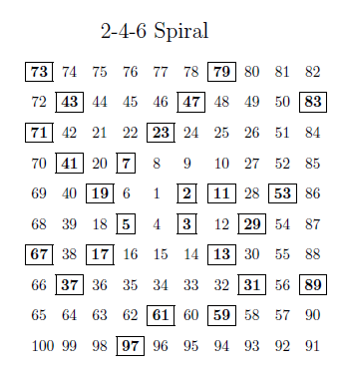
A brief History: Ulam first penned his spiral in
1963, when he became bored at a scientific meeting
and began doodling! He then noticed that by
circling the prime number there seemed to be
patterns. He was quoted as saying in reference to
the spiral, “appears to exhibit a strongly
nonrandom appearance”.
The Spiral: This spiral which I will refer to as the Traditional Ulam Spiral, is an
square shaped spiral of all positive integers. This traditional spiral is characterized
by a growth in side length of the squares of 2-4-6-8-… . The side length for each
square starting with the inner most square can be written as:
Side Length=2+2n, where n=0,1,2,… is an ordered index of the side lengths
starting with the smallest square.

Slide 4
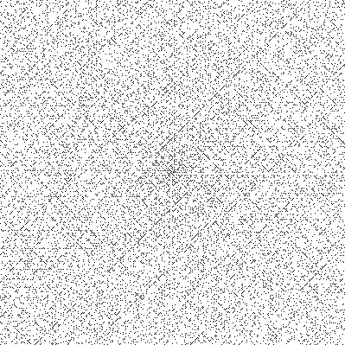
Prime Patterns of the Traditional Ulam Spiral

Slide 5
Lines of the Spiral
~As it turns out the lines of the spiral can be represented with quadratic
equations. But how do you find the physical equation from a
spiral of numbers? The answer to this is by using difference charts!
Step # | Value | 1st Difference | 2nd Difference | 3rd Difference
0 | 2
1 | 10 | 8
2 | 26 | 16 | 8
3 | 50 | 24 | 8 | 0
4 | 82 | 32 | 8 | 0

Slide 6


Differences, derivatives, and polynomials oh my?
~As it turns out you can use these difference charts to determine any quadratic
or even higher degree polynomials if you want.
For the Quadratic: $y=ax^{2}+bx+c$
$a=\frac{2nd Difference}{2}$
$b=1st 1st Difference−a$
$c=Value of Step 0$
For the Cubic: $y=ax^{3}+bx^{2}+cx+d$
$a=\frac{3rd Difference}{6}$
$b=\frac{1st Second Difference−3rd Difference}{2}$,
$c=1st First Difference−a−b$
$d=Value of Step 0$
Step # | Value | 1st Difference | 2nd Difference | 3rd Difference
0 | 2
1 | 10 | 8
2 | 26 | 16 | 8
This equation is $y=4x^{2}+4x+2$

Slide 7
Differences, derivatives, and polynomials oh my?
~These difference charts have a few significant commonalities to note.
1) For a quadratics the 2nd difference will never change, for cubics
the 3rd difference will never change, for quartics the 4th difference will never
change,…etc.
2) The 2nd derivative of any quadratic can be used to confirm the 2nd
difference
3) For the Traditional Ulam Spiral, the quadratic growth patterns we are
concerned with were are those such that a=4.

Slide 8
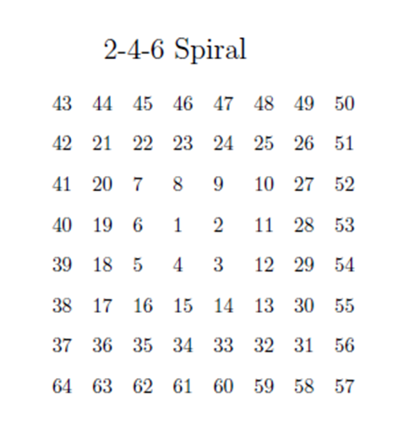

The Traditional Ulam Spiral
The four main diagonals(denoted by $D_{n}$, where
n is the number the main diagonal starts on are:
$$D_{1}:y=4x^{2}+2x+1$$
$D_{2}:y=4x^{2}+4x+2$
$$D_{3}:y=4x^{2}+6x+3$$
$$D_{5}:y=4x^{2}+8x+5$$
All quadratic progressions in the form of
horizontal/vertical/diagonal lines can be classified
using.
b≡0(mod8): Follow the same direction as $D_{5}$
b≡1(mod8): Follow the same direction as the
Horizontal line going left starting at 1
b≡2(mod8): Follow the same direction as $D_{1}$
b≡3(mod8): Follow the same direction as the
Vertical line going up starting at 1.
b≡4(mod8): Follow the same direction as $D_{2}$
b≡5(mod8): Follow the same direction as the
Horizontal line going right starting at 2.
b≡6(mod8): Follow the same direction as $D_{3}$
b≡7(mod8): Follow the same direction as the
Vertical line going down starting at 3.

Slide 9
Other Variations of the Ulam Spiral
~By changing the growth rate for the side lengths of the square in the Ulam
spiral it is possible to get different pictures for quadratic progressions. So far,
progressions I have examined are such that:
1) Side Length 2-3-4, progression of 2+1n, n=0,1,2,…
~4 diagonals
~a=2
2) Traditional 2-4-6, progression of 2+2n, n=0,1,2,…
~8 diagonals
~a=4
3) Side Length 2-5-8, progression of 2+3n, n=0,1,2,…
~12 diagonals
~a=6
4) Side Length 2-6-10, progression of 2+4n, n=0,1,2,…
~16 diagonals
~a=8
Note: It should be seen by this point that by increasing the length of the 2nd
square in the spiral by one integer that the leading coefficient a will increase
by two integer values. This also tells us we can create spirals which can
generate quadratics that start with any even positive leading a coefficient.
Notes:
Reorder by the 2nd coordinate. 2-3-4 (4diagona) 2x^2, 2-4-6 (8 diagonal) 4x^2, 2-5-8(12 diagonal) 6x^2, 2-6-10 (16 diagona) 8x^2,… so you can see by making the 2nd square length one unit longer we can generate quadratics that state with all the positive even integers.

Slide 10
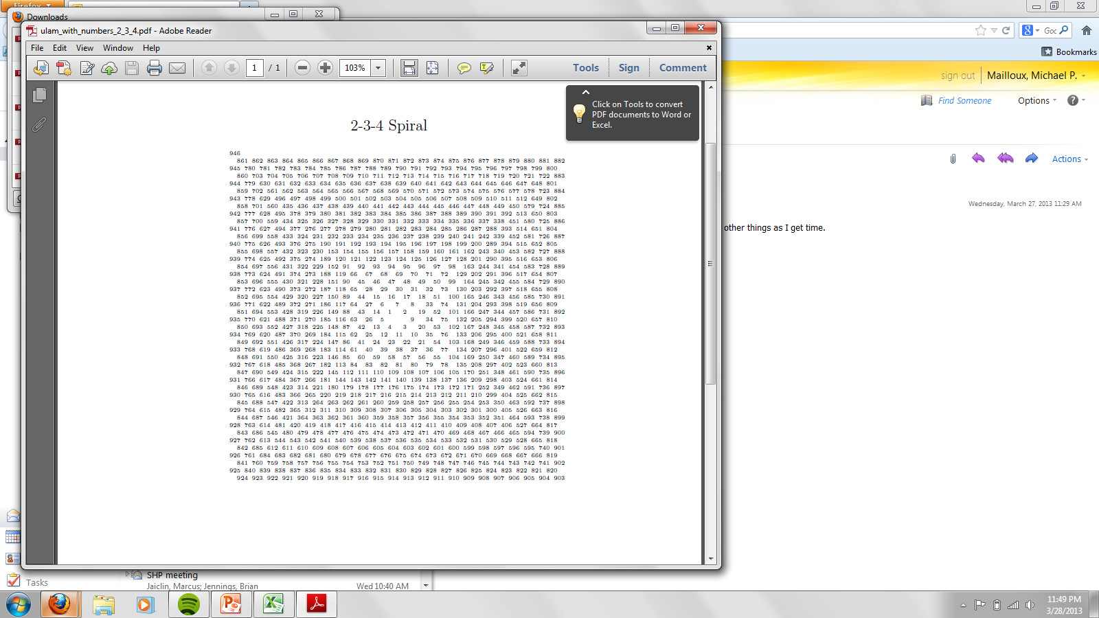
2-3-4 Spiral

Slide 11
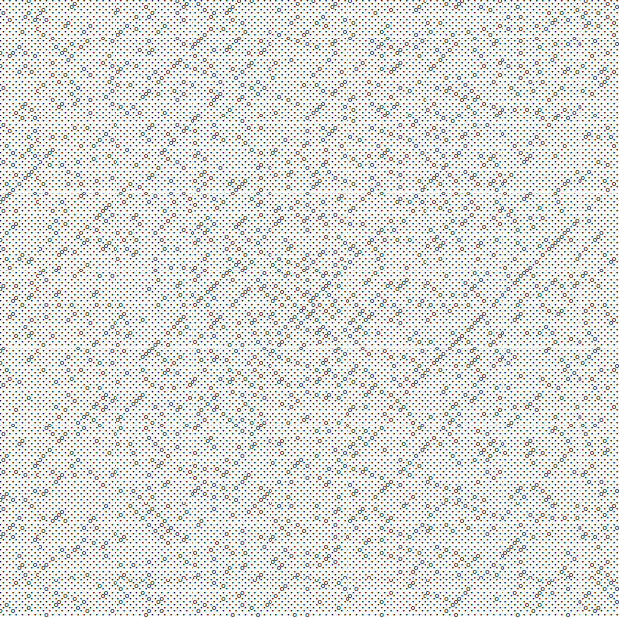
2-3-4 Spiral (Primes)

Slide 12
2-3-4 Spiral
~ The quadratics of significance which represent the diagonals of this spiral
examined all had the leading coefficient of a=2.
~ Diagonals can be sorted by direction using b≡x(mod4).
1) b≡0(mod4): Quadratics which will follow the same direction as the main
diagonal starting at 2
2) b≡1(mod4):Quadratics which will follow the same direction as the main
diagonal starting at 3
3) b≡2(mod4). Quadratics which will follow the same direction as the main
diagonal starting at 4
4) b≡3(mod4). Quadratics which will follow the same direction as the main
diagonal starting at 1
Notes:
Recheck mod diagonal

Slide 13
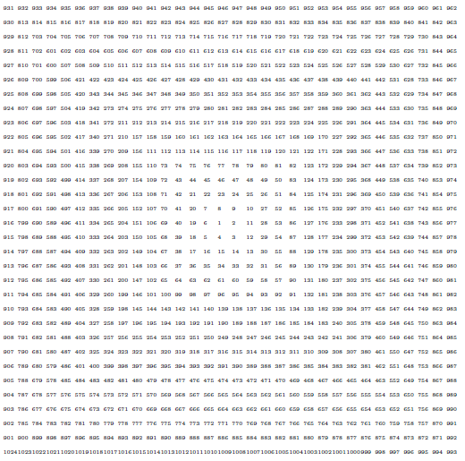
Traditional Ulam 2-4-6

Slide 14
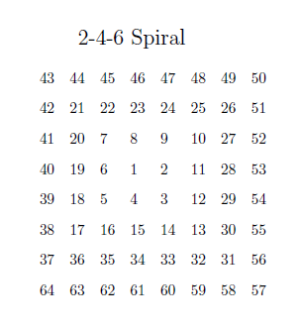
The Traditional Ulam Spiral
~Like the previous spirals the vertical/horizontal/diagonal lines can
be classified into categories based on the congruence of b.
~This spiral has a leading coefficient of a=4
~Thus, the direction a quadratic progression will go is based on
b≡x(mod8).

Slide 15
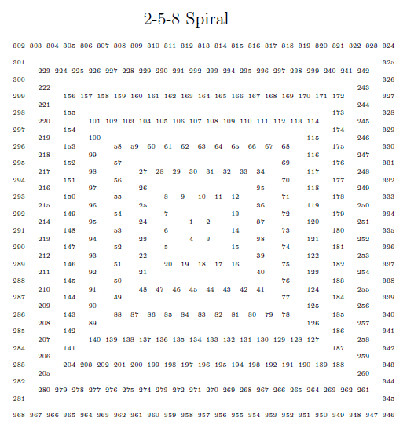

Slide 16
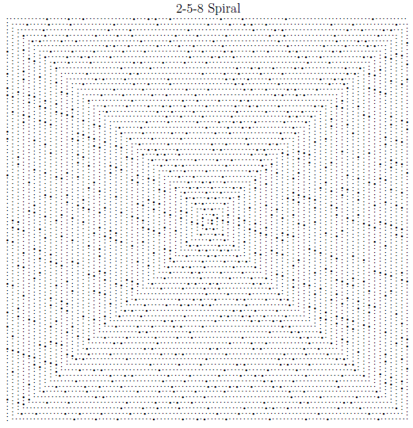

Slide 17
2-5-8 Spiral
~Like the previous spirals the vertical/horizontal/diagonal lines can be classified into categories based on the congruence of b.
~This spiral has a leading coefficient of a=6
~Thus, the direction a quadratic progression will go is based on
b≡x(mod12).

Slide 18
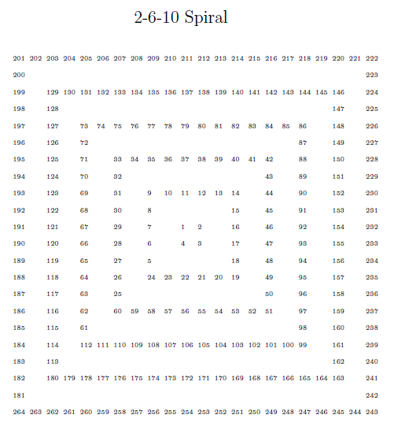

Slide 19
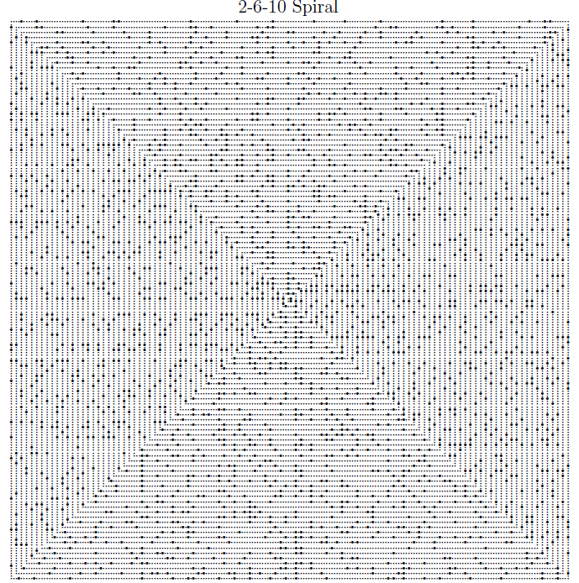

Slide 20
2-6-10 Spiral
~Like the previous spirals the vertical/horizontal/diagonal lines can
be classified into categories based on the congruence of b.
~This spiral has a leading coefficient of a=8
~Thus, the direction a quadratic progression will go is based on
b≡x(mod16).

Slide 21


Odds and Evens
~When it comes to the search for the diagonals that can be seen when
looking at pictures of the variations of the Ulam spiral, one thing that
can be useful is taking a quadratic equation that’s only outputs in the
spiral are odd.
Start with: $y=x^{2}+2x+1$
Even Inputs: f(2x)$={(2x)}^{2}+2\left(2x\right)+1=4x^{2}+4x+1$
Odd Inputs: f(2x+1)$={(2x+1)}^{2}+2\left(2x+1\right)+1=4x^{2}+8x+4$
Start with: $y=x^{2}+x+1$
Even Inputs: f(2x)$={(2x)}^{2}+\left(2x\right)+1=4x^{2}+2x+1$
Odd Inputs: f(2x+1)$={(2x+1)}^{2}+\left(2x+1\right)+1=4x^{2}+6x+3$

Slide 22
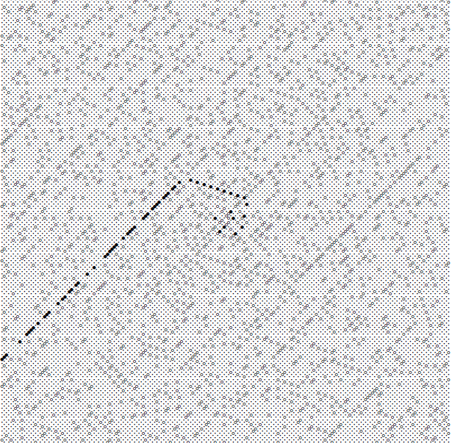

Spiraling Quadratics
~While it is clear that many of quadratic progressions desirable to
look at are merely vertical/horizontal/straight lines, there are some more
Interesting ones which do not quite fit this mold. An example can be seen
below of one of these spiraling progressions in the Ulam 2-3-4 spiral. Notice
how despite seeming to jump around chaotically, it stabilizes into a diagonal
eventually. In fact the jumping around isn't quite as random as it appears
either.
Notice how this picture which highlights the
positions of prime numbers, bolded is
one of these quadratic progressions!
This progressions is in fact modeled by,
y=$2x^{2}+2x+19$. Note: The b value of this
equation b=2 categorizes this equation in
the correct directional category based on
the diagonal it settles on eventually!

Slide 23
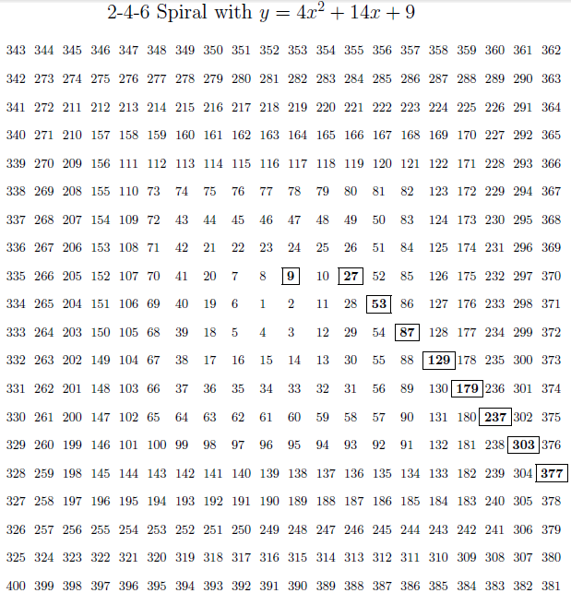

Slide 24

The “Little” Differences Make the Biggest Impacts
X | Y | 1st Difference | 2nd Difference
0 | 9
1 | 27 | 18
2 | 53 | 26 | 8
3 | 87 | 34 | 8
$$y=4x^{2}+14x+9$$
For this equation we will look at how
the “little differences behave. To start if
the progression is to enter one of the main
diagonals from 9 it would progress to
either 23, 24, or 25.
(x=0)
x | y | 1st | 2nd
0 | 9 |  | 8
1 | 23 | 14 | 8
 |  |  | 8
x | y | 1st | 2nd
0 | 9 |  | 8
1 | 24 | 15 | 8
 |  |  | 8
x | y | 1st | 2nd
0 | 9 |  | 8
1 | 25 | 16 | 8
 |  |  | 8
18-14=4 18-15=3 18-16=2
Since none of the “little” differences are zero the progression will not yet settle into a
diagonal.

Slide 25

The “Little” Differences Make the Biggest Impacts
X | Y | 1st Difference | 2nd Difference
0 | 9
1 | 27 | 18
2 | 53 | 26 | 8
3 | 87 | 34 | 8
$$y=4x^{2}+14x+9$$
Now we must repeat the process from
before with 27 because none of our
little differences were zero before.
(x=1)
x | y | 1st | 2nd
1 | 27 |  | 8
2 | 51 | 24 | 8
 |  |  | 8
x | y | 1st | 2nd
1 | 27 |  | 8
2 | 52 | 25 | 8
 |  |  | 8
x | y | 1st | 2nd
1 | 27 |  | 8
2 | 53 | 26 | 8
3 | 87 | 34 | 8
26-24=2 26-25=1 26-26=0
Since the “little” difference is zero when the y-value goes from 27 to 53 we have found
the diagonal our progression will settle on.

Slide 26
Breaking Down the Spiraling Quadratics
~The reason these spirals are caused is because the quadratic progressions
are growing at a faster or slower rate then any of the diagonals the quadratic
can settle in.
~However, as the rate of growth of the “legal” diagonals becomes in sync, it can be
seen that the quadratic progression will settle into the first “legal” diagonal which
has the same rate of growth as the quadratic progressions at the moment.
~Once in one of the “legal” diagonals the quadratic progression will forever
stay on the “legal” diagonal.
~ When breaking down the spirals it is best to look at an Ulam Spiral as being
separated into quadrants broken up by the main diagonals.

Slide 27
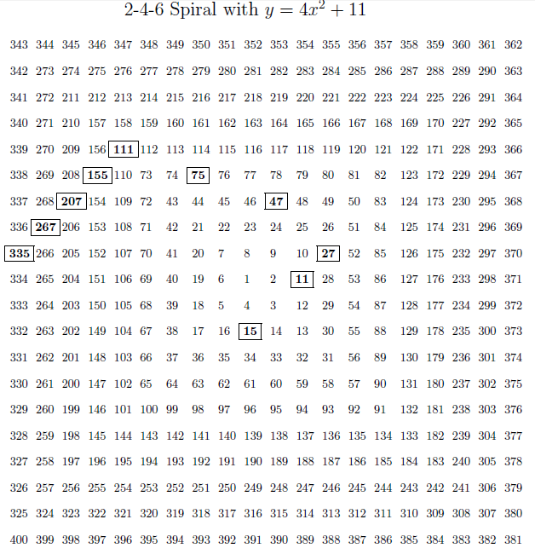

Slide 28

The “Little” Differences Make the Biggest Impacts
~We can also determine what the next start of the little differences based on the
number of main diagonals crossed. An example of this can be seen below for the
Traditional Ulam Spiral looking at the quadratic progressions of: $y=4x^{2}+11$
y(1)->y(2) | # of Main Diagonals Less then 4 crossed | Start of the little differences | → + | Next start of little differences
11→15 | 3 | -12 | +6 | -6
15→27 | 1 | -6 | +2 | -4
27→47 | 1 | -4 | +2 | -2
47→75 | 0 | -2 | +0 | -2
75→111 | 1 | -2 | +2 | 0
111→155 | 0 | 0 | +0 | 0
155→207 | 0 | 0 | +0 | 0
Note:# Diagonals less then 4 crossed does not include being on a main diagonal.

Slide 29

The “Little” Differences Make the Biggest Impacts
~In this case for the Traditional Ulam Spiral, the number of main diagonals less
then 4 crossed can be used to predict the next start of the little differences.
Conversely, the next little difference start can be used to predict the number of
main diagonals that were jumped to get to the next value.
Traditional Ulam
Little Difference next Start= Last Start+2|# of main diagonals less then 4 crossed|
Main diagonals crossed=$\frac{Next Little Difference Start−Last Little Difference Start}{2}$
While this expresses the relation ship for the traditional Ulam Spiral, the
relationship will change slightly depending on how fast the sides of the square
grow.

Slide 30
Works Cited
~http://www.maa.org/devlin/devlin_04_09.html
~http://en.wikipedia.org/wiki/File:Stanislaw_Ulam_ID_badge.png
~ http://mathworld.wolfram.com/PrimeSpiral.html

Slide 31
Thank You For Listening!

Slide 32
The “Little” Differences Make the Biggest Impacts
x | y | 1st | 2nd
0 | Z |  | X
1 | K | J | X
 |  |  | X
x | y | 1st | 2nd
0 | Z |  | X
1 | K+1 | J+1 | X
 |  |  | X
x | y | 1st | 2nd
0 | Z |  | X
1 | K+2 | J+2 | X
 |  |  | X
Actual first difference(D)-J=? D-(J+1)=? D-(J+2)=?
~These little difference charts can be used to determine when the quadratic
Progressions will settle into “legal” diagonals. To do this you take a step by
Step approach and compare the y value to what the next y-value will be if the
Progression will settle into one if the “legal diagonals” . If one of the D-(J+i)=0,
then the quadratic progression will settle into that “legal” diagonal for good. If
Of our little differences do not equal 0, then the quadratic will continue to dance
Around the spiral. This same process is continued until, one of the little differences
Is equal to zero.

