Slide 1
Yield-Curve Strategies
Ryan Poirier
SUNY Plattsburgh

Slide 2
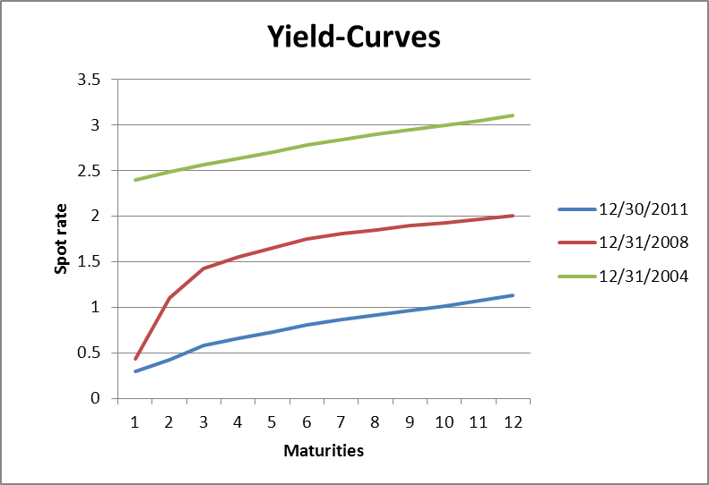
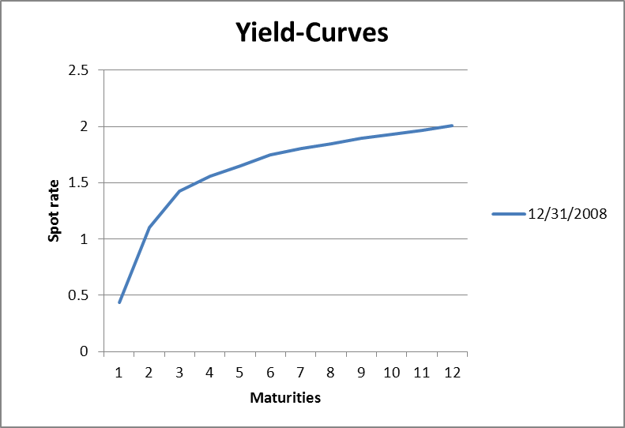
Overview
Strategies :
Bullet: Centralized investment
Barbell: Straddled investment around the corresponding Bullet
Bullet
Barbell

Slide 3

Regression
$y_{n,t}=α_{t}+β_{t}\left(n\right)+γ_{t}\left(n^{2}\right){+ε}_{t,s}$
Where:
$y_{n,t}=spot rate$
$n=maturity$
$α_{t}=level$
$β_{t}=slope$
$γ_{t}=curvature$

Slide 4


Changes in Coefficients
$\text{Δ}α_{t,s}\text{=}α_{t}−α_{t−s}$
$\text{Δ}β_{t,s}\text{=}β_{t}−β_{t−s}$
$\text{Δ}γ_{t,s}\text{=}γ_{t}−γ_{t−s}$
Notation:
t = time in the sample
s = interval
${\text{Δ}α}_{t,s}=$Change in level at time t, over the interval s

Slide 5
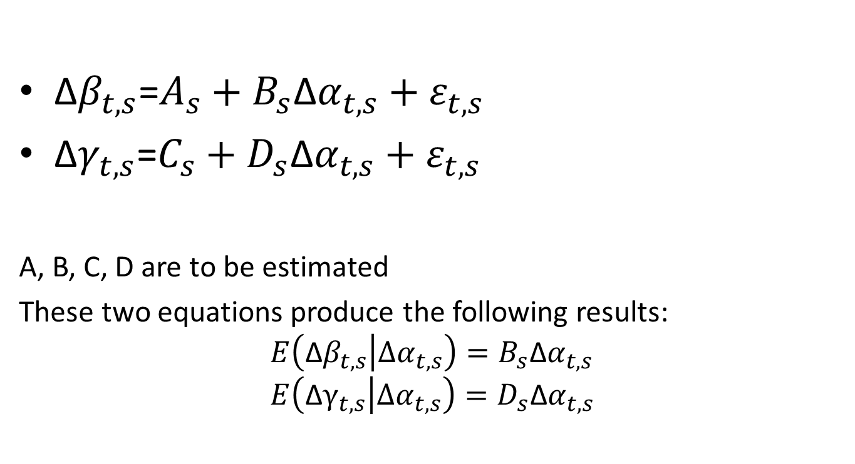
Interaction between changes in coefficients
$\text{Δ}β_{t,s}\text{=}A_{s}+B_{s}\text{Δ}α_{t,s}+ε_{t,s}$
$\text{Δ}γ_{t,s}\text{=}C_{s}+D_{s}\text{Δ}α_{t,s}+ε_{t,s}$
A, B, C, D are to be estimated
These two equations produce the following results:
$$E\left(\text{Δ}β_{t,s} | Δα_{t,s}\right)=B_{s}\text{Δ}α_{t,s} \\ E\left(\text{Δ}γ_{t,s} | Δα_{t,s}\right)=D_{s}\text{Δ}α_{t,s}$$

Slide 6
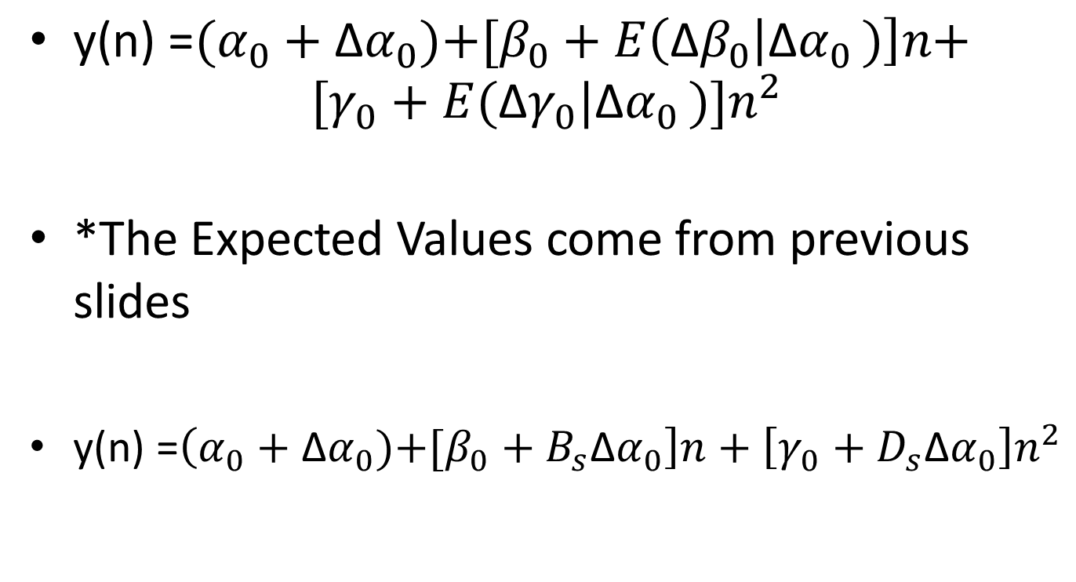
Equation for rates
$\text{y}\text{(}\text{n}\text{) =}(α_{0}+\text{Δ}α_{0}\text{)+[}β_{0}+E\left(\text{Δ}β_{0} | \text{Δ}α_{0 })\right]n\text{+}$
$\text{[}γ_{0}+E(\text{Δ}γ_{0}|\text{Δ}α_{0 }\text{)]}n^{2}$
*The Expected Values come from previous slides
$\text{y}\text{(}\text{n}\text{) =}\left(α_{0}+\text{Δ}α_{0}\text{)+[}β_{0}+B_{s}\text{Δ}α_{0}\right]n+\left[γ_{0}+D_{s}\text{Δ}α_{0}\right]n^{2}$

Slide 7
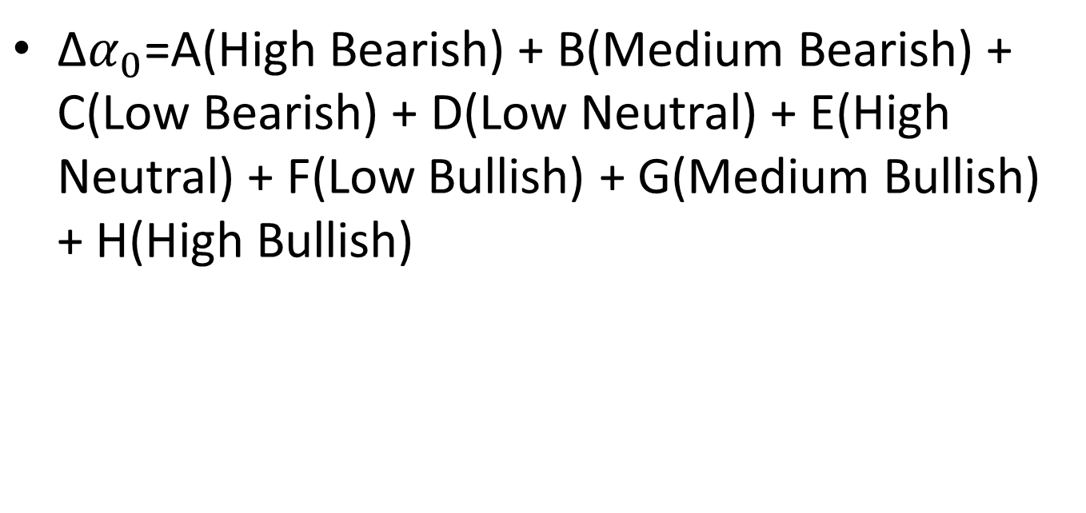
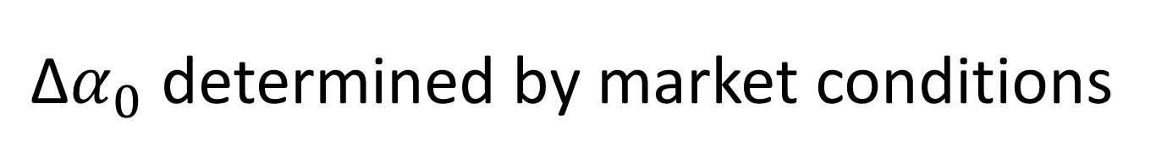
$\text{Δ}α_{0}$ determined by market conditions
$\text{Δ}α_{0}$=A(High Bearish) + B(Medium Bearish) + C(Low Bearish) + D(Low Neutral) + E(High Neutral) + F(Low Bullish) + G(Medium Bullish) + H(High Bullish)

Slide 8
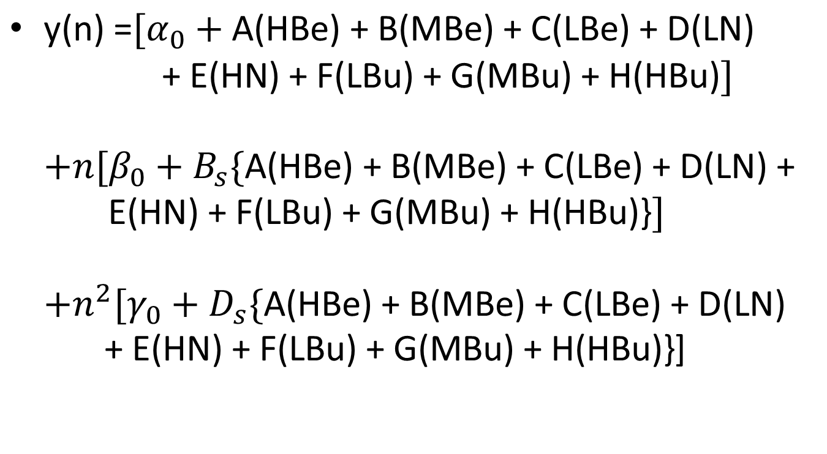
Final Estimation of rates
$\text{y}\text{(}\text{n}\text{) =}[α_{0}+\text{A}\text{(}\text{HBe}\text{) + }\text{B}\text{(}\text{MBe}\text{) + }\text{C}\text{(}\text{LBe}\text{) + }\text{D}\text{(}\text{LN}\text{)}$
$\text{+} \text{E}\text{(}\text{HN}\text{) + }\text{F}\text{(}\text{LBu}\text{) + }\text{G}\text{(}\text{M}\text{Bu}\text{) + }\text{H}\text{(}\text{HBu}\text{)}\text{]}$
$\text{+}n[β_{0}+B_{s}\{\text{A}\text{(}\text{HBe}\text{) + }\text{B}\text{(}\text{MBe}\text{) + }\text{C}\text{(}\text{LBe}\text{) + }\text{D}\text{(}\text{LN}\text{) + }\text{E}\text{(}\text{HN}\text{) + }\text{F}\text{(}\text{LBu}\text{) + }\text{G}\text{(}\text{MBu}\text{) + }\text{H}\text{(}\text{HBu}\text{)\}}\text{]}$
$\text{+}n^{2}\text{[}γ_{0}+D_{s}\text{\{}\text{A}\text{(}\text{HBe}\text{) + }\text{B}\text{(}\text{MBe}\text{) + }\text{C}\text{(}\text{LBe}\text{) + }\text{D}\text{(}\text{LN}\text{) + }\text{E}\text{(}\text{HN}\text{) + }\text{F}\text{(}\text{LBu}\text{) + }\text{G}\text{(}\text{MBu}\text{) + }\text{H}\text{(}\text{HBu}\text{)\}}$]

Slide 9
Initial Yield Curves

Slide 10
Coupon Rates

Slide 11
Term To Maturity

