Slide 1
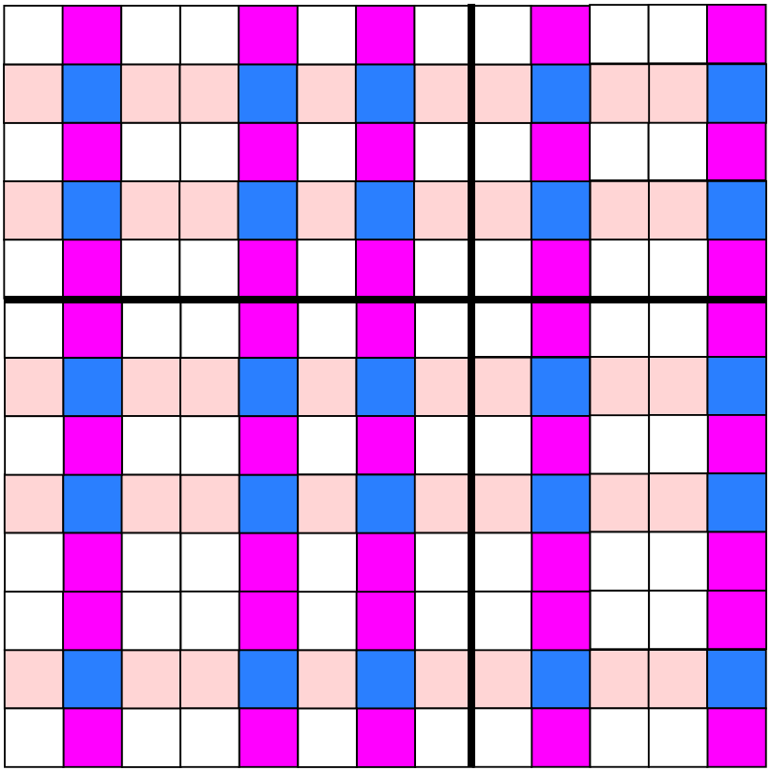
An Introduction to Self-Similar and Combinatorial Tiling Part II
Moisés Rivera
Vassar College

Slide 2
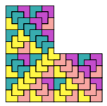
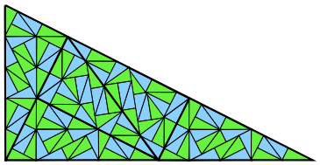
Self-Similar vs. Combinatorial Tiling
Substitution/Inflate and Subdivide Rule
Self-Similar Tiling

Slide 3
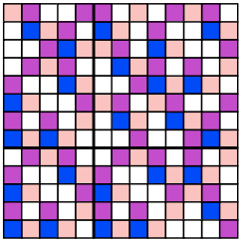
Self-Similar vs. Combinatorial Tiling
Substitution/Inflate and Subdivide Rule
No geometric resemblance to itself
Substitution of non-constant length
Combinatorial Tiling
Self-Similar Tiling

Slide 4
One-Dimensional Symbolic Substitution
A is a finite set called an alphabet whose elements are letters.
A* is the set of all words with elements from A.
A symbolic substitution is any map σ : A → A*.

Slide 5
One-Dimensional Symbolic Substitution
A is a finite set called an alphabet whose elements are letters.
A* is the set of all words with elements from A.
A symbolic substitution is any map σ : A → A*.
Let A = {a,b} and let σ(a) = ab and σ(b) = a.

Slide 6
One-Dimensional Symbolic Substitution
A is a finite set called an alphabet whose elements are letters.
A* is the set of all words with elements from A.
A symbolic substitution is any map σ : A → A*.
Let A = {a,b} and let σ(a) = ab and σ(b) = a.
If we begin with a we get:
a → ab → ab a → ab a ab → ab a ab ab a → ab a ab ab a ab a ab →···

Slide 7
One-Dimensional Symbolic Substitution
A is a finite set called an alphabet whose elements are letters.
A* is the set of all words with elements from A.
A symbolic substitution is any map σ : A → A*.
Let A = {a,b} and let σ(a) = ab and σ(b) = a.
If we begin with a we get:
a → ab → ab a → ab a ab → ab a ab ab a → ab a ab ab a ab a ab →···
The block lengths are Fibonacci numbers 1, 2, 3, 5, 8, 13, …
substitution of non-constant length or combinatorial substitution

Slide 8

Substitution Matrix
The substitution matrix M is the n×n matrix with entries given by
    m_{ij} = the number of tiles of type i in the substitution of the tile of type j

Slide 9
Substitution Matrix
The substitution matrix M is the n×n matrix with entries given by
    m_{ij} = the number of tiles of type i in the substitution of the tile of type j
σ(a) = ab
σ(b) = a

Slide 10
Substitution Matrix
The substitution matrix M is the n×n matrix with entries given by
    m_{ij} = the number of tiles of type i in the substitution of the tile of type j
σ(a) = ab
σ(b) = a
substitution matrix for one-dimensional Fibonacci substitution:

Slide 11
Eigenvectors and Eigenvalues
Eigenvector - a non-zero vector v that, when multiplied by square matrix A yields the original vector multiplied by a single number λ

Slide 12
Eigenvectors and Eigenvalues
Eigenvector - a non-zero vector v that, when multiplied by square matrix A yields the original vector multiplied by a single number λ
λ is the eigenvalue of A corresponding to v.

Slide 13
Eigenvectors and Eigenvalues
Eigenvector - a non-zero vector v that, when multiplied by square matrix A yields the original vector multiplied by a single number λ
λ is the eigenvalue of A corresponding to v.
This equation has non-trivial solutions if and only if
Solve for λ to find eigenvalues.

Slide 14
Expansion Constant
Eigenvalues are the roots of the characteristic polynomial

Slide 15
Expansion Constant
Eigenvalues are the roots of the characteristic polynomial
Perron Eigenvalue - largest positive real valued eigenvalue that is larger in modulus than the other eigenvalues of the matrix

Slide 16
Expansion Constant
Eigenvalues are the roots of the characteristic polynomial
Perron Eigenvalue - largest positive real valued eigenvalue that is larger in modulus than the other eigenvalues of the matrix
Perron Eigenvalue of Fibonacci substitution matrix:
the golden mean

Slide 17
The Fibonacci Direct Product Substitution
The direct product of the one-dimensional Fibonacci substitution with itself.
{a,b}x{a,b}
where (a,a) = 1, (a,b) = 2, (b,a) = 3, (b,b) = 4.

Slide 18
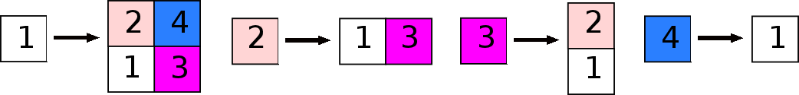
The Fibonacci Direct Product Substitution
The direct product of the one-dimensional Fibonacci substitution with itself.
{a,b}x{a,b}
where (a,a) = 1, (a,b) = 2, (b,a) = 3, (b,b) = 4.

Slide 19
The Fibonacci Direct Product Substitution
The direct product of the one-dimensional Fibonacci substitution with itself.
{a,b}x{a,b}
where (a,a) = 1, (a,b) = 2, (b,a) = 3, (b,b) = 4.
Not self-similar
Not an inflate and subdivide rule

Slide 20
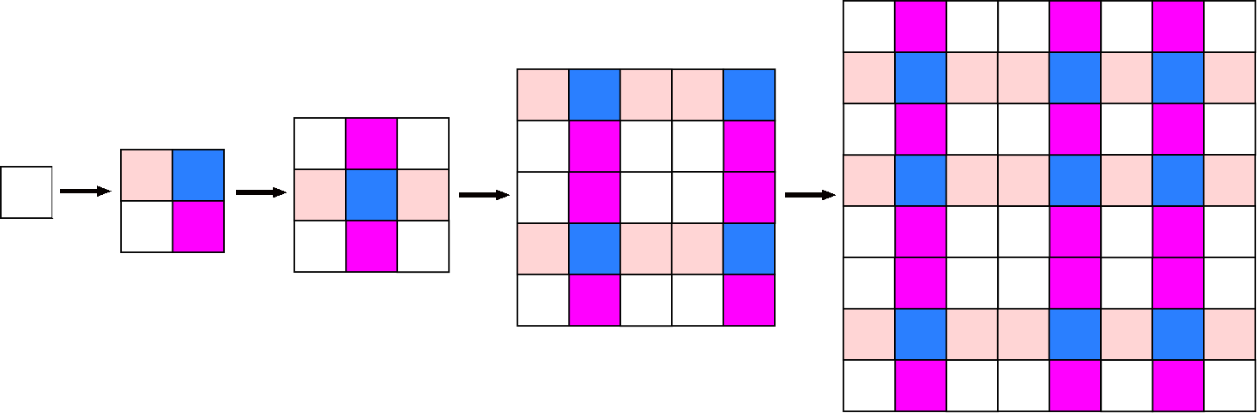
Several Iterations of Tile Types

Slide 21
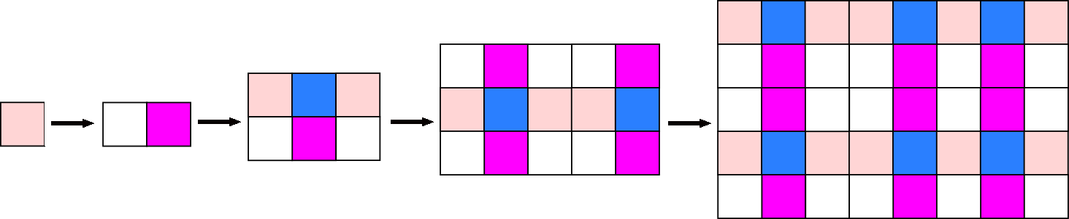
Several Iterations of Tile Types

Slide 22
Substitution Matrix

Slide 23
Substitution Matrix
The substitution matrix for the Fibonacci Direct Product is

Slide 24
Expansion Constant
Eigenvalues are the roots of the characteristic polynomial

Slide 25
Expansion Constant
Eigenvalues are the roots of the characteristic polynomial
Perron Eigenvalue of Fibonacci Direct Product substitution matrix:
the golden mean squared

Slide 26
Replace-and-rescale Method

Slide 27
Replace-and-rescale Method
Rescale volumes by the Perron Eigenvalue raised to the n^{th} power: 1/γ^{2n} where n corresponds to the n^{th}-level of our block.

Slide 28

Replace-and-rescale Method
Rescale volumes by the Perron Eigenvalue raised to the n^{th} power: 1/γ^{2n} where n corresponds to the n^{th}-level of our block.
This results in a level-0 tile with different lengths that the original. Repeat for other tile types. The substitution rule is now self-similar.

Slide 29
Self-Similar Fibonacci Direct Product
Combinatorial Substitution Rule

Slide 30
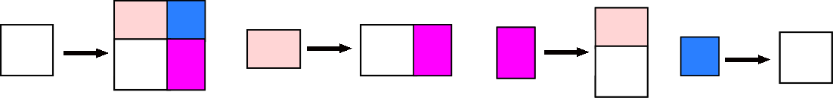
Self-Similar Fibonacci Direct Product
Combinatorial Substitution Rule
Self-Similar Inflate and Subdivide Rule

Slide 31
Replace-and-rescale Method
Compare level-5 tiles of the Fibonacci Direct Product (left)
Combinatorial Tiling

Slide 32
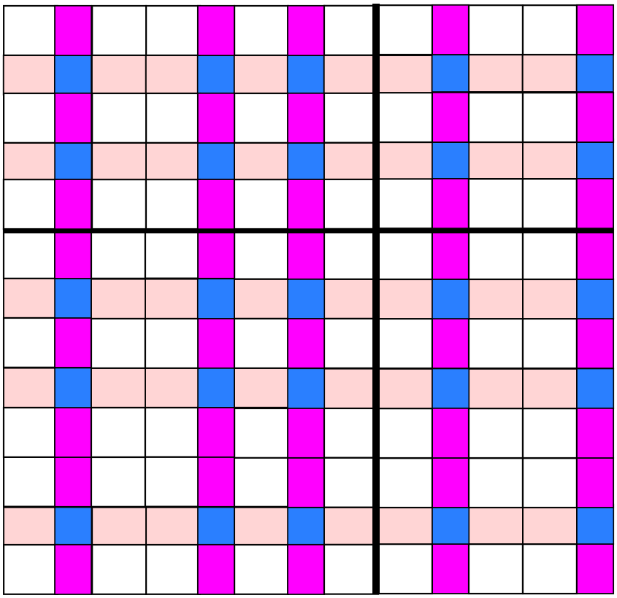
Replace-and-rescale Method
Compare level-5 tiles of the Fibonacci Direct Product (left) and the self-similar tiling (right).
Combinatorial Tiling
Self-Similar Tiling

Slide 33
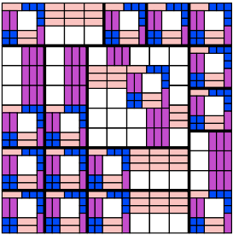
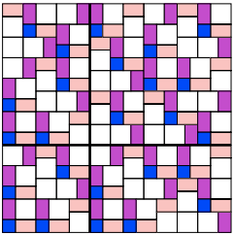
Replace-and-rescale Method
Not known whether replace-and-rescale method always works
Replace-and-rescale method works in all known examples
Self-Similar Fibonacci DPV
Self-Similar non-Pisot DPV

Slide 34
References
N.P. Frank, A primer of substitution tilings of the Euclidean plane, Expositiones Mathematicae, 26 (2008) 4, 295-386
Further Readings
R. Kenyon, B. Solomyak, On the Characterization of Expansion Maps for Self-Affine Tiling, Discrete Comput Geom, 43 (2010), 577-593

