Slide 1
Models for Quasicrystal Growth
By Gus Wheeler & Jehan Shams
Notes:
LE DEUX

Slide 2
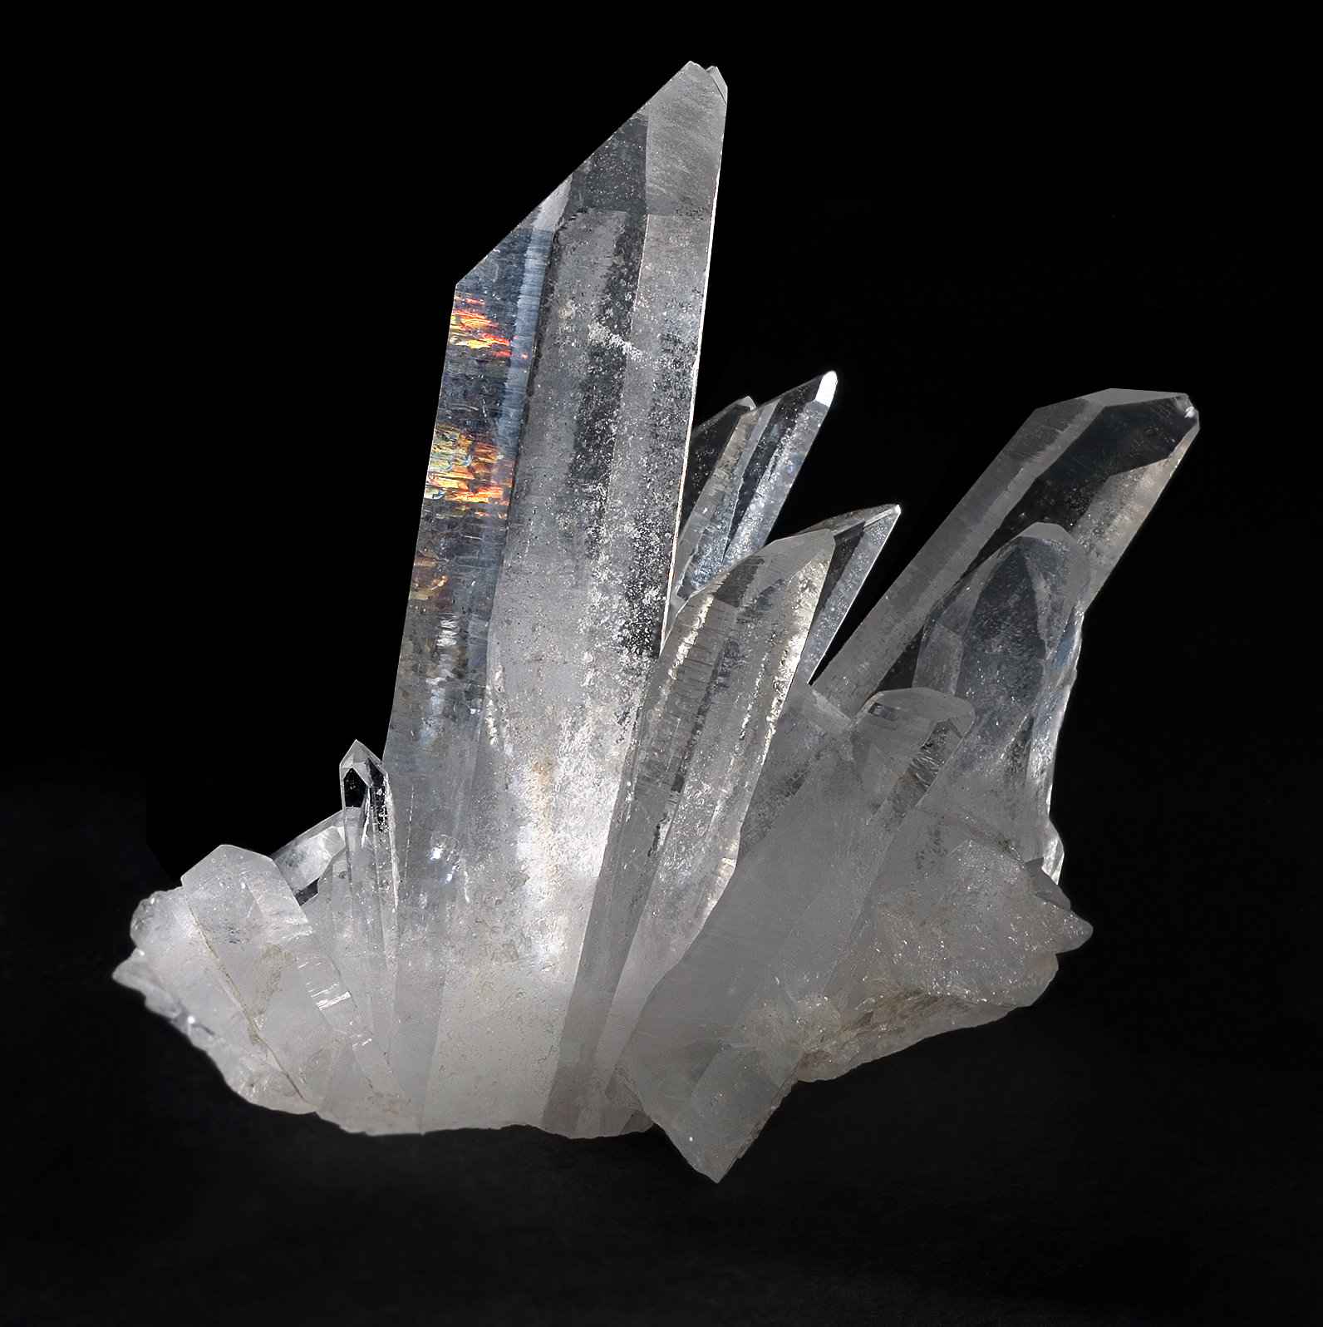
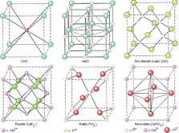
What are crystals?
Quartz Crystal
A solid with substituent atoms arranged periodically along all three dimensions
Unit Cells are the simplest repeating units that can characterize the total order of the crystal
Various Cubic Unit Cells
Notes:
JEHAN

Slide 3
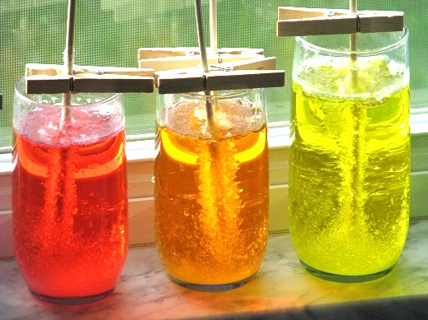
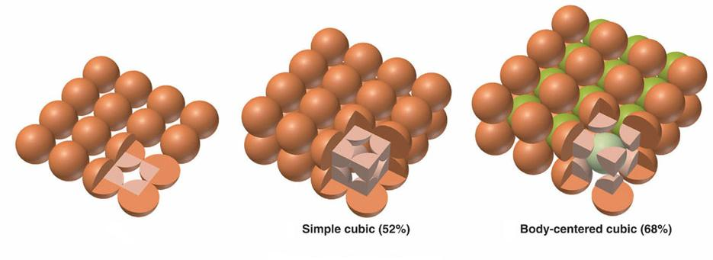
How Do Crystals Grow?
The generative step is nucleation; where a small number of atoms become arranged in a crystal lattice. A “foundation” on which additional particles deposit themselves.
Crystal Packing
Rock Candy
Notes:
JEHAN

Slide 4
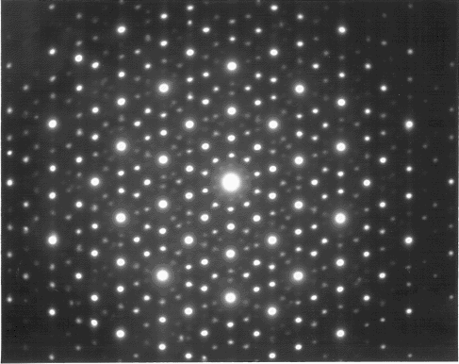
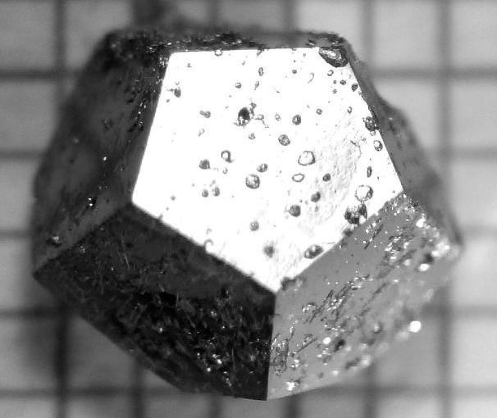
What makes a Quasicrystal Quasi?
Quasicrystals exhibit long ranged order, yet are not periodic along a number of dimensions.
Ho-Mg-Zn Quasicrystal
The OG 10-fold Diffraction Pattern
Notes:
JEHAN

Slide 5
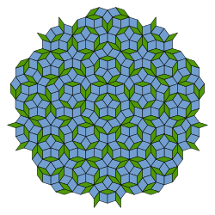
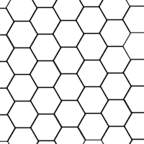
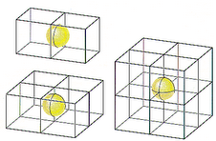
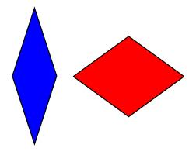
Mathematical Metaphors
Even tiling & unit cells
Penrose tiling & tiles
Notes:
GUSS

Slide 6
Two Leading Models
Deterministic models assume quasicrystals are energetically stable.
Stochastic models assume quasicrystals are stable due to entropic contributions.
Notes:
BRO-FIST

Slide 7
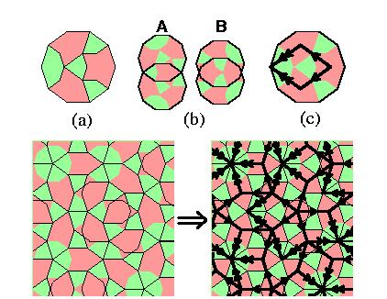
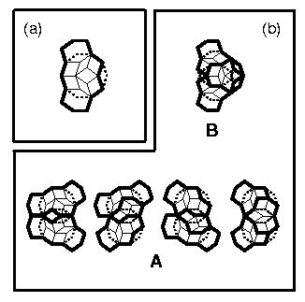
Deterministic
Models
Deterministic models rely on matching rules to determine how the “tiles” attach to the crystalline nucleus, and to ensure quasiperiodicity.
(a)Decagonal tile with colored overlapping rule.
(b) Permitted overlap
(c) inscribed and oriented fat Penrose rhombus
C-cluster
Notes:
GUSS

Slide 8
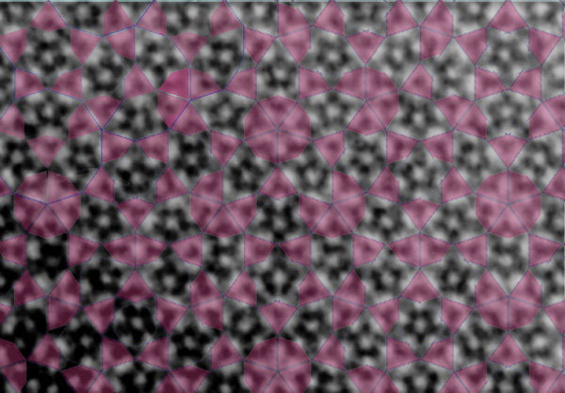
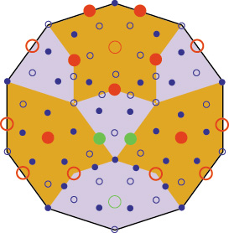
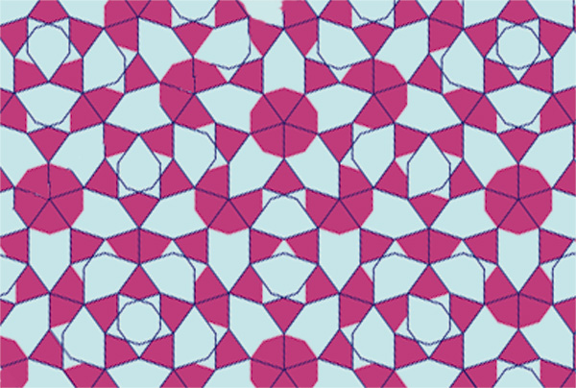
A candidate model for atomic decoration of the decagonal tile
High Angle Annular Dark Field lattice image of Al₇₂Ni₂₀Co₈ with overlaid decagon tiling
Large circles represent Ni (red) or Co (purple) and small cicles Al. The structure has two distinct layers along the periodic “c-axis” solid cirlces represent c=0 and open cirlces c=.5

Slide 9
Deterministic problems
Many models are highly restricted to specific quasicrystals. Such models lack overarching “unit cell” geometries
“It appears impossible to grow ideal quasiperiodic structures by purely local algorithms without incorporating a certain amount of defects” – Grimm & Joseph, 1999
Notes:
GUSS

Slide 10
Stochastic Models
Stochastic models dictate that tiles attach to the nucleus in accordance with some probability.
No matching rules are needed, instead each tile is geometrically constrained by the placement of neighboring tiles.
Notes:
JEHAN

Slide 11
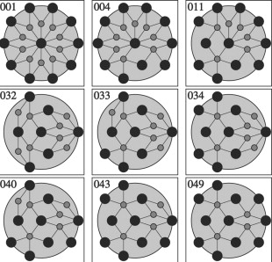
Stochastic Problems
Stochastic models tend to deviate from the desired random tiling because of the phenomenon of phason strain.
Phason strain over time
Notes:
JEHAN

Slide 12

EVENT HORIZON TIME
“[the] two-dimensional tiling results can most readily be applied to decagonal quasicrystals which have periodcally spaced layers with Penrose tiling structure. The extension to three-dimensional icosahedral symmetry is a future challenge” – Steinhardt & Jeong (1996)
“If the quasicrystals are grown slowly, then thermodynamic relaxation to the ground state is possible …some of the most perfect quasicrystals, …are formed by rapid quenching. [reasearchers] suggested a similar mechanism for overlapping clusters [which] allows random tilings” – Steinhardt
Notes:
GUS

Slide 13

BiBLiOGRAPHY
And image sources
Grimme, Uwe and Joseph Dieter, “Modeling Quasicrystal Growth.” (1999)
Keys, Aaron S. and Sharon C. Glotzer, “How do Quasicrystals Grow?” Phys. Rev. (2007)
Steinhardt, P.J. and H.-C. Jeong, Nature 392, 433 (1996)
Steinhardt, P.J. and H.-C. Jeong, Phys. Rev. (1997)
Steinhardt, Paul J. “A New Paradigm for the structure of Quasicrystals”, www.physics.princeton.edu/~steinh/quasi/ (3/30/13)
JCrystalSoft Inc. “Quasicrystals” www.jcrystal.com/steffenweber/qc.html (3/29/13)
Notes:
NADA

