Slide 1

Block Isoperimetric problems
What do math and Legos™ have in common? Whales.
Notes:
THANK YOU AND WE ARE SO EXCITED TO SHARE OUR RESEARCH AND BE APART OF THE 2013 JOINT MATH MEETINGS
CASEY AND HIS WHALE SHIRT STORY

Slide 2
Our Research Problem
Using Legos™, what is the smallest perimeter that will enclose a given area?

Slide 3
Historical motivation
Our Research Problem
Background Information
Whale Theorem Proof
Hydropronic Sequence
Future Work

Slide 4
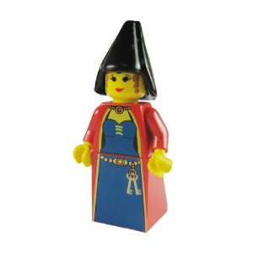
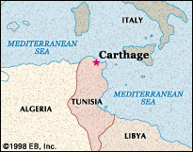
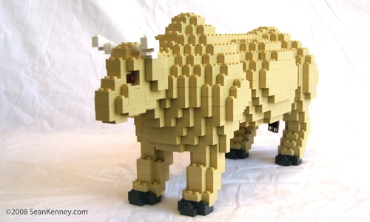
Queen Dido
Notes:
Queen of Carthage needed refuge.
Proposed to have as much land as an ox’s hide could surround.
In doing so, she cut thin stripes and arranged them to form of a circumference of a circle.
The most area given a fixed perimeter is a circle.
Adaptations of this problem are now known as isoperimetric problems.
Inspired by Queen Dido and her arrangement with the Royalty of Northern Africa, isoperimetric problems deal with the greatest area given a specified perimeter.
Block isoperimetric problems work within the restrictions of a Lego™ plane – meaning that our geometries are constructed only with straight lines.
This is what the 2010 REU group researched.

Slide 5

Previous Work
Maximum area is always square or pronic.
Perimeter is always even.
Conclusion: A square or a square-like rectangle has the greatest amount of area.
Notes:
*describe pronic
*p is perimeter MA is maximum area

Slide 6
Relations Between The Projects
They maximized area given a specified perimeter. We wanted to minimize perimeter given a specified area.
Research Question: Given a specified area, what is the most efficient way to enclose that given area?
Notes:
Taking the previous groups work into consideration, we decided to work with the reverse of their problem.

Slide 7



Definitions!
Lego™ Curve: a single continuous arrangement of 1x1 blocks such that each block has exactly two neighbors. *
Neighbor: a block that occupies the space adjacent to another block in one of the four cardinal directions along the grid. *
* Referenced from work of: Bower, Espinoza, Green, Roca, and Townsend

Slide 8




Improper LegoTM Curves

Slide 9
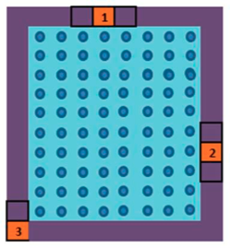
Definitions!
Perimeter: the number of blocks used to create a Lego™ curve. (Reminder: Perimeters are always even)
Area: the number of studs enclosed by a Lego™ curve.

Slide 10
Whale Theorem
Our Research Problem
Background Information
Whale Theorem Proof
Hydropronic Sequence
Future Work

Slide 11

The Whale Theorem
Using Legos™, what is the smallest perimeter needed to enclose a specified area?
Notes:
We have proved that P(A) gives the minimum perimeter for all natural integers. Let me take you through an outline of proof.

Slide 12
Proof
Our Research Problem
Background Information
Whale Theorem Proof
Hydropronic Sequence
Future Work
Notes:
Rather than looking at the algebra, we will look at visual representations of significant points in the proof.

Slide 13
Arrangement of Blocks
Area: 45
Next Square or Pronic: 49
Notes:
We came up with an algorithm that produces a perimeter and describes how to arrange area blocks as well as the lego curve that uses to the perimeter produced by P(A). Take examples- A :45
1) Go to the next square or pronic

Slide 14
Arrangement of Blocks
Area: 45
Next Square or Pronic: 49

Slide 15
Arrangement of Blocks
Area: 45
Next Square or Pronic: 49

Slide 16
Arrangement of Blocks
Area: 45
Next Square or Pronic: 49

Slide 17
Arrangement of Blocks
Area: 45
Next Square or Pronic: 49

Slide 18
Arrangement of Blocks
Area: 45
Next Square or Pronic: 49

Slide 19
Arrangement of Blocks
Area: 45
Next Square or Pronic: 49

Slide 20
Arrangement of Blocks
Area: 45
Next Square or Pronic: 49

Slide 21

Non Square & Non Pronic Formula
In order to find the next possible square or pronic use this formula:
Examples:
  A = 8
  A = 2012

Slide 22
Examples
A = 8
A = 2012
Notes:
Say 9 is 3 x 3
2025 = 45 x 45

Slide 23
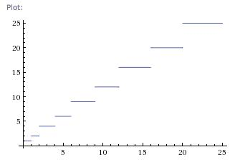
Graph of:
Next Square or Pronic
Desired Area to Enclose
Notes:
This is a visual representation of how A* produces the next square or pronic

Slide 24
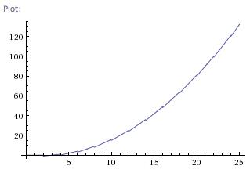
Graph of:
Area
Perimeter
Notes:
MA(P(A)-2) is < A when A* is square
MA(P(A)-2) is < A when A* is pronic

Slide 25
HYDRoPRONIC Numbers
Our Research Problem
Background Information
Whale Theorem Proof
Hydropronic Numbers
Future Work

Slide 26
Hydropronic Numbers
A number that is not square or pronic and can be arranged as a rectangle using its two closest factors to maintain minimum perimeter.
3, 8, 10, 15, 18, 21, 24, 28, 32, 35, 40, 45…etc
Notes:
If time, ask if they want to guess the next few

Slide 27
Hydropronic Numbers
Example: A = 24
  Factors: 1, 2, 3, 4, 6, 8, 12, 24
  Arrange a rectangle of 6 x 4

Slide 28
Hydropronic
Area: 24
Hydropronic: 6 x 4 (24)
Notes:
8 blocks on top
8 blocks on bottom
4 blocks on both sides = 24 blocks total. The same number of blocks as the whale theorem

Slide 29
Whale Theorem
Area: 24
Next Square or Pronic: 5 x 5 (25)

Slide 30
Optimal Perimeters for Area = 24
Notes:
Whale Conjecture on your left
Hydropronic arrangement on your right

Slide 31
Finding Hydropronic Numbers
Notes:
A_k is the largest smaller than A, while A* is the smallest larger than A
A* is proved, A_k is just A* with the second (x+1) factor -1(basically proven)
Also introduced the two qualifications of hydropronics here

Slide 32
WhaLego Sequence
Numbers that can be arranged as rectangles and maintain the minimum perimeter are in the WhaLego sequence. All of these numbers can be classified as square, pronic, or hydropronic.
The first few numbers in this sequence are:
1, 2, 3, 4, 6, 8, 9, 10, 12, 15, 16, 18, 20, 21…etc
Notes:
Ask them what each color represents.
Red – square
Blue – pronic
Purple – hydropronic

Slide 33
Future work & References
Our Research Problem
Background Information
Whale Theorem Proof
Hydropronic Numbers
Future Work

Slide 34
Future Work
Furthering Hydropronic Sequence
  Finding a generating formula
Lego Double Bubble Problem
  Enclosing two areas
  WhaLego sequence shows up
3-Dimensional Spaces

Slide 35
References
Brower, T.; Espinoza, J.; Green, A.; Roca, A.; Townsend, B. LEGOTM Isoperimetric Problem, preprint (2010).
Capogna, L.; Donatella, D.; Pauls, S.; Tyson, J. An Introduction to the Heisenberg Group and the Sub-Riemannian Isoperimetric Problem, 1st ed., Birkhauser Verlag AG, Basel, Boston, 2007.

Slide 36
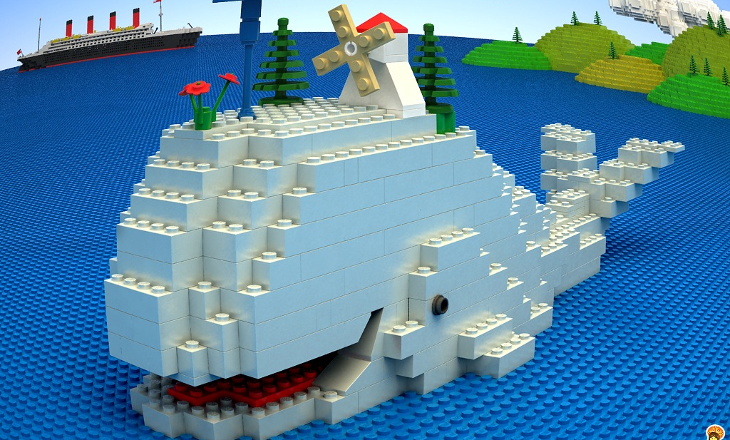

Questions?
Special thanks to the National Science Foundation (DMS- 1005046), Dr. Casey Douglas, and the St. Mary’s College of Maryland Department of Mathematics and Computer Science.

