Slide 1
The {4,6|4} Coxeter-Petrie Sponge
Kaison Tanabe

Slide 2
The Basics
Regular polygons and polyhedra

Slide 3
15 Regular Polyhedron
9 Finite
  5 Platonic (convex, regular)
  4 Star Kepler-Poinsot solids (concave, semi-regular)
6 Infinite
  3 plane-fillings
  3 sponges

Slide 4
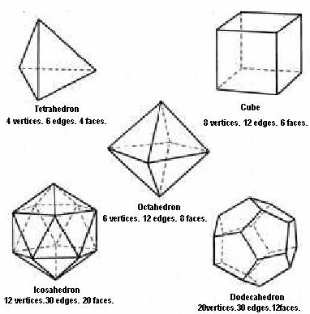
Platonic Solids

Slide 5
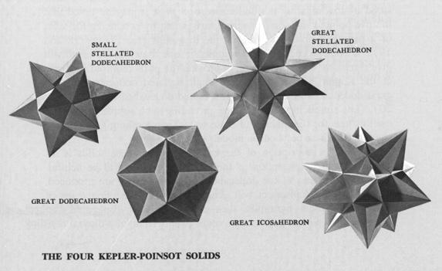
Kepler-Poinsot Polyhedra

Slide 6
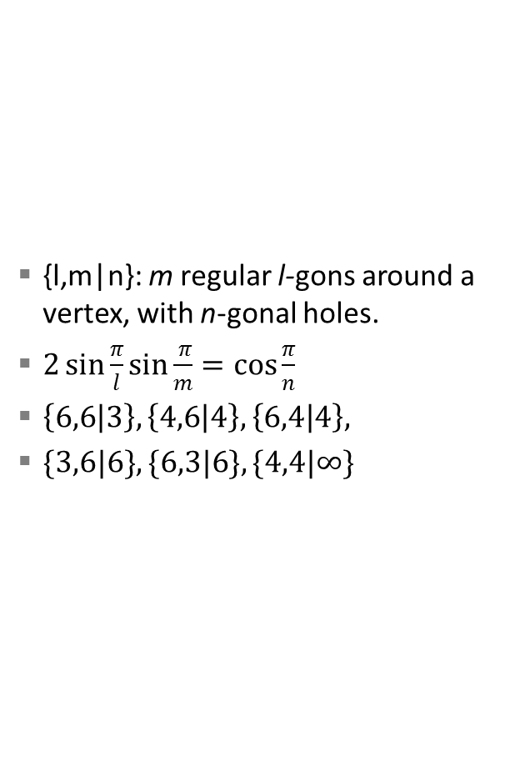
Regular Skew Polyhedron
{l,m|n}: m regular l-gons around a vertex, with n-gonal holes.
$2\sin{\frac{π}{l}}\sin{\frac{ π}{m}=\cos{\frac{π}{n}}}$
$\left\{6,6 | 3\right\}, \left\{4,6 | 4\right\}, \left\{6,4 | 4\right\},$
$\{3,6|6\}, \{6,3|6\}, \{4,4|∞\}$

Slide 7


{6,4|4}

Slide 8
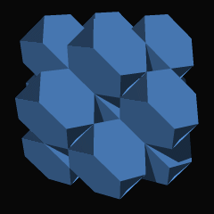

{6,6|3}

Slide 9
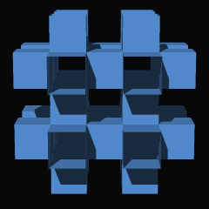

{4,6|4}

