Slide 1


Using Origami to Find
Rational Approximations of Irrational Roots
Jeremy Lee
Amherst Regional High School
Hudson River Undergraduate Mathematics Conference
Williams College
April 6th, 2013

Slide 2


Origami Instructions

Slide 3
Folding paper allows us to find rational approximations of the square root of two.

Slide 4


Origami Instructions
Side Unit fits Diagonal Once with remainder.

Slide 5
Origami Instructions
Side Unit fits Diagonal Once with remainder.
Remainder fits side unit twice with remainder₂ space

Slide 6
Origami Instructions
Side Unit fits Diagonal Once with remainder.
Remainder fits side unit twice with remainder₂ space
Remainder₂ fits Remainder unit twice with Remainder₃ left over.

Slide 7
Summary of Origami Exercise
As we keep doing the exercise, you always get the number two after the first step. The next remainder will fit into previous remainder twice again.

Slide 8
Summary of Origami Exercise
All these approximations of the square root of two come from the continued fractions representation of the square root of two.

Slide 9
Continued Fractions Method

Slide 10
Continued Fractions Method

Slide 11
Continued Fractions Method

Slide 12
Continued Fractions Method

Slide 13
Continued Fractions Method
There will be twos continuing throughout the fraction after one.

Slide 14
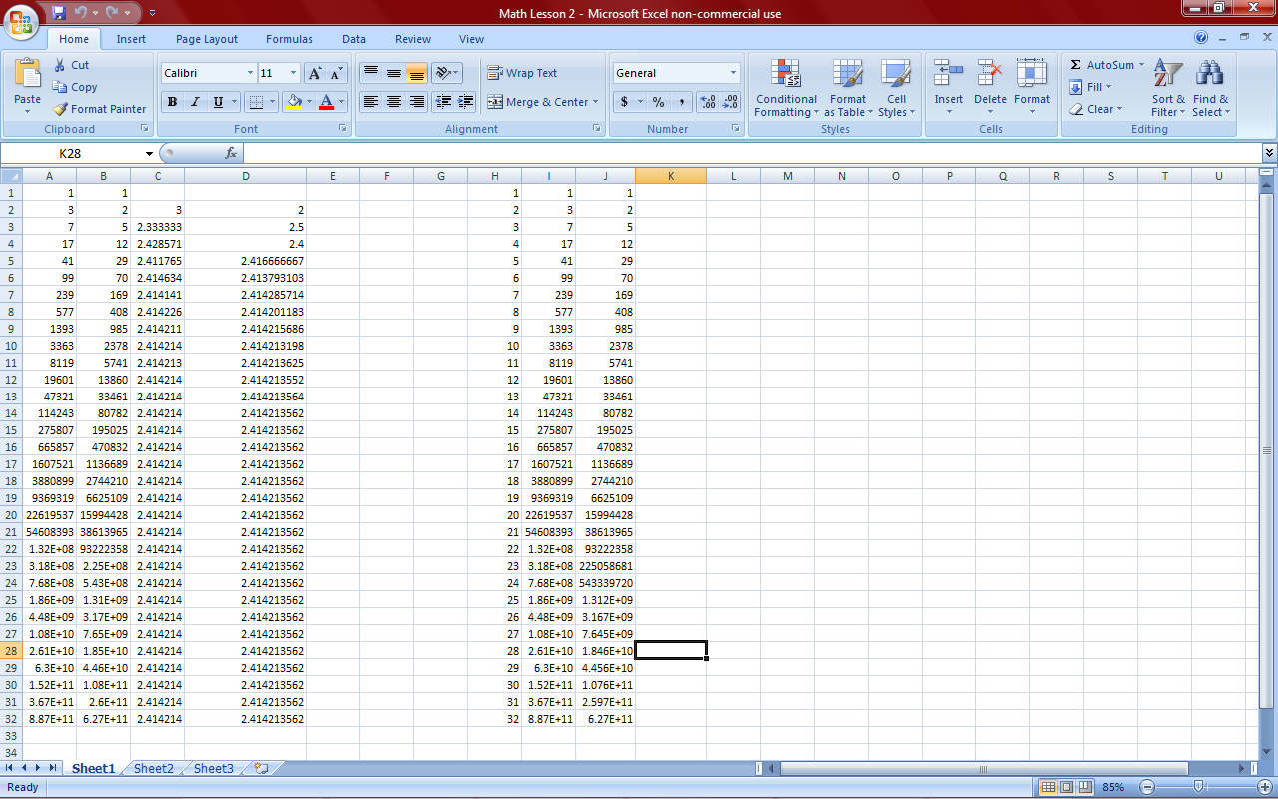
How to Use Continued Fractions to Build Approximations
h_{i} k_{i}

Slide 15
Rational Approximations Of the Square Root of Two
h_{i} k_{i}

Slide 16
Denoting Parts of the Square Root of Two
Continued Fraction
Let Big Box equal x
What does the big box converge to?

Slide 17
Algebra that Continued Fractions
Converges to the Square Root of Two
Why does the answer have to be ?
Assuming that this continued fraction converges, that is what x converges to.
Therefore the continued fraction equals the square root of 2.

Slide 18
The Babylonian Method
Let’s try it with the square root of 2
Have x₀ equal 1, our first approximate.

Slide 19
Algebra that Babylonian Method
Converges to the Square Root of Two
The reason why x is positive is because if the Babylonian Method converges , the result is what it will converge to.
If x is negative then the result is the negative square root of two.
There is a wonderful blog entry that is focused on the Babylonian Method and how it works with the square root of two.
http://johncarlosbaez.wordpress.com/2011/12/02/babylon-and-the-square-root-of-2/

Slide 20
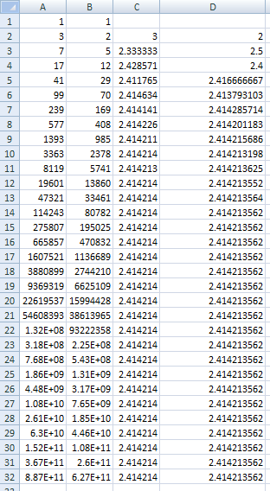
h_{i} k_{i} h_{i+1}/h_{i} k_{i+1}/k_{i}
What are the explicit formulas for each the numerator and the denominator of all rational approximations of the square root of two?
There is almost a common ratio between consecutive numerators of the rational approximations. There is almost a common ratio between consecutive denominators of the rational approximations. The ratio is around 1 + sqrt(2) for both of these relationships.
Maybe, h_{i} and k_{i} are the sums of two geometric sequences with a common ratio of 1 + sqrt(2)

Slide 21
Rational Approximations Numerator

Slide 22

i h_{i}

Slide 23
Rational Approximations Denominator

Slide 24

i h_{i} k_{i}

Slide 25
Connection between Continued Fractions and Babylonian Method
What happens when the continued fraction approximation is put into the Babylonian Method?
This is the Babylonian Method by taking a continued fraction approximation and average it with twice its reciprocal.
The result is the continued fraction approximation of the square root of two, it’s just the number of steps of the continued fractions approximation is doubled for the Babylonian Method. You only did one step of the Babylonian Method.

Slide 26
Conclusion
We did an origami experiment that finds the same rational approximations as the continued fractions method.
We found that the continued fraction and Babylonian Methods produced the same rational approximations for the square root of two.
The Blog Entry
http://johncarlosbaez.wordpress.com/2011/12/02/babylon-and-the-square-root-of-2/

Slide 27
Conclusion
We did an origami experiment that finds the same rational approximations as the continued fractions method.
We found that the continued fraction and Babylonian Methods produced the same rational approximations for the square root of two.
Could we do something similar with Fibonacci Numbers and the Golden Ratio which has the square root of five in it?
The Blog Entry
http://johncarlosbaez.wordpress.com/2011/12/02/babylon-and-the-square-root-of-2/

