Slide 1
Composite Generating Functions
David Vella,
Skidmore College
dvella@skidmore.edu

Slide 2
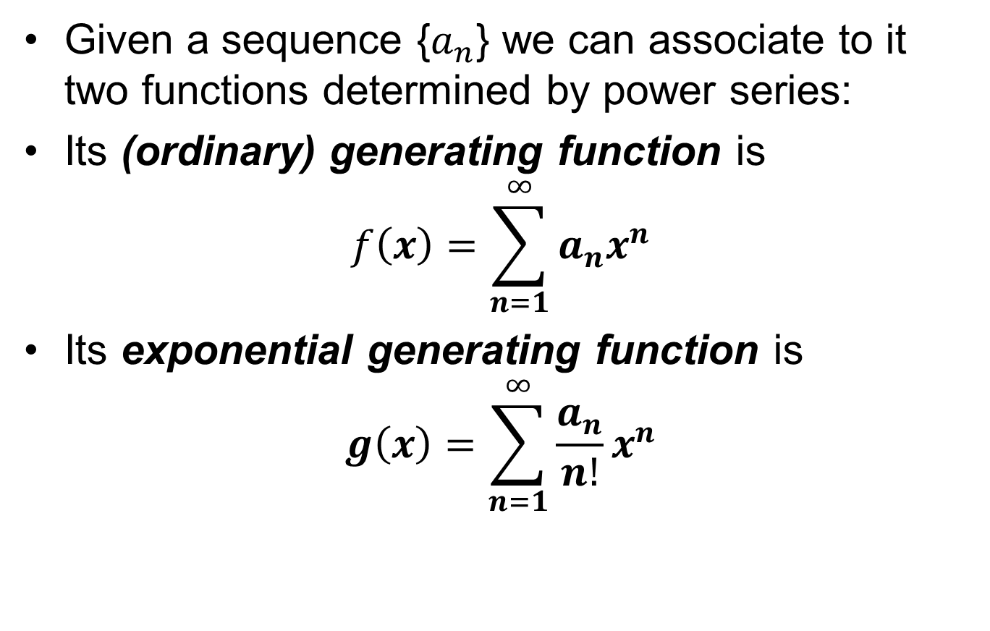
Generating Functions and
Exponential Generating Functions
Given a sequence {$a_{n}$} we can associate to it two functions determined by power series:
Its (ordinary) generating function is
$$f\left(x\right)=\sum_{n=1}^{∞}{a_{n}x^{n}}$$
Its exponential generating function is
$$g\left(x\right)=\sum_{n=1}^{∞}{\frac{a_{n}}{n!}x^{n}}$$

Slide 3
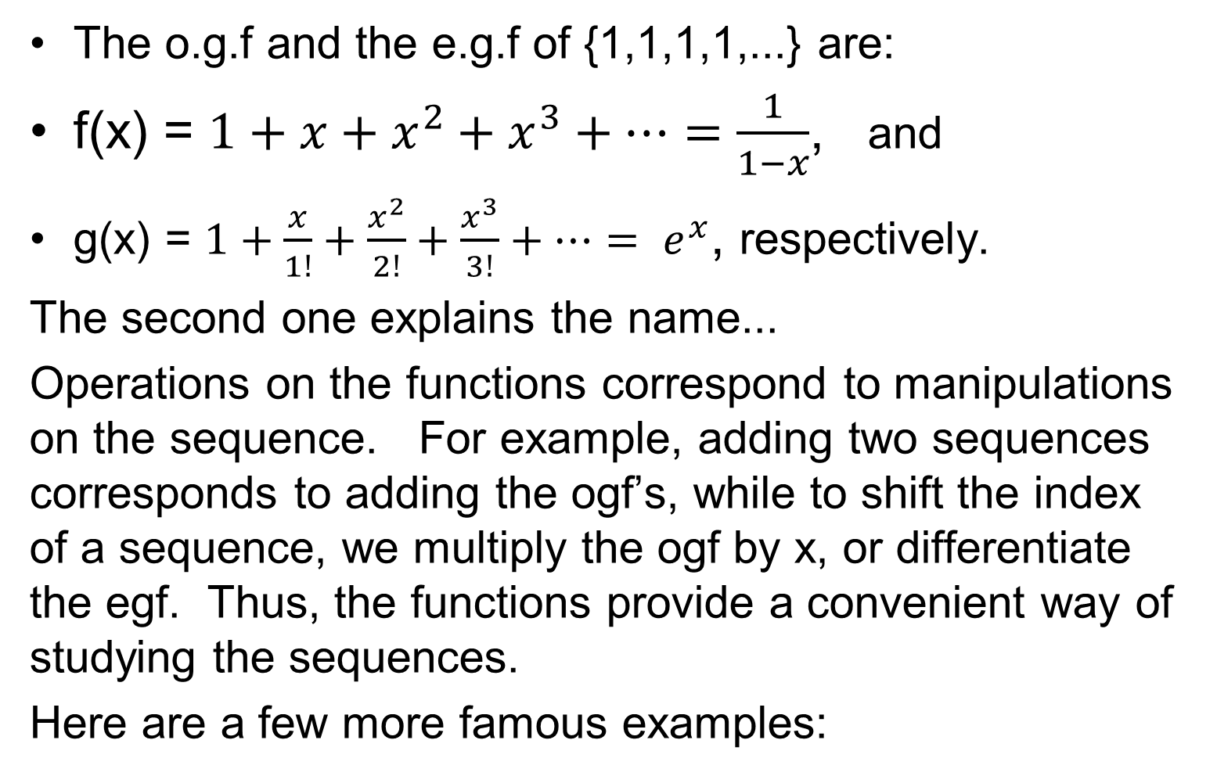
Examples
The o.g.f and the e.g.f of {1,1,1,1,...} are:
f(x) = $1+x+x^{2}+x^{3}+…=\frac{1}{1−x}$, and
g(x) = $1+\frac{x}{1!}+\frac{x^{2}}{2!}+\frac{x^{3}}{3!}+…= e^{x}$, respectively.
The second one explains the name...
Operations on the functions correspond to manipulations on the sequence. For example, adding two sequences corresponds to adding the ogf’s, while to shift the index of a sequence, we multiply the ogf by x, or differentiate the egf. Thus, the functions provide a convenient way of studying the sequences.
Here are a few more famous examples:

Slide 4
Bernoulli & Euler Numbers
The Bernoulli Numbers B_{n} are defined by the following egf:
The Euler Numbers E_{n} are defined by the following egf:

Slide 5
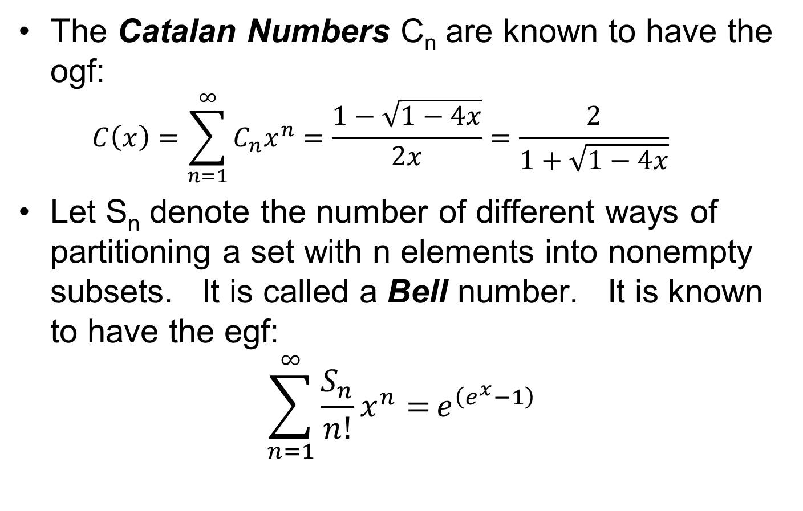
Catalan and Bell Numbers
The Catalan Numbers C_{n} are known to have the ogf:
  $$C\left(x\right)=\sum_{n=1}^{∞}{C_{n}x^{n}=\frac{1−\sqrt{1−4x}}{2x}=\frac{2}{1+\sqrt{1−4x}}}$$
Let S_{n} denote the number of different ways of partitioning a set with n elements into nonempty subsets. It is called a Bell number. It is known to have the egf:
$$\sum_{n=1}^{∞}{{\frac{S_{n}}{n!}x}^{n}=}e^{\left(e^{x}−1\right)}$$

Slide 6
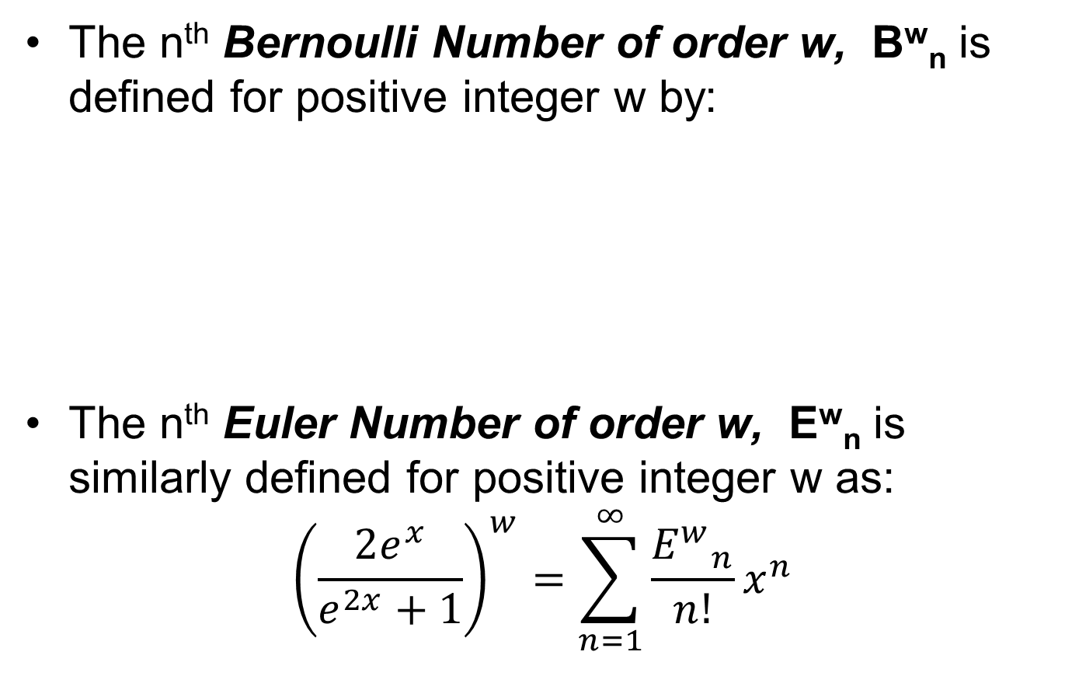
Higher Order Bernoulli and Euler Numbers
The n^{th} Bernoulli Number of order w, B^{w}_{n} is defined for positive integer w by:
The n^{th} Euler Number of order w, E^{w}_{n} is similarly defined for positive integer w as:
$${\left(\frac{2e^{x}}{e^{2x}+1}\right)}^{w}=\sum_{n=1}^{∞}{\frac{{E^{w}}_{n}}{n!}x^{n}}$$

Slide 7
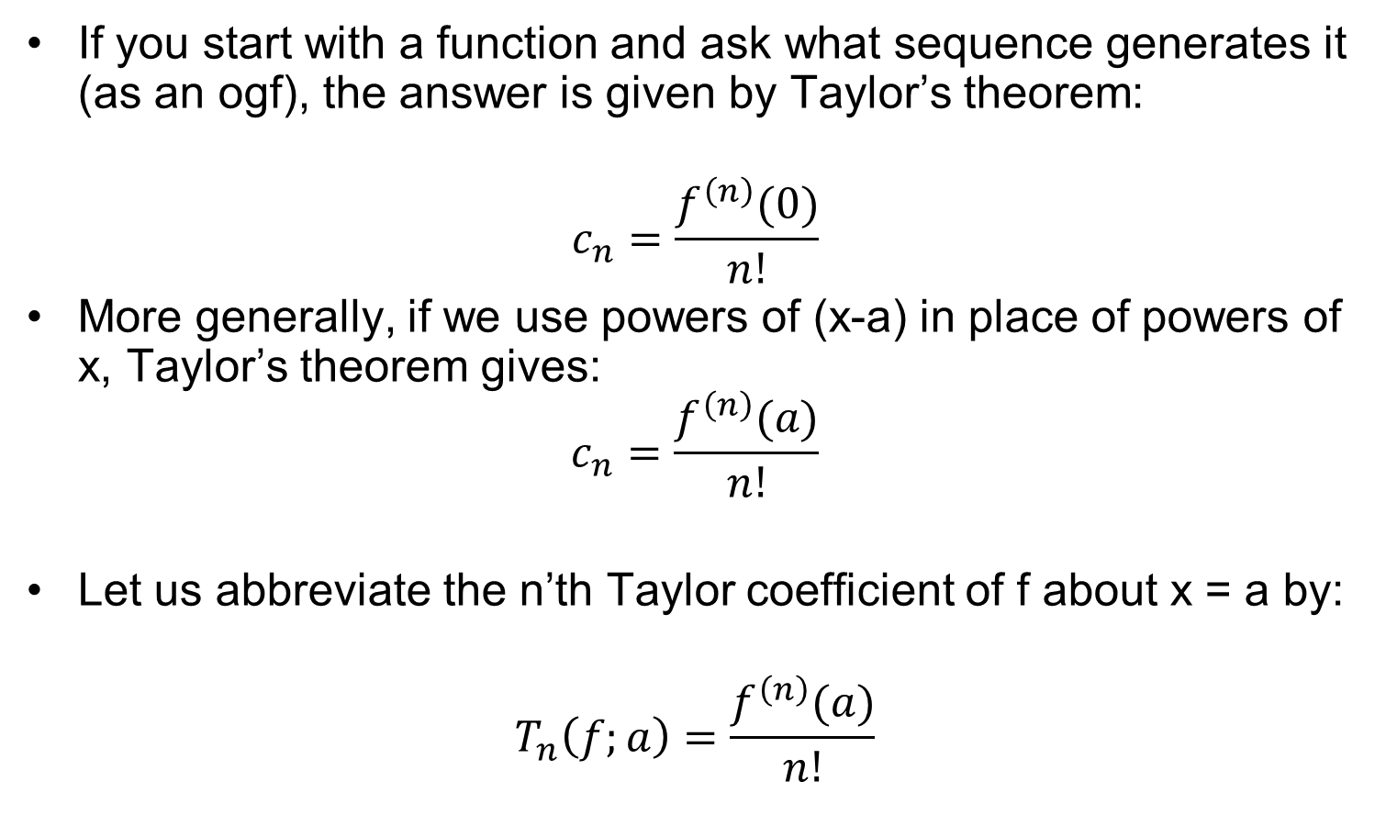
Reversing the Process
If you start with a function and ask what sequence generates it (as an ogf), the answer is given by Taylor’s theorem:
$$c_{n}=\frac{f^{\left(n\right)}(0)}{n!}$$
More generally, if we use powers of (x-a) in place of powers of x, Taylor’s theorem gives:
$$c_{n}=\frac{f^{\left(n\right)}(a)}{n!}$$
Let us abbreviate the n’th Taylor coefficient of f about x = a by:
$$T_{n}\left(f;a\right)=\frac{f^{\left(n\right)}(a)}{n!}$$

Slide 8
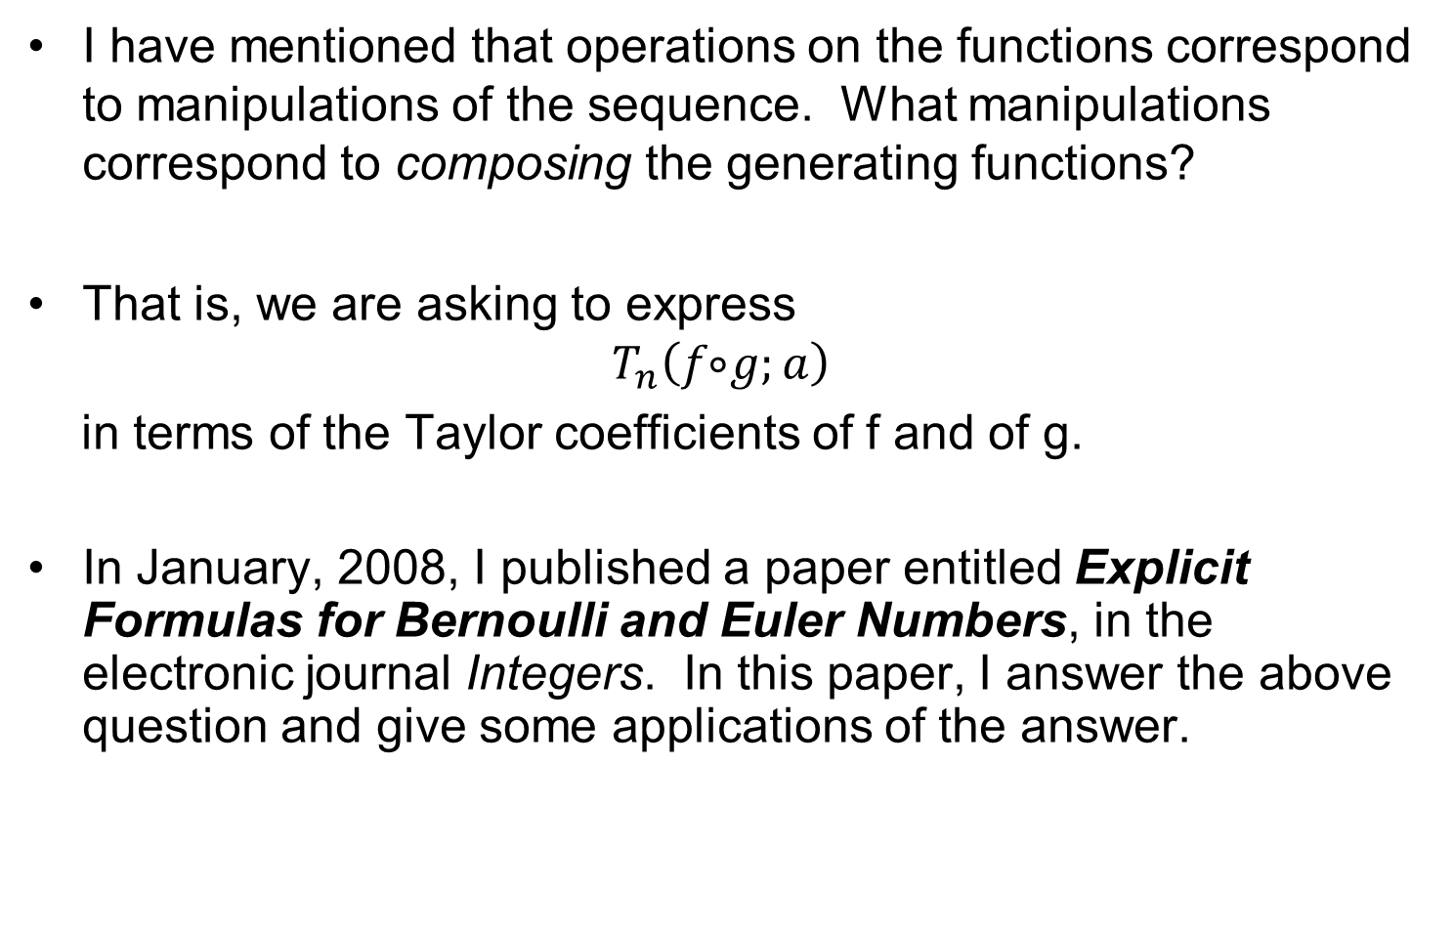
A Key Question
I have mentioned that operations on the functions correspond to manipulations of the sequence. What manipulations correspond to composing the generating functions?
That is, we are asking to express
$$T_{n}\left(f ⃘g;a\right)$$
in terms of the Taylor coefficients of f and of g.
In January, 2008, I published a paper entitled Explicit Formulas for Bernoulli and Euler Numbers, in the electronic journal Integers. In this paper, I answer the above question and give some applications of the answer.

Slide 9
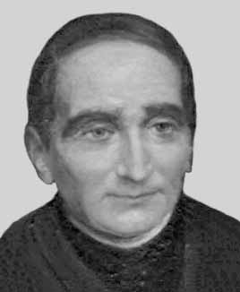
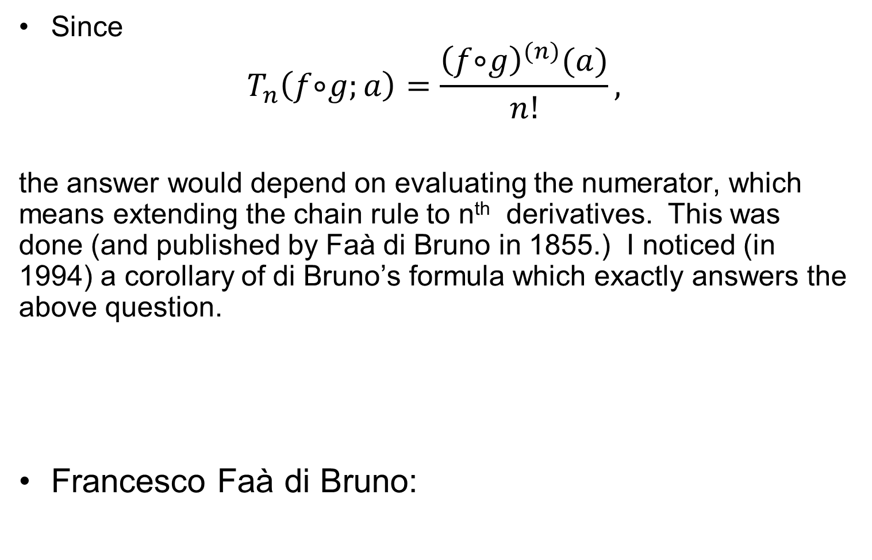
A Key Answer
Since
$$T_{n}\left(f ⃘g;a\right)=\frac{{\left(f ⃘g\right)}^{(n)}(a)}{n!},$$
the answer would depend on evaluating the numerator, which means extending the chain rule to n^{th} derivatives. This was done (and published by Faà di Bruno in 1855.) I noticed (in 1994) a corollary of di Bruno’s formula which exactly answers the above question.
Francesco Faà di Bruno:

Slide 10
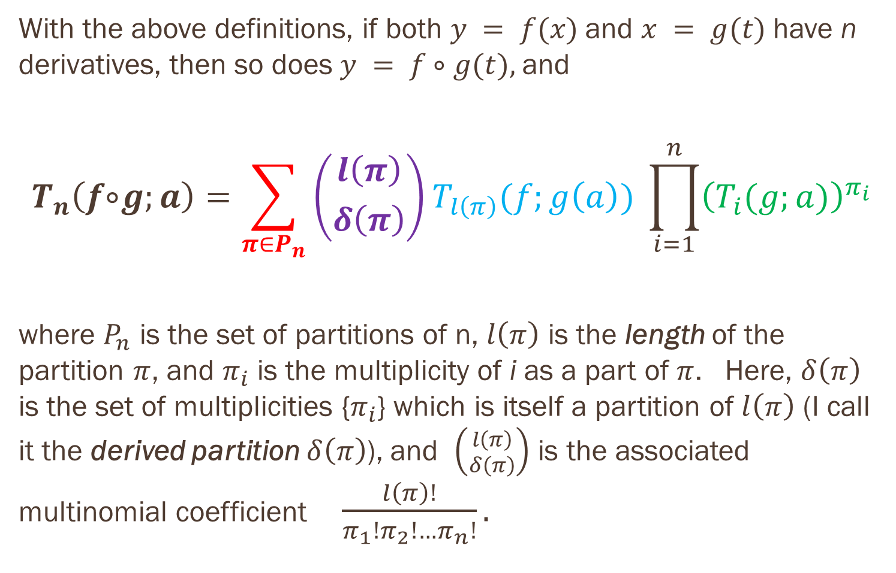
The Main Result
With the above definitions, if both $y = f(x)$and $x = g(t)$have n derivatives, then so does $y = f ⃘ g(t),$and
$$T_{n}\left(f ⃘g;a\right)=\sum_{π∈P_{n}}{\left({l\left(π\right) \atop δ\left(π\right)}\right)}T_{l\left(π\right)}(f;g\left(a\right)) \prod_{i=1}^{n}{{\left(T_{i}(g;a)\right)}^{π_{i}}}$$
where $P_{n}$ is the set of partitions of n, $l\left(π\right)$ is the length of the partition $π$, and $π_{i}$ is the multiplicity of i as a part of $π$. Here, $δ\left(π\right)$ is the set of multiplicities {$π_{i}$} which is itself a partition of $l\left(π\right)$ (I call it the derived partition $δ\left(π\right)$), and $\left({l\left(π\right) \atop δ\left(π\right)}\right)$ is the associated multinomial coefficient $\frac{l\left(π\right)!}{π_{1}!π_{2}!…π_{n}!}.$

Slide 11
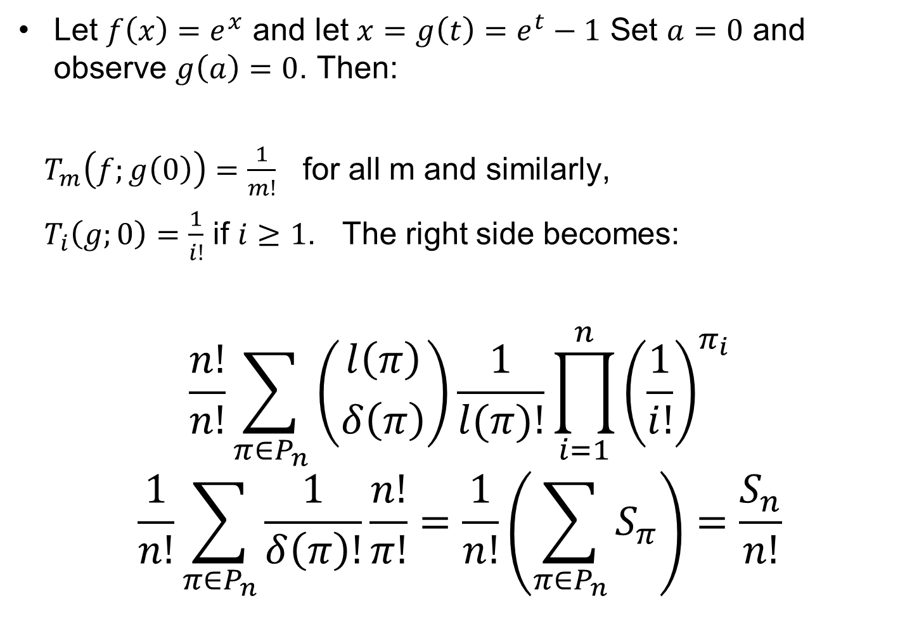
Illustration – How to use this machine
Let $f\left(x\right)=e^{x}$ and let $x=g\left(t\right)=e^{t}−1$ Set $a=0$ and observe $g\left(a\right)=0$. Then:
$T_{m}\left(f;g\left(0\right)\right)=\frac{1}{m!}$ for all m and similarly,
$T_{i}\left(g;0\right)=\frac{1}{i!}$ if $i≥1$. The right side becomes:
$$\frac{n!}{n!}\sum_{π∈P_{n}}{\left({l\left(π\right) \atop δ\left(π\right)}\right)}\frac{1}{l(π)!}\prod_{i=1}^{n}{{\left(\frac{1}{i!}\right)}^{π_{i}}}$$
$$\frac{1}{n!}\sum_{π∈P_{n}}{\frac{1}{δ\left(π\right)!}}\frac{n!}{π!}=\frac{1}{n!}\left(\sum_{π∈P_{n}}{S_{π}}\right)=\frac{S_{n}}{n!}$$

Slide 12
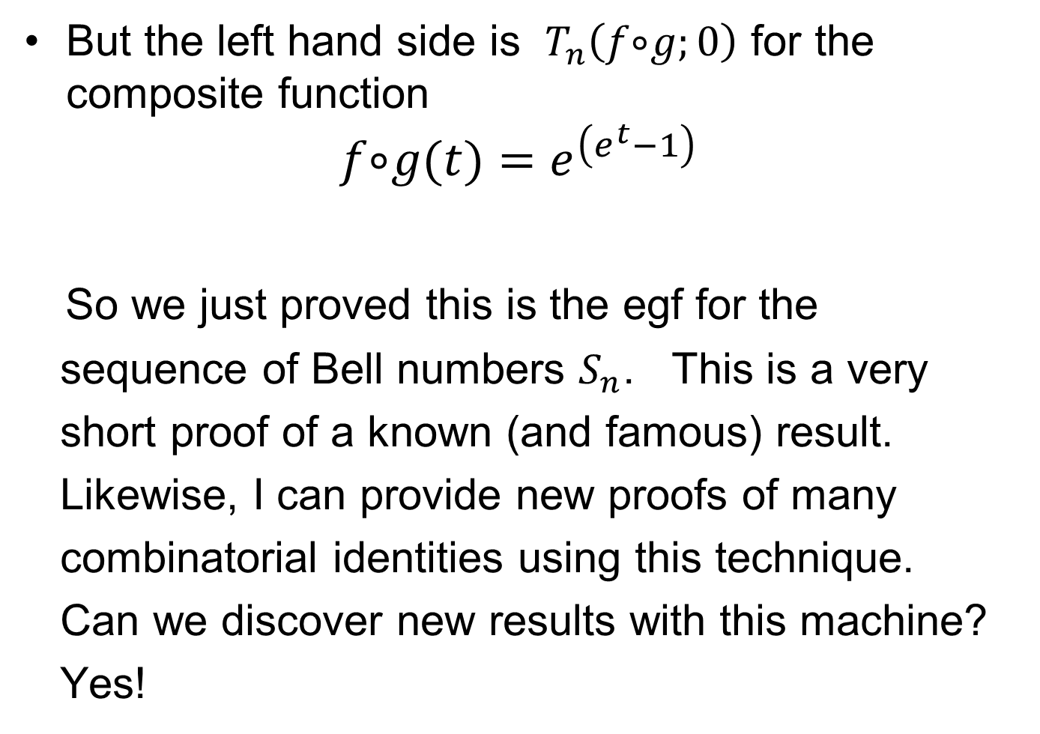
Illustrations, continued
But the left hand side is $T_{n}\left(f ⃘g;0\right)$ for the composite function
$$f ⃘g(t)=e^{\left(e^{t}−1\right)}$$
So we just proved this is the egf for the
sequence of Bell numbers $S_{n}$. This is a very
short proof of a known (and famous) result.
Likewise, I can provide new proofs of many
combinatorial identities using this technique.
Can we discover new results with this machine?
Yes!

Slide 13
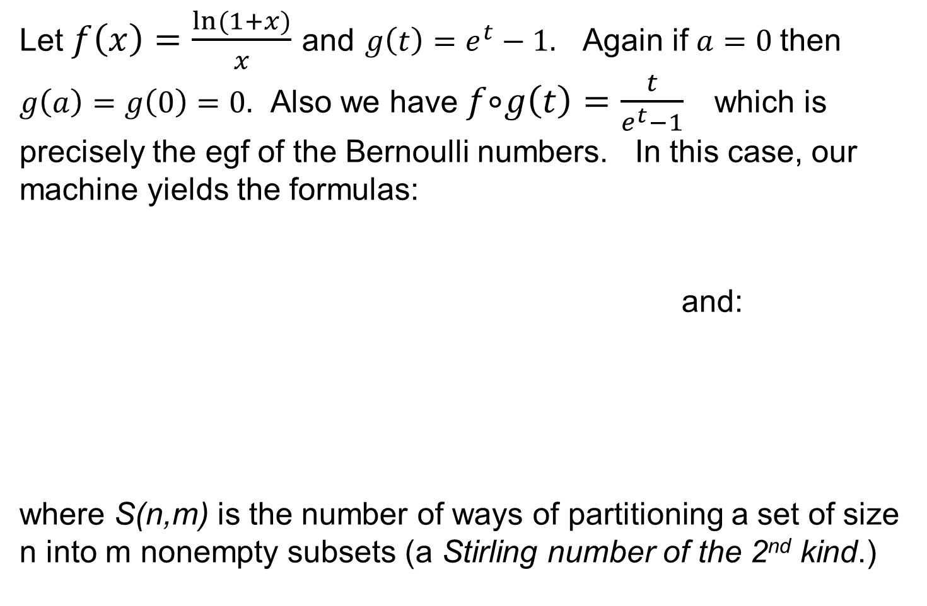
Illustrations, continued
Let $f\left(x\right)=\frac{ln(1+x)}{x}$ and $g\left(t\right)=e^{t}−1.$ Again if $a=0$then $g\left(a\right)=g\left(0\right)=0.$ Also we have $f ⃘g\left(t\right)=\frac{t}{e^{t}−1}$ which is precisely the egf of the Bernoulli numbers. In this case, our machine yields the formulas:
and:
where S(n,m) is the number of ways of partitioning a set of size n into m nonempty subsets (a Stirling number of the 2nd kind.)

Slide 14
Illustrations, continued
This was published in my 2008 paper, along with similar formulas for Euler numbers.
These formulas can be generalized in at least two ways:
Express the higher order Bernoulli numbers in terms of the usual Bernoulli numbers, since the egf for them is obviously a composite. Similarly for the higher order Euler numbers. This result is still unpublished (but I spoke at HRUMC a couple of years ago about it.)
Generalize my corollary of di Bruno’s formula to the multivariable case. (The next talk is about this in the case of multivariable Bernoulli numbers!)
For the remainder of this talk, I’d like to focus on one case where the identity I obtain from my machine is not obviously useful (or is it?)

Slide 15
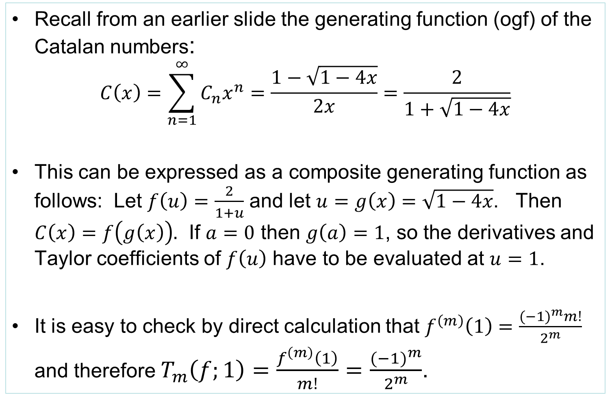
Final Example: the Catalan numbers
Recall from an earlier slide the generating function (ogf) of the Catalan numbers:
  $$C\left(x\right)=\sum_{n=1}^{∞}{C_{n}x^{n}=\frac{1−\sqrt{1−4x}}{2x}=\frac{2}{1+\sqrt{1−4x}}}$$
This can be expressed as a composite generating function as follows: Let $f\left(u\right)=\frac{2}{1+u}$ and let $u=g\left(x\right)=\sqrt{1−4x}$. Then $C\left(x\right)=f\left(g\left(x\right)\right).$ If $a=0$ then $g\left(a\right)=1$, so the derivatives and Taylor coefficients of $f\left(u\right)$ have to be evaluated at $u=1$.
It is easy to check by direct calculation that $f^{\left(m\right)}\left(1\right)=\frac{{(−1)}^{m}m!}{2^{m}}$ and therefore $T_{m}\left(f;1\right)=\frac{f^{\left(m\right)}\left(1\right)}{m!}=$ $\frac{{(−1)}^{m}}{2^{m}}$.

Slide 16
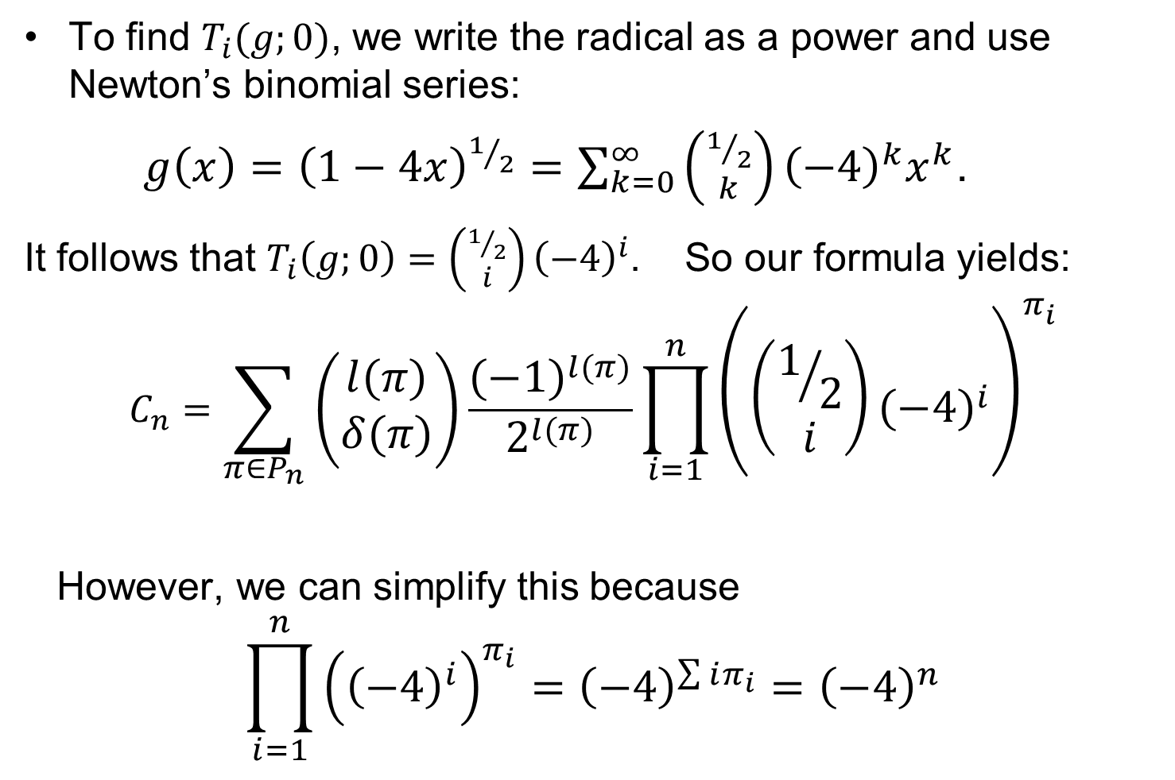
Catalan numbers, continued
To find $T_{i}(g;0)$, we write the radical as a power and use Newton’s binomial series:
$g\left(x\right)={\left(1−4x\right)}^{1/2}=\sum_{k=0}^{∞}{\left({1/2 \atop k}\right){\left(−4\right)}^{k}x^{k}}$.
It follows that $T_{i}\left(g;0\right)=\left({1/2 \atop i}\right){\left(−4\right)}^{i}$. So our formula yields:
$$C_{n}=\sum_{π∈P_{n}}{\left({l\left(π\right) \atop δ\left(π\right)}\right)}\frac{{\left(−1\right)}^{l(π)}}{2^{l(π)}}\prod_{i=1}^{n}{{\left(\left({1/2 \atop i}\right){\left(−4\right)}^{i}\right)}^{π_{i}}}$$
However, we can simplify this because
$$\prod_{i=1}^{n}{{\left({\left(−4\right)}^{i}\right)}^{π_{i}}={\left(−4\right)}^{\sum{iπ_{i}}}={\left(−4\right)}^{n}}$$

Slide 17
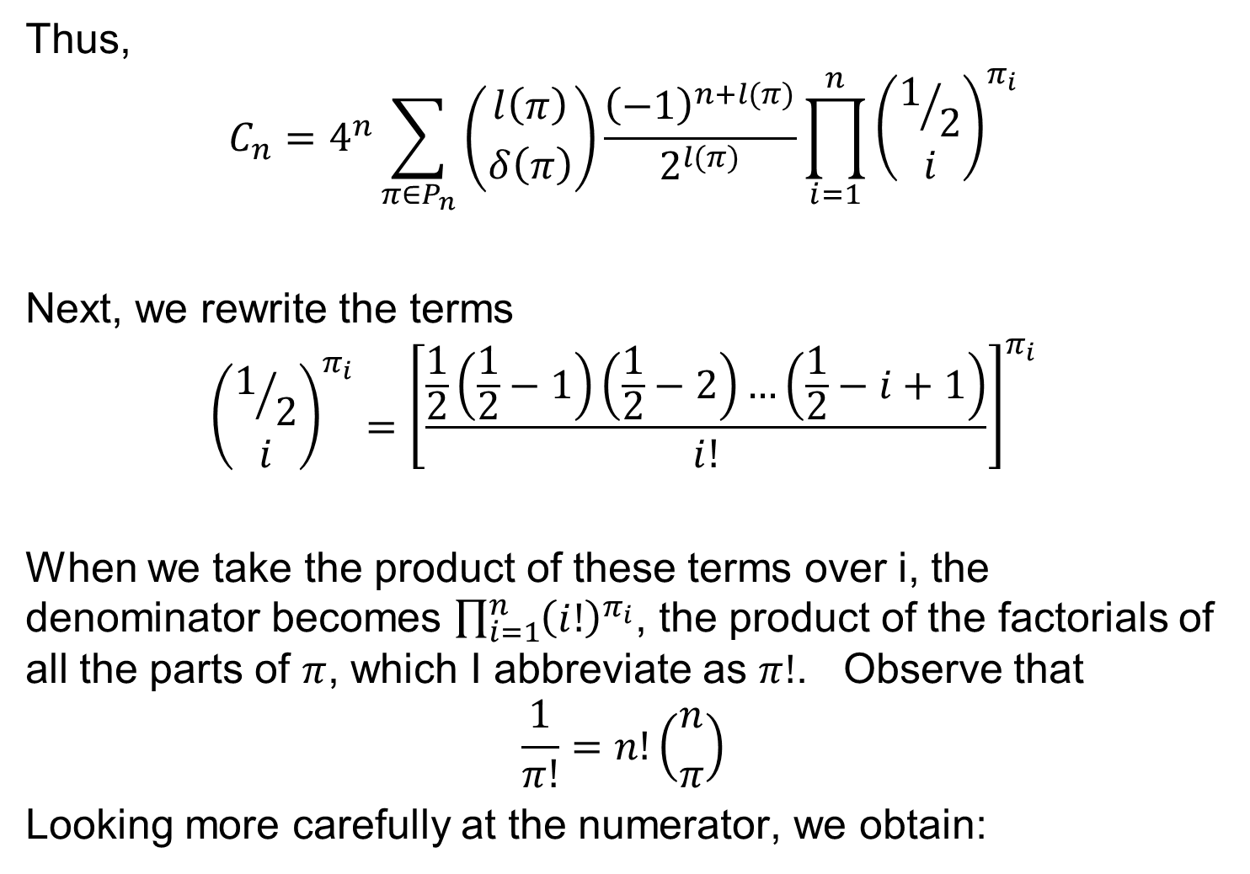
Simplifications
Thus,
$$C_{n}=4^{n}\sum_{π∈P_{n}}{\left({l\left(π\right) \atop δ\left(π\right)}\right)}\frac{{\left(−1\right)}^{n+l(π)}}{2^{l(π)}}\prod_{i=1}^{n}{{\left({1/2 \atop i}\right)}^{π_{i}}}$$
Next, we rewrite the terms
$${\left({1/2 \atop i}\right)}^{π_{i}}={\left[\frac{\frac{1}{2}\left(\frac{1}{2}−1\right)\left(\frac{1}{2}−2\right)…\left(\frac{1}{2}−i+1\right)}{i!}\right]}^{π_{i}}$$
When we take the product of these terms over i, the denominator becomes $\prod_{i=1}^{n}{{\left(i!\right)}^{π_{i}}}$, the product of the factorials of all the parts of $π$, which I abbreviate as $π!$. Observe that
$$\frac{1}{π!}=n!\left({n \atop π}\right)$$
Looking more carefully at the numerator, we obtain:

Slide 18
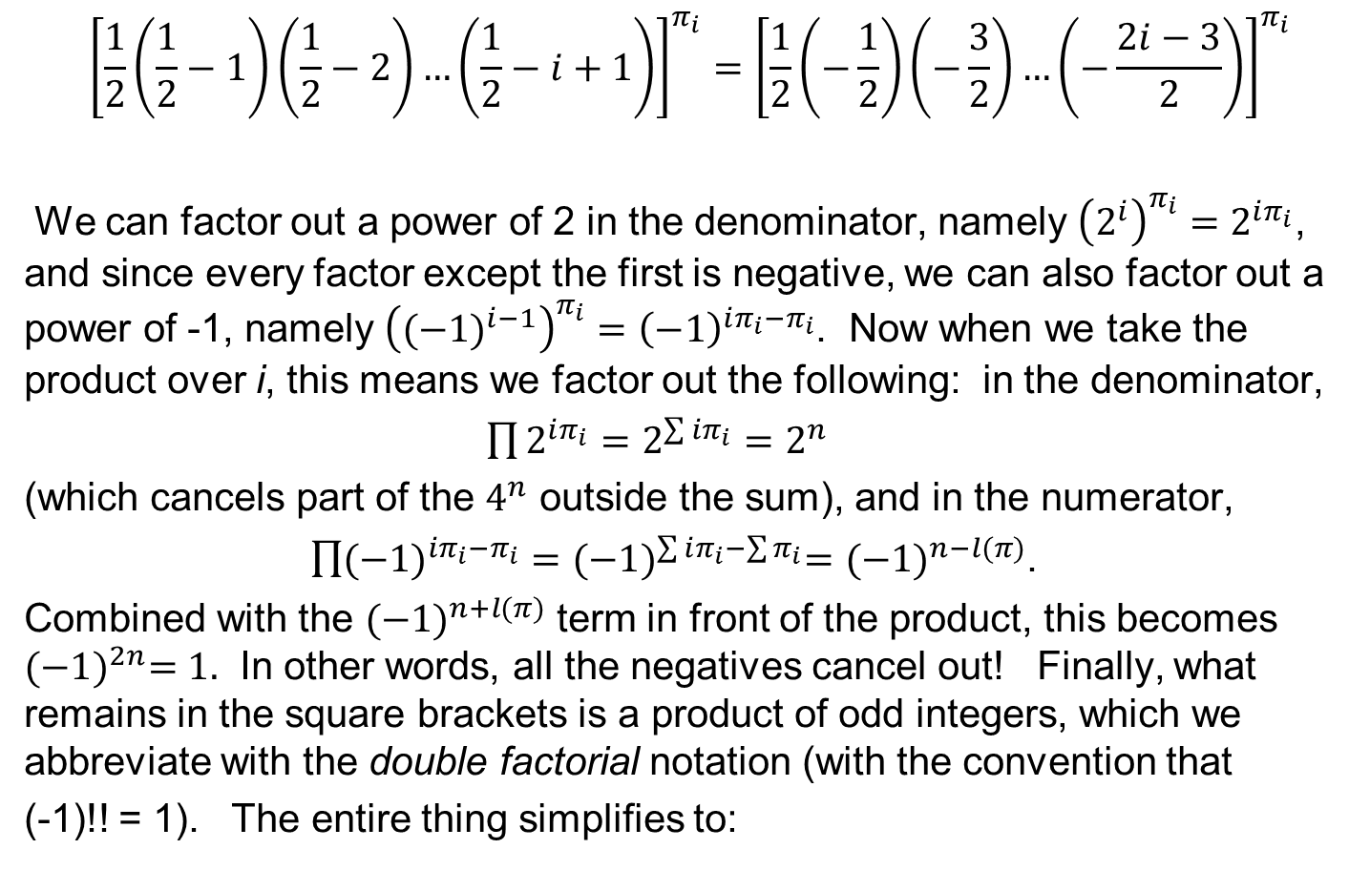
Simplifications, continued
$${\left[\frac{1}{2}\left(\frac{1}{2}−1\right)\left(\frac{1}{2}−2\right)…\left(\frac{1}{2}−i+1\right)\right]}^{π_{i}}={\left[\frac{1}{2}\left(−\frac{1}{2}\right)\left(−\frac{3}{2}\right)…\left(−\frac{2i−3}{2}\right)\right]}^{π_{i}}$$
We can factor out a power of 2 in the denominator, namely ${\left(2^{i}\right)}^{π_{i}}=2^{iπ_{i}}$, and since every factor except the first is negative, we can also factor out a power of -1, namely ${\left({(−1)}^{i−1}\right)}^{π_{i}}={\left(−1\right)}^{iπ_{i}−π_{i}}$. Now when we take the product over i, this means we factor out the following: in the denominator,
$\prod{2^{iπ_{i}}}=2^{\sum{iπ_{i}}}=2^{n}$
(which cancels part of the $4^{n}$ outside the sum), and in the numerator,
$\prod{{(−1)}^{iπ_{i}−π_{i}}}={(−1)}^{\sum{iπ_{i}−\sum{π_{i}}}}={(−1)}^{n−l(π)}$.
Combined with the ${(−1)}^{n+l(π)}$ term in front of the product, this becomes ${(−1)}^{2n}=1.$ In other words, all the negatives cancel out! Finally, what remains in the square brackets is a product of odd integers, which we abbreviate with the double factorial notation (with the convention that
(-1)!! = 1). The entire thing simplifies to:

Slide 19
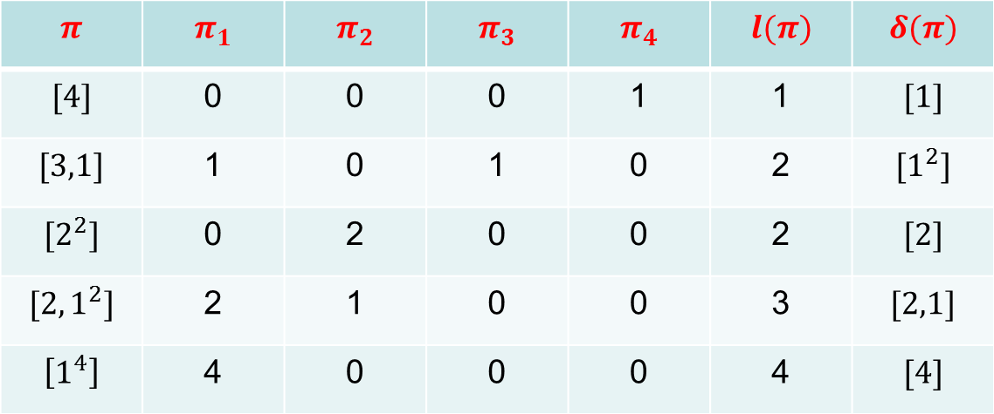

New formula for the Catalan numbers!
We have proved:
$$C_{n}=\frac{2^{n}}{n!}\sum_{π∈P_{n}}{\left({n \atop π}\right)\left({l\left(π\right) \atop δ\left(π\right)}\right)}\frac{1}{2^{l(π)}}\prod_{i=1}^{n}{{\left(\left(2i−3\right)‼\right)}^{π_{i}}}$$
Let’s illustrate this with n = 4. We need the table:
$$π$$ | $$π_{1}$$ | $$π_{2}$$ | $$π_{3}$$ | $$π_{4}$$ | $$l(π)$$ | $$δ(π)$$
$$[4]$$ | 0 | 0 | 0 | 1 | 1 | $$[1]$$
$$[3,1]$$ | 1 | 0 | 1 | 0 | 2 | $$[1^{2}]$$
$$[2^{2}]$$ | 0 | 2 | 0 | 0 | 2 | $$[2]$$
$$[2,1^{2}]$$ | 2 | 1 | 0 | 0 | 3 | $$[2,1]$$
$$\left[1^{4}\right]$$ | 4 | 0 | 0 | 0 | 4 | $$[4]$$

Slide 20
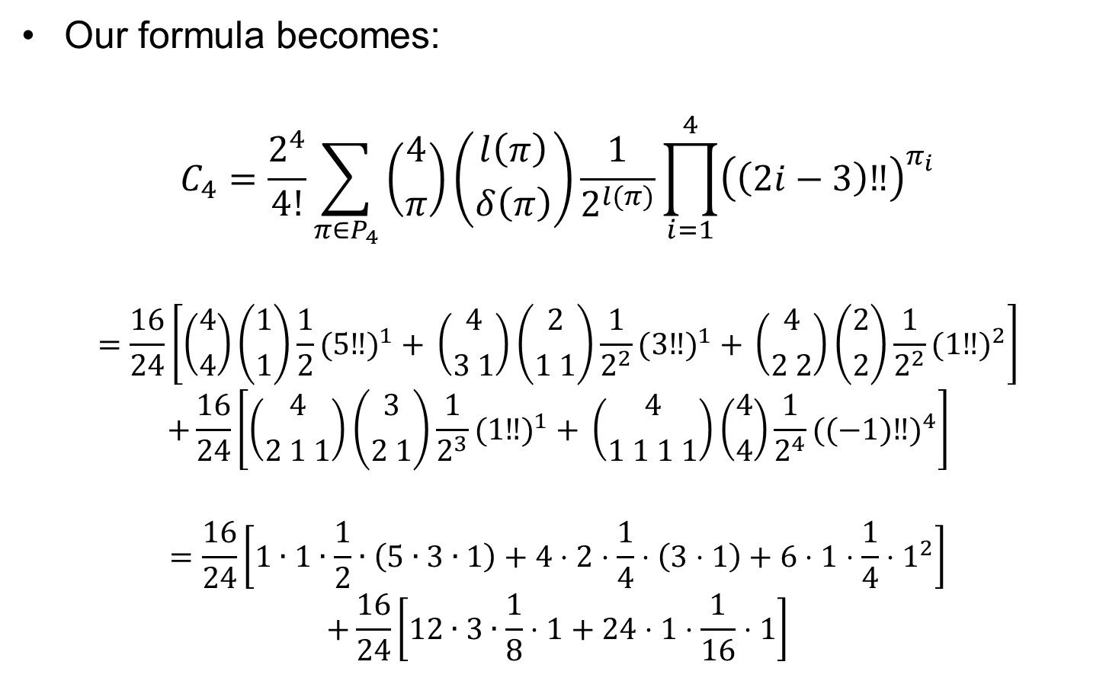
Catalan example (n = 4)
Our formula becomes:
$$C_{4}=\frac{2^{4}}{4!}\sum_{π∈P_{4}}{\left({4 \atop π}\right)\left({l\left(π\right) \atop δ\left(π\right)}\right)}\frac{1}{2^{l(π)}}\prod_{i=1}^{4}{{\left(\left(2i−3\right)‼\right)}^{π_{i}}}$$
$$=\frac{16}{24}\left[\left({4 \atop 4}\right)\left({1 \atop 1}\right)\frac{1}{2}{(5‼)}^{1} + \left({4 \atop 3 1}\right)\left({2 \atop 1 1}\right)\frac{1}{2^{2}}{(3‼)}^{1} + \left({4 \atop 2 2}\right)\left({2 \atop 2}\right)\frac{1}{2^{2}}{(1‼)}^{2}\right]$$
$$+\frac{16}{24}\left[\left({4 \atop 2 1 1}\right)\left({3 \atop 2 1}\right)\frac{1}{2^{3}}{(1‼)}^{1} + \left({4 \atop 1 1 1 1}\right)\left({4 \atop 4}\right)\frac{1}{2^{4}}{((−1)‼)}^{4}\right]$$
$$=\frac{16}{24}\left[1∙1∙\frac{1}{2}∙\left(5∙3∙1\right)+4⋅2⋅\frac{1}{4}⋅\left(3⋅1\right)+6⋅1⋅\frac{1}{4}⋅1^{2}\right]$$
$$+\frac{16}{24}\left[12∙3∙\frac{1}{8}⋅1+24⋅1⋅\frac{1}{16}⋅1\right]$$

Slide 21
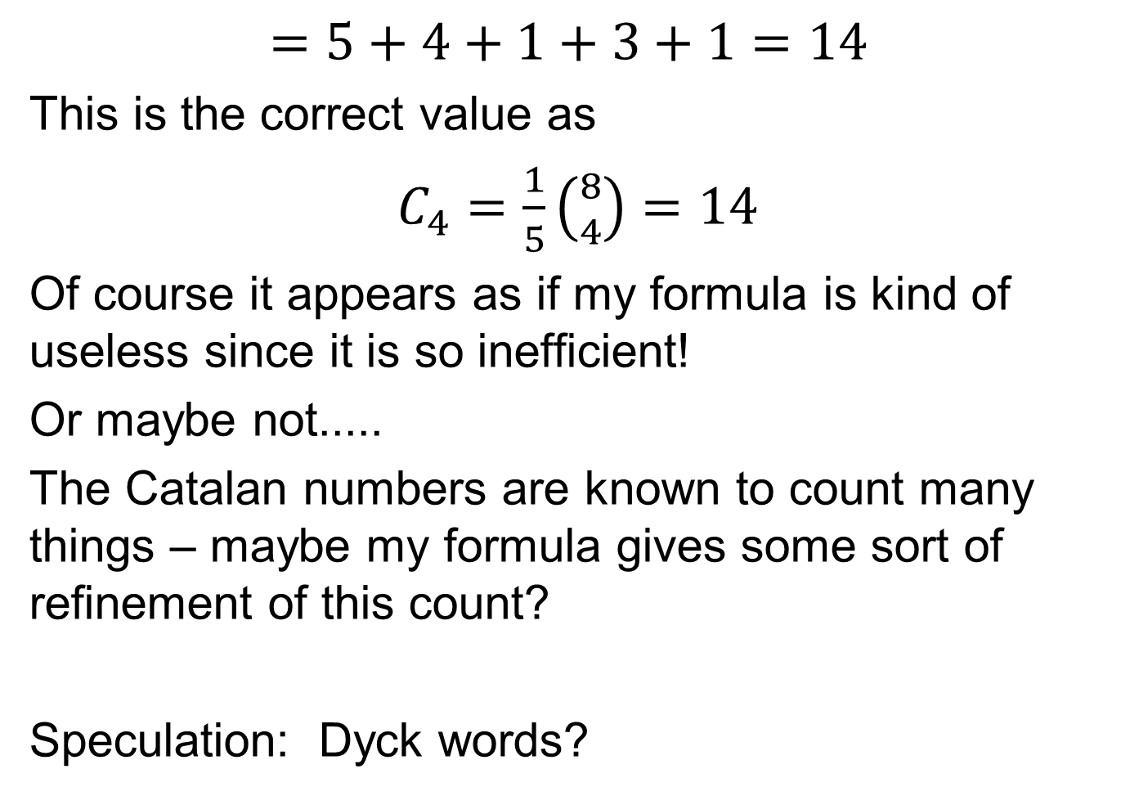
Catalan example (n = 4)
$$=5+4+1+3+1=14$$
This is the correct value as
$C_{4}=\frac{1}{5}\left({8 \atop 4}\right)=14$
Of course it appears as if my formula is kind of useless since it is so inefficient!
Or maybe not.....
The Catalan numbers are known to count many things – maybe my formula gives some sort of refinement of this count?
Speculation: Dyck words?

Slide 22
The 14 Dyck words of length 8
AAAABBBB | AABAABBB | ABAAABBB
AAABABBB | AABABABB | ABAABABB
AAABBABB | AABABBAB | ABAABBAB
AAABBBAB | AABBAABB | ABABAABB
 | AABBABAB | ABABABAB
I tried many ways to ‘naturally’ break these up into groups of sizes 5,4,1,3,1
but always without success. But then – what if we lump the terms together corresponding to partitions of the same length? This leads to groups of size
5,5,3,1 – and such groups DO appear naturally in the table....
I have some ideas on how to do this in general (no proof yet), but I believe that I can make the individual terms in my sum always correspond to such groups of Dyck words. Hopefully this will lead to a bijective proof of my formula.

Slide 23
Reference
The 2008 paper, which has the explicit formulas for the ordinary Bernoulli & Euler numbers (but not the higher order ones), can be downloaded from this website:
http://www.integers-ejcnt.org/
Just click on the 2008 volume. My paper is the first one in the January issue.

Slide 24
Appendix: My Bernoulli number formula
Let’s see how it works for n = 4:
Length
Derived
B₄ =
Partitions of 4
[4] | [3,1] | [2,2] | [2,1,1] | [1,1,1,1]
1 | 2 | 2 | 3 | 4
[1] | [1,1] | [2] | [1,2] | [4]

Slide 25
Appendix: My second Bernoulli number formula
For example:

Slide 26
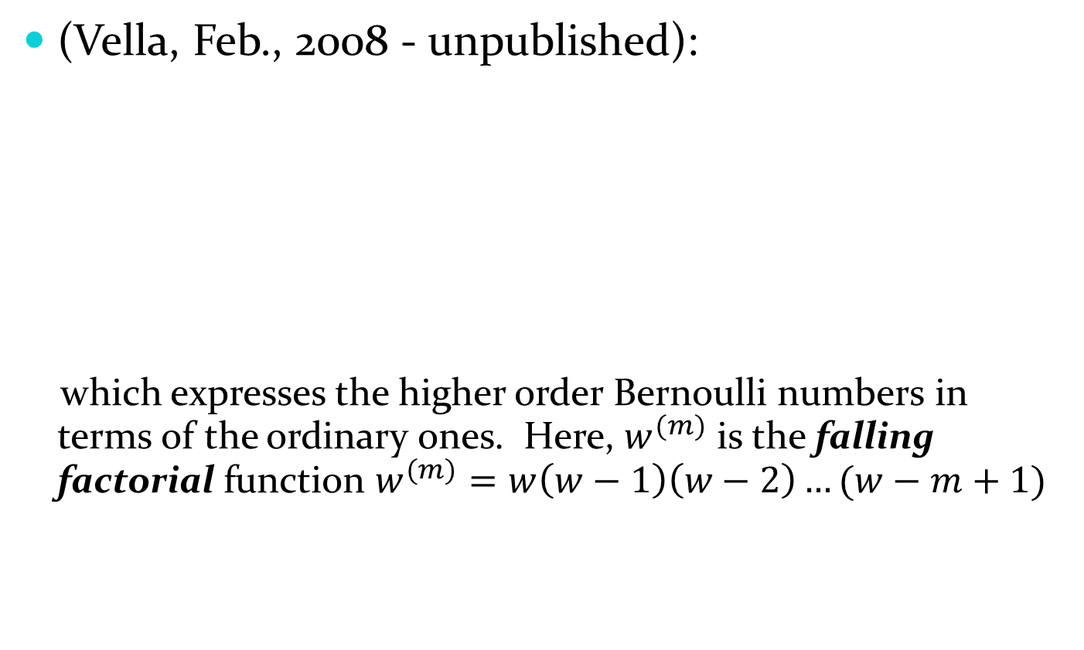
Appendix: My higher order
Bernoulli number formula
(Vella, Feb., 2008 - unpublished):
which expresses the higher order Bernoulli numbers in terms of the ordinary ones. Here, $w^{(m)}$ is the falling factorial function $w^{(m)}=w\left(w−1\right)\left(w−2\right)…(w−m+1)$

Slide 27
Appendix: Example of Higher Order Bernoulli formula
For example, let’s compute B₄². There are 5 partitions of 4, but only three of them have length at most 2: [4], [3,1] and [2,2]:

