Slide 1
Leonhard Euler’s Rendition on a Theorem of Newton
By Katherine Voorhees
Russell Sage College
April 6, 2013

Slide 2
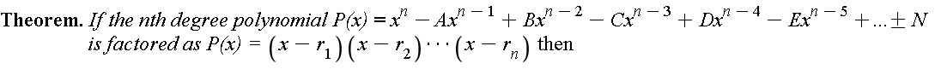
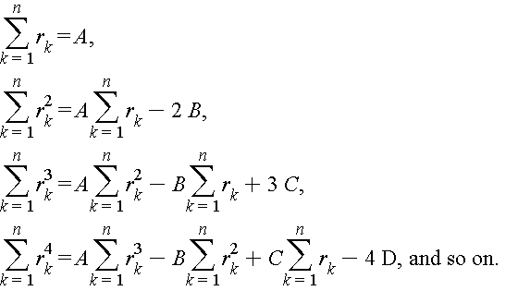
A Theorem of Newton

Slide 3
Application and significance
A Theorem of Newton derives a relationship between the roots and the coefficients of a polynomial without regard to negative signs.
Since Euler employed them so often, he considered it important to create a rigorous proof as none existed other than induction.
Most famously in his solution to the Basel Problem, posed by Pietro Mengoli in 1644, which asked for the sum of the reciprocals of the perfect squares.
It stumped mathematicians into the 1730’s but the great mind of Euler produced four solutions to this problem by 1741.
These formulas helped Euler to arrive at the exact sum for infinite series of the form, wher
p=2,4,6,8,10,12 up to much larger even values.

Slide 4
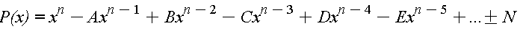
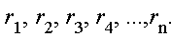
Relationship between the roots and coefficients of polynomials
Euler said if a polynomial of the form
Has roots, then then,
A=sum of all the roots
B=sum of products taken two at a time
C=sum of products taken three at a time
D=sum of products taken four at a time
…. Until
N=product of all roots
Euler had no interest in proving these!

Slide 5
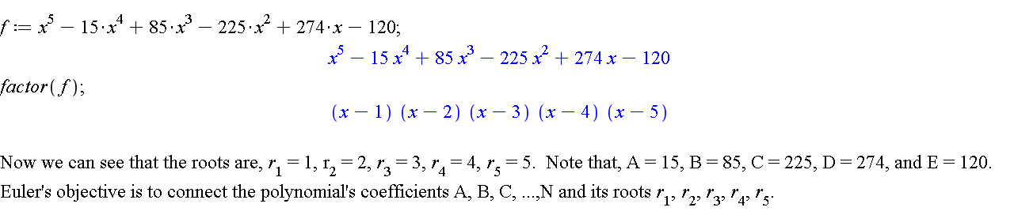
Let’s consider a fifth degree polynomial

Slide 6
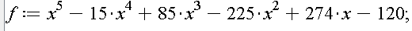
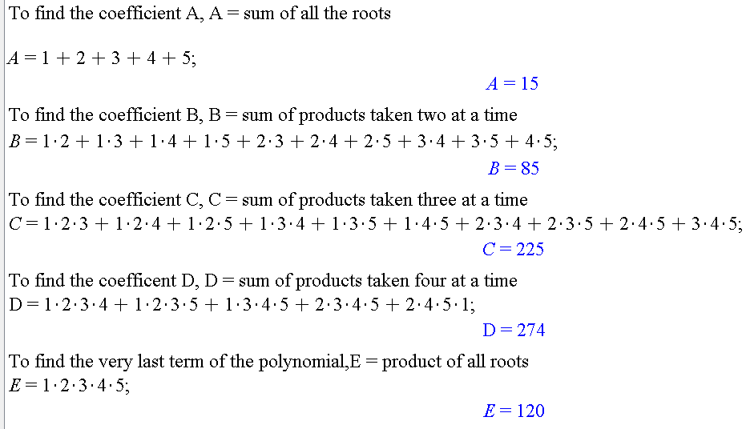
Verifying with

Slide 7
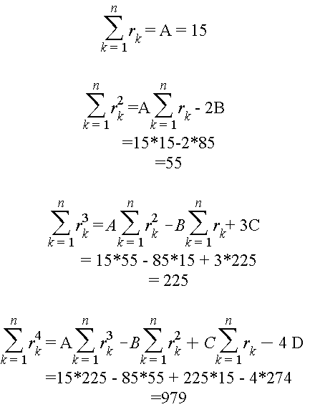
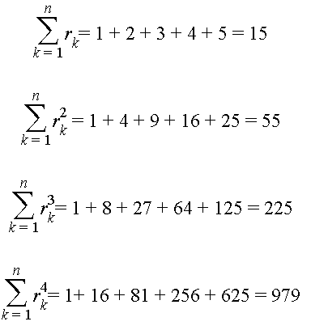
Applying Newton’s Formulas
A Theorem of Newton
Using Euler’s Formulas

Slide 8
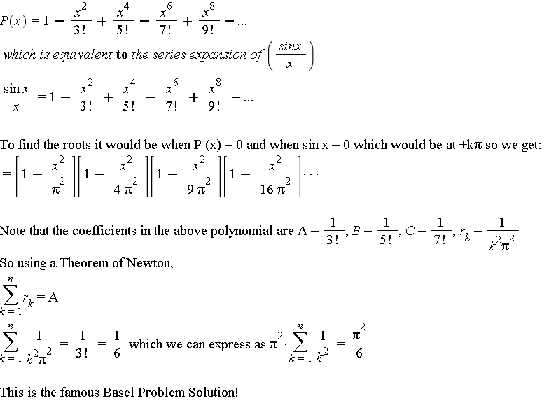
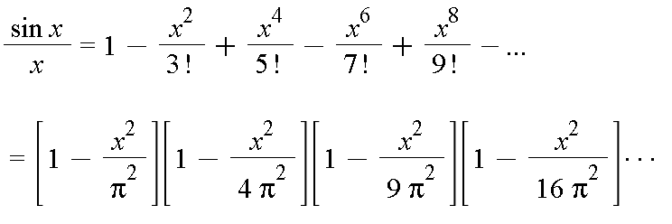
How Euler Applied Newton’s Theorem
In his proof, he compared the an infinite polynomial to the series expansion of (sin x)/x

Slide 9
Conclusion
Euler extended these results in a similar manner for even exponential powers.
These results did not extend for odd powers however and it leaves a challenge for future mathematicians.
Although Euler was a great mind, he never found the exact sum for
Little is still known about this today.

Slide 10
Sandifer, Ed. "How Euler Did It: A Theorem of Newton." MAA Online. Mathematical Association of America, Apr. 2008. Web. 11 Feb. 2013.
Dunham, William. "Euler and Infinite Series." Euler: The Master of Us All. Vol. 22. [Washington, D.C.]: Mathematical Association of America, 1999. 39-60. Print.
QUESTIONS??
REFERENCES

