Slide 1
Chutes & Ladders: Expected Duration
By: Erin Weld

Slide 2
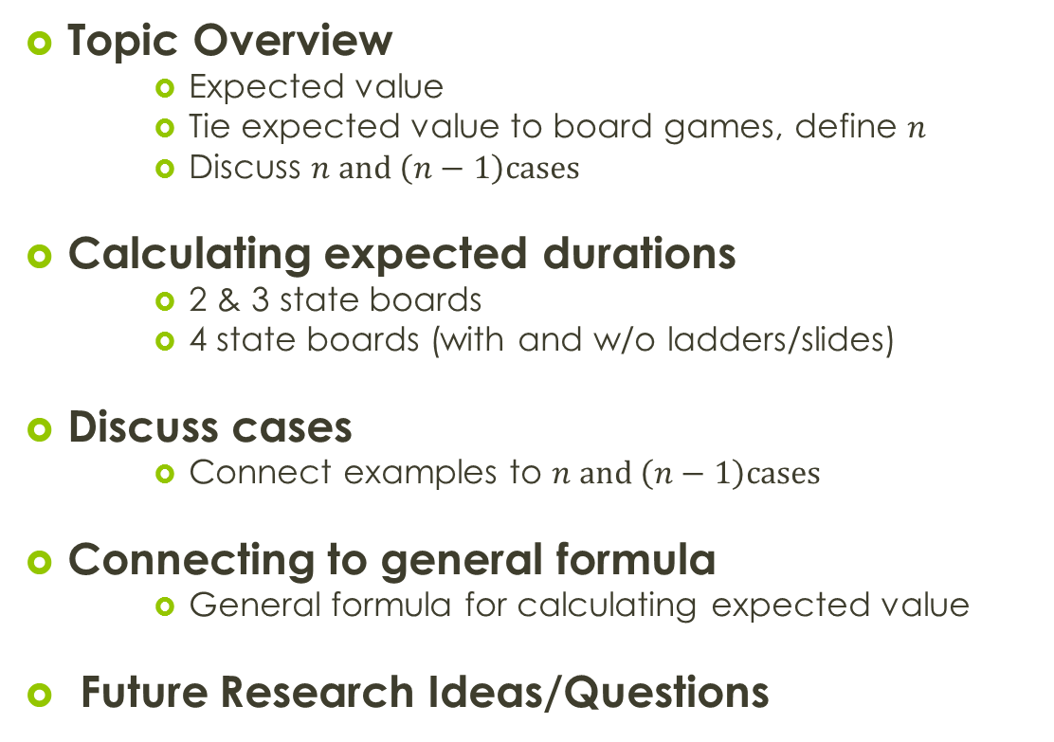
Agenda:
Topic Overview
      Expected value
      Tie expected value to board games, define $n$
      Discuss $n and \left(n−1\right)cases$
Calculating expected durations
      2 & 3 state boards
      4 state boards (with and w/o ladders/slides)
Discuss cases
      Connect examples to $n and \left(n−1\right)cases$
Connecting to general formula
      General formula for calculating expected value
Future Research Ideas/Questions

Slide 3
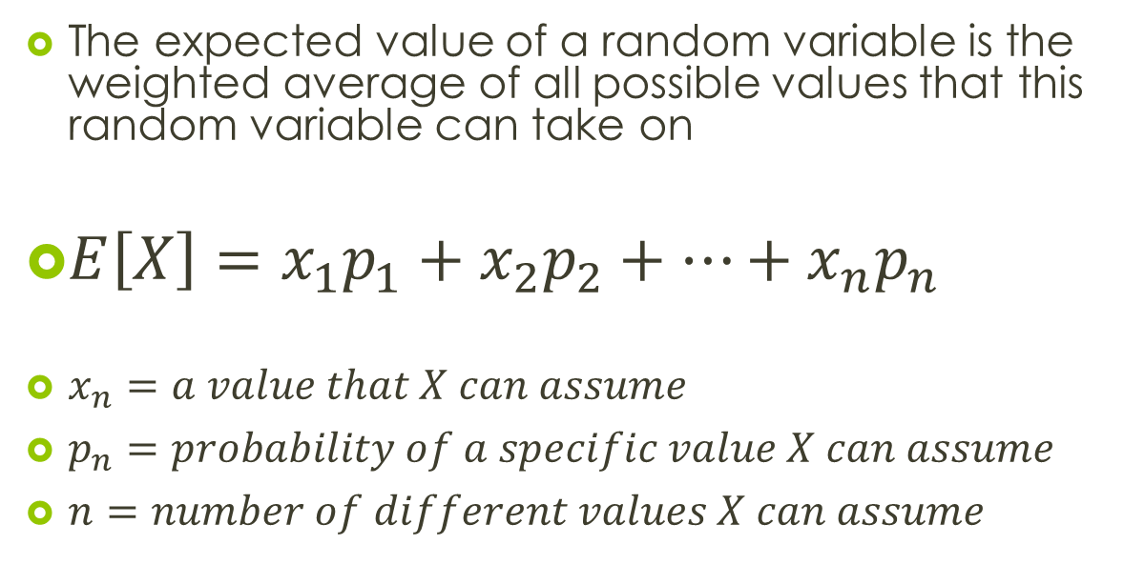
Expected Value
The expected value of a random variable is the weighted average of all possible values that this random variable can take on
$E\left[X\right]=x_{1}p_{1}+x_{2}p_{2}+…+x_{n}p_{n}$
$x_{n}=a value that X can assume$
$p_{n}=probability of a specific value X can assume$
$n=number of different values X can assume$

Slide 4
Expected Value:
Board Games
The expected value of a board game is the number of spins it will take for one person to complete a single game
$$Let X=number of spins for a single person to complete a single game$$

Slide 5
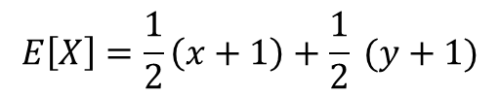
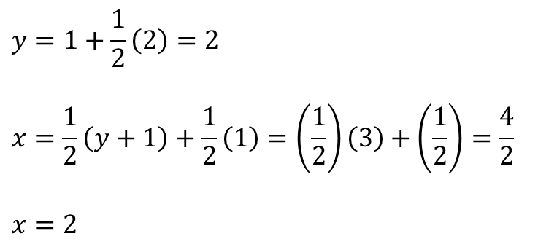



3-State Game
1 | 2 | 3
2 Space Spinner
$$E\left[X\right]=\frac{1}{2}\left(x+1\right)+\frac{1}{2} (y+1)$$
$$Let x=E\left[\# of spins | 1\right]$$
$$Let y=E[\#of spins|2]$$
$$y=1+\frac{1}{2}\left(2\right)=2$$
$$x=\frac{1}{2}\left(y+1\right)+\frac{1}{2}\left(1\right)=\left(\frac{1}{2}\right)\left(3\right)+\left(\frac{1}{2}\right)=\frac{4}{2}$$
$$x=2$$
Substitute:
E[X] $=\frac{1}{2}\left(3\right)+\frac{1}{2}\left(3\right)=\frac{6}{2}=3$
$$E\left[X\right]=3$$

Slide 6
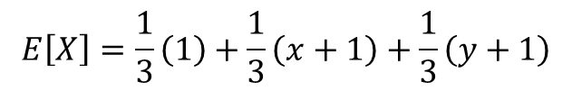
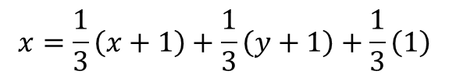
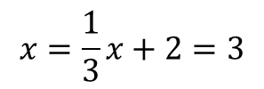
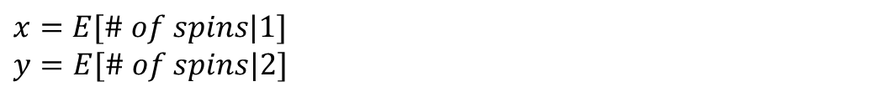
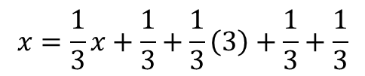

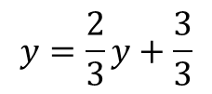
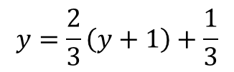
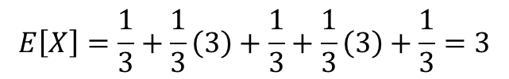
3-State Game
1 | 2 | 3
3 Space Spinner
$$E\left[X\right]=\frac{1}{3}\left(1\right)+\frac{1}{3}\left(x+1\right)+\frac{1}{3}\left(y+1\right)$$
$$x=E[\# of spins|1]$$
$$y=E[\# of spins|2]$$
$$y=\frac{2}{3}\left(y+1\right)+\frac{1}{3}$$
$$x=\frac{1}{3}\left(x+1\right)+\frac{1}{3}\left(y+1\right)+\frac{1}{3}\left(1\right)$$
$$y=\frac{2}{3}y+\frac{3}{3}$$
$$x=\frac{1}{3}x+\frac{1}{3}+\frac{1}{3}\left(3\right)+\frac{1}{3}+\frac{1}{3}$$
$$y=3$$
$$x=\frac{1}{3}x+2=3$$
$$E\left[X\right]=\frac{1}{3}+\frac{1}{3}\left(3\right)+\frac{1}{3}+\frac{1}{3}\left(3\right)+\frac{1}{3}=3$$

Slide 7
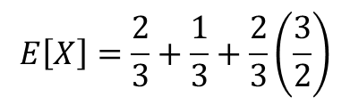
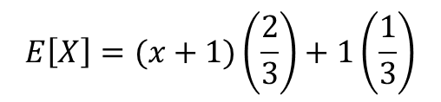
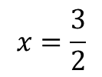
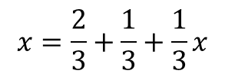
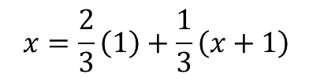


4-State Game with a ladder to the finish & a slide
4 | 3
1 | 2
3 Space Spinner
$$E\left[X\right]=E\left[\# of spins | 1 or 3\right]+E\left[\# of spins | 2\right]$$
$$x=E[\# of spins|1 or 3]$$
$$E\left[X\right]=(x+1)\left(\frac{2}{3}\right)+1\left(\frac{1}{3}\right)$$
$$x=\frac{2}{3}\left(1\right)+\frac{1}{3}\left(x+1\right)$$
$$E\left[X\right]=\frac{2}{3}+\frac{1}{3}+\frac{2}{3}\left(\frac{3}{2}\right)$$
$$x=\frac{2}{3}+\frac{1}{3}+\frac{1}{3}x$$
$$E\left[X\right]=1+1=2$$
$$x=\frac{3}{2}$$

Slide 8
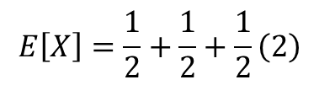
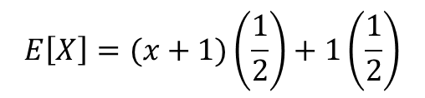

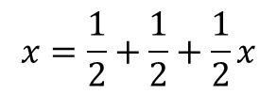
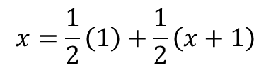
4-State Game with a ladder to the finish & a slide
4 | 3
1 | 2
4 Space Spinner
$$E\left[X\right]=E\left[\# of spins | 1 or 3\right]+E\left[\# of spins | 2 or 4\right]$$
$$x=E[\# of spins|1 or 3]$$
$$E\left[X\right]=(x+1)\left(\frac{1}{2}\right)+1\left(\frac{1}{2}\right)$$
$$x=\frac{1}{2}\left(1\right)+\frac{1}{2}\left(x+1\right)$$
$$E\left[X\right]=\frac{1}{2}+\frac{1}{2}+\frac{1}{2}\left(2\right)$$
$$x=\frac{1}{2}+\frac{1}{2}+\frac{1}{2}x$$
$$E\left[X\right]=1+1=2$$
$$x=2$$

Slide 9

2 Cases: $n, (n−1)$
In the examples the two cases had the same expected value
These results can be connected to research completed in 2011
Regular 101 state Chutes & Ladder game board, the 100 and 99 space spinners produce the same expected value
E[X]=90.28
Jones, M. A. Chutes and Ladders for the Impatient.

Slide 10

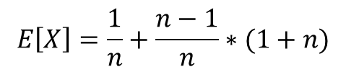
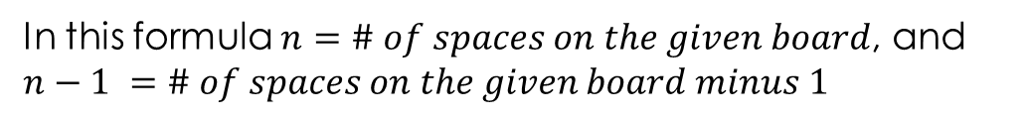
General Formula without a ladder to the end
$$E\left[X\right]=\frac{1}{n}+\frac{n−1}{n}∗(1+n)$$
$$E\left[X\right]=1+n−1=n$$
In this formula $n=\# of spaces on the given board$, and $n−1 =\# of spaces on the given board minus 1$

Slide 11
Future Research
Calculating the general formula for the board that has a direct path to the end of the game
Modify the spinner so that every number is not equally likely to occur

Slide 12
Questions?

