Slide 1
How Did Ancient Greek Mathematicians Trisect an Angle?
By Carly Orden

Slide 2
Three Ancient Greek
Construction Problems
1. Squaring of the circle
2. Doubling of the cube
3. Trisecting any given angle*
* Today, we will focus on #3

Slide 3
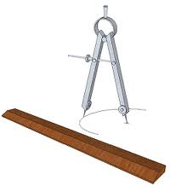
Methods at the Time
Pure geometry
Constructability (ruler and compass only)
Euclid’s Postulates 1-3

Slide 4
What is Constructible?
Constructible: Something that is constructed with only a ruler and compass
  Examples:
    To construct a midpoint of a given a line segment
    To construct a line perpendicular to a given line segment

Slide 5
What is Constructible?
Problems that can be solved using just ruler and compass
  Doubling a square
  Bisecting an angle
    … (keep in mind we want to trisect an angle)

Slide 6
Impossibility of the Construction Problems
All 3 construction problems are impossible to solve with only ruler and compass
Squaring of the circle (Wantzel 1837)
Doubling of the cube (Wantzel 1837)
Trisecting any given angle (Lindemann 1882)

Slide 7
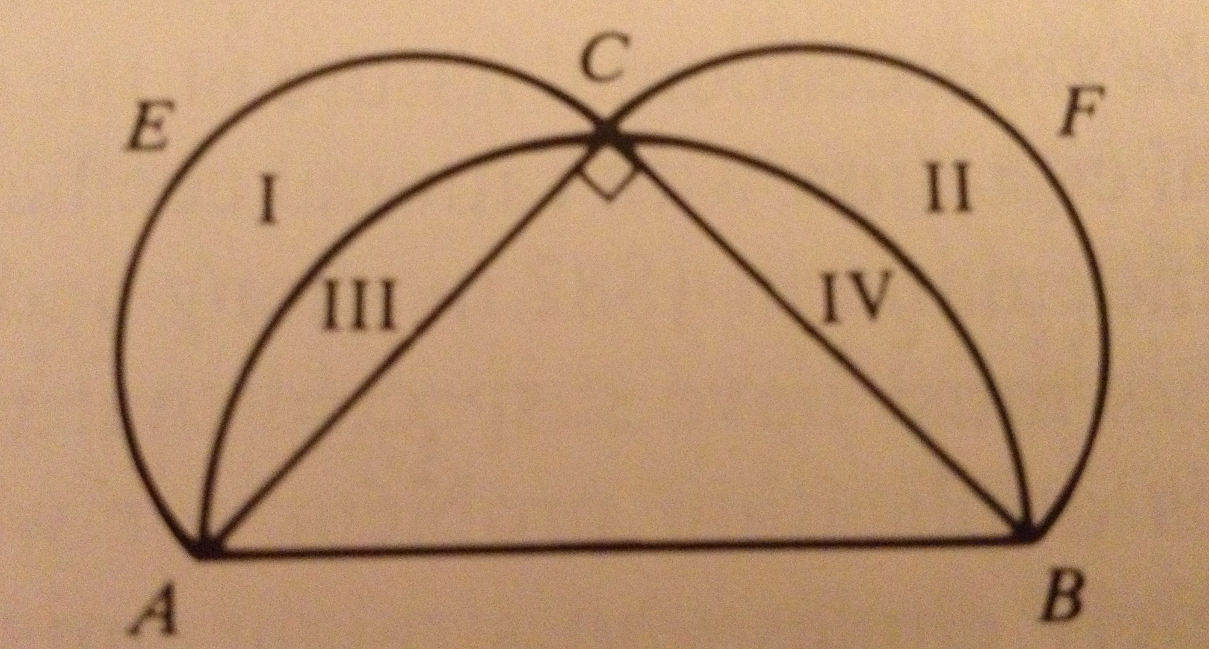
Squaring of the Circle
Hippocrates of Chios (460-380 B.C.)
  Squaring of the lune
  Area I + Area II = Area ΔABC

Slide 8
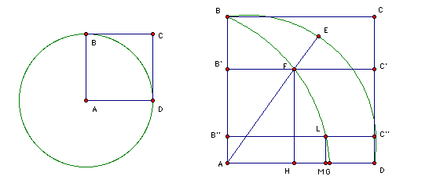
Squaring of the Circle
Hippias of Elis (circa 425 B.C.)
  Property of the “Quadratrix”:
  <BAD : <EAD = (arc BED) : (arc ED) = AB : FH

Slide 9
Duplication of the Cube
Two myths: (circa 430 B.C.)
  Cube-shaped altar of Apollo must be doubled to rid plague
  King Minos wished to double a cube-shaped tomb

Slide 10
Duplication of the Cube
Hippocrates and the “continued mean proportion”
  Let “a” be the side of the original cube
  Let “x” be the side of the doubled cube
  Modern Approach: given side a, we must construct a cube with side x such that x³ = 2a³
  Hippocrates’ Approach: two line segments x and y must be constructed such that a:x = x:y = y:2a

Slide 11
Trisection of Given Angle
But first…
Recall: We can bisect an angle using ruler and compass

Slide 12
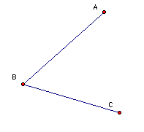
Bisecting an Angle

Slide 13
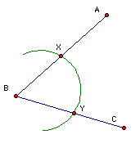
Bisecting an Angle
construct an arc centered at B

Slide 14
Bisecting an Angle
construct an arc centered at B
XB = YB

Slide 15
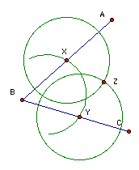
Bisecting an Angle
construct an arc centered at B
XB = YB
construct two circles with the same radius,
centered at X and Y respectively

Slide 16
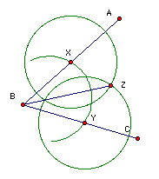
Bisecting an Angle
construct an arc centered at B
XB = YB
construct two circles with the same radius,
centered at X and Y respectively
construct a line from B to Z

Slide 17
Bisecting an Angle
construct an arc centered at B
XB = YB
construct two circles with the same radius,
centered at X and Y respectively
construct a line from B to Z
BZ is the angle bisector

Slide 18
Bisecting an Angle
draw an arc centered at B
XB = YB
draw two circles with the same radius,
centered at X and Y respectively
draw a line from B to Z
BZ is the angle bisector
Next natural question: How do we trisect an angle?

Slide 19
Trisecting an Angle
Impossible with just ruler and compass!!

Slide 20
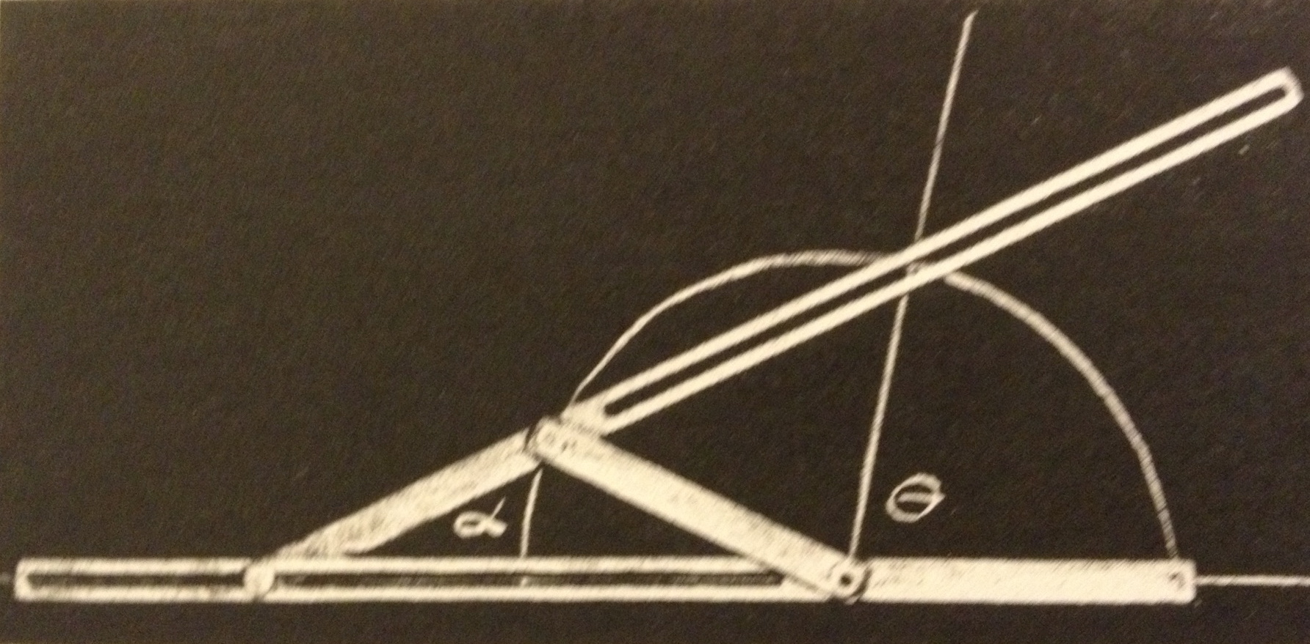
Trisecting an Angle
Impossible with just ruler and compass!!
Must use additional tools: a “sliding linkage”

Slide 21
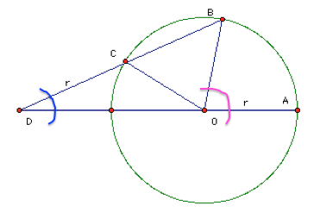
Proof by Archimedes
(287-212 B.C.)
We will show that <ADB = 1/3 <AOB

Slide 22
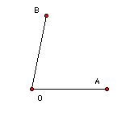
Proof by Archimedes
(287-212 B.C.)

Slide 23
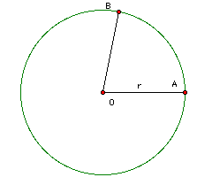
Proof by Archimedes
(287-212 B.C.)

Slide 24
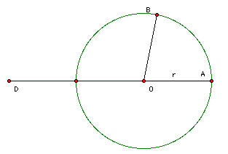
Proof by Archimedes
(287-212 B.C.)

Slide 25
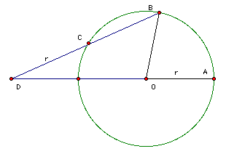
Proof by Archimedes
(287-212 B.C.)

Slide 26
Proof by Archimedes
(287-212 B.C.)
We will show that <ADB = 1/3 <AOB

Slide 27
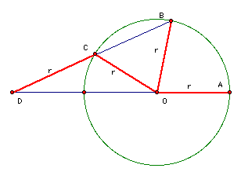
Proof by Archimedes
(287-212 B.C.)
DC=CO=OB=r

Slide 28
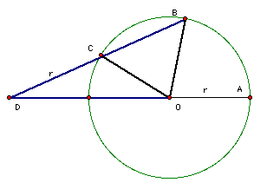
Proof by Archimedes
(287-212 B.C.)
DC=CO=OB=r
∆DCO and ∆COB are both isosceles

Slide 29
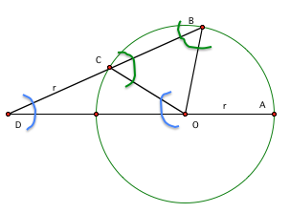
Proof by Archimedes
(287-212 B.C.)
DC=CO=OB=r
∆DCO and ∆COB are both isosceles
<ODC = <COD and <OCB = <CBO

Slide 30
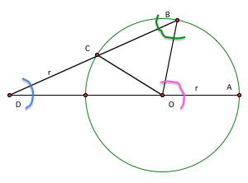
Proof by Archimedes
(287-212 B.C.)
DC=CO=OB=r
∆DCO and ∆COB are both isosceles
<ODC = <COD and <OCB = <CBO
<AOB = <ODC + <CBO

Slide 31
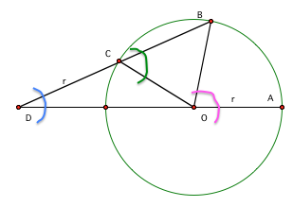
Proof by Archimedes
(287-212 B.C.)
DC=CO=OB=r
∆DCO and ∆COB are both isosceles
<ODC = <COD and <OCB = <CBO
<AOB = <ODC + <CBO
= <ODC + <OCB

Slide 32
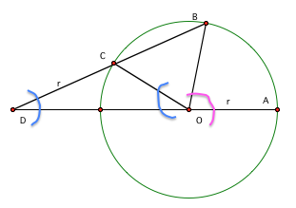
Proof by Archimedes
(287-212 B.C.)
DC=CO=OB=r
∆DCO and ∆COB are both isosceles
<ODC = <COD and <OCB = <CBO
<AOB = <ODC + <CBO
= <ODC + <OCB
= <ODC + <ODC + <COD

Slide 33
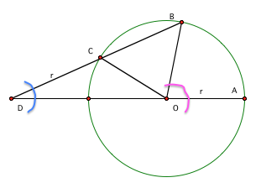
Proof by Archimedes
(287-212 B.C.)
DC=CO=OB=r
∆DCO and ∆COB are both isosceles
<ODC = <COD and <OCB = <CBO
<AOB = <ODC + <CBO
= <ODC + <OCB
= <ODC + <ODC + <COD
= 3<ODC

Slide 34
Proof by Archimedes
(287-212 B.C.)
DC=CO=OB=r
∆DCO and ∆COB are both isosceles
<ODC = <COD and <OCB = <CBO
<AOB = <ODC + <CBO
= <ODC + <OCB
= <ODC + <ODC + <COD
= 3<ODC
= 3<ADB

Slide 35
Proof by Archimedes
(287-212 B.C.)
DC=CO=OB=r
∆DCO and ∆COB are both isosceles
<ODC = <COD and <OCB = <CBO
<AOB = <ODC + <CBO
= <ODC + <OCB
= <ODC + <ODC + <COD
= 3<ODC
= 3<ADB
Therefore <ADB = 1/3 <AOB

Slide 36
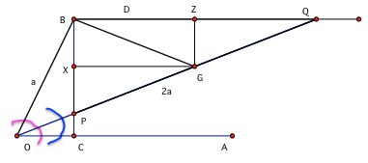
Proof by Nicomedes
(280-210 B.C.)
We will show that <AOQ = 1/3 <AOB

Slide 37
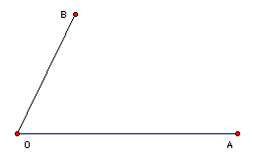
Proof by Nicomedes
(280-210 B.C.)

Slide 38
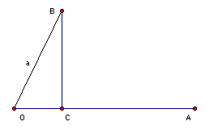
Proof by Nicomedes
(280-210 B.C.)

Slide 39
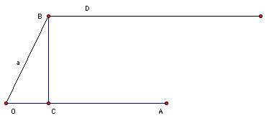
Proof by Nicomedes
(280-210 B.C.)

Slide 40
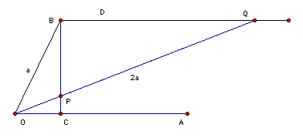
Proof by Nicomedes
(280-210 B.C.)

Slide 41
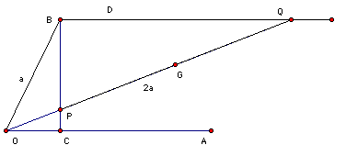
Proof by Nicomedes
(280-210 B.C.)

Slide 42
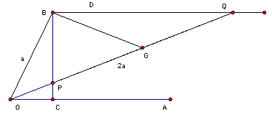
Proof by Nicomedes
(280-210 B.C.)

Slide 43
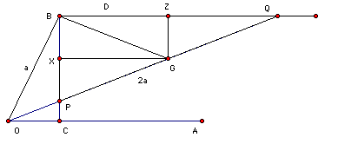
Proof by Nicomedes
(280-210 B.C.)

Slide 44
Proof by Nicomedes
(280-210 B.C.)
We will show that <AOQ = 1/3 <AOB

Slide 45
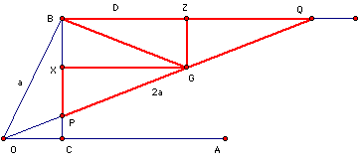
Proof by Nicomedes
(280-210 B.C.)
∆GZQ ≅ ∆PXG ≅ ∆BZG

Slide 46
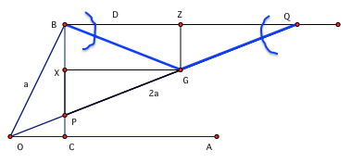
Proof by Nicomedes
(280-210 B.C.)
∆GZQ ≅ ∆PXG ≅ ∆BZG
GQ = BG so <BQG=<QBG

Slide 47
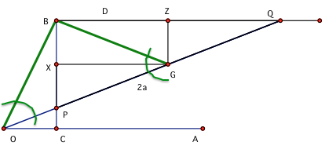
Proof by Nicomedes
(280-210 B.C.)
∆GZQ ≅ ∆PXG ≅ ∆BZG
GQ = BG so <BQG=<QBG
OB = GB so <BOG = <BGO

Slide 48
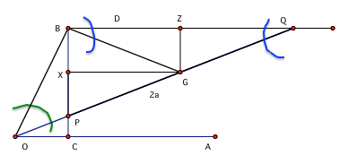
Proof by Nicomedes
(280-210 B.C.)
∆GZQ ≅ ∆PXG ≅ ∆BZG
GQ = BG so <BQG=<QBG
OB = GB so <BOG = <BGO
= <BQG + <QBG

Slide 49
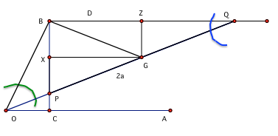
Proof by Nicomedes
(280-210 B.C.)
∆GZQ ≅ ∆PXG ≅ ∆BZG
GQ = BG so <BQG=<QBG
OB = GB so <BOG = <BGO
= <BQG + <QBG
= 2<BQG

Slide 50
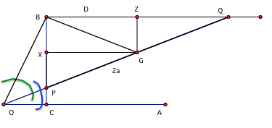
Proof by Nicomedes
(280-210 B.C.)
∆GZQ ≅ ∆PXG ≅ ∆BZG
GQ = BG so <BQG=<QBG
OB = GB so <BOG = <BGO
= <BQG + <QBG
= 2<BQG
= 2<POC

Slide 51
Proof by Nicomedes
(280-210 B.C.)
∆GZQ ≅ ∆PXG ≅ ∆BZG
GQ = BG so <BQG=<QBG
OB = GB so <BOG = <BGO
= <BQG + <QBG
= 2<BQG
= 2<POC
<AOQ = 1/3 <AOB as desired.

Slide 52
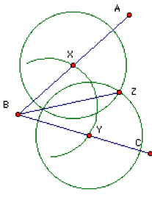
Conclusion
Bisect an angle: using ruler and compass
Trisect an angle: using ruler, compass, and sliding linkage

