Slide 1
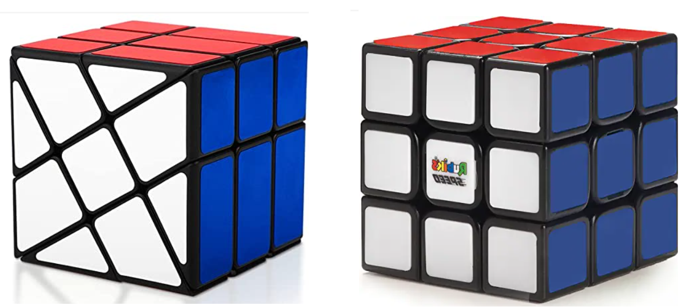
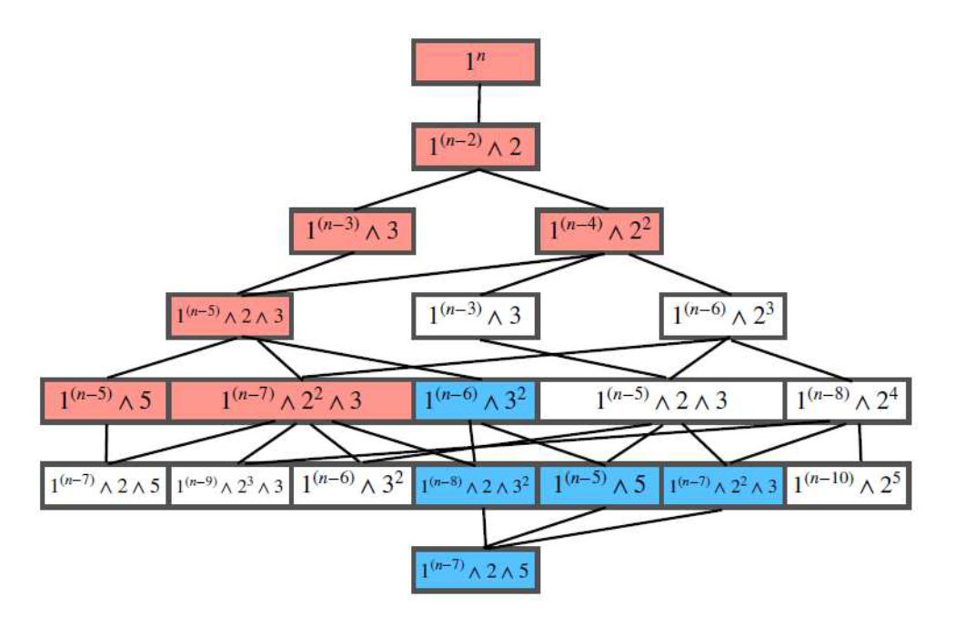
The Fibonacci Sequence and Math Outreach
Steven J Miller, Williams College: sjm1@williams.edu
Joint with Cameron and Kayla Miller, Anna Mello and her classes, and SMALL 2022
The 20th International Fibonacci Conference, Sarajevo, July 29, 2020
https://web.williams.edu/Mathematics/sjmiller/public_html/math/talks/talks.html

Slide 2
Outline:
Discuss efforts to engage/excite young students.
Highlight interplay of math outreach and math research.

Slide 3
If you can place two you win!

Slide 4
If you can place two you win!
IMPOSSIBLE: Need more, and I’m cheap!

Slide 5
IMPOSSIBLE: Need more, and I’m cheap!
(Well, when it’s my money: 21st FibConf will be well supported….)

Slide 6
Needed more, added smallest amount possible….

Slide 9
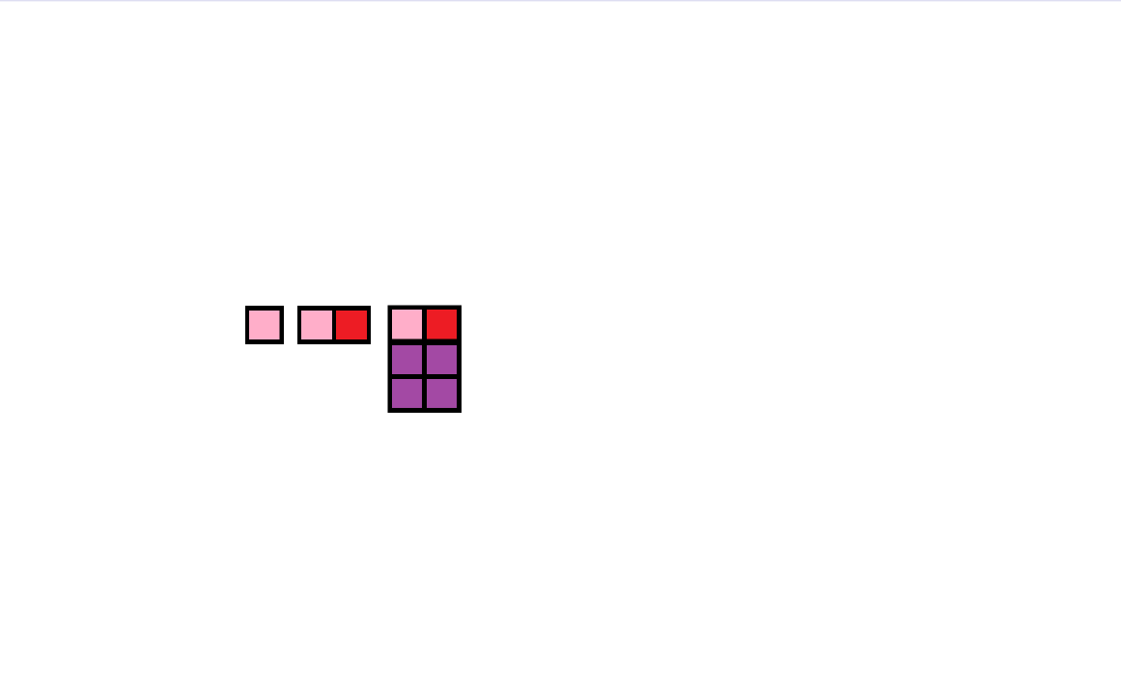

Slide 10
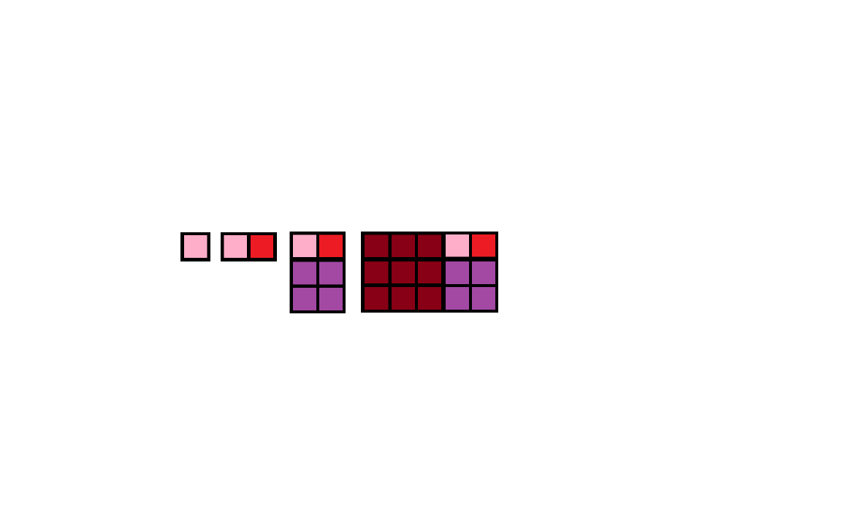

Slide 11
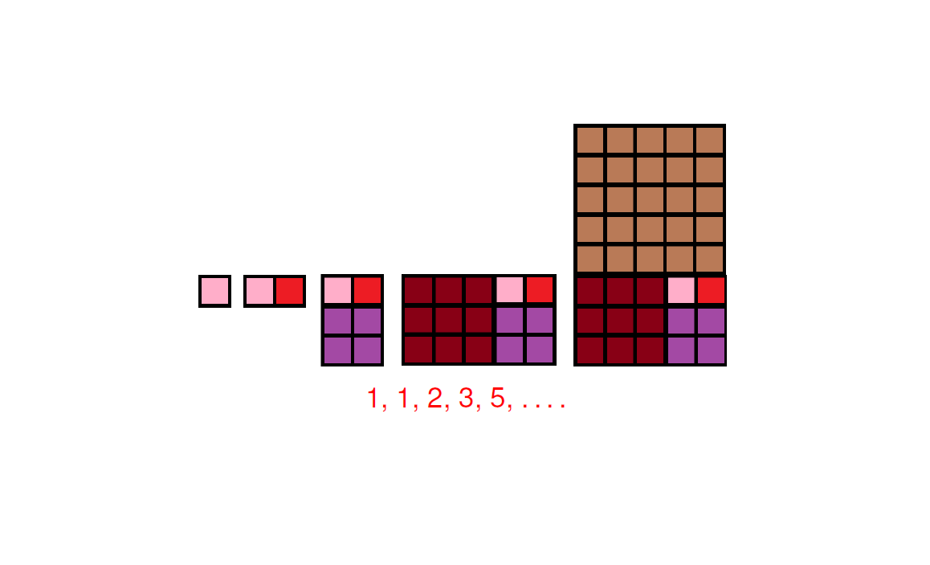

Slide 12
Talk about freedom in where to put boxes.
Show beautiful video Nature by Numbers: https://www.youtube.com/watch?v=me6Dnl2DOtM

Slide 13
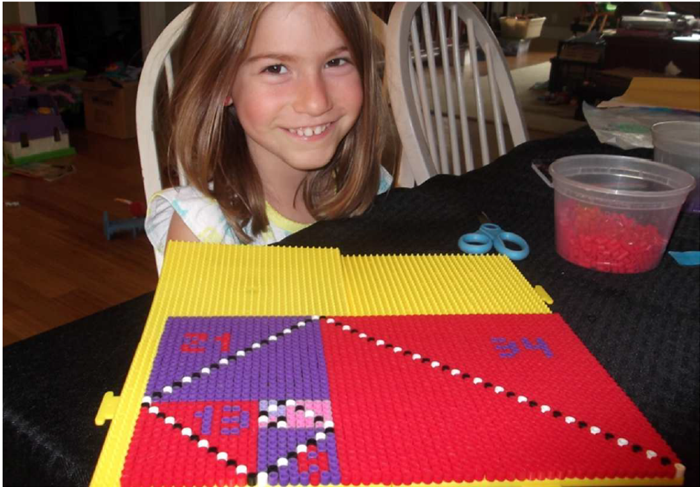
https://math.williams.edu/to-bead-or-not-to-bead/ https://math.williams.edu/to-bead-or-not-to-bead-ii/

Slide 14
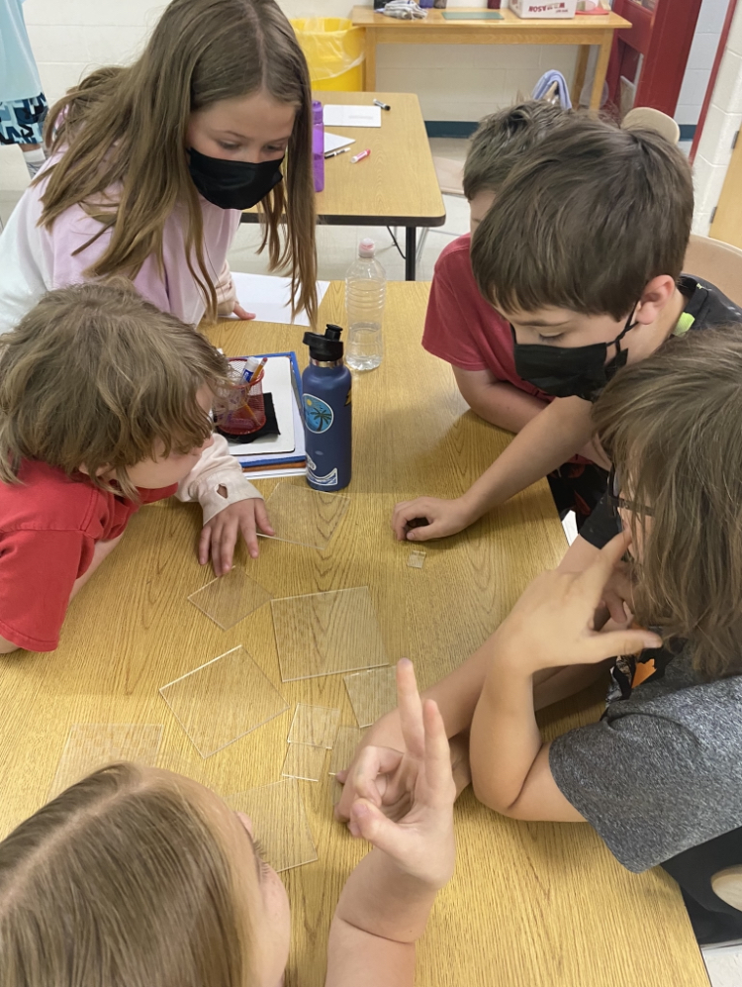
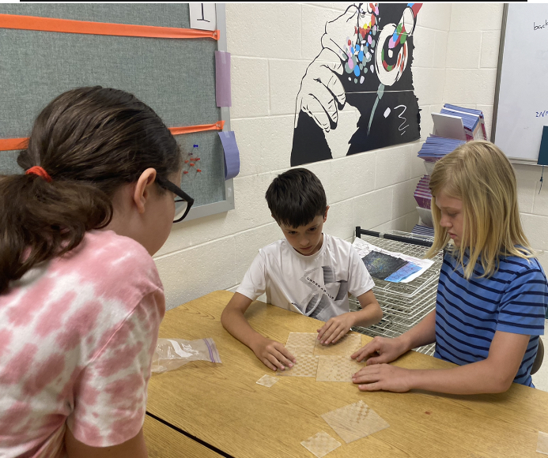

Slide 15
What do you observe? 1, 1, 2, 3, 5, 8, 13, 21, 34, 55, 89…

Slide 16
What do you observe? 1, 1, 2, 3, 5, 8, 13, 21, 34, 55, 89…
Odd, odd, even.
Sum of previous two.
The pattern goes even even odd for every sequence if you start with 1,1 or any odd numbers. If you start with an even number like 3,2 the sequence is shaken up so it goes odd even, odd, but after that it goes back to the other odd odd even sequence. If you start with two even numbers it will always be even. If you make a diagram it goes in a shell that matches a nautilus shell. -William
Why is the Fibonacci sequence everywhere?
What is the purpose of the Fibonacci sequence?
Why do the Fibonacci sequence numbers sound so good on instruments?
Can the Fibonacci sequence be found in other shapes than a swirl?
Can Fibonacci be found in technology like phones, laptops, or TVs? -Maddie

Slide 17
What do you observe? 1, 1, 2, 3, 5, 8, 13, 21, 34, 55, 89…
Odd, odd, even.
Sum of previous two.
The pattern goes even even odd for every sequence if you start with 1,1 or any odd numbers. If you start with an even number like 3,2 the sequence is shaken up so it goes odd even, odd, but after that it goes back to the other odd odd even sequence. If you start with two even numbers it will always be even. If you make a diagram it goes in a shell that matches a nautilus shell. -William
Why is the Fibonacci sequence everywhere?
What is the purpose of the Fibonacci sequence?
Why do the Fibonacci sequence numbers sound so good on instruments?
Can the Fibonacci sequence be found in other shapes than a swirl?
Can Fibonacci be found in technology like phones, laptops, or TVs? -Maddie
Note: often introducing kids to
notation (such as F_{n}),
seeing how notation matters / helps,
Spreadsheets (to generate list)….

Slide 18
What do you observe? 1, 1, 2, 3, 5, 8, 13, 21, 34, 55, 89…
One of my college research student (Justin Cheigh):
Does every Fibonacci number have a 1, 2, 3, 5 or 8 as one of its digits…?
Math outreach led to an interesting (and new?) question.

Slide 19
What do you observe? 1, 1, 2, 3, 5, 8, 13, 21, 34, 55, 89…
One of my college research student (Justin Cheigh):
Does every Fibonacci number have a 1, 2, 3, 5 or 8 as one of its digits…?
Math outreach led to an interesting (and new?) question.
Question: Given a base B, for what subsets S of {0, 1, …, B-1} must either all or all sufficiently large numbers always have at least one digit in S? What if S is a set of pairs of digits?

Slide 20
What do you observe? 1, 1, 2, 3, 5, 8, 13, 21, 34, 55, 89…
One of my college research student (Justin Cheigh):
Does every Fibonacci number have a 1, 2, 3, 5 or 8 as one of its digits…?
Math outreach led to an interesting (and new?) question.
Question: Given a base B, for what subsets S of {0, 1, …, B-1} must either all or all sufficiently large numbers always have at least one digit in S? What if S is a set of pairs of digits?
Partial Answer: all Fibonacci numbers contain:
• a digit in {0, . . . , 9} \ {6}
• a digit in {0, . . . , 9} \ {4}
• a digit in {0, . . . , 9} \ {2} (disregarding F₂ = 2, so all sufficiently large!)
SMALL ‘22 (especially Guilherme Zeus Dantas E Moura, Annika Mauro, Zoe Mcdonald, Santiago Velazquez).

Slide 21
Hvala!
Work supported by NSF Grant DMS1947438, Harvey Mudd, Michigan and Williams, and the Journal of Number Theory.

