Slide 1
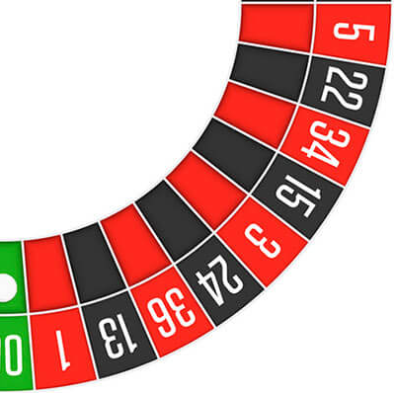
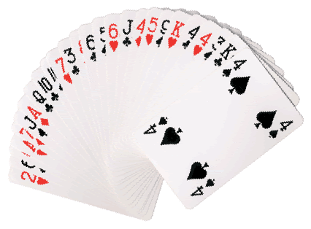
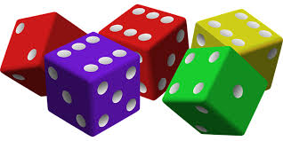
Introduction to Probability
Steven J Miller, Williams College
sjm1@Williams.edu
https://web.williams.edu/Mathematics/sjmiller/public_html/math/talks/talks.html

Slide 2
Part I: Factorials
https://web.williams.edu/Mathematics/sjmiller/public_html/math/talks/talks.html

Slide 3
Basics
Will explore simple probabilities.
Problems from card games, dice, ….
In many situations each event is equally likely, so the probability an event A happens is the number of ways A can happen, divided by the number of ways something can happen.
Example: Imagine we roll a fair die; our result is in the set {1, 2, 3, 4, 5, 6}.
What is the probability we roll a 6?
What is the probability we roll an even number?

Slide 4
Basics
Will explore simple probabilities.
Problems from card games, dice, ….
In many situations each event is equally likely, so the probability an event A happens is the number of ways A can happen, divided by the number of ways something can happen.
Example: Imagine we roll a fair die; our result is in the set {1, 2, 3, 4, 5, 6}.
What is the probability we roll a 6? 1/6 (six possible rolls, only one is a 6)
What is the probability we roll an even number? 3/6 or 1/2 (six possible rolls, and 2, 4 and 6 are even while the rest are odd).

Slide 5
Factorial Function n!
One of the most useful functions in probability is the factorial function. We denote the factorial of an integer n by writing n! (so n followed by an exclamation point).
It has a nice meaning: n! is the number of ways to arrange n objects when order matters.
Thus if we want to order the elements of {a} there is just one way.
If we want to order the elements of {a,b} there are two ways: ab and ba.
If we want to order the elements of {a,b,c} there are six ways:
abc, acb, bac, bca, cab, cba (why did we list this way?)

Slide 6
Factorial Function n!
It has a nice meaning: n! is the number of ways to arrange n objects when order matters.
If we want to order the elements of {a,b,c} there are six ways:
abc, acb, bac, bca, cab, cba (why did we list this way?)
We want to make sure we do not miss any cases. We first do all the ways with a as the first element, and then use the PREVIOUS result about how to order a set of two elements. Then we do all the ways with b as the first element, then all the ways with c first.

Slide 7
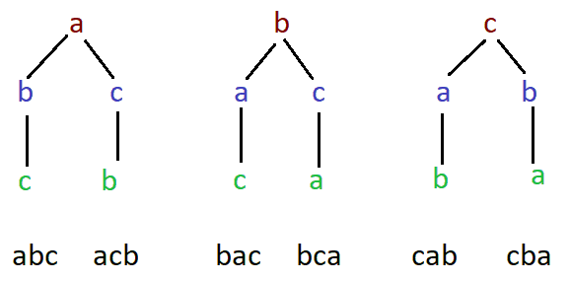
Factorial Function n!
It has a nice meaning: n! is the number of ways to arrange n objects when order matters. If we want to order the elements of {a,b,c} there are six ways:
abc, acb, bac, bca, cab, cba (why did we list this way?)

Slide 8
Factorial Function n!
It has a nice meaning: n! is the number of ways to arrange n objects when order matters.
How many ways are there to order {a,b,c,d}?

Slide 9
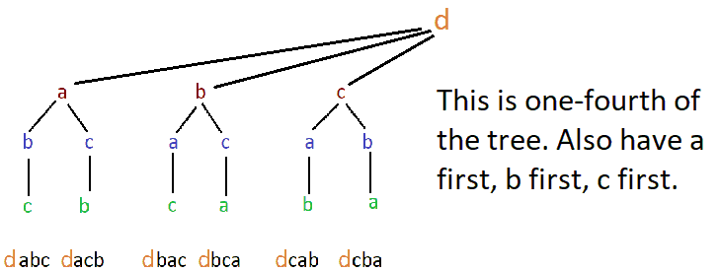
Factorial Function n!
It has a nice meaning: n! is the number of ways to arrange n objects when order matters.
How many ways are there to order {a,b,c,d}?

Slide 10
Factorial Function n!
The factorial function grows very rapidly.
The number of ways to order a deck of 52 cards is 52!, which is 80658175170943878571660636856403766975289505440883277824000000000000 (or about 10⁶⁸). To put in perspective, there are about 10⁸⁰ to 10⁹⁰ objects in the universe!
The number of ways to order the standard alphabet is 26! which is 403291461126605635584000000 (or about 10²⁶).

Slide 11
Factorial Function n!
What should 0! equal?
4! = 24 3! = 6 2! = 2 1! = 1
We have the interpretation that n! is the number of ways to order n objects when order matters.
How many ways are there to order zero objects?

Slide 12
Factorial Function n!
What should 0! equal?
4! = 24 3! = 6 2! = 2 1! = 1
We have the interpretation that n! is the number of ways to order n objects when order matters.
How many ways are there to order zero objects?
We DEFINE 0! to be 1; there is one way to do nothing (you can’t do nothing in more than one way). This turns out to be a VERY useful definition.

Slide 13
Factorial Function and Recursion
Note $4!=4 ∗3 ∗2 ∗1=4 ∗\left(3 ∗2 ∗1\right)=4 ∗3!.$
Similarly $5!=5 ∗ 4 ∗3 ∗2 ∗1=5∗\left(4 ∗ 3 ∗2 ∗1\right)=5 ∗4!.$
If you know n! it is very easy to find (n+1)!
$$\left(n+1\right)! =\left(n+1\right)∗n ∗ …∗3 ∗2 ∗1$$
$=\left(n+1\right)∗\left(n ∗\left(n−1\right)∗ …∗3 ∗2 ∗1\right)$
$$=\left(n+1\right)∗n!$$
(If you have seen Fibonacci numbers, another example of a recurrence.)

Slide 14
Part II: Permutations
https://web.williams.edu/Mathematics/sjmiller/public_html/math/talks/talks.html

Slide 15
Permutations: nPr or _{n}P_{r}
The factorial function is great for ordering n objects; what if we only want to order some of them?
For example, imagine we have five people: {a, b, c, d, e}. How many ways are there to choose two people where order matters (so the first chosen is president, the second is vice-president)? How many ways are there to choose three people where order matters?

Slide 16
Permutations: nPr
The factorial function is great for ordering n objects; what if we only want to order some of them? nPr or _{n}P_{r} is the number of ways to choose r people from n when order matters. P stands for permutations.
For example, imagine we have five people: {a, b, c, d, e}.
How many ways are there to choose two people where order matters (so the first chosen is president, the second is vice-president)?
20 ways: We have 5 choices for the first spot, and then 4 for the second: 5 * 4 = 20.
How many ways are there to choose three people where order matters?
60 ways: We have 5 choices for the first spot, 4 for the second, then 3 for the third:
5 * 4 * 3 = 60.
We denote the first 5P2 or ₅P₂ and the second 5P3 or ₅P₃.

Slide 17
Permutations: nPr
The factorial function is great for ordering n objects; what if we only want to order some of them? nPr or _{n}P_{r} is the number of ways to choose r people from n when order matters. P stands for permutations.
What if we want to choose 4 people from 11, order matters?
We have 11 choices for the first, then 10 for the second, then 9 for the third, then 8 for the fourth, or $11 ∗10 ∗9 ∗8.$
How can you write using factorials? Hint: you must do one of the most important algebraic attacks in mathematics: you multiply by 1. This doesn’t change the answer, but allows you to re-write the algebra.

Slide 18
Permutations: nPr
The factorial function is great for ordering n objects; what if we only want to order some of them? nPr or _{n}P_{r} is the number of ways to choose r people from n when order matters. P stands for permutations.
What if we want to choose 4 people from 11, order matters?
We have 11 choices for the first, then 10 for the second, then 9 for the third, then 8 for the fourth, or $11 ∗10 ∗9 ∗8.$
HINT: Note $11 ∗10 ∗9 ∗8$ looks a lot like 11!; what would we need to multiply it by to get 11!? You can’t multiply by anything other than 1 or you change the value, so what should we multiply it by?

Slide 19
Permutations: nPr
The factorial function is great for ordering n objects; what if we only want to order some of them? nPr or _{n}P_{r} is the number of ways to choose r people from n when order matters. P stands for permutations.
What if we want to choose 4 people from 11, order matters?
We have 11 choices for the first, then 10 for the second, then 9 for the third, then 8 for the fourth, or $11 ∗10 ∗9 ∗8.$
HINT: Note $11 ∗10 ∗9 ∗8$ looks a lot like 11!; what would we need to multiply it by to get 11!? You can’t multiply by anything other than 1 or you change the value, so what should we multiply it by? Multiply by 7!/7!, so
$11 ∗10 ∗9 ∗8$ = $11 ∗10 ∗9 ∗8 ∗ \frac{7!}{7!} =\frac{11 ∗ 10 ∗ 9 ∗ 8 ∗ 7!}{7!} =\frac{11!}{7!}$

Slide 20
Permutations: nPr
The factorial function is great for ordering n objects; what if we only want to order some of them? nPr or _{n}P_{r} is the number of ways to choose r people from n when order matters. P stands for permutations.
What if we want to choose 4 people from 11, order matters?
$11 ∗10 ∗9 ∗8$ = $11 ∗10 ∗9 ∗8 ∗ \frac{7!}{7!} =\frac{11 ∗ 10 ∗ 9 ∗ 8 ∗ 7!}{7!} =\frac{11!}{7!}$
More generally, what if we want to choose r people from n, order matters?

Slide 21
Permutations: nPr
The factorial function is great for ordering n objects; what if we only want to order some of them? nPr or _{n}P_{r} is the number of ways to choose r people from n when order matters. P stands for permutations.
What if we want to choose 4 people from 11?
$11 ∗10 ∗9 ∗8$ = $11 ∗10 ∗9 ∗8 ∗ \frac{7!}{7!} =\frac{11 ∗ 10 ∗ 9 ∗ 8 ∗ 7!}{7!} =\frac{11!}{7!}$
More generally, what if we want to choose r people from n, order matters? It is
$n ∗\left(n−1\right) ∗ …∗(n−\left(r−1\right))$ =$n ∗\left(n−1\right) ∗ …∗(n−\left(r−1\right))∗ \frac{(n−r)!}{(n−r)!}$
We thus find nPr or _{n}P_{r} equals $\frac{n!}{(n−r)!}$

Slide 22
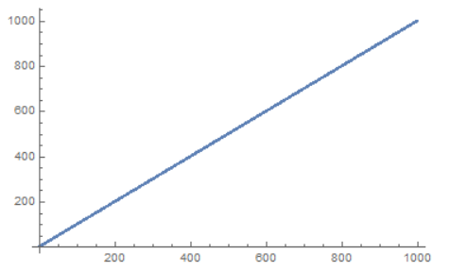
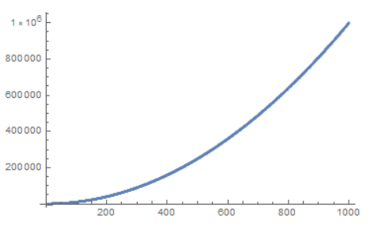
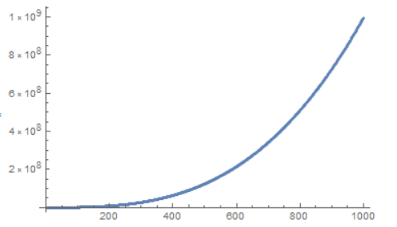
Permutations: nPr
We thus find nPr or _{n}P_{r} equals $\frac{n!}{(n−r)!}$. Grows a lot slower than n!
r = 1 r = 2 r = 3
What do these growth rates look like? They look like …..

Slide 23
Permutations: nPr
We thus find nPr or _{n}P_{r} equals $\frac{n!}{(n−r)!}$. Grows a lot slower than n!
r = 1 r = 2 r = 3
What do these growth rates look like? They look like polynomials.
First looks linear, others are harder but are quadratics and then cubics.
Can we prove? Can we find formulas for these?

Slide 24
Permutations: nPr
We thus find nPr or _{n}P_{r} equals $\frac{n!}{(n−r)!}$. Grows a lot slower than n!
r = 1 r = 2 r = 3
nP1 or _{n}P₁ is n!/(n-1)!. As n! = n * (n-1)! we have it equals n, so linear!
nP2 or _{n}P₂ is n!/(n-2)!. As n! = n * (n-1) * (n-2)! we have it equals n * (n-1), which equals n² – n, so quadratic!
In general, nPr is a polynomial of degree r. Good exercise to prove this.

Slide 25
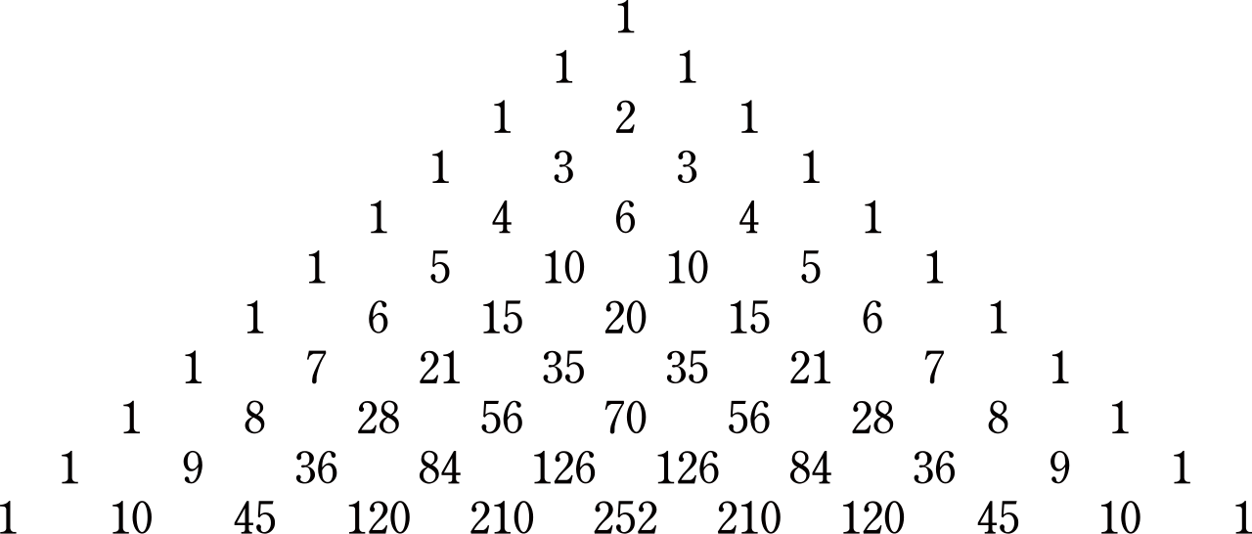
Part III: Combinations
https://web.williams.edu/Mathematics/sjmiller/public_html/math/talks/talks.html

Slide 26
Permutation Review: nPr or _{n}P_{r}
We saw n! is the number of ways of order n objects when order matters.
Then nPr or _{n}P_{r} is the number of ways of choosing r objects from n, when order matters. Note n! is nPr for some r – what r is it?

Slide 27
Permutation Review: nPr or _{n}P_{r}
We saw n! is the number of ways of order n objects when order matters.
Then nPr or _{n}P_{r} is the number of ways of choosing r objects from n, when order matters. Note n! is nPr for some r – it is r = n.
We saw we could write 11P4 as $11 ∗10 ∗9 ∗8 OR \frac{ 11!}{7!}$.
Both have advantages. We can see what is going on with $11 ∗10 ∗9 ∗8$, BUT if we have a factorial function defined then we can compute 11!/7! faster; imagine having to write out the product of 2020P1010.
Additionally, the ratio of factorials will help us see connections later in nCr.

Slide 28
Combinations: nCr or _{n}C_{r}
We saw n! is the number of ways of order n objects when order matters.
Then nPr or _{n}P_{r} is the number of ways of choosing r objects from n, when order matters. Note n! is nPr for some r – it is r = n.
We now introduce a new function: nCr or _{n}C_{r} is the number of ways to choose r objects from n when order DOES NOT matter; the C stands for combinations.
Let’s evaluate _{n}C_{r} for some r; can you think of some r where it is easy to figure out what _{n}C_{r} is? Try r = ….

Slide 29
Combinations: nCr or _{n}C_{r}
We saw n! is the number of ways to order n objects when order matters.
Then nPr or _{n}P_{r} is the number of ways of choosing r objects from n, when order matters. Note n! is nPr for some r – it is r = n.
We now introduce a new function: nCr or _{n}C_{r} is the number of ways to choose r objects from n when order DOES NOT matter; the C stands for combinations.
Let’s evaluate _{n}C_{r} for some r; can you think of some r where it is easy to figure out what _{n}C_{r} is? Hint: Try r = 0 or n. Then we find….

Slide 30
Combinations: nCr or _{n}C_{r}
We saw n! is the number of ways to order n objects when order matters.
Then nPr or _{n}P_{r} is the number of ways of choosing r objects from n, when order matters. Note n! is nPr for some r – it is r = n.
We now introduce a new function: nCr or _{n}C_{r} is the number of ways to choose r objects from n when order DOES NOT matter; the C stands for combinations.
Let’s evaluate _{n}C_{r} for some r; can you think of some r where it is easy to figure out what _{n}C_{r} is? Hint: Try r = 0 or n. Then we find _{n}C₀ = _{n}C_{n} = 1.

Slide 31
Combinations: nCr or _{n}C_{r}
We now introduce a new function: nCr or _{n}C_{r} is the number of ways to choose r objects from n when order DOES NOT matter; the C stands for combinations.
Let’s evaluate _{n}C_{r} for some r; can you think of some r where it is easy to figure out what _{n}C_{r} is? We find _{n}C₀ = _{n}C_{n} = 1.
What would _{n}C_{r} be when r = 1 or n-1? Note this is different than most presentations; we have NOT given the formula for _{n}C_{r} but instead are trying to find it….

Slide 32
Combinations: nCr or _{n}C_{r}
We now introduce a new function: nCr or _{n}C_{r} is the number of ways to choose r objects from n when order DOES NOT matter; the C stands for combinations.
Let’s evaluate _{n}C_{r} for some r. We find _{n}C₀ = _{n}C_{n} = 1.
What would _{n}C_{r} be when r = 1 or n-1?
If r = 1 we choose just one person. There are n ways to choose one person so _{n}C₁ = n.
If r = n-1 we choose everyone but one person for our set. There are n ways to choose a person to exclude, so _{n}C_{n-1} = n.
Hmm. Notice _{n}C₀ = _{n}C_{n} = 1 and _{n}C₁ = _{n}C_{n-1} = n. Any thoughts on what might be true more generally? Maybe compare the values at r and at what?

Slide 33
Combinations: nCr or _{n}C_{r}
We now introduce a new function: nCr or _{n}C_{r} is the number of ways to choose r objects from n when order DOES NOT matter; the C stands for combinations.
Let’s evaluate _{n}C_{r} for some r. We find _{n}C₀ = _{n}C_{n} = 1.
What would _{n}C_{r} be when r = 1 or n-1?
If r = 1 we choose just one person. There are n ways to choose one person so _{n}C₁ = n.
If r = n-1 we choose everyone but one person for our set. There are n ways to choose a person to exclude, so _{n}C_{n-1} = n.
Hmm. Notice _{n}C₀ = _{n}C_{n} = 1 and _{n}C₁ = _{n}C_{n-1} = n. Any thoughts on what might be true more generally? Maybe compare the values at r and n-r. Are these equal?

Slide 34
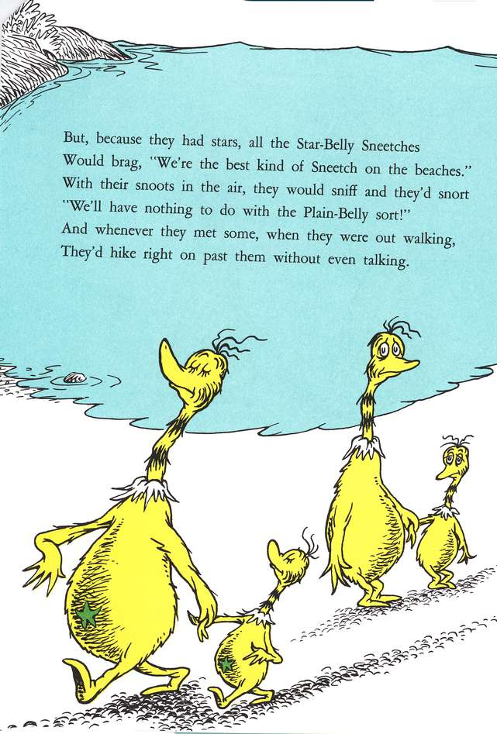
Combinations: nCr or _{n}C_{r}
We now introduce a new function: nCr or _{n}C_{r} is the number of ways to choose r objects from n when order DOES NOT matter; the C stands for combinations.
Let’s evaluate _{n}C_{r} for some r. We find _{n}C₀ = _{n}C_{n} = 1 and _{n}C₁ = _{n}C_{n-1} = n.
Compare the values at r and n-r. Are these equal?
Note choosing r from n to BE in the group is the same as choosing n-r to EXCLUDE.

Slide 35
Combinations: nCr or _{n}C_{r}
nCr or _{n}C_{r} is the number of ways to choose r objects from n when order DOES NOT matter; the C stands for combinations.
The factorial function is great for ordering n objects; what if we only want to order some of them? nPr or _{n}P_{r} is the number of ways to choose r people from n when order matters. P stands for permutations.
How do you think $nCr, r! and nPr= \frac{n!}{\left(n−r\right)!}$ are related?
r! is the number of ways to order r objects.
nPr is the number of ways to choose r objects from n when order matters.
nCr is the number of ways to choose r objects from n when order doesn’t matter.

Slide 36
Combinations: nCr or _{n}C_{r}
nCr or _{n}C_{r} is the number of ways to choose r objects from n when order DOES NOT matter; the C stands for combinations.
The factorial function is great for ordering n objects; what if we only want to order some of them? nPr or _{n}P_{r} is the number of ways to choose r people from n when order matters. P stands for permutations.
Claim: $nCr ∗r!=nPr= \frac{n!}{\left(n−r\right)!},$thus $nCr= \frac{n!}{r!\left(n−r\right)!}.$
Proof: $nPr$ is the number of ways to choose r objects from n when order MATTERS.
How many ways are there to order r objects? This is just r!.
Thus each UNORDERED group of size r contributes r! ORDERED sets.

Slide 37
Comparing nCr and nPr
nCr or _{n}C_{r} is the number of ways to choose r objects from n when order DOES NOT matter, while nPr or _{n}P_{r} is the number of ways to choose r people from n when order matters. P stands for permutations.
How many ways are there to choose 13 cards from a deck of 52 cards when order matters?
How many ways are there to choose 13 cards from a deck of 52 cards when order does not matter?
What is the probability of getting a given set of 13 cards?

Slide 38
Comparing nCr and nPr
nCr or _{n}C_{r} is the number of ways to choose r objects from n when order DOES NOT matter, while nPr or _{n}P_{r} is the number of ways to choose r people from n when order matters. P stands for permutations.
How many ways are there to choose 13 cards from a deck of 52 cards when order matters? 52P13 = 3,954,242,643,911,239,680,000 (about 10^{21.6}).
How many ways are there to choose 13 cards from a deck of 52 cards when order does not matter? 52C13 = 635,013,559,600 (about 10^{11.8})
What is the probability of getting a given set of 13 cards? 1/52C13 or about 1/10^{11.8}.

Slide 39
Distinct Deals in Bridge
nCr or _{n}C_{r} is the number of ways to choose r objects from n when order DOES NOT matter, while nPr or _{n}P_{r} is the number of ways to choose r people from n when order matters. P stands for permutations.
In a hand of bridge, each of the four players is dealt 13 cards. It does not matter what order you get the cards, only which cards you get.
How many ways are there to deal the cards?

Slide 40
Distinct Deals in Bridge
nCr or _{n}C_{r} is the number of ways to choose r objects from n when order DOES NOT matter, while nPr or _{n}P_{r} is the number of ways to choose r people from n when order matters. P stands for permutations.
In a hand of bridge, each of the four players is dealt 13 cards. It does not matter what order you get the cards, only which cards you get.
How many ways are there to deal the cards?
Answer: $52C13 ∗39C13 ∗26C13 ∗13C13$
Equals 53,644,737,765,488,792,839,237,440,000 (about 10^{28.7})
Do you think in all of human history there have ever been two deals the same?

Slide 41
Distinct Deals in Bridge
In a hand of bridge, each of the four players is dealt 13 cards. It does not matter what order you get the cards, only which cards you get.
How many ways are there to deal the cards?
Answer: $52C13 ∗39C13 ∗26C13 ∗13C13$
Equals 53,644,737,765,488,792,839,237,440,000 (about 10^{28.7295})
Do you think in all of human history there have ever been two deals the same?
Number of seconds since the universe began:
$60∗60∗24∗366 ∗14,000,000,000$ or about 10^{17.6}.
About 108,000,000,000 people have been born, if each deals a hand a second since the dawn of time get up to about 10^{28.6795}.

Slide 42
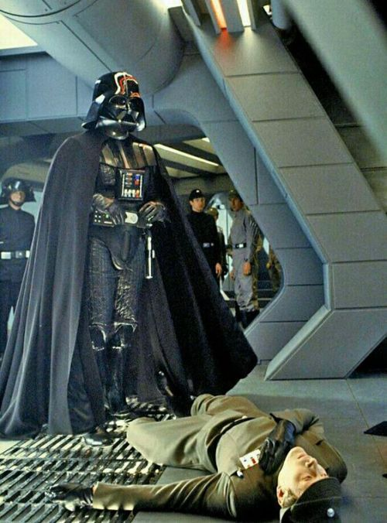
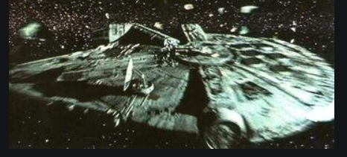
Part IV: May the Fourth Probabilities
https://web.williams.edu/Mathematics/sjmiller/public_html/math/talks/talks.html

Slide 43
Happy Star Wars Day!
In honor of today being Star Wars Day (May the Fourth be with you), will discuss some probabilities inspired by Star Wars.
Pre-requisite: The Geometric Series Formula (covered in an earlier lecture: Induction and Sums: Part III: From the Geometric Series Formula to Primes https://youtu.be/UWNM8EtzoMI, assuming algebra I, 22 minutes):
$$If \left|r\right|< 1 then 1+r+r2+r3+r4+ ∙∙∙ = \frac{1}{1−r}$$

Slide 44
The Geometric Series Formula (Review)
The Geometric Series Formula is one of the most important in mathematics. It is one of the few sums we can evaluate exactly.
If |r| < 1 then 1 + r + r² + r³ + r⁴ + … = $\frac{1}{1−r}.$
This is often proved by first computing the finite sum, up to r^{n}, and taking a limit. Note since |r| < 1 that each term r^{n} gets small fast…..

Slide 45
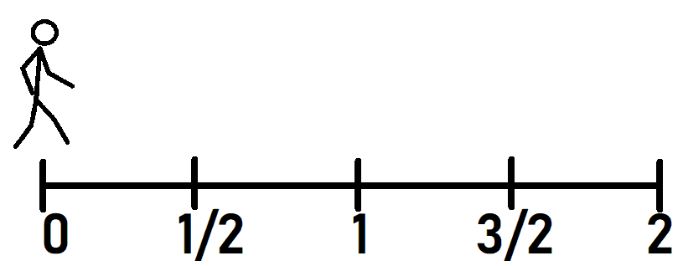
The Geometric Series Converges if |r| < 1: Review
$1 +r+r2+r3+r4 +…$ = $\frac{1}{1−r}.$
Why does this converge? Take r = ½. We then have 1 + ½ + ¼ + …. = $\frac{1}{1 −\frac{1}{2}} =2$, and we can view this as we start at 0, and each step covers half the distance to 2. We thus never reach it in finitely many steps, but we cover half the ground each time.

Slide 46
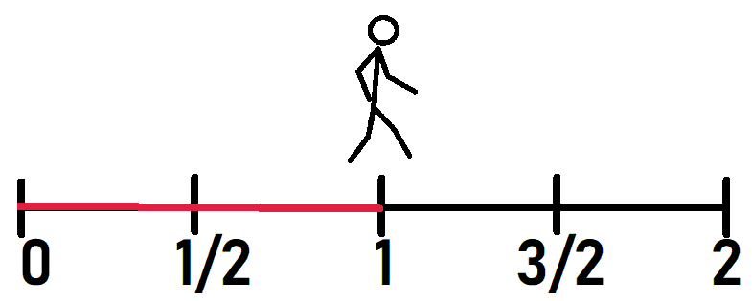
The Geometric Series Converges if |r| < 1: Review
$1 +r+r2+r3+r4 +…$ = $\frac{1}{1−r}.$
Why does this converge? Take r = ½. We then have 1 + ½ + ¼ + …. = $\frac{1}{1 −\frac{1}{2}} =2$, and we can view this as we start at 0, and each step covers half the distance to 2. We thus never reach it in finitely many steps, but we cover half the ground each time.

Slide 47
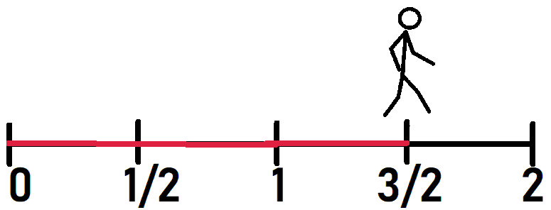
The Geometric Series Converges if |r| < 1: Review
$1 +r+r2+r3+r4 +…$ = $\frac{1}{1−r}.$
Why does this converge? Take r = ½. We then have 1 + ½ + ¼ + …. = $\frac{1}{1 −\frac{1}{2}} =2$, and we can view this as we start at 0, and each step covers half the distance to 2. We thus never reach it in finitely many steps, but we cover half the ground each time.

Slide 48
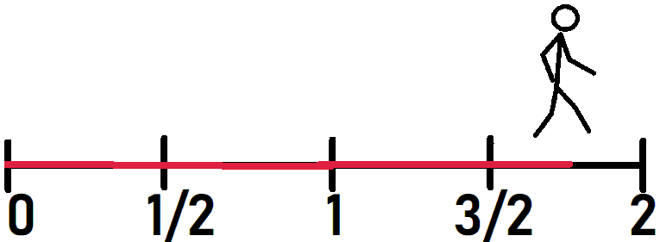
The Geometric Series Converges if |r| < 1: Review
$1 +r+r2+r3+r4 +…$ = $\frac{1}{1−r}.$
Why does this converge? Take r = ½. We then have 1 + ½ + ¼ + …. = $\frac{1}{1 −\frac{1}{2}} =2$, and we can view this as we start at 0, and each step covers half the distance to 2. We thus never reach it in finitely many steps, but we cover half the ground each time.

Slide 49
The Geometric Series Formula: Review
The Geometric Series Formula is one of the most important in mathematics. It is one of the few sums we can evaluate exactly.
Lemma: If |r| < 1 then 1 + r + r² + r³ + r⁴ + … + r^{n} = $\frac{1 −r^{n+1}}{1−r}.$
Proof: Let S_{n} = 1 + r + r² + r³ + r⁴ + … + r^{n}
Then r S_{n} = r + r² + r³ + r⁴ + … + r^{n} + r^{n+1}
What should we do now?

Slide 50
The Geometric Series Formula: Review
The Geometric Series Formula is one of the most important in mathematics. It is one of the few sums we can evaluate exactly.
Lemma: If |r| < 1 then 1 + r + r² + r³ + r⁴ + … + r^{n} = $\frac{1 −r^{n+1}}{1−r}.$
Proof: Let S_{n} = 1 + r + r² + r³ + r⁴ + … + r^{n}
Then r S_{n} = r + r² + r³ + r⁴ + … + r^{n} + r^{n+1}
Subtract: S_{n} – r S_{n} = 1 – r^{n+1},
So (1-r) S_{n} = 1 – r^{n+1}, or S_{n}

Slide 51
The Geometric Series Formula: Review
The Geometric Series Formula is one of the most important in mathematics. It is one of the few sums we can evaluate exactly.
Lemma: If |r| < 1 then 1 + r + r² + r³ + r⁴ + … + r^{n} = $\frac{1 −r^{n+1}}{1−r}.$
Proof: Let S_{n} = 1 + r + r² + r³ + r⁴ + … + r^{n}
Then r S_{n} = r + r² + r³ + r⁴ + … + r^{n} + r^{n+1}
Subtract: S_{n} – r S_{n} = 1 – r^{n+1},
So (1-r) S_{n} = 1 – r^{n+1}, or S_{n} = $\frac{1 −r^{n+1}}{1−r}$.
If we let n go to infinity, we see r^{n+1} goes to

Slide 52
The Geometric Series Formula: Review
The Geometric Series Formula is one of the most important in mathematics. It is one of the few sums we can evaluate exactly.
Lemma: If |r| < 1 then 1 + r + r² + r³ + r⁴ + … + r^{n} = $\frac{1 −r^{n+1}}{1−r}.$
Proof: Let S_{n} = 1 + r + r² + r³ + r⁴ + … + r^{n}
Then r S_{n} = r + r² + r³ + r⁴ + … + r^{n} + r^{n+1}
Subtract: S_{n} – r S_{n} = 1 – r^{n+1},
So (1-r) S_{n} = 1 – r^{n+1}, or S_{n} = $\frac{1 −r^{n+1}}{1−r}$.
If we let n go to infinity, we see r^{n+1} goes to 0, so we get the infinite sum is $\frac{1 }{1−r}$.

Slide 53
The Darth Vader Problem
Only the Emperor is less forgiving than Darth Vader; one mistake and you are dead! No one seems to fail him twice….
If your probability of failing him on a task is p, how many tasks till you die?

Slide 54
The Darth Vader Problem
If your probability of failing him on a task is p,
how many tasks till you die?
Could be unlucky and fail at the first task and die.
Could be very lucky and never fail and live a long, long time….
What is the probability your first failure is on your first task?
What is the probability your first failure is on your second task?
What is the probability your first failure is on your third task?
What is the probability your first failure is on your n^{th} task?

Slide 55
The Darth Vader Problem
If your probability of failing him on a task is p,
how many tasks till you die?
Could be unlucky and fail at the first task and die.
Could be very lucky and never fail and live a long, long time….
What is the probability your first failure is on your first task? p
What is the probability your first failure is on your second task? (1-p) p
What is the probability your first failure is on your third task? (1-p)² p
What is the probability your first failure is on your n^{th} task? (1-p)^{n-1} p

Slide 56
The Darth Vader Problem
If your probability of failing him on a task is p,
how many tasks till you die?
What is the probability your first failure is on your first task? p
What is the probability your first failure is on your second task? (1-p) p
What is the probability your first failure is on your third task? (1-p)² p
What is the probability your first failure is on your n^{th} task? (1-p)^{n-1} p
The EXPECTED VALUE of a random variable is the sum of the product of each value it takes on times the probability it takes on that value.
Here it is : $1∗Prob\left(first fail at 1\right)+2∗Prob\left(first fail at 2\right)+ ∙∙∙$

Slide 57
The Darth Vader Problem
If your probability of failing him on a task is p,
how many tasks till you die?
What is the probability your first failure is on your first task? p
What is the probability your first failure is on your second task? (1-p) p
What is the probability your first failure is on your third task? (1-p)² p
What is the probability your first failure is on your n^{th} task? (1-p)^{n-1} p
The EXPECTED VALUE of a random variable is the sum of the product of each value it takes on times the probability it takes on that value.
Here it is : $1∗p+2∗\left(1−p\right)p+3∗\left(1−p\right)2 p+ ∙∙∙ +n∗$(1-p)^{n-1} $p+∙∙∙$

Slide 58
The Darth Vader Problem: LOWER BOUND
If your probability of failing a task is p, how many tasks till you die?
The EXPECTED VALUE of a random variable is the sum of the product
of each value it takes on times the probability it takes on that value.
$$S\left(p\right)=p(1+2∗\left(1−p\right)+3∗\left(1−p\right)2 +4\left(1−p\right)3+ ∙∙∙)$$
Note $p(1+\left(1−p\right)+\left(1−p\right)2 +\left(1−p\right)3+ ∙∙∙$) $≤S\left(p\right)$
Using the Geometric Series formula with r = ???

Slide 59
The Darth Vader Problem: LOWER BOUND
If your probability of failing a task is p, how many tasks till you die?
The EXPECTED VALUE of a random variable is the sum of the product
of each value it takes on times the probability it takes on that value.
$$S\left(p\right)=p(1+2∗\left(1−p\right)+3∗\left(1−p\right)2 +4\left(1−p\right)3+ ∙∙∙)$$
Note $p(1+\left(1−p\right)+\left(1−p\right)2 +\left(1−p\right)3+ ∙∙∙$) $≤S\left(p\right)$
Using the Geometric Series formula with r = 1-p we get $p\frac{1}{1−(1−p)}$ $≤S\left(p\right)$
Gives the useless lower bound of S(p) is at least 1.

Slide 60
The Darth Vader Problem: UPPER BOUND
If your probability of failing a task is p, how many tasks till you die?
The EXPECTED VALUE of a random variable is the sum of the product
of each value it takes on times the probability it takes on that value.
$$S\left(p\right)=p(1+2∗\left(1−p\right)+3∗\left(1−p\right)2 +4\left(1−p\right)3+ ∙∙∙)$$
Note $p(1+2\left(1−p\right)+22\left(1−p\right)2 +23\left(1−p\right)3+ ∙∙∙$) $≥S\left(p\right)$
If (1-p) < ??? then we can use the geometric series with ratio r = ???.

Slide 61
The Darth Vader Problem: UPPER BOUND
If your probability of failing a task is p, how many tasks till you die?
The EXPECTED VALUE of a random variable is the sum of the product
of each value it takes on times the probability it takes on that value.
$$S\left(p\right)=p(1+2∗\left(1−p\right)+3∗\left(1−p\right)2 +4\left(1−p\right)3+ ∙∙∙)$$
Note $p(1+2\left(1−p\right)+22\left(1−p\right)2 +23\left(1−p\right)3+ ∙∙∙$) $≥S\left(p\right)$
If (1-p) < ½ then 2(1-p) < 1 so can use the Geometric Series formula and get $p \frac{1}{1−2(1−p)}≥S\left(p\right)$
For example, if p = ¾ gives an upper bound of 3/2 or 1.5.

Slide 62
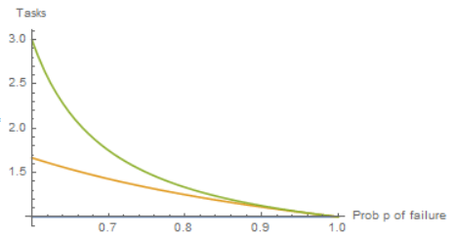
The Darth Vader Problem
If your probability of failing a task is p, how many tasks till you die?
The EXPECTED VALUE of a random variable is the sum of the product
of each value it takes on times the probability it takes on that value.
$$S\left(p\right)=p(1+2∗\left(1−p\right)+3∗\left(1−p\right)2 +4\left(1−p\right)3+ ∙∙∙)$$
Bounds: $If \left(1−p\right)<\frac{1}{2} so p>\frac{1}{2}$
Then $1 ≤S\left(p\right)≤ \frac{p}{1 −2\left(1−p\right)}.$

Slide 63
The Darth Vader Problem
If your probability of failing a task is p, how many tasks till you die?
The EXPECTED VALUE of a random variable is the sum of the product
of each value it takes on times the probability it takes on that value.
$$S\left(p\right)=p(1+2∗\left(1−p\right)+3∗\left(1−p\right)2 +4\left(1−p\right)3+ ∙∙∙)$$
Using Calculus one can show S(p) = 1/p; is this formula reasonable?
Look at extreme cases: what happens as p goes to 0 or 1?

Slide 64
The Darth Vader Problem
If your probability of failing a task is p, how many tasks till you die?
The EXPECTED VALUE of a random variable is the sum of the product
of each value it takes on times the probability it takes on that value.
$$S\left(p\right)=p(1+2∗\left(1−p\right)+3∗\left(1−p\right)2 +4\left(1−p\right)3+ ∙∙∙)$$
Using Calculus one can show S(p) = 1/p; is this formula reasonable?
Look at extreme cases: what happens as p goes to 0 or infinity?
As p goes to 1 you are a complete failure, and only do one tasks.
As p goes to 0 you never fail, and tasks goes to infinity!

Slide 65
The Darth Vader Problem
Probability of failing a task is p, how many tasks till you die?
$$S\left(p\right)=p(1+2∗\left(1−p\right)+3∗\left(1−p\right)2 +4\left(1−p\right)3+ ∙∙∙)$$
Let q = 1-p. Note this is p(1 + 2q + 3q² + 4q³ $+ ∙∙∙$).
We can rewrite: It is
p(1 + q + q² + q³ $+ ∙∙∙$) + p(q + q² + q³ $+ ∙∙∙$) + p (q² + q³ + q⁴ $+ ∙∙∙$) + $∙∙∙$
Each is a geometric series with ratios ???

Slide 66
The Darth Vader Problem
Probability of failing a task is p, how many tasks till you die?
$$S\left(p\right)=p(1+2∗\left(1−p\right)+3∗\left(1−p\right)2 +4\left(1−p\right)3+ ∙∙∙)$$
Let q = 1-p. Note this is p(1 + 2q + 3q² + 4q³ $+ ∙∙∙$).
We can rewrite: It is
p(1 + q + q² + q³ $+ ∙∙∙$) + p(q + q² + q³ $+ ∙∙∙$) + p (q² + q³ + q⁴ $+ ∙∙∙$) + $∙∙∙$
Each is a geometric series with ratios q, q, q, … but different starting terms.
S(p) = p (1 + q + q² + $∙∙∙$) + pq (1 + q + q² + $∙∙∙$) + pq² (1 + q + q² $+ ∙∙∙$) + $∙∙∙$
S(p) = $\left(p+pq+pq2+pq3+∙∙∙\right)$ $\frac{1}{1−q}$ =

Slide 67
The Darth Vader Problem
Probability of failing a task is p, how many tasks till you die?
$$S\left(p\right)=p(1+2∗\left(1−p\right)+3∗\left(1−p\right)2 +4\left(1−p\right)3+ ∙∙∙)$$
Let q = 1-p. Note this is p(1 + 2q + 3q² + 4q³ $+ ∙∙∙$).
We can rewrite: It is
p(1 + q + q² + q³ $+ ∙∙∙$) + p(q + q² + q³ $+ ∙∙∙$) + p (q² + q³ + q⁴ $+ ∙∙∙$) + $∙∙∙$
Each is a geometric series with ratios q, q, q, … but different starting terms.
S(p) = p (1 + q + q² + $∙∙∙$) + pq (1 + q + q² + $∙∙∙$) + pq² (1 + q + q² $+ ∙∙∙$) + $∙∙∙$
S(p) = $\left(p+pq+pq2+pq3+∙∙∙\right)$ $\frac{1}{1−q}$ = $p \left(1+q+q2+q3+∙∙∙\right)$ $\frac{1}{1−q}$ = $p$ $\frac{1}{1−q}$ $\frac{1}{1−q}$
Thus S(p) = 1/p as claimed! And without calculus!

Slide 68
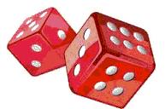
Part V: Die Another Game
https://youtu.be/tBz2GIxfYXA?t=2
https://web.williams.edu/Mathematics/sjmiller/public_html/math/talks/talks.html

Slide 69
The Darth Vader Problem: Review
Probability of failing a task is p, how many tasks till you die?
Answer: Expect 1/p.
Equivalently, if the probability of a success is p, the number of tasks or tries you need before the first success is 1/p.

Slide 70
The Sixes Game
Probability of failing a task is p, how many tasks till you die?
Answer: Expect 1/p.
Equivalently, if the probability of a success is p, the number of tasks or tries you need before the first success is 1/p.
We can use this to study a new game!
The sixes game: you roll a fair die until you get a 6. How many rolls do you expect before this happens?

Slide 71
The Sixes Game
Probability of failing a task is p, how many tasks till you die?
Answer: Expect 1/p
Equivalently, if the probability of a success is p, the number of tasks or tries you need before the first success is 1/p.
We can use this to study a new game!
The sixes game: you roll a fair die until you get a 6. How many rolls do you expect before this happens?
Answer: As the probability of rolling a 6 is p = 1/6 (all six outcomes are equally likely) we expect it will take 6 rolls.

Slide 72
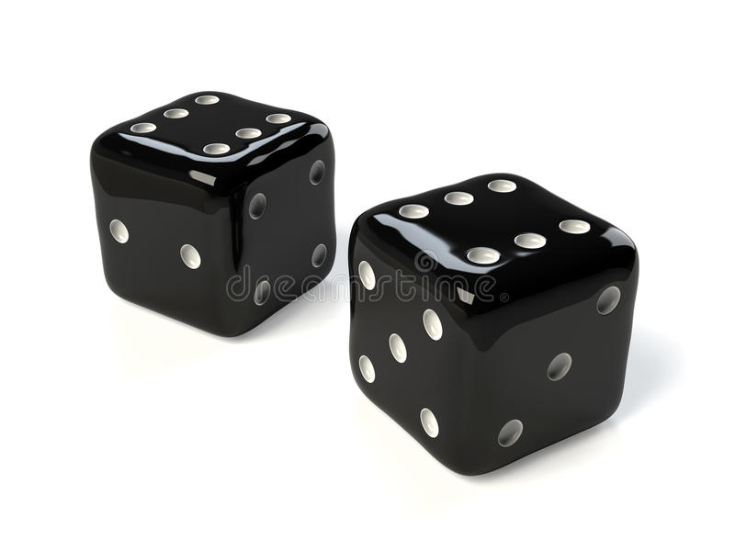
The Double Sixes Game
You have two fair die.
On each turn you can roll one or both of the die.
The goal is to have both show a 6.
Thus once one of the die lands on a 6 you can stop rolling it.
Questions:
How many rolls do you expect before you have double sixes?
What is the probability you win on your first turn? On your second? On your n^{th}?
Can we use the Darth Vader Theorem here? Why or why not?

Slide 73
The Double Sixes Game
You have two fair die.
On each turn you can roll one or both of the die.
The goal is to have both show a 6.
Thus once one of the die lands on a 6 you can stop rolling it.
Questions:
How many rolls do you expect before you have double sixes?
What is the probability you win on your first turn? On your second? On your n^{th}?
Can we use the Darth Vader Theorem here? Why or why not?
Hard to use: the difficulty is that our probability of a success is NOT constant; it depends on whether or not we rolled a 6 earlier…. Need a new method.

Slide 74
The Double Sixes Game
You have two fair die.
On each turn you can roll one or both of the die.
The goal is to have both show a 6.
Thus once one of the die lands on a 6 you can stop rolling it.
We will first find the probability of winning after a given number of rolls.
It is easy to find the probability of winning on the first roll: It is ???.

Slide 75
The Double Sixes Game
You have two fair die.
On each turn you can roll one or both of the die.
The goal is to have both show a 6.
Thus once one of the die lands on a 6 you can stop rolling it.
We will first find the probability of winning after a given number of rolls.
It is easy to find the probability of winning on the first roll: It is 1/36.
What is the probability you win on the second roll? It is ???.

Slide 76
The Double Sixes Game
You have two fair die.
On each turn you can roll one or both of the die.
The goal is to have both show a 6.
Thus once one of the die lands on a 6 you can stop rolling it.
We will first find the probability of winning after a given number of rolls.
It is easy to find the probability of winning on the first roll: It is 1/36.
What is the probability you win on the second roll? It is
10/36 * 1/6 + 25/36 * 1/36. But why???

Slide 77
The Double Sixes Game
You have two fair die. On each turn you can roll one or both of the die.
The goal is to have both show a 6. Thus once one of the die lands on a 6 you can stop rolling it.

Slide 78
Great Probability Results
We can continue the analysis, but there are more and more branches as we go down.
We introduce a WONDERFUL idea in probability:
The Law of Complementary Events: If the probability something happens is p, then the probability it does not happen is ????.

Slide 79
Great Probability Results
We can continue the analysis, but there are more and more branches as we go down.
We introduce a WONDERFUL idea in probability:
The Law of Complementary Events: If the probability something happens is p, then the probability it does not happen is 1-p.

Slide 80
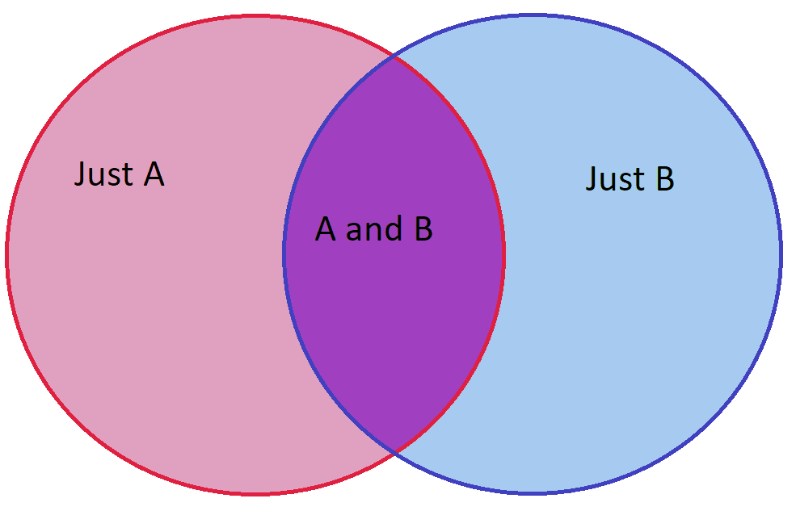
Great Probability Results
We introduce another WONDERFUL idea in probability:
The Law of Double Counting: The probability A or B happens is the sum of the probability each happens minus the probability they both happen:
Prob(A or B) = Prob(A) + Prob(B) – Prob(A and B).

Slide 81
The Double Sixes Game
You have two fair die. On each turn you can roll one or both of the die.
Want both to show a 6. Once one of the die lands on a 6 you can stop rolling it.
What is the probability we win by the n^{th} turn?
It is 1 minus the probability we have NOT won.
What is the probability we haven’t won? It is ???.
The Law of Complementary Events: If the probability something happens is p, then the probability it does not happen is 1-p.
The Law of Double Counting: The probability A or B happens is the sum of the probability each happens minus the probability they both happen:
Prob(A or B) = Prob(A) + Prob(B) – Prob(A and B).

Slide 82
The Double Sixes Game
You have two fair die. On each turn you can roll one or both of the die.
Want both to show a 6. Once one of the die lands on a 6 you can stop rolling it.
What is the probability we win by the n^{th} turn?
It is 1 minus the probability we have NOT won.
What is the probability we haven’t won? It is (5/6)^{n} + (5/6)^{n} – (25/36)^{n}.
Where did this come from? It is the probability the first die is never a 6 PLUS the probability the second is never a six, MINUS the probability neither die is ever a 6 (we must subtract as we we DOUBLE COUNTED that that probability).
The Law of Complementary Events: If the probability something happens is p, then the probability it does not happen is 1-p.
The Law of Double Counting: The probability A or B happens is the sum of the probability each happens minus the probability they both happen:
Prob(A or B) = Prob(A) + Prob(B) – Prob(A and B).

Slide 83
The Double Sixes Game
You have two fair die. On each turn you can roll one or both of the die.
The goal is to have both show a 6. Thus once one of the die lands on a 6 you can stop rolling it.
What is the probability we win BY the n^{th} turn? 1 – 2*(5/6)^{n} + (25/36)^{n}.
It is 1 minus the probability we have NOT won.
What is the probability we haven’t won? It is (5/6)^{n} + (5/6)^{n} – (25/36)^{n}.
So…, what is the probability we win ON the n^{th} turn?
The Law of Complementary Events: If the probability something happens is p, then the probability it does not happen is 1-p.

Slide 84
The Double Sixes Game
You have two fair die. On each turn you can roll one or both of the die.
The goal is to have both show a 6. Thus once one of the die lands on a 6 you can stop rolling it.
What is the probability we win BY the n^{th} turn? 1 – 2*(5/6)^{n} + (25/36)^{n}.
It is 1 minus the probability we have NOT won.
What is the probability we haven’t won? It is (5/6)^{n} + (5/6)^{n} – (25/36)^{n}.
So…, what is the probability we win ON the n^{th} turn?
It is the probability we win BY the n^{th} turn MINUS the probability we win BY the (n-1)^{st} turn! (1 – 2*(5/6)^{n} + (25/36)^{n}) – (1 – 2*(5/6)^{n-1} + (25/36)^{n-1})
The Law of Complementary Events: If the probability something happens is p, then the probability it does not happen is 1-p.

Slide 85
The Double Sixes Game
You have two fair die. On each turn you can roll one or both of the die.
The goal is to have both show a 6. Thus once one of the die lands on a 6 you can stop rolling it.
What is the probability we win BY the n^{th} turn? 1 – 2*(5/6)^{n} + (25/36)^{n}.
It is 1 minus the probability we have NOT won.
What is the probability we haven’t won? It is (5/6)^{n} + (5/6)^{n} – (25/36)^{n}.
So…, what is the probability we win ON the n^{th} turn?
It is the probability we win BY the n^{th} turn MINUS the probability we win BY the (n-1)^{st} turn! (2/6)(5/6)^{n-1} – (11/36)(25/36)^{n-1}.
The Law of Complementary Events: If the probability something happens is p, then the probability it does not happen is 1-p.

Slide 86
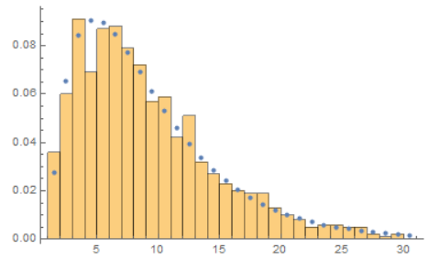
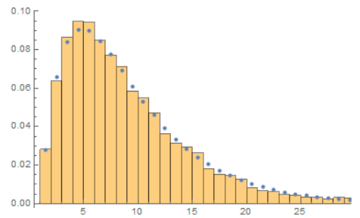
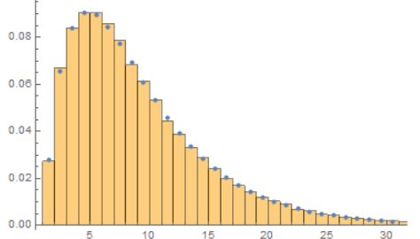
The Double Sixes Game
You have two fair die. On each turn you can roll one or both of the die.
The goal is to have both show a 6. Thus once one of the die lands on a 6 you can stop rolling it.
Probability win on n^{th} turn: (2/6)(5/6)^{n-1} – (11/36)(25/36)^{n-1}.
100 trials 10,000 trials 100,000 trials

Slide 87
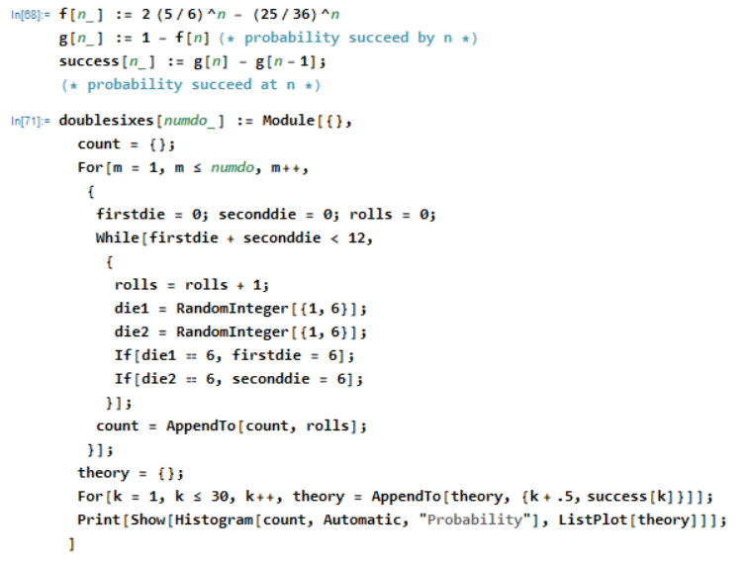
The Double Sixes Game: Code
Mathematica code to simulate

Slide 88
The Double Sixes Game: Expected Value
Need the FULL strength of the Darth Vader Theorem (friendly version).
The Darth Vader Theorem: If the probability of a success is p, then the expected number of trials until a success is 1/p. Furthermore:
$S\left(p\right)=p(1+2∗\left(1−p\right)+3∗\left(1−p\right)2 +4\left(1−p\right)3+ ∙∙∙)$ = 1/p.

Slide 89
The Double Sixes Game: Expected Value
Need the FULL strength of the Darth Vader Theorem (friendly version).
To computed the expected number of rolls until the Double Sixes game ends we need to compute the sum of n * Prob(takes exactly n rolls), n from 1 to infinity.
As Prob(takes exactly n rolls) = (2/6)(5/6)^{n-1} – (11/36)(25/36)^{n-1}.
Notation: $\sum_{n=1}^{∞}{an} means a1+a2+a3+ ∙∙∙$ (using a Greek Sigma for Sum)
We have $\sum_{n=1}^{∞}{n\left(\text{(2/6)(5/6)}\text{n}\text{−1 − (11/}\text{36)(25/36)}\text{n}\text{−1}\right)}$.
First term: $\frac{2}{6}\left(1+2 \left(\frac{5}{6}\right)+3{\left(\frac{5}{6}\right)}^{2}+4{\left(\frac{5}{6}\right)}^{3}+∙∙∙\right)$
The Darth Vader Theorem: If the probability of a success is p, then the expected number of trials until a success is 1/p. Furthermore:
$S\left(p\right)=p(1+2∗\left(1−p\right)+3∗\left(1−p\right)2 +4\left(1−p\right)3+ ∙∙∙)$ = 1/p.

Slide 90
The Double Sixes Game: Expected Value
Need the FULL strength of the Darth Vader Theorem (friendly version).
Notation: $\sum_{n=1}^{∞}{an} means a1+a2+a3+ ∙∙∙∙$ (using a Greek Sigma for Sum)
We have $\sum_{n=1}^{∞}{n\left(\text{(2/6)(5/6)}\text{n}\text{−1 − (11}\text{/36)(25/36)}\text{n}\text{−1}\right)}$.
Equals $\frac{2}{6}\sum_{n=1}^{∞}{n \text{(5/6)}\text{n}\text{−1}}$ - $\frac{11}{36}\sum_{n=1}^{∞}{n \text{(}\text{2}\text{5/}\text{3}\text{6)}\text{n}\text{−1}}$.
Each looks a lot like the Darth Vader Theorem – need to adjust a bit. What should p be for the first? For the second?
The Darth Vader Theorem: If the probability of a success is p, then the expected number of trials until a success is 1/p. Furthermore:
$S\left(p\right)=p(1+2∗\left(1−p\right)+3∗\left(1−p\right)2 +4\left(1−p\right)3+ ∙∙∙)$ = 1/p.

Slide 91
The Double Sixes Game: Expected Value
Need the FULL strength of the Darth Vader Theorem (friendly version).
Notation: $\sum_{n=1}^{∞}{an} means a1+a2+a3+ ∙∙∙∙$ (using a Greek Sigma for Sum)
We have $\sum_{n=1}^{∞}{n\left(\text{(2/6)(5/6)}\text{n}\text{−1 − (1}\text{1/36)(25/36)}\text{n}\text{−1}\right)}$.
Equals $\frac{2}{6}\sum_{n=1}^{∞}{n \text{(5/6)}\text{n}\text{−1}}$ - $\frac{11}{36}\sum_{n=1}^{∞}{n \text{(}\text{2}\text{5/}\text{3}\text{6)}\text{n}\text{−1}}$.
Each looks a lot like the Darth Vader Theorem – need to adjust a bit. What should be for the first? p = 1/6 (want 1-p = 5/6)
For the second? p = 11/36 (want 1-p = 25/36)
The Darth Vader Theorem: If the probability of a success is p, then the expected number of trials until a success is 1/p. Furthermore:
$S\left(p\right)=p(1+2∗\left(1−p\right)+3∗\left(1−p\right)2 +4\left(1−p\right)3+ ∙∙∙)$ = 1/p.

Slide 92
The Double Sixes Game: Expected Value
Need the FULL strength of the Darth Vader Theorem (friendly version).
Notation: $\sum_{n=1}^{∞}{an} means a1+a2+a3+ ∙∙∙∙$ (using a Greek Sigma for Sum)
We have $\sum_{n=1}^{∞}{n\left(\text{(2/6)(5/6)}\text{n}\text{−1 − (}\text{11/36)(25/36)}\text{n}\text{−1}\right)}$.
Equals $\frac{2}{6}\sum_{n=1}^{∞}{n \text{(5/6)}\text{n}\text{−1}}$ - $\frac{11}{36}\sum_{n=1}^{∞}{n \text{(}\text{2}\text{5/}\text{3}\text{6)}\text{n}\text{−1}}$.
Equals 2 * $\frac{1}{6}\sum_{n=1}^{∞}{n \text{(}\text{1 − 1}\text{/6)}\text{n}\text{−1}}$ - $\frac{11}{36}\sum_{n=1}^{∞}{n \text{(}\text{1 − 11}\text{/36)}\text{n}\text{−1}}$.
What is the first term? What is second?
The Darth Vader Theorem: If the probability of a success is p, then the expected number of trials until a success is 1/p. Furthermore:
$S\left(p\right)=p(1+2∗\left(1−p\right)+3∗\left(1−p\right)2 +4\left(1−p\right)3+ ∙∙∙)$ = 1/p.

Slide 93
The Double Sixes Game: Expected Value
Need the FULL strength of the Darth Vader Theorem (friendly version).
Notation: $\sum_{n=1}^{∞}{an} means a1+a2+a3+ ∙∙∙∙$ (using a Greek Sigma for Sum)
We have $\sum_{n=1}^{∞}{n\left(\text{(2/6)(5/6)}\text{n}\text{−1 − (11/}\text{36)(25/36)}\text{n}\text{−1}\right)}$.
Equals $\frac{2}{6}\sum_{n=1}^{∞}{n \text{(5/6)}\text{n}\text{−1}}$ - $\frac{11}{36}\sum_{n=1}^{∞}{n \text{(}\text{2}\text{5/}\text{3}\text{6)}\text{n}\text{−1}}$.
Equals 2 * $\frac{1}{6}\sum_{n=1}^{∞}{n \text{(}\text{1 − 1}\text{/6)}\text{n}\text{−1}}$ - $\frac{11}{36}\sum_{n=1}^{∞}{n \text{(}\text{1 − 11}\text{/36)}\text{n}\text{−1}}$.
What is the first term? 2 $∗\frac{1}{1/6}$ What is second? $\frac{1}{11/36}$ . Answer is ….
The Darth Vader Theorem: If the probability of a success is p, then the expected number of trials until a success is 1/p. Furthermore:
$S\left(p\right)=p(1+2∗\left(1−p\right)+3∗\left(1−p\right)2 +4\left(1−p\right)3+ ∙∙∙)$ = 1/p.

Slide 94
The Double Sixes Game: Expected Value
Need the FULL strength of the Darth Vader Theorem (friendly version).
Notation: $\sum_{n=1}^{∞}{an} means a1+a2+a3+ ∙∙∙∙$ (using a Greek Sigma for Sum)
We have $\sum_{n=1}^{∞}{n\left(\text{(2/6)(5/6)}\text{n}\text{−1 − (11/}\text{36)(25/36)}\text{n}\text{−1}\right)}$.
Equals 2 * $\frac{1}{6}\sum_{n=1}^{∞}{n \text{(}\text{1 − 1}\text{/6)}\text{n}\text{−1}}$ - $\frac{25}{11} \frac{11}{36}\sum_{n=1}^{∞}{n \text{(}\text{1 − 11}\text{/36)}\text{n}\text{−1}}$.
What is the first term? 2 $∗\frac{1}{1/6}$ What is second? $\frac{1}{11/36}$ .
Answer is $2∗6 −\frac{36}{11}$ = $\frac{96}{11}$ (or about 8.7 rolls until you get both sixes).
The Darth Vader Theorem: If the probability of a success is p, then the expected number of trials until a success is 1/p. Furthermore:
$S\left(p\right)=p(1+2∗\left(1−p\right)+3∗\left(1−p\right)2 +4\left(1−p\right)3+ ∙∙∙)$ = 1/p.

Slide 95
The Double Sixes Game: Expected Value
Answer is $2∗6 −\frac{36}{11}$ = $\frac{96}{11}$ (or about 8.7 rolls until you get both sixes).
Is this answer reasonable? Are you surprised by it? What tests can you do to see if it makes sense? What lower or upper bounds can you find?

Slide 96
The Double Sixes Game: Expected Value
Answer is $2∗6 −\frac{36}{11}$ = $\frac{96}{11}$ (or about 8.7 rolls until you get both sixes).
Is this answer reasonable? Are you surprised by it? What tests can you do to see if it makes sense?
In the six game (roll one die, stop when you get a 6) we saw the expected number of rolls is 6; as we now need TWO 6s, reasonable that it takes LONGER, and 6 is a LOWER BOUND.
If we played the six game twice (roll the first die until we get a 6, then start rolling the second die till we get a 6) expect to need 12 rolls. Thus 12 should be an UPPER BOUND. (Actually, can improve to 11 as an upper bound….)

Slide 97
Review: Big Takeaways
The Darth Vader Theorem: If the probability of a success is p, then the expected number of trials until a success is 1/p. Furthermore:
$S\left(p\right)=p(1+2∗\left(1−p\right)+3∗\left(1−p\right)2 +4\left(1−p\right)3+ ∙∙∙)$ = 1/p.
The Law of Complementary Events: If the probability something happens is p, then the probability it does not happen is 1-p.
The Law of Double Counting: The probability A or B happens is the sum of the probability each happens minus the probability they both happen:
Prob(A or B) = Prob(A) + Prob(B) – Prob(A and B).
The Power of Algebra: Sometimes have to do a bit of algebraic manipulations to make what you have look like something you know.

Slide 98
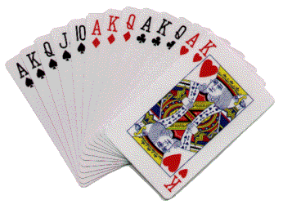
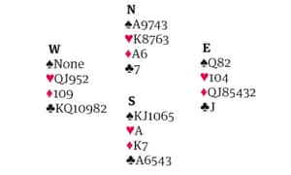
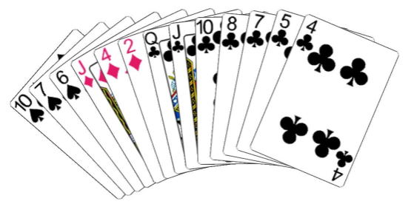
Part VI: Bridge Hands: Long Suits
$$nCr = \left({n \atop r}\right)$$
Thus $5C2 = \left({5 \atop 2}\right) =10$
https://web.williams.edu/Mathematics/sjmiller/public_html/math/talks/talks.html

Slide 99
Review: nCr
Recall the combinatorial function nCr: it is the number of ways to choose r objects from n, when order DOES NOT matter.
We use C for “combinations”.
We often write $\left({n \atop r}\right)$for nCr, and it equals $\frac{n!}{r!\left(n−r\right)!}$.
For example, 5C2 = 10. If we have 5 people {A,B,C,D,E} there are 5 ways to choose the first and then 4 ways to choose the second, and that gives us 5*4 = 20; however, this is ORDERED, this is 5P2. We remove the order by dividing by 2!, the number of ways to order two objects.

Slide 100
Review: Distinct Deals in Bridge
In a hand of bridge, each of the four players is dealt 13 cards. It does not matter what order you get the cards, only which cards you get.
How many ways are there to deal the cards?
Answer: $52C13 ∗39C13 ∗26C13 ∗13C13$
Equals 53,644,737,765,488,792,839,237,440,000 (about 10^{28.7295})
Do you think in all of human history there have ever been two deals the same?
Number of seconds since the universe began:
$60∗60∗24∗366 ∗14,000,000,000$ or about 10^{17.6}.
About 108,000,000,000 people have been born, if each deals a hand a second since the dawn of time get up to about 10^{28.6795}.

Slide 101
Long Suits in Bridge
In a hand of bridge, each of the four players is dealt 13 cards. It does not matter what order you get the cards, only which cards you get.
What is the probability you are dealt at least 7 cards in a suit?

Slide 102
Long Suits in Bridge
In a hand of bridge, each of the four players is dealt 13 cards. It does not matter what order you get the cards, only which cards you get.
What is the probability you are dealt at least 7 cards in a suit?
Break a hard problem into a lot of easier problems.
Note cannot have two 7 card suits (this is why we start with 7 and not 6!).
It is Prob(exactly one 7 card suit) + … + Prob(exactly one 13 card suit).
What are these probabilities? What is Prob(exactly one 7 card suit)?

Slide 103
Long Suits in Bridge
In a hand of bridge, each of the four players is dealt 13 cards. It does not matter what order you get the cards, only which cards you get.
What is the probability you are dealt at least 7 cards in a suit?
Break a hard problem into a lot of easier problems.
Note cannot have two 7 card suits (this is why we start with 7 and not 6!).
It is Prob(exactly one 7 card suit) + … + Prob(exactly one 13 card suit).
What are these probabilities?
Prob(exactly one 7 card suit) = $4C1 ∗13C7 ∗39C6$
Why? 4C1 ways to choose the suit, 13C7 ways to choose 7 cards in that suit, 39C6 ways to fill out the hand.

Slide 104
Long Suits in Bridge
In a hand of bridge, each of the four players is dealt 13 cards. It does not matter what order you get the cards, only which cards you get. NOTE: $nCr = \left({n \atop r}\right)$
What is the probability you are dealt at least 7 cards in a suit?
It is Prob(exactly one 7 card suit) + … + Prob(exactly one 13 card suit).
$$4C1∗13C7∗39C6 + 4C1∗13C8∗39C5+ ···+4C1∗13C13∗39C0$$
Can write compactly as $\sum_{k=7}^{13}{\left({4 \atop 1}\right)\left({13 \atop k}\right)}\left({39 \atop 13−k}\right)$ = 25,604,567,408.
There are $52C13$ = 635,013,559,600 hands.
Probability at least 7 in a suit is $\frac{\text{25,604,567,408}}{\text{635,013,559,600}}$ or about .04 (thus 4%).
Low probability, but happens enough that need to be prepared for it!

Slide 105
Long Suits in Bridge
In a hand of bridge, each of the four players is dealt 13 cards. It does not matter what order you get the cards, only which cards you get.
Probability at least 7 in a suit is $\frac{\text{25,604,567,408}}{\text{635,013,559,600}}$ or about .04 (thus 4%).
Similarly probability at least 8 is $\frac{\text{3}\text{,}\text{209}\text{,}\text{923}\text{,}\text{136}}{\text{635,013,559,600}}$ or about .005 (thus .5%).
Not surprisingly, almost all hands with at least 7 in a suit have exactly 7 in a suit.
It is $\frac{\text{25,604,567,408}\text{ − }\text{3,209,923,136}}{\text{25,604,567,408}}$ or about 87.5%

Slide 106
Long Suits in Bridge
In a hand of bridge, each of the four players is dealt 13 cards. It does not matter what order you get the cards, only which cards you get.
Probability at least 7 in a suit is $\frac{\text{25,604,567,408}}{\text{635,013,559,600}}$ or about .04 (thus 4%).
Similarly probability at least 8 is $\frac{\text{3}\text{,}\text{209}\text{,}\text{923}\text{,}\text{136}}{\text{635,013,559,600}}$ or about .005 (thus .5%).
What is the probability you have exactly 6 in a suit? What is the complication?

Slide 107
Long Suits in Bridge
In a hand of bridge, each of the four players is dealt 13 cards. It does not matter what order you get the cards, only which cards you get.
Probability at least 7 in a suit is $\frac{\text{25,604,567,408}}{\text{635,013,559,600}}$ or about .04 (thus 4%).
Similarly probability at least 8 is $\frac{\text{3}\text{,}\text{209}\text{,}\text{923}\text{,}\text{136}}{\text{635,013,559,600}}$ or about .005 (thus .5%).
What is the probability you have exactly 6 in a suit? What is the complication? The challenge is you could have TWO 6 card suits.

Slide 108
Recall a Great Probability Result
We recall a WONDERFUL idea in probability:
The Law of Double Counting: The probability A or B happens is the sum of the probability each happens minus the probability they both happen:
Prob(A or B) = Prob(A) + Prob(B) – Prob(A and B).

Slide 109
Probability have a suit with EXACTLY 6 cards
How many ways are there for a player to have exactly 6 cards in a specific suit?
The Law of Double Counting: The probability A or B happens is the sum of the probability each happens minus the probability they both happen:
Prob(A or B) = Prob(A) + Prob(B) – Prob(A and B).

Slide 110
Probability have a suit with EXACTLY 6 cards
How many ways are there for a player to have exactly 6 cards in a specific suit?
$$4C1 ∗13C6 ∗39C7.$$
There are 4C1 ways to choose the specific suit that they have 6 cards in, 13C6 ways to choose the 6 cards in the suit, and then 39C7 ways to choose the remaining cards.
The problem is while unlikely, it is POSSIBLE that they have another 6 (or even 7!) card suit in the remaining 39C7 cards…. How do we fix?
The Law of Double Counting: The probability A or B happens is the sum of the probability each happens minus the probability they both happen:
Prob(A or B) = Prob(A) + Prob(B) – Prob(A and B).

Slide 111
Probability have a suit with EXACTLY 6 cards
How many ways are there for a player to have exactly 6 cards in a specific suit?
$$4C1 ∗13C6 ∗39C7.$$
How many ways are there to have two suits with exactly 6 cards?
$$???.$$
How many ways are there to have one suit with 7 and one with 6 cards?
$$???.$$
The Law of Double Counting: The probability A or B happens is the sum of the probability each happens minus the probability they both happen:
Prob(A or B) = Prob(A) + Prob(B) – Prob(A and B).

Slide 112
Probability have a suit with EXACTLY 6 cards
How many ways are there for a player to have exactly 6 cards in a specific suit?
$$4C1 ∗13C6 ∗39C7.$$
How many ways are there to have two suits with exactly 6 cards?
$$4C2 ∗13C6 ∗13C6 ∗26C1.$$
How many ways are there to have one suit with 7 and one with 6 cards?
$$4C1 ∗13C7 ∗3C1 ∗13C6.$$
How likely do you think the last two probabilities are relative to the first? Is this REALLY something we need to worry about?
The Law of Double Counting: The probability A or B happens is the sum of the probability each happens minus the probability they both happen:
Prob(A or B) = Prob(A) + Prob(B) – Prob(A and B).

Slide 113
Probability have a suit with EXACTLY 6 cards
How many ways are there for a player to have exactly 6 cards in a specific suit?
$$4C1 ∗13C6 ∗39C7 =\text{105}\text{,}\text{574}\text{,}\text{751}\text{,}\text{568}.$$
How many ways are there to have two suits with exactly 6 cards?
$$4C2 ∗13C6 ∗13C6 ∗26C1 =\text{459}\text{,}\text{366}\text{,}\text{336}.$$
How many ways are there to have one suit with 7 and one with 6 cards?
$$4C1 ∗13C7 ∗3C1 ∗13C6 =\text{11}\text{,}\text{778}\text{,}\text{624}.$$
NO!!! While 459 million is a big number relative to most of our bank accounts, it is pretty small relative to 105 billion!
The Law of Double Counting: The probability A or B happens is the sum of the probability each happens minus the probability they both happen:
Prob(A or B) = Prob(A) + Prob(B) – Prob(A and B).

Slide 114
Probability have a suit with EXACTLY 6 cards
How many ways are there for a player to have exactly 6 cards in a specific suit?
$$4C1 ∗13C6 ∗39C7 =\text{105}\text{,}\text{574}\text{,}\text{751}\text{,}\text{568}.$$
How many ways are there to have two suits with exactly 6 cards?
$$4C2 ∗13C6 ∗13C6 ∗26C1 =\text{459}\text{,}\text{366}\text{,}\text{336}.$$
How many ways are there to have one suit with 7 and one with 6 cards?
$$4C1 ∗13C7 ∗3C1 ∗13C6 =\text{11}\text{,}\text{778}\text{,}\text{624}.$$
There are 52C13 = 635,013,559,600 possible hands.
Thus the probability have EXACTLY one 6 card suit is $\frac{\text{105,574,751,568} −\text{459,366,336} −\text{11,778,624}}{\text{635,013,559,600}}$ = $\frac{\text{938}\text{,}\text{425}\text{,}\text{059}}{\text{5}\text{,}\text{669}\text{,}\text{763}\text{,}\text{925}}$, about 16.6%!
The Law of Double Counting: The probability A or B happens is the sum of the probability each happens minus the probability they both happen:
Prob(A or B) = Prob(A) + Prob(B) – Prob(A and B).

Slide 115
Probability have a suit with EXACTLY 6 cards
The probability have EXACTLY one 6 card suit is
$\frac{\text{105,574,751,568} −\text{459,366,336} −\text{11,778,624}}{\text{635,013,559,600}}$ = $\frac{\text{938}\text{,}\text{425}\text{,}\text{059}}{\text{5}\text{,}\text{669}\text{,}\text{763}\text{,}\text{925}}$, about 16.6%!
The probability have EXACTLY TWO 6 card suits is
$\frac{\text{459,366,336} }{\text{635,013,559,600}}$ = $\frac{\text{28}\text{,}\text{710}\text{,}\text{396}}{\text{39}\text{,}\text{688}\text{,}\text{347}\text{,}\text{475}}$, about .07%!
The probability have EXACTLY 7 in one suit and EXACTLY 6 in another is
$\frac{\text{11,778,624}}{\text{635,013,559,600}}$ = $\frac{\text{736}\text{,}\text{164}}{\text{39,688,347,475}}$, about .00185%!
If play 100 games, first happens 17 times on average, we do expect to see often!
If play 1000 games, second happens .72 times on average, so don’t expect to see!
If play 10,000 games, third happens .19 times on average, so don’t expect to see!
This helps us figure out what bidding conventions we need – what is worth having!

Slide 116
Recap
Often more than one way to compute an answer.
Break a complicated probability into a sum of simpler probabilities; important that the cases are disjoint and cover all the possibilities.
Tremendous power in using nCr to compute the number of combinations.
Frequently there are smaller effects / lower order terms that you TECHNICALLY need to have the right answer, but they change things by a negligible amount….
If you can compute something two ways, do so – a great way to check your work!
If you can write a computer program to test your work that is OUTSTANDING!

Slide 117
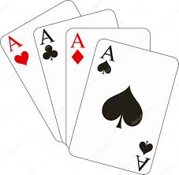
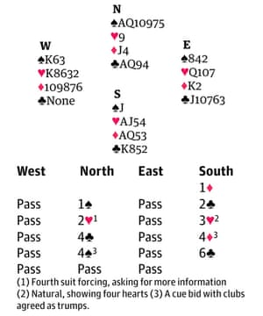
Part VII: Bridge Hands with bad splits, Aces Up
https://web.williams.edu/Mathematics/sjmiller/public_html/math/talks/talks.html

Slide 118
Review: nCr
Recall the combinatorial function nCr: it is the number of ways to choose r objects from n, when order DOES NOT matter.
We use C for “combinations”.
We often write $\left({n \atop r}\right)$for nCr, and it equals $\frac{n!}{r!\left(n−r\right)!}$.
For example, 5C2 = 10. If we have 5 people {A,B,C,D,E} there are 5 ways to choose the first and then 4 ways to choose the second, and that gives us 5*4 = 20; however, this is ORDERED, this is 5P2. We remove the order by dividing by 2!, the number of ways to order two objects.

Slide 119
Trump Splits II: The Bad 5-0 Split
In a hand of bridge, each of the four players is dealt 13 cards. It does not matter what order you get the cards, only which cards you get.
What if you and your partner have 8 trump; what are the odds the remaining 5 are all in the same hand?

Slide 120
Trump Splits II: The Bad 5-0 Split
In a hand of bridge, each of the four players is dealt 13 cards. It does not matter what order you get the cards, only which cards you get.
What if you and your partner have 8 trump; what are the odds the remaining 5 are all in the same hand?
One solution: There are $2C1 ∗ 5C5 ∗ 21C8 ∗ 13C13 =\text{406}\text{,}\text{980}$.
(there are 2 ways to choose which player gets the 5 trump, then give all 5 to that player, then give that player any 8 of the remaining 21 cards, then give all the remaining cards to the final player)
The number of ways to assign the remaining 26 cards is $26C13 ∗13C13=\text{104}\text{,}\text{006}\text{,0}\text{00}$.
Thus probability is $\text{406,9}\text{80}$ / $\text{104,006,000}$ = 9/230 or about .039 (or 3.9%).

Slide 121
Trump Splits II: The Bad 5-0 Split
In a hand of bridge, each of the four players is dealt 13 cards. It does not matter what order you get the cards, only which cards you get.
What if you and your partner have 8 trump; what are the odds the remaining 5 are all in the same hand?
One solution: There are $2C1 ∗ 5C5 ∗ 21C8 ∗ 13C13 =\text{406}\text{,}\text{980}$.
Number of ways to assign 26 cards is $26C13 ∗13C13=\text{104,006,000}$.
Thus probability is $\text{406,9}\text{80}$ / $\text{104,006,000}$ = 9/230 or about .039 (or 3.9%).
Could we say the answer is 2 * (1/2)⁵ as there are two players who could get all 5, and each card has a 50-50 chance?

Slide 122
Trump Splits II: The Bad 5-0 Split
In a hand of bridge, each of the four players is dealt 13 cards. It does not matter what order you get the cards, only which cards you get.
What if you and your partner have 8 trump; what are the odds the remaining 5 are all in the same hand?
One solution: There are $2C1 ∗ 5C5 ∗ 21C8 ∗ 13C13 =\text{406}\text{,}\text{980}$.
Thus probability is $\text{406,9}\text{80}$ / $\text{104,006,000}$ = 9/230 or about .039 (or 3.9%).
Could we say the answer is 2 * (1/2)⁵ as there are two players who could get all 5, and each card has a 50-50 chance? Note this equals 1/16 or 6.25%. Why is this wrong?

Slide 123
Trump Splits II: The Bad 5-0 Split
In a hand of bridge, each of the four players is dealt 13 cards. It does not matter what order you get the cards, only which cards you get.
What if you and your partner have 8 trump; what are the odds the remaining 5 are all in the same hand?
One solution: There are $2C1 ∗ 5C5 ∗ 21C8 ∗ 13C13 =\text{406}\text{,}\text{980}$.
Thus probability is $\text{406,9}\text{80}$ / $\text{104,006,000}$ = 9/230 or about .039 (or 3.9%).
Could we say the answer is 2 * (1/2)⁵ as there are two players who could get all 5, and each card has a 50-50 chance? Note this equals 1/16 or 6.25%. Why is this wrong? As we hand out the cards, subsequent ones no longer have a 50-50 chance. Answer is 2 (13/26)(12/25)(11/24)(10/23)(9/22) = 9/230.

Slide 124
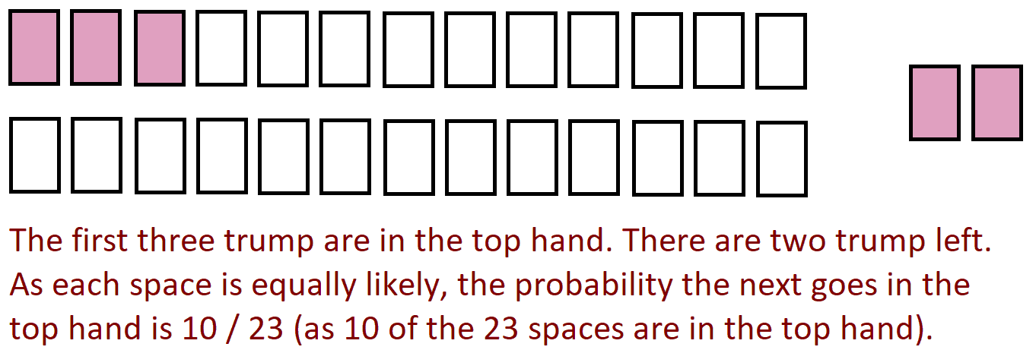
Trump Splits II: The Bad 5-0 Split
What if you and your partner have 8 trump; what are the odds the remaining 5 are all in the same hand?
Could we say the answer is 2 * (1/2)⁵ as there are two players who could get all 5, and each card has a 50-50 chance? Note this equals 1/16 or 6.25%. Why is this wrong? As we hand out the cards, subsequent ones no longer have a 50-50 chance. Answer is 2 (13/26)(12/25)(11/24)(10/23)(9/22) = 9/230.

Slide 125
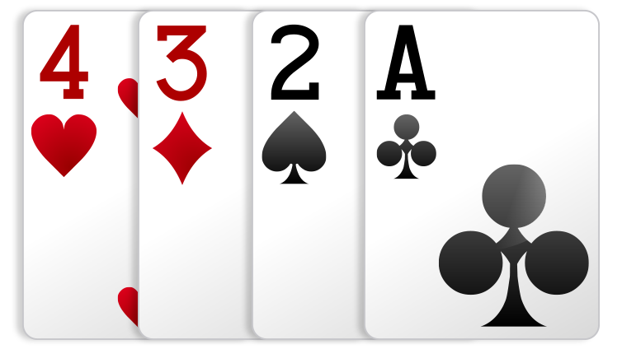
Aces Up
What is the probability the last four cards are in different suits, and thus no matter how well you play, you will LOSE?

Slide 126
Aces Up
What is the probability the last four cards are in different suits?
There are many ways to compute this.
We could look at each card, one at a time, and each is in a different suit than the previous.
We can choose one card from each suit.
Which do you prefer? Why? Will they give the same answer (they better!).
Try to solve it. Note there are 52P4 = 6,497,400 ways to choose 4 cards when order DOES matters, and 52C4 = 270,725 ways to choose 4 cards when order DOES NOT matter.

Slide 127
Aces Up
What is the probability the last four cards are in different suits?
There are many ways to compute this.
We could look at each card, one at a time, and each is in a different suit than the previous. $\frac{52}{52} ∗ \frac{??}{??} ∗$ $\frac{??}{??} ∗ \frac{??}{??}$ = $\frac{??}{??}$
We can choose one card from each suit.
Which do you prefer? Why? Will they give the same answer (they better!).
Try to solve it. Note there are 52P4 = 6,497,400 ways to choose 4 cards when order DOES matters, and 52C4 = 270,725 ways to choose 4 cards when order DOES NOT matter.

Slide 128
Aces Up
What is the probability the last four cards are in different suits?
There are many ways to compute this.
We could look at each card, one at a time, and each is in a different suit than the previous. $\frac{52}{52} ∗ \frac{39}{51} ∗$ $\frac{??}{??} ∗ \frac{??}{??}$ = $\frac{??}{??}$
We can choose one card from each suit.
Which do you prefer? Why? Will they give the same answer (they better!).
Try to solve it. Note there are 52P4 = 6,497,400 ways to choose 4 cards when order DOES matters, and 52C4 = 270,725 ways to choose 4 cards when order DOES NOT matter.

Slide 129
Aces Up
What is the probability the last four cards are in different suits?
There are many ways to compute this.
We could look at each card, one at a time, and each is in a different suit than the previous. $\frac{52}{52} ∗ \frac{39}{51} ∗$ $\frac{26}{50} ∗ \frac{13}{49}$ = $\frac{2197}{20825}$ or about 10.5%
We can choose one card from each suit. $\frac{\left({?? \atop ??}\right) ∗\left({?? \atop ??}\right)∗\left({?? \atop ??}\right)∗\left({?? \atop ??}\right)}{\left({?? \atop ??}\right)}$
Which do you prefer? Why? Will they give the same answer (they better!).
Try to solve it. Note there are 52P4 = 6,497,400 ways to choose 4 cards when order DOES matters, and 52C4 = 270,725 ways to choose 4 cards when order DOES NOT matter.

Slide 130
Aces Up
What is the probability the last four cards are in different suits?
There are many ways to compute this.
We could look at each card, one at a time, and each is in a different suit than the previous. $\frac{52}{52} ∗ \frac{39}{51} ∗$ $\frac{26}{50} ∗ \frac{13}{49}$ = $\frac{2197}{20825}$ or about 10.5%
We can choose one card from each suit.. $\frac{\left({13 \atop 1}\right)∗\left({13 \atop 1}\right)∗\left({13 \atop 1}\right)∗\left({13 \atop 1}\right)}{\left({52 \atop 4}\right)}$ = $\frac{2197}{20825}$.
Always good to calculate something two different ways!
Also, if you can, test with a computer program!!!

Slide 131
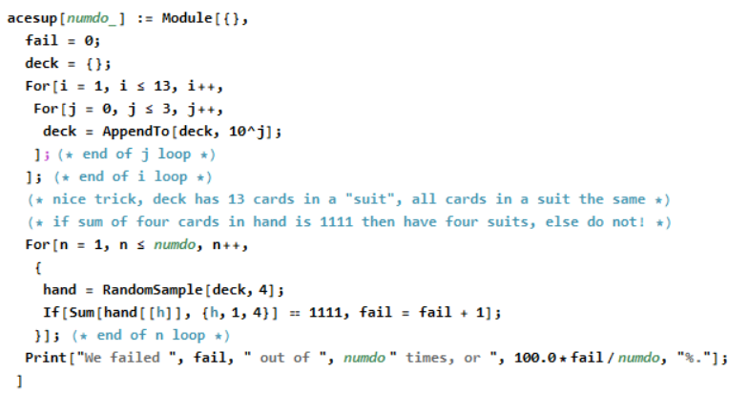
Aces Up
What is the probability the last four cards are in different suits?

Slide 132
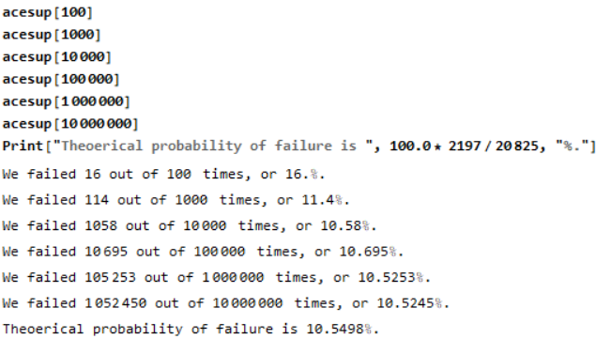
Aces Up
What is the probability the last four cards are in different suits?

Slide 133
Recap
Often more than one way to compute an answer.
Break a complicated probability into a sum of simpler probabilities; important that the cases are disjoint and cover all the possibilities.
Tremendous power in using nCr to compute the number of combinations.
Frequently there are smaller effects / lower order terms that you TECHNICALLY need to have the right answer, but they change things by a negligible amount….
If you can compute something two ways, do so – a great way to check your work!
If you can write a computer program to test your work that is OUTSTANDING!

Slide 134
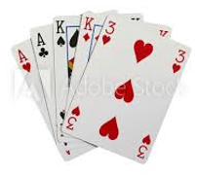
Part VIII: Advanced Bridge and Poker Hands
https://web.williams.edu/Mathematics/sjmiller/public_html/math/talks/talks.html
Steven J Miller – Williams College – sjm1@williams.edu

Slide 135
Review: nCr
Recall the combinatorial function nCr: it is the number of ways to choose r objects from n, when order DOES NOT matter.
We use C for “combinations”.
We often write $\left({n \atop r}\right)$for nCr, and it equals $\frac{n!}{r!\left(n−r\right)!}$.
For example, 5C2 = 10. If we have 5 people {A,B,C,D,E} there are 5 ways to choose the first and then 4 ways to choose the second, and that gives us 5*4 = 20; however, this is ORDERED, this is 5P2. We remove the order by dividing by 2!, the number of ways to order two objects.

Slide 136
Modified Two Handed Bridge: Getting all Trump
Let’s say hearts are trump. Go through the deck looking at the cards two at a time. In each pair choose one card, and discard the other.
You end with 26 cards; one comes from cards 1 and 2, one comes from cards 3 and 4, …, one comes from cards 51 and 52.
If you always choose a heart if it is available, what is the probability you end up with all 13 hears?
What could prevent you from being able to have all 13 hearts?

Slide 137
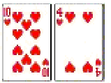
Modified Two Handed Bridge: Getting all Trump
Let’s say hearts are trump. Go through the deck looking at the cards two at a time. In each pair choose one card, and discard the other.
You end with 26 cards; one comes from cards 1 and 2, one comes from cards 3 and 4, …, one comes from cards 51 and 52.
If you always choose a heart if it is available, what is the probability you end up with all 13 hears?
What could prevent you from being able to have all 13 hearts?
You lose if you ever have two hearts in the same pair.

Slide 138
Modified Two Handed Bridge: Getting all Trump
Let’s say hearts are trump. Go through the deck looking at the cards two at a time. In each pair choose one card, and discard the other. You end with 26 cards; one comes from cards 1 and 2, …, one comes from cards 51 and 52. If you always choose a heart if it is available, what is the probability you end up with all 13 hears?
Here is one way to view it: You choose ??? of the 26 pairs to have exactly one heart, each pair you have ??? choices to place the heart, you then have ??? ways to place the 13 hearts in these spots, and you then have ??? ways to place the remaining 39 cards. You then divide by the number of ways to place the 52 cards, which is ???. Notice using order.

Slide 139
Modified Two Handed Bridge: Getting all Trump
Let’s say hearts are trump. Go through the deck looking at the cards two at a time. In each pair choose one card, and discard the other. You end with 26 cards; one comes from cards 1 and 2, …, one comes from cards 51 and 52. If you always choose a heart if it is available, what is the probability you end up with all 13 hears?
Here is one way to view it: You choose 13 of the 26 pairs to have exactly one heart, each pair you have 2 choices to place the heart, you then have 13! ways to place the 13 hearts in these spots, and you then have 39! ways to place the remaining 39 cards. You then divide by the number of ways to place the 52 cards, which is 52P52 = 52!. Notice using order.
Answer: $26C13 ∗213 ∗13!∗39! / 52!$ = 77824/580027, approximately 13.4%.

Slide 140
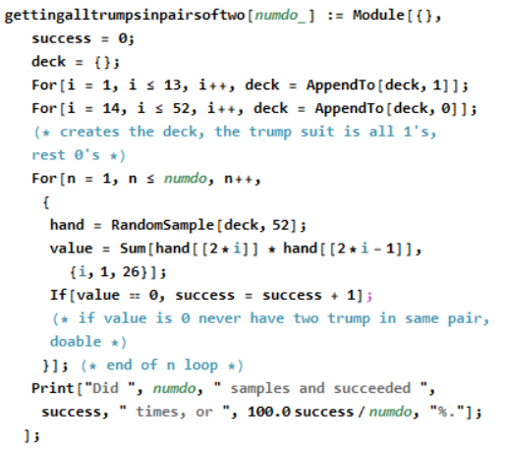
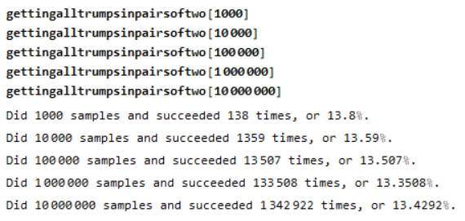
Modified Two Handed Bridge: Getting all Trump
.

Slide 141
Modified Two Handed Bridge: Getting all Trump
.
Worth commenting on the code.
The deck is {1,…,1,0,…,0} where we have 13 cards are a 1, and 39 cards are a 0.
Why?
We only care if a card is trump or not trump – that is all we need to keep track of when we code!

Slide 142
Modified Two Handed Bridge: Getting all Trump
.
Other versions:
It is trivial to do if you look at the cards one at a time.
What if you look at the cards 4 at a time and you choose one each time? It is JUST barely possible – compute the probability you can do it.
Can you do it if you choose one out of every 6 cards?

Slide 143
Poker Problem: 5 Cards, at least two Aces, two Kings
Consider a 5 card poker hand. What is the probability have at least
two Aces and at least two Kings?
How can you do this? What hands would work? What is the difficulty?

Slide 144
Poker Problem: 5 Cards, at least two Aces, two Kings
Consider a 5 card poker hand. What is the probability have at least
two Aces and at least two Kings?
How can you do this? What hands would work? What is the difficulty?
AAAKK, AAKKK, AAKKX
Challenge is could have three of a kind and a pair.
Have to be careful not to double count.
What are the probabilities of each of the three configurations? How many hands?

Slide 145
Poker Problem: 5 Cards, at least two Aces, two Kings
Consider a 5 card poker hand. What is the probability have at least
two Aces and at least two Kings?
How can you do this? What hands would work? What is the difficulty?
AAAKK: $4C3 ∗4C2 = 4 ∗6 = 24$
AAKKK: $4C2 ∗4C3 = 6 ∗4 = 24$
AAKKX: $4C2 ∗4C2 ∗44C1 = 6 ∗6 ∗44 =1584$
5 card hands: $52C5 =\text{2}\text{,}\text{598}\text{,}\text{960}$.
Probability is $\frac{24+24+1584}{\text{2598960}} = \frac{1633}{\text{2598960}} = .0628\%.$

Slide 146
Poker Problem: 5 Cards, at least two Aces, two Kings
Consider a 5 card poker hand. What is the probability have at least
two Aces and at least two Kings
AAAKK: $4C3 ∗4C2 = 4 ∗6 = 24$
AAKKK: $4C2 ∗4C3 = 6 ∗4 = 24$
AAKKX: $4C2 ∗4C2 ∗44C1 = 6 ∗6 ∗44 =1584$
5 card hands: $52C5 =\text{2}\text{,}\text{598}\text{,}\text{960}$.
Probability is $\frac{24+24+1584}{\text{2598960}} = \frac{1633}{\text{2598960}} = .0628328\%.$
Another Approach: Choose two Aces, choose two kings, choose another card.
$4C2 ∗4C2 ∗48C1 =1728, so \frac{1728}{\text{2598960}}$ or about .0664881%.
Which is right? Why?

Slide 147
Poker Problem: 5 Cards, at least two Aces, two Kings
Consider a 5 card poker hand. What is the probability have at least
two Aces and at least two Kings?
AAAKK: $4C3 ∗4C2 = 4 ∗6 = 24$
AAKKK: $4C2 ∗4C3 = 6 ∗4 = 24$
AAKKX: $4C2 ∗4C2 ∗44C1 = 6 ∗6 ∗44 =1584$
5 card hands: $52C5 =\text{2}\text{,}\text{598}\text{,}\text{960}$.
Probability is $\frac{24+24+1584}{\text{2598960}} = \frac{1633}{\text{2598960}} = .0628328\%.$
Another Approach: Choose two Aces, choose two kings, choose another card.
Another Approach: $4C2 ∗4C2 ∗48C1 =1728, so \frac{1728}{\text{2598960}}$ or about .0664881%.
The first – the second approach triple counts! The “third” ace could be in the 48C1.
Note (1728-1584) = 144, and 144/3 = 48 = 24+24, the AAAKK and AAKKK.

Slide 148
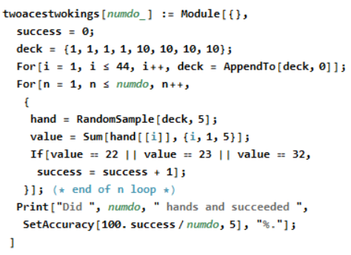
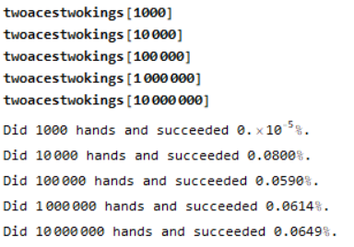
Poker Problem: 5 Cards, at least two Aces, two Kings
Consider a 5 card poker hand. What is the probability have at least
two Aces and at least two Kings? Is it $.0628328\% or .0664881\%$?

Slide 149
Poker Problem: 5 Cards, at least two Aces, two Kings
Consider a 5 card poker hand. What is the probability have at least
two Aces and at least two Kings? Is it $.0628328\% or .\text{0664881\%}$?
The problem is that the simulation is not good enough to determine which probability is correct, as they are so close. We need to go up to 100,000,000; it took about 20 seconds to do a million….

Slide 150
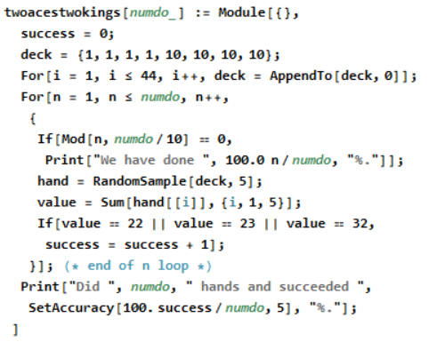
Poker Problem: 5 Cards, at least two Aces, two Kings
Consider a 5 card poker hand. What is the probability have at least
two Aces and at least two Kings? Is it $.0628328\% or$0664881%?
Did 100,000,000 hands and succeeded approximately 0.0626%.
Took 21.46 seconds to do 1,000,000 and 2157.58 seconds for 100,000,000.

Slide 151
Part IX: Advanced Combinations
https://web.williams.edu/Mathematics/sjmiller/public_html/math/talks/talks.html

Slide 152
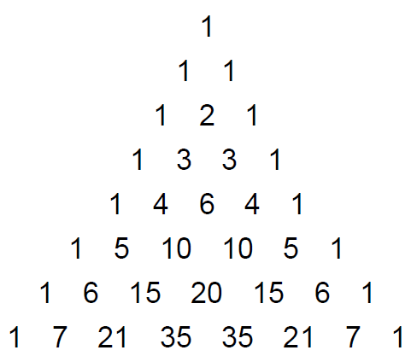
Expanding (x + y)^{n}
(x + y)⁰ = 1
(x + y)¹ = 1 x + 1 y
(x + y)² = 1 x² + 2 x y + 1 y².
(x + y)³ = 1 x³ + 3 x² y + 3 x y² + 1 y³.
We can keep going and get more and more rows…..

Slide 153
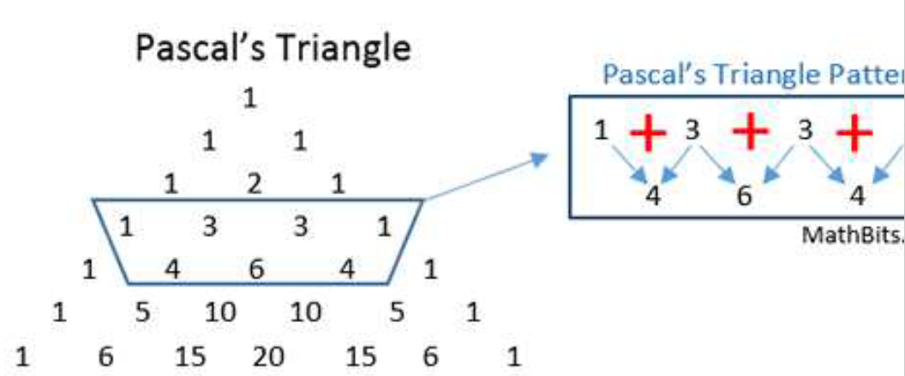
Why is the Pascal Relation true? Each number is the sum of what is immediately above to the right and to the left.

Slide 154
FOIL
FOIL stands for FIRST, OUTSIDE, INSIDE and LAST.
It provides a framework to multiply (a+b) and (c+d).
We have:
(a + b) * (c + d) = a * c + a * d + b * c + b * d.
FIRST OUTSIDE INSIDE LAST

Slide 155
FOIL
FOIL stands for FIRST, OUTSIDE, INSIDE and LAST.
We can repeatedly apply it, and its generalizations…..
We have:
(x + y)² = (x + y) * (x + y) = x * x + x * y + y * x + y * y = x² + x y + y x + y² = x² + 2 x y + y².
So:
(x + y)³ = (x + y) * (x + y)² = (x + y) * (x² + 2 x y + y²)
= x * (x² + 2 x y + y²) + y * (x² + 2 x y + y²)
= (x³ + 2 x² y + x y²) + (x² y + 2 x y² + y³)
= x³ + 3 x² y + 3 x y² + y³.

Slide 156
Expanding (x + y)^{n}
(x + y)¹ = 1 x + 1 y
(x + y)² = 1 x² + 2 x y + 1 y².
(x + y)³ = 1 x³ + 3 x² y + 3 x y² + 1 y³.
This is the start of Pascal’s Triangle…..
How should we define (x + y)⁰? Well, we often say things to to zeroth power are 1, so we extend to….

Slide 157
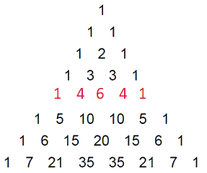
Expanding (x + y)^{n} and nCr
Consider $\left(x+y\right)4$
We have $\left(x+y\right)∗\left(x+y\right)∗\left(x+y\right)∗(x+y)$
When we multiply out, for each factor we take an x or a y (but not both)
Thus we could have
xxxx = x⁴ (1 = 4C4 way),
xxxy, xxyx, xyxx, yxxx, all of which give x³ y (4 = 4C3 ways),
xxyy, xyxy yxxy, xyyx, yxyx, yyxx, all of which give x² y² (6 = 4C2 ways),
yyyx, yyxy, yxyy, xyyy, all of which give x y³ (4 = 4C1 ways),
yyyy = y⁴ (1 = 4C0 way).
So every term will be of the form xª y^{b} with a+b = 4 and a, b non-negative; so xª y^{4-a}.
What is the connection with nCr? The coefficient of xª y^{4-a} is 4Ca.
Makes sense: we have 4 factors, choosing a of them to be x, and 4-a to be y.

Slide 158
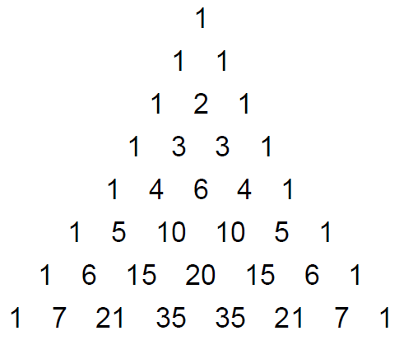
Pascal’s Triangle
The numbers in the n^{th} row of Pascal’s Triangle are the coefficients we obtain in expanding (x+y)^{n}.
Equivalently, we have two diagonals of 1, and all other elements are the sum of the elements in the row above immediately to the left and immediately to the right.

Slide 159
Expanding (x + y)^{n} and nCr
Consider $\left(x+y\right)4$
We have $\left(x+y\right)∗\left(x+y\right)∗\left(x+y\right)∗(x+y)$
When we multiply out, for each factor we take an x or a y (but not both)
So every term will be of the form xª y^{b} with a+b = 4 and a, b non-negative; so xª y^{4-a}.
What is the connection with nCr? The coefficient of xª y^{4-a} is 4Ca.
Makes sense: we have 4 factors, choosing a of them to be x, and 4-a to be y.
Thus $\left(x+y\right)$⁴ = 4C4 x⁴ + 4C3 x³ y + 4C2 x² y² + 4C1 x y³ + 4C0 y⁴.
More generally have the

Slide 160
Sketch of the proof: Assume we know one row, say (x+y)⁵ = x⁵ + 5 x⁴ y + 10 x³ y² + 10 x² y³ + 5 x y⁴ + y⁵.
Then
(x+y)⁶ = (x+y) (x+y)⁵
= x (x+y)⁵ + y (x+y)⁵
= x (x⁵ + 5 x⁴ y + 10 x³ y² + 10 x² y³ + 5 x y⁴ + y⁵) + y (x⁵ + 5 x⁴ y + 10 x³ y² + 10 x² y³ + 5 x y⁴ + y⁵)
= (x⁶ + 5 x⁵ y + 10 x⁴ y² + 10 x³ y³ + 5 x² y⁴ + x y⁵) + (x⁵ y + 5 x⁴ y² + 10 x³ y³ + 10 x² y⁴ + 5 x y⁵ + y⁶)
= x⁶ + 5 x⁵ y + 10 x⁴ y² + 10 x³ y³ + 5 x² y⁴ + x y⁵
+ x⁵ y + 5 x⁴ y² + 10 x³ y³ + 10 x² y⁴ + 5 x y⁵ + y⁶
= x⁶ + (5+1) x⁵ y + (10+5) x⁴ y² + (10+10) x³ y³ + (5+10) x² y⁴ + (1+5) x y⁵ + y⁶
= x⁶ + 6 x⁵ y + 15 x⁴ y² + 20 x³ y³ + 15 x² y⁴ + 6 x y⁵ + y⁶

Slide 161
Pascal’s Identity: Often write nCk as
Rather than doing algebra, we can tell a story involving nCr’s….
Why is this true? Note have n+1 fans and must choose k, order doesn’t matter.
Left: There are $\left({n \atop k+1}\right)$ways to choose k+1 people from n.
Right: $\left({1 \atop 0}\right)$ way not to take the Yankee fan, then $\left({n \atop k}\right)$ ways to choose k Sox fans, and second term is $\left({1 \atop 1}\right)$ way to choose the Yankee fan, and then $\left({n \atop k−1}\right)$ ways to choose k-1 Sox fans (so again have k fans overall).

Slide 162
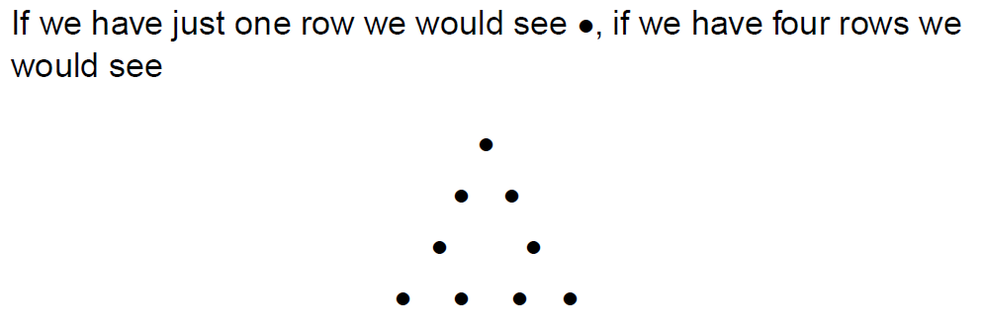
Pascal’s Triangle

Slide 163
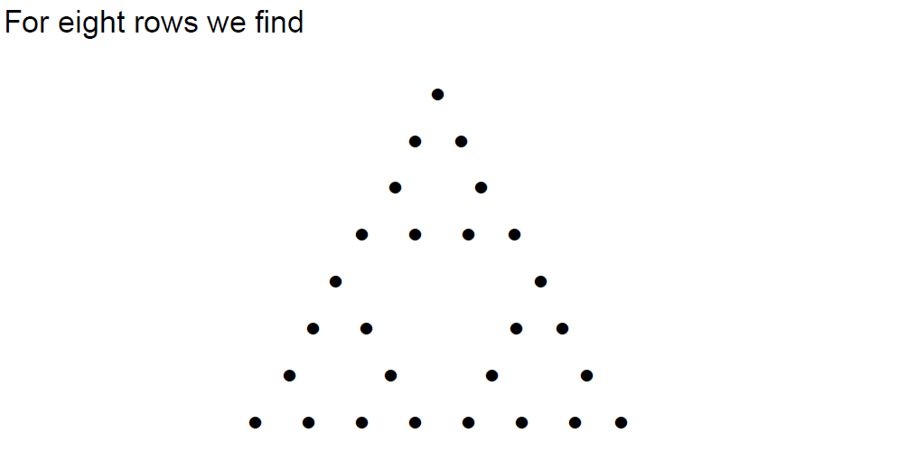
Pascal’s Triangle

Slide 164
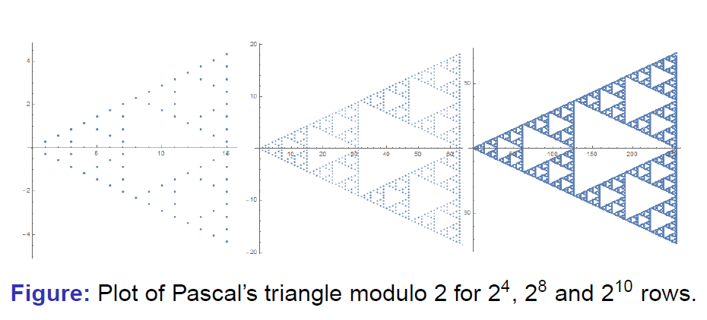
Pascal’s Triangle
https://www.youtube.com/watch?v=tt4_4YajqRM (start 1:35)

Slide 165
Combinations: nCr or _{n}C_{r}
nCr or _{n}C_{r} is the number of ways to choose r objects from n when order DOES NOT matter; the C stands for combinations.
Theorem: $nCr ∗r!=nPr= \frac{n!}{\left(n−r\right)!},$thus $nCr= \frac{n!}{r!\left(n−r\right)!}.$
What value of r leads to the largest value of nCr?

Slide 166
Combinations: nCr or _{n}C_{r}
nCr or _{n}C_{r} is the number of ways to choose r objects from n when order DOES NOT matter; the C stands for combinations.
Theorem: $nCr ∗r!=nPr= \frac{n!}{\left(n−r\right)!},$thus $nCr= \frac{n!}{r!\left(n−r\right)!}.$
What value of r leads to the largest value of nCr? It is r = n/2 (if n/2 is not an integer, it is the integer on either side).
To see this, note nCr looks like a polynomial of degree n^{r} if r is at most n/2, so we want the exponent to be as large as possible, and then use symmetry for r greater than n/2 to relate those values to r less than n/2. (This is NOT a proof, this is a heuristic – see how you go from _{n}C_{r} to _{n}C_{r+1}.

Slide 167
Combinations: nCr or _{n}C_{r}
nCr or _{n}C_{r} is the number of ways to choose r objects from n when order DOES NOT matter; the C stands for combinations.
Theorem: $nCr ∗r!=nPr= \frac{n!}{\left(n−r\right)!},$thus $nCr= \frac{n!}{r!\left(n−r\right)!}.$
What value of r leads to the largest value of nCr? It is r = n/2 (if n/2 is not an integer, it is the integer on either side).
PROOF:
${nC}_{r+1}= \frac{n!}{(r+1)!\left(n−(r+1)\right)!} =\frac{n!}{\left(r+1\right)r!\left(n−(r+1)\right)!}\frac{(n−r)}{\left(n−r\right)} =\frac{n!}{r!\left(n−r\right)!}$ $\frac{n−r}{ r+1} =nCr\frac{n−r}{ r+1}$
As r < n/2, $we have \frac{n−r}{ r+1}$ > 1. Note $\frac{n−r}{ r+1}$> 1 if n-r > r+1 or r < $\frac{n−1}{ 2}$.

