Slide 1
LATKE-HAMANTASCHEN DEBATE
Steven Miller
Math/Stats Department

Slide 2
The Primacy of Three

Slide 3
The Primacy of Three
Have e < 3 < π.

Slide 4
The Primacy of Three
Have e < 3 < π.
Triangularizations.

Slide 5
The Primacy of Three
Have e < 3 < π.
Triangularizations.
Holy Trinity

Slide 6
The Primacy of Three
Have e < 3 < π.
Triangularizations.
Phi Beta Kappa

Slide 7
Pascal’s Triangle

Slide 9
Sierpinski’s Hamentaschen

Slide 10
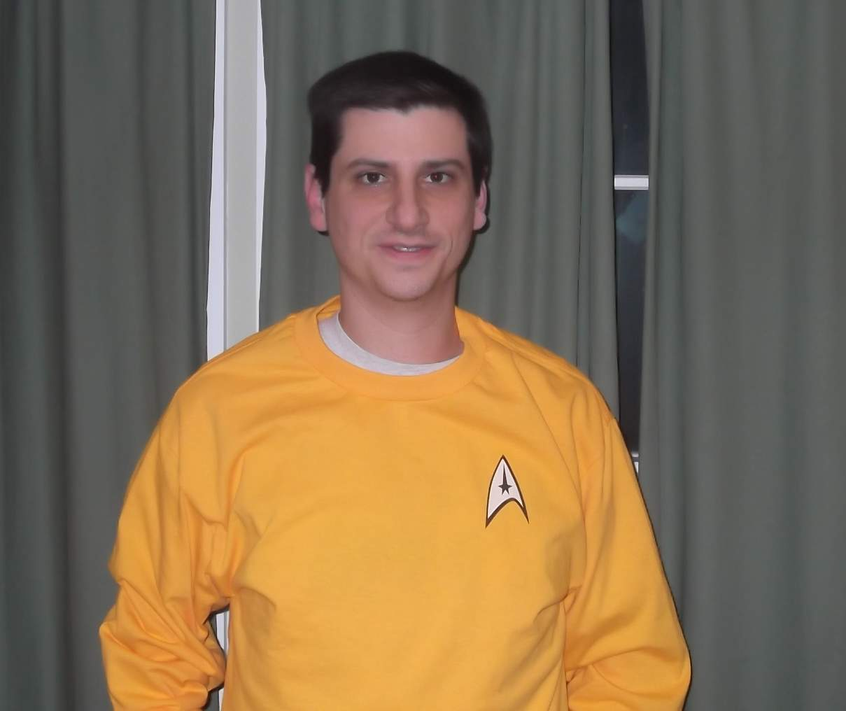

Slide 11
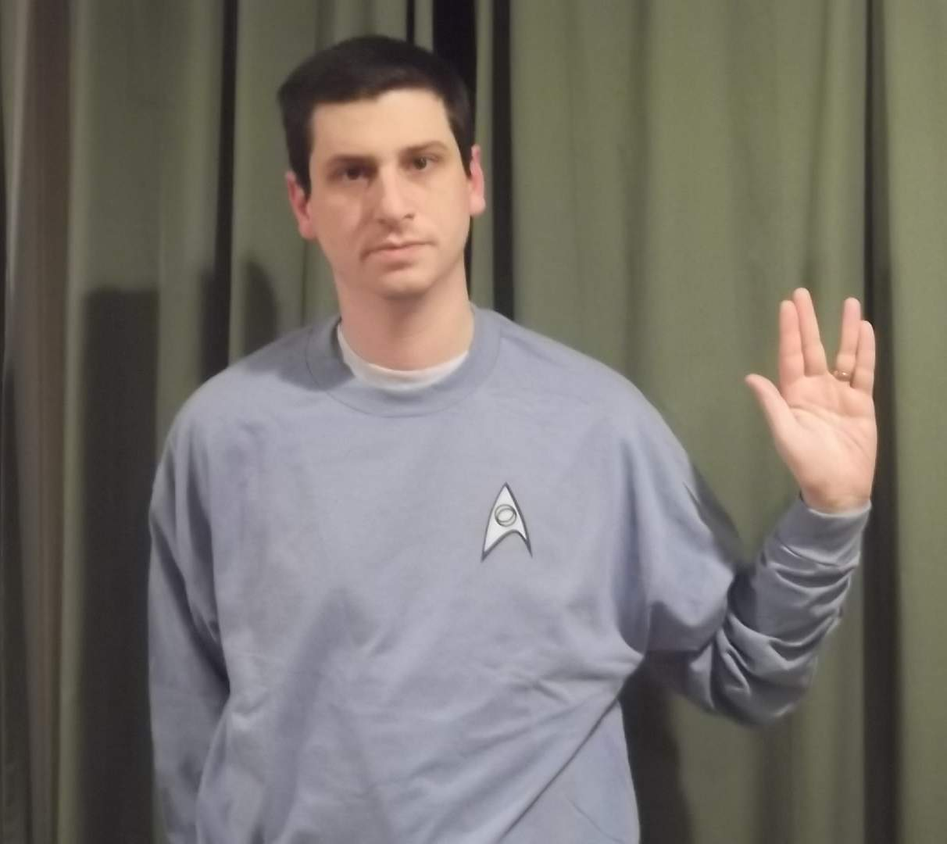

Slide 12
Thanks to my assistants

