Slide 1
L-function Lecture 2: PANTHers 2021
COMPLEX ANALYSIS IN AN HOUR
Miller: sjm1@williams.edu
https://web.williams.edu/Mathematics/sjmiller/public_html/

Slide 2
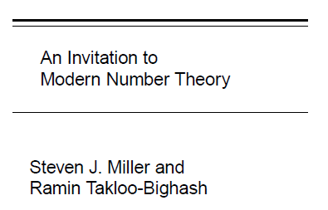
Complex Analysis: Math 372
https://web.williams.edu/Mathematics/sjmiller/public_html/372Fa17/index.htm
Videos of lectures: https://web.williams.edu/Mathematics/sjmiller/public_html/videoclasses/index.htm

Slide 3
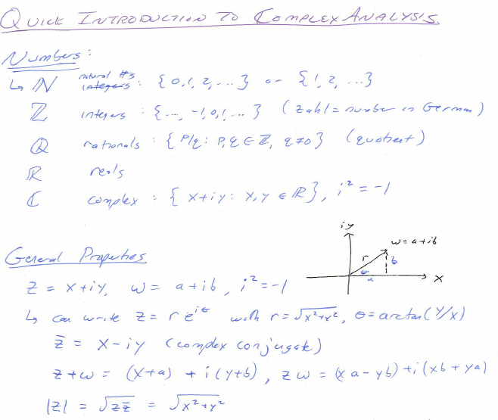
https://web.williams.edu/Mathematics/sjmiller/public_html/372Fa17/coursenotes/Math302_LecNotes_Intro.pdf

Slide 4
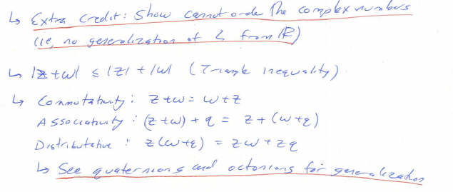

Slide 6
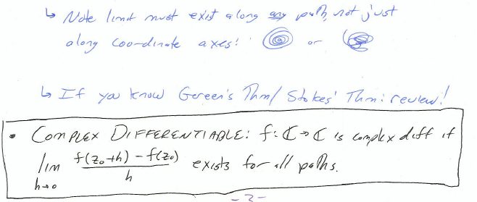

Slide 7
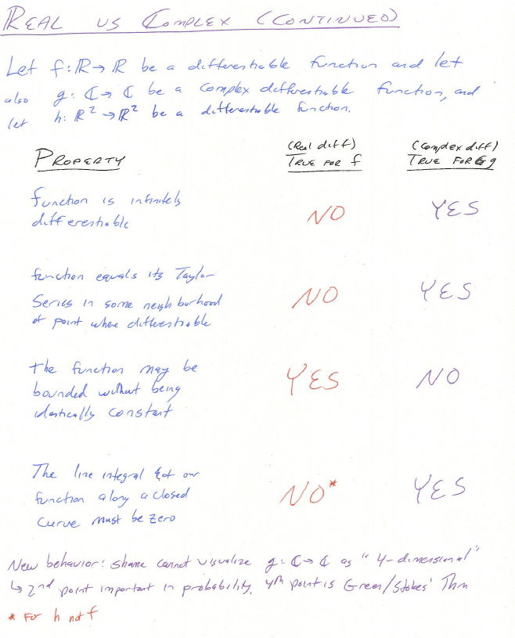

Slide 8
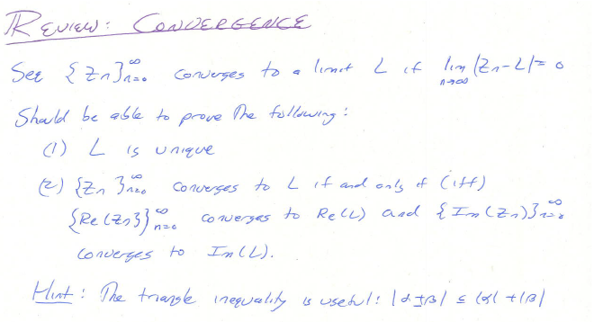

Slide 9
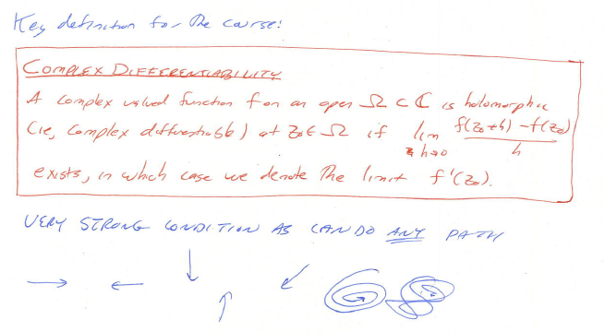

Slide 10
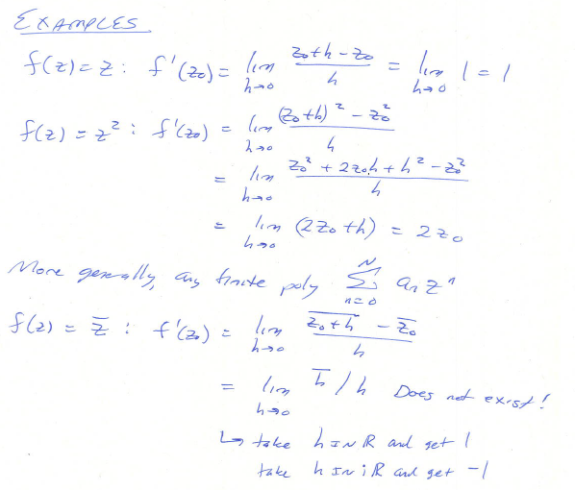

Slide 11
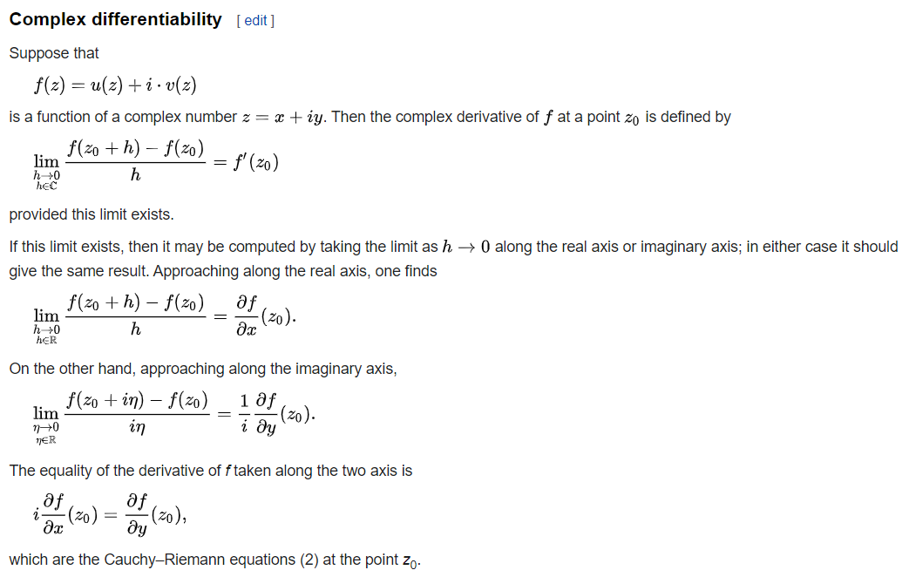

Slide 12
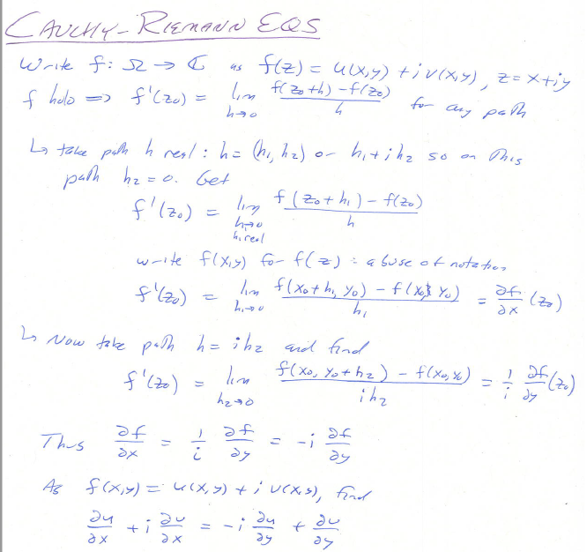

Slide 13
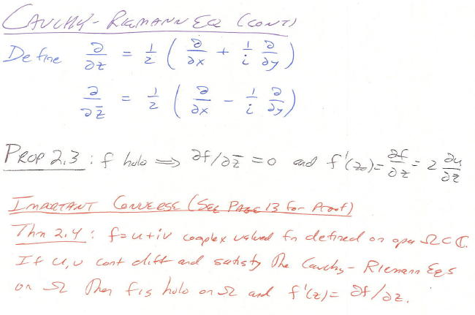

Slide 14
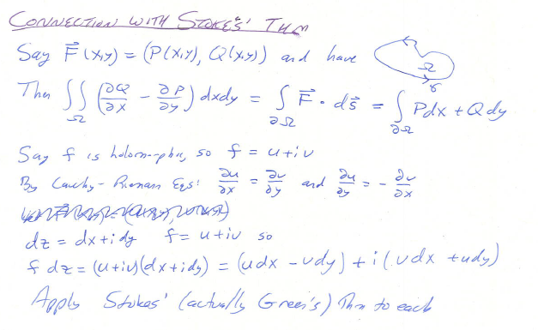

Slide 15
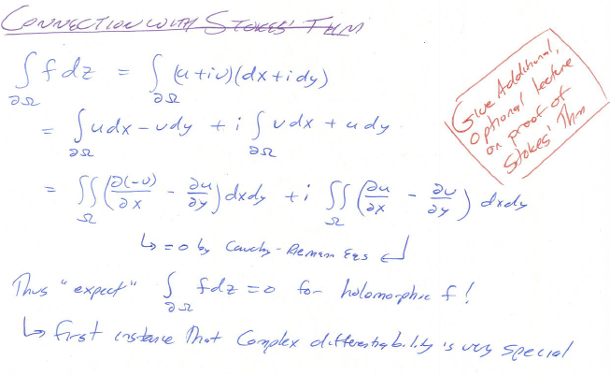

Slide 17
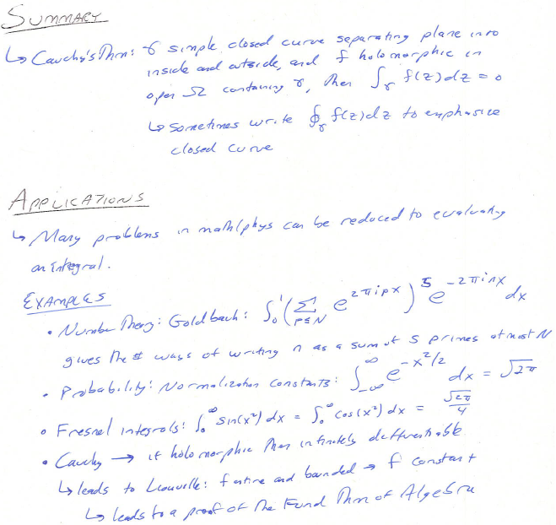
https://web.williams.edu/Mathematics/sjmiller/public_html/372Fa17/index.htm

Slide 18
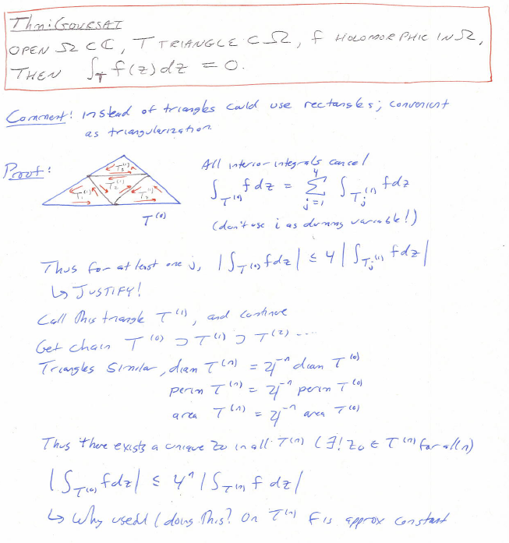

Slide 19
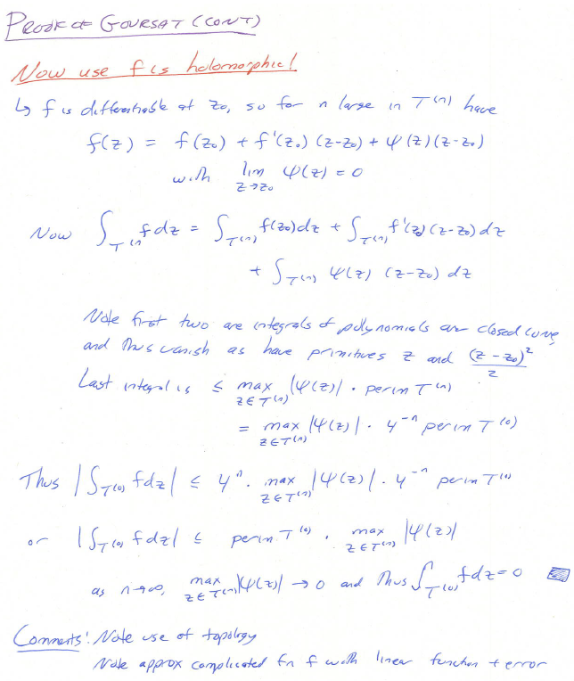

Slide 20
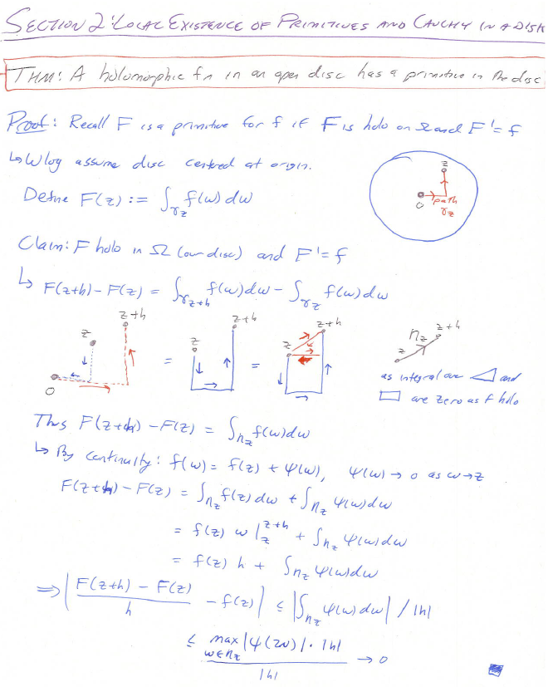

Slide 21
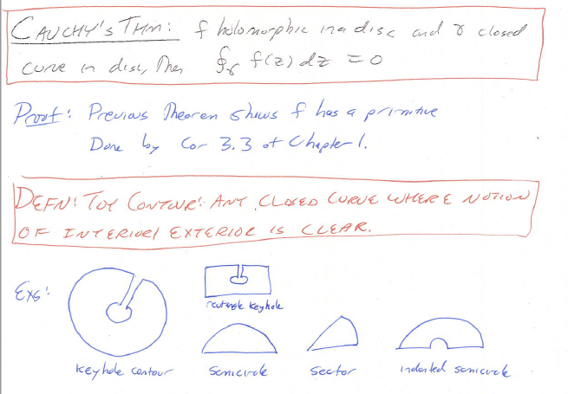

Slide 22
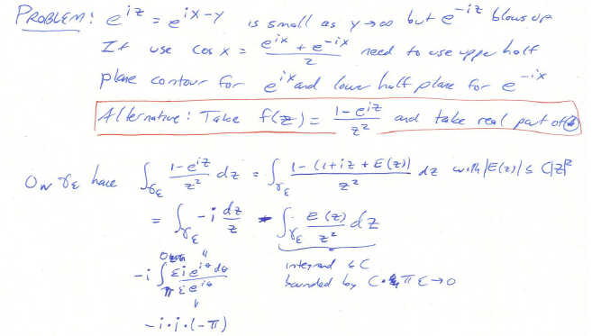
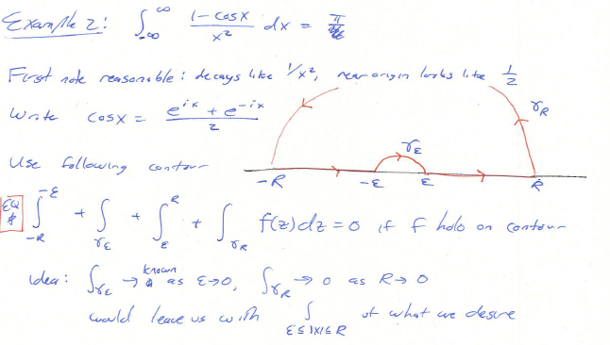
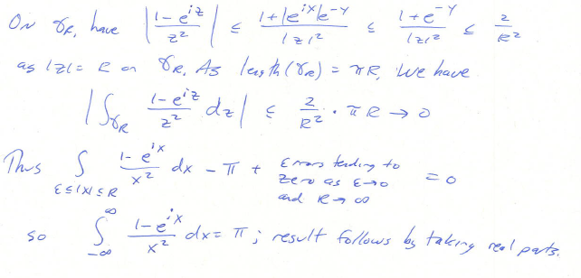

Slide 23
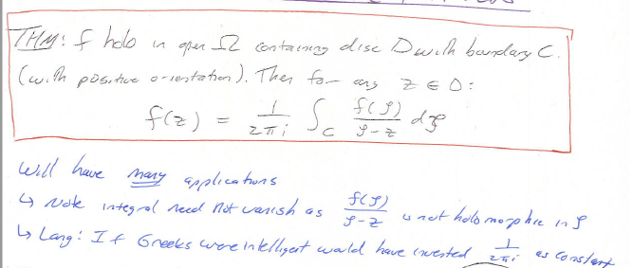

Slide 24
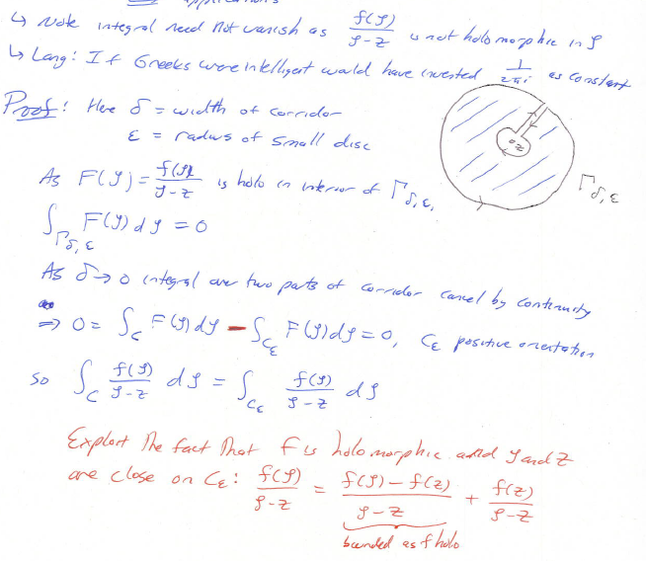

Slide 25
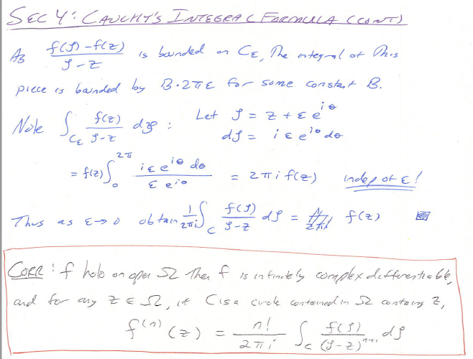

Slide 27
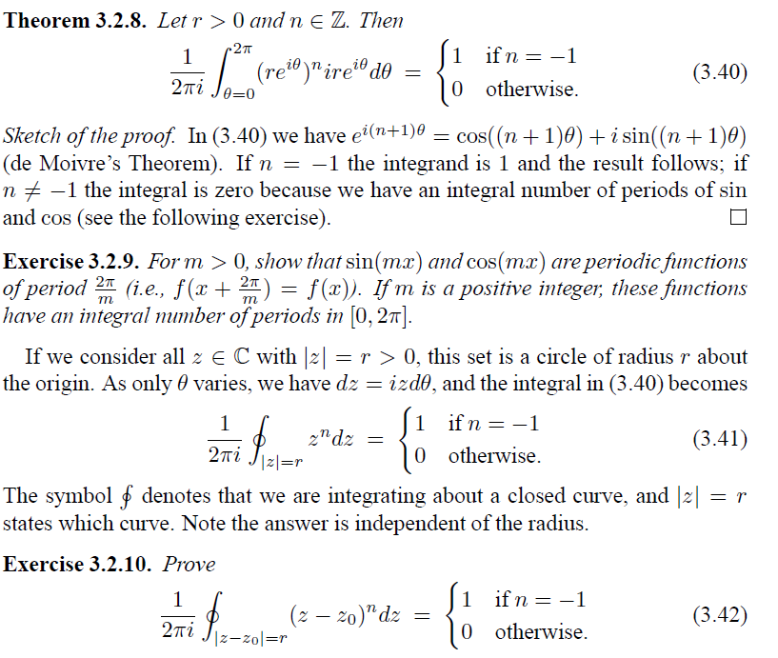

Slide 28
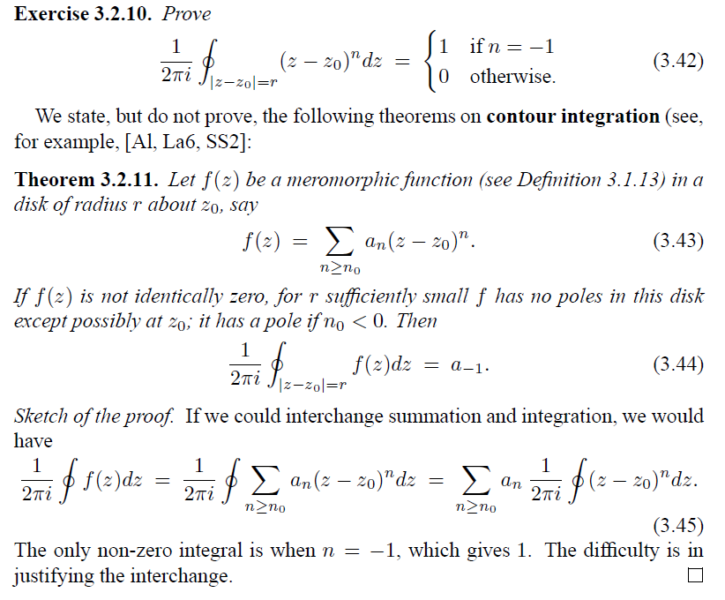

Slide 29
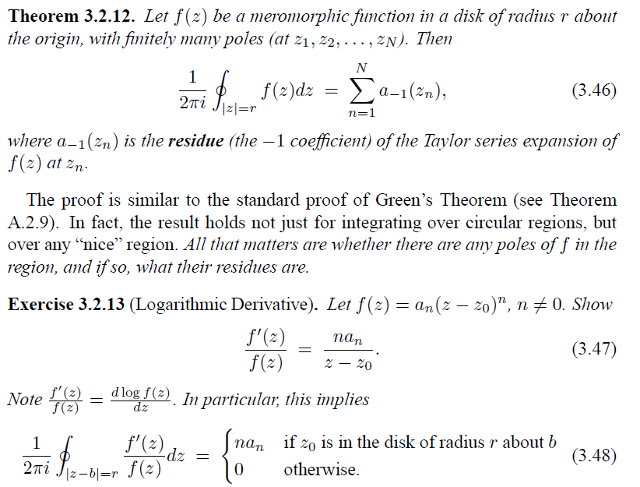

Slide 31
