Slide 1
L-function Lecture 4: PANTHers 2021
Comments on L-Function Talks: II
Miller: sjm1@williams.edu
https://web.williams.edu/Mathematics/sjmiller/public_html/

Slide 2
Part I (Classical RMT, Intro L-fns, Dirichlet): http://youtu.be/2PuUbk6gUMM (slides: part 1)
https://web.williams.edu/Mathematics/sjmiller/public_html/math/talks/Michigan2012Part1.pdf
Part II (Convolving families, cusp forms: slides here): http://youtu.be/vJz6W24tDik (slides part 2)
https://web.williams.edu/Mathematics/sjmiller/public_html/math/talks/Michigan2012Part2.pdf
More talks, as well as papers, available here:
https://web.williams.edu/Mathematics/sjmiller/public_html/

Slide 7
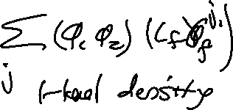

Slide 8
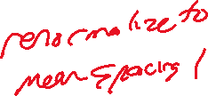
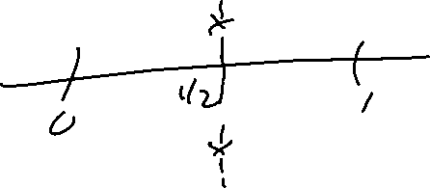
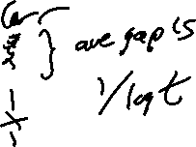
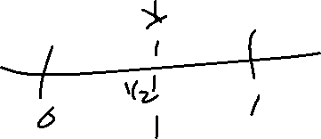

Slide 10
